Slide 1
Supplier Development, Localization and Industrialization – SDL&I
The Manufacturing and Supply of Smart Meters for Distribution
Presented by Ayanda Ramokolo Date: 24 January 2025

Slide 2

Eskom Supplier Development and Localisation Mandate¹
Mandate
Our mandate is to achieve maximum and sustainable local development impact through leveraging Eskom’s procurement spend in a manner that allows flexibility within the business In Order To accommodate government local development initiatives and policies

Slide 3
Specific Goals
B-BBEE Status Level of Contributor | Number of points (90/10 system) | Number of points (80/20 system)
1 | 10 | 20
2 | 9 | 18
3 | 6 | 14
4 | 5 | 12
5 | 4 | 8
6 | 3 | 6
7 | 2 | 4
8 | 1 | 2
Non-compliant contributor | 0 | 0
Point scored on B-BBEE level

Slide 4
Specific Goals (Continued)
NB: The following documents are required to claim preference points,
Valid B-BBEE certificate issued by a SANAS accredited verification agency / sworn affidavit / CIPC affidavit.
Tenderer failing to provide documentation for the allocation of preference points will not be disqualified, but’
May only score point out of 90/80 for price.
Scores 0 points out of 10/20 for specific goals.

Slide 5
Designated products with thresholds (Mandatory for Contract award)
The stipulated minimum threshold for local production and content for Residential Electricity Meters is set as follows for the specific types of maters:
Meter Category | % Local Content
Prepaid Electricity Meters Postpaid Electricity Meters | 70% 70%
Smart Meters | 50%
Above item (Smart Meter) to appear on the SBD 6.2 with the applicable thresholds. Tenderers to indicate whether or not each threshold will be met.

Slide 6
Tender returnable documents
SBD 6.2 to indicate tender enquiry number and sourcing entity (Eskom SOC Ltd.) and to be duly signed by an authorized person (Finance director or someone in Executive management position) / delegated person by someone in executive position.
Annexure C Documents must be duly signed by an authorized / delegated person. If someone else signs apart from the authorized (director etc.) a delegation of authority letter must be attached confirming authority to sign.
Exemption letter from the Department of Trade, Industry & Competition (the dtic) where necessary should the local content threshold of 50% not be attained in the manufacturing of the smart meters.
The above documents are mandatory for contract award.
Exemption requirements

Slide 7
Annexure C
2

Slide 8
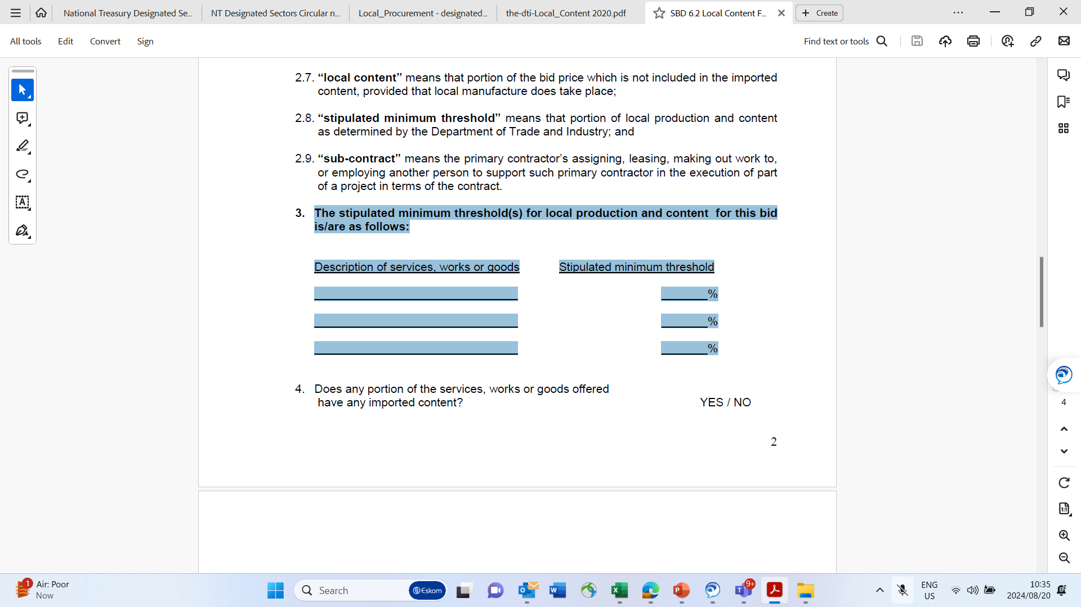
SBD 6.2

Slide 9
SBD 6.2
1

Slide 10
Exemption requirements
Where local content threshold for any designated product cannot be met due to shortages in raw materials or inputs to be used in a specific item or item not available locally.
Supplier to obtain written exemption from the Department of Trade Industry and Competition (the dtic) if there is a requirement to import the raw materials or input to meet the demand.
Contacts with details at the dtic:
MsCathrine Matidza: CMatidza@thedtic.gov.za(012 394 5598/ 066 471 8982 )
Mr Raphael Kitiaka: MRKitiaka@thedtic.gov.za(012 394 3500 / 073 497 2051)
Ms Mamosai Seleka: MSeleka@thedtic.gov.za(012 394 1213 / 060 705 0677 )
Ms Rendani Raluthaga: RRaluthaga@thedtic.gov.za(012 394 1412 / 060 705 1690)
Ms Miyelani Masinga: MMasinga@thedtic.gov.za(012 394 1664 )
Ms Girlly Mahlambi: GMahlambi@thedtic.gov.za( 012 394 1394)

Slide 11
Objective Criteria (NIPP)
National Industrial Participation Programme
“NIPP is a programme that seeks to leverage economic benefits and support the development of South African industry by effectively utilising the instrument of government procurement.
The NIPP programme is mandatory for all government and parastatal purchases or lease contracts (goods and services) with an imported content equal to or exceeding USD 5 million.

Slide 12
BBBEE and Local Content
B-BBEE Requirements
Tenderers will be required to maintain or improve their B-BBEE Recognition Level for the duration of the contract.
In the case of a trust, consortium or joint venture (including unincorporated consortia and joint ventures), a consolidated B-BBEE Status Level Verification Certificate needs to be established for the newly formed entity of the JV and submitted before the tender closes.
Local Procurement Content
Local procurement content is total spending minus the imported component.
Tenderers will stipulate local procurement content for the works.
Local Procurement Content | Eskom target | Tenderer Proposal
 | 50%

Slide 13
Joint Ventures
There are two types of Joint Ventures (JV):
Incorporated JV - An arrangement whereby two or more entities establish a separate legal entity to pursue an agreed business objective for mutual benefit, typically involving a pooling of resources (capital, personnel and / or physical equipment) by the participants.
Unincorporated JV - An association of entities formed to pursue an agreed business objective but for which no separate legal entity is established. The JV participants are bound to co-operate with each other by the terms of the contract amongst them.
Should the tenderer indicate that a joint venture is intended, the Procurement Practitioner, with the assistance of Eskom Legal, must ensure that the JV agreement is legally valid and that it includes a contractual term that the JV partners will be mutually and severally liable. The JV agreement must also include a term that indicates the entity that will be the lead partner and a term that indicates the ratio according to which work and/or payment will be split.

Slide 14
Joint Ventures
It is acceptable for an unincorporated JV to submit a letter of intent. It must be followed up with a JV agreement should the tenderers be successful. That agreement should be assessed for its legal validity, that it includes a term that the JV partners will mutually and severally be liable, that it indicates who will be the lead partner, and that it indicates the ratio in which work and/or payment will be split.

Slide 15
Jobs created/retained
Tenderers are required to submit proposals for the type and number of jobs that will be created and retained in South Africa as a direct result of being awarded a contract.
Type of Jobs to be created | Number of Jobs to be created
Type of Jobs to be retained | Number of Jobs to be retained

Slide 16
Condition of contract award
Procurement spend on entities with a minimum 51% black ownership
The winning tenderer is encouraged to procure/spend on designated groups on the following paid invoices for both:
the indirect expenses (e.g. overheads) on goods and services supplied to the contractor/supplier by designated groups; and
direct spend on goods and services supplied by the subcontractors for the execution of the scope of work.
Activities, as a proportion of the local procurement content, which may be subcontracted to designated black owned enterprises must be submitted in a table below
Procurement from Designated Group | Eskom Target | Tenderer Proposal
Black Owned | 4.0%
Black Women Owned | 3.0%
Black Youth Owned | 2.0%
Black Persons with Disability | 1.0%

Slide 17
Condition of contract award
Skills development
The candidates selected for skills development shall be currently unemployed graduates from university schools and technical, vocational, education and training (TVET) campuses of South Africa.
The threshold will be as follows to ensure successful implementation of this initiative:
The successful tenderer will be obligated to skill one candidate for every R2 Million spend cumulatively through purchase orders/instructions awarded to the supplier.
The tenderer will be expected to submit a letter of competence/proof of attendance/service contract/certificate of compliance as proof that a candidate has been appointed for work experience. The supplier will be required to implement this requirement a month after the threshold is reached.
Skill type / Occupation | Tenderer proposed number of Candidates
Project Engineer’s / Manager
Technicians / Electrician
Smart Meter Data Analyst / Capture
Scope of work-related skill types/Occupation
Total

Slide 18
Skills development
The process of developing these skills shall involve the participation by tenderers directly and through their supply network. In certain cases, the SETA’s accredited training providers can be approached to participate in developing critical and scarce skills.
Note: That these targets for skills development candidates categorically exclude Eskom employees and registered learners.
  The tenderers are required to take full responsibility for the total cost of developing the requisite skills, and Eskom shall not make any financial contribution towards the fulfilment of this obligation.
  Tenderers also are advised to approach their relevant SETAs to access grants, subsidies, and incentives as well as South African Revenue Services for tax rebates that are earmarked for skills development initiatives.

Slide 19
SDL&I Retention and Performance Security
Eskom will apply a retention of 2.5% of the invoice amount for failure to meet SDL&I obligations.
As security for the fulfilment of SDL&I obligations, Eskom will apply a retention of 2.5% on every invoice amount (excluding VAT) for failure to submit SDL&I performance reports every quarter; or failure to meet the SDL&I obligations in this contract. The retained amounts shall only be released to the contractor upon: The tenderer will be expected to submit their performance reports on a quarterly basis towards SDL&I obligations. SDL&I will assess the submitted performance report against the Implementation plan then issue a compliance report. Should the report yield non-compliance results, Eskom will retain the 2.5%. Should the compliance results be positive, Eskom will release the retained funds to the tenderer.

Slide 20
THANK YOU

