Slide 1
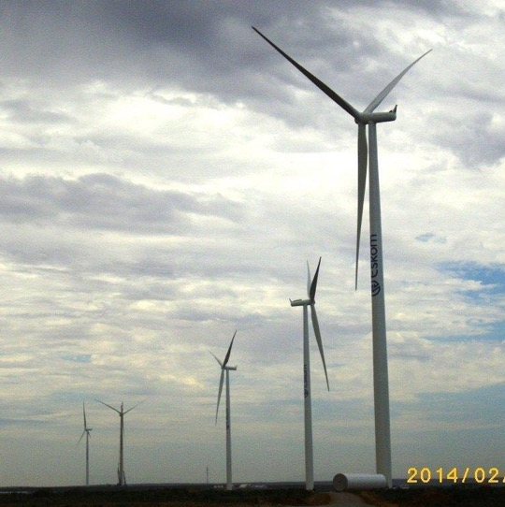
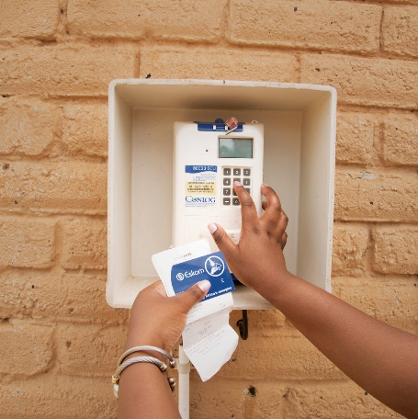

OHS LOW RISK WORK TENDER

Slide 2

ESKOM ‘S COMMITMENT TO SHEQ
Eskom’s top management commitment to safety, health, environment and quality is demonstrated by Eskom SHEQ Policy.
One of Eskom’s core values is Zero harm and is articulated in the SHEQ policy.
The contractors and consultants must also have their OHS or SHEQ policies signed by CEOs
The contractors and consultants must also have their OHS plans

Slide 3
OHS TENDER RETURNABLE
Ref | OHS Tender Returnable
1 | Annexure B Is the acknowledgement of Eskom's OHS legal and other requirements form signed and submitted by the tenderer?
2 | Valid Letter of Good Standing (COIDA or equivalent) There must be a proof that the employees who are injured at work can be compensated for injuries and diseases acquired at the workplace.
3 | OHS policy signed by the CEO The submitted policy document must comply to OHS Act Section 7 SHEQ policy is still acceptable

Slide 4





