Slide 1




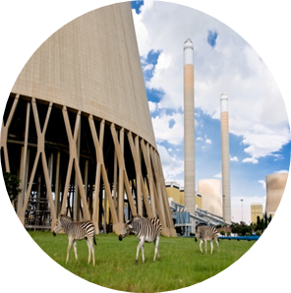

Clarifications: Loose Guy wire retention, restore and replacement.
SDL&I Evaluations
24 February 2023
Rudzani Tshikungulu

Slide 2

We have a mandate to contribute positively to the development of the country
Our mandate is to achieve maximum and sustainable local development impact through leveraging Eskom’s procurement spend in a manner that allows flexibility within the business in order to accommodate government local development initiatives and policies

Slide 3
Supplier Development & Localization (SD&L) measures impact along these key performance areas
Key performance area
Definition
  Skills development
  Increasing the skill base (number and skill level) of South African workers in areas relevant to the energy sector and where there is a national scarcity of skills
  Local content
  Utilisation of Eskom and suppliers’ spend to develop South African based suppliers relevant to the energy sector (focusing primarily on BBB-EE and Black Owned suppliers)
  Industrialisation
  Utilisation of Eskom and suppliers’ spend to foster the establishment of new competitive industries in the energy sector
Job creation and Employment
  Creation of new jobs by suppliers as a direct result of Eskom business
  Supplier development
  Providing a platform to develop emerging suppliers, and further opportunities for national and international suppliers
3

Slide 4
Designated sectors - DTIc
Note: As a mandatory tender returnable suppliers must submit completed and dully signed Annexure C and SBD6.2
.
Sector | Threshold
Wire | 100%
Cement | 100%
Line hardware | 100%

Slide 5
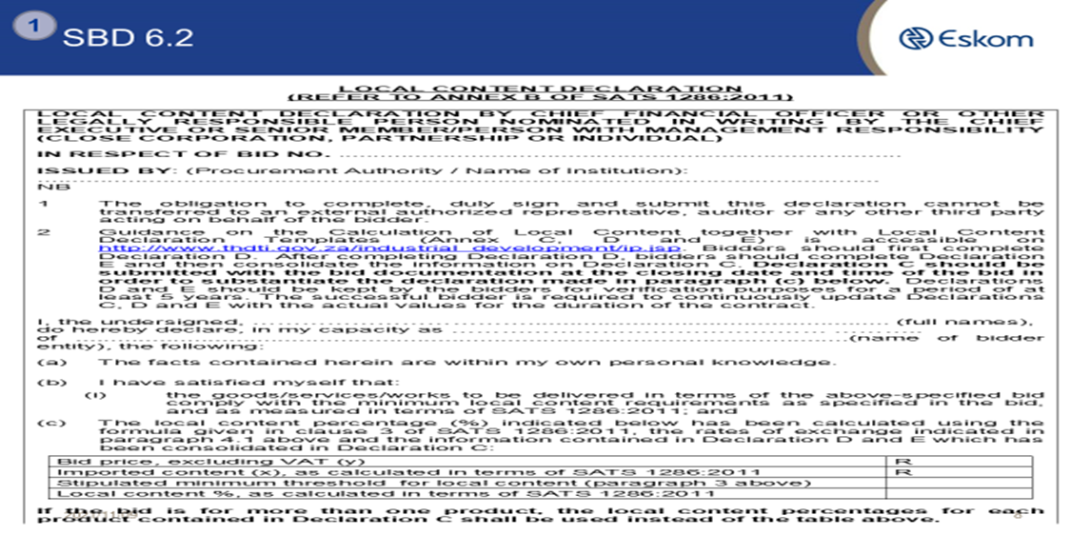
Designated Sector - DTIc
Note: As a tender returnable suppliers must submit Local Content Declaration Annexure C and SBD 6.2.
.
Industry | Threshold
Wire Products | 100%

Slide 6
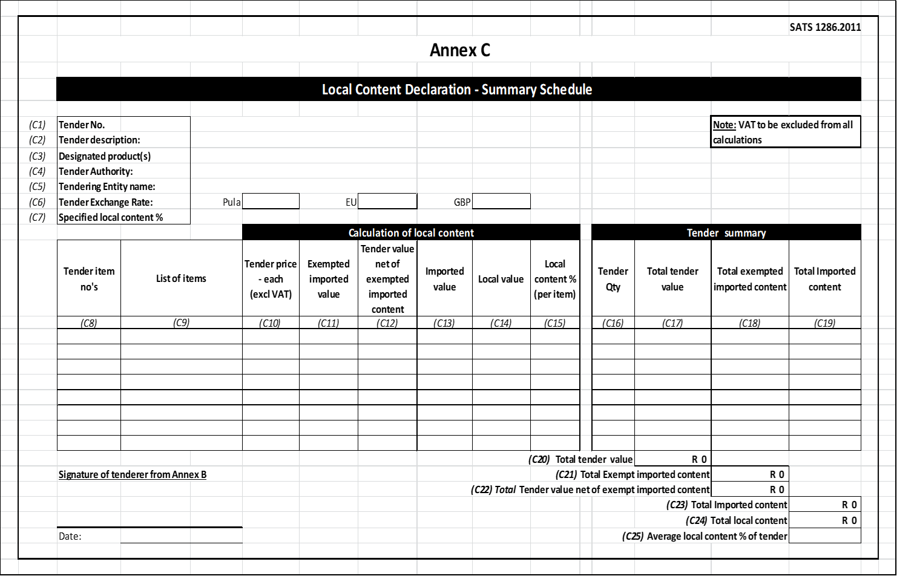
Annexure C
.

Slide 7
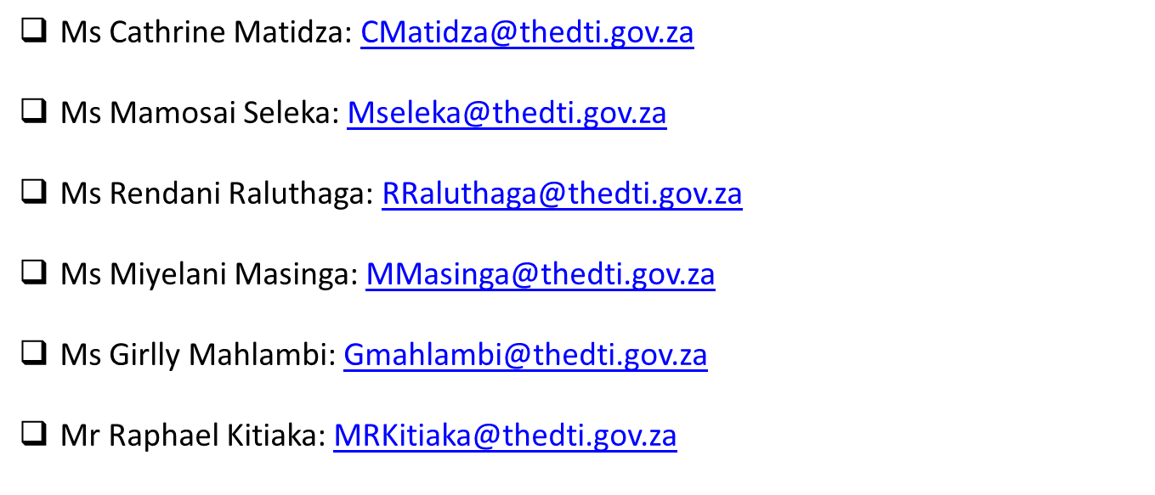
Local Content Enquiries: Bidding Documents, Calculations & Annexures
.

Slide 8
Evaluation criteria
The 80:20 rule will apply in this project:
B-BBEE = 20
Price = 80
.

Slide 9
Preference Points B-BBEE

Slide 10

B-BBEE requirements
The certificate must be valid.
Verification Agency must be SANAS accredited.
There should be a logo of SANAS on the certificate.
QSEs and EMEs – Sworn affidavit is acceptable

Slide 11
Validity of Affidavit

Slide 12
Job creation – (not a weighted criteria)Creation (Not a weighted Criteria)
Suppliers will be required to propose the number and type of jobs to be created as a result of a project.
The requirements with regard to job creation will be as follows:
  Core team which will be made up of specialised skills should comprise of supplier’s in house staff.
  Semi skilled and unskilled labour that will be used in executing the works to the extent that is possible should be sourced from areas local to the site where the substation is located.

Slide 13
SDL&I Contractual requirements / Undertaking
(Not a weighted Criteria)

Slide 14
Monitoring ation (Not a weighted Criteria)
Implementation schedule to be submitted within a month of contract signing.
Quarterly or monthly reports on progress of implementation of SD&L to be submitted to the PM.
SDL&I penalty (2.5% retention / Performance Bond)

Slide 15

Thank You
Notes:
15

