Slide 1
RFB 2674-2022 Debriefing Session
Solution design, migration and software development services for a firearms control solution for the South African Police Service
SITA SOC Ltd
18 October 2022
Presented by: Amie Nel

Slide 2
Annex A Section: Purpose and background summary
The purpose of the published Request for Bid (RFB) is to invite Suppliers to submit bids to supply, design, do migration, and development services for the specified Firearms Control Solution (FCS) for the South African Police Service (SAPS) in order to establish the FCS within a period of thirty-six (36) months.

Slide 3
Annex A Section: Purpose and background - Solution Options
Fully Bespoke
Fully COTS
Hybrid Bespoke and COTS
Immaterial if the delivered solution is bespoke, COTS or hybrid (bespoke and COTS), the supplier is required to transfer and relinquish all rights, full ownership and full intellectual property to SITA without any further claims to the delivered solution, and related components or artefacts.
The successful supplier is fully authorised to enter into such an agreement with SITA without any additional or further renumeration.
The ownership transfer includes all solution components and enables SITA to change, maintain and support the delivered product(s) without any infringement in any regard.

Slide 4
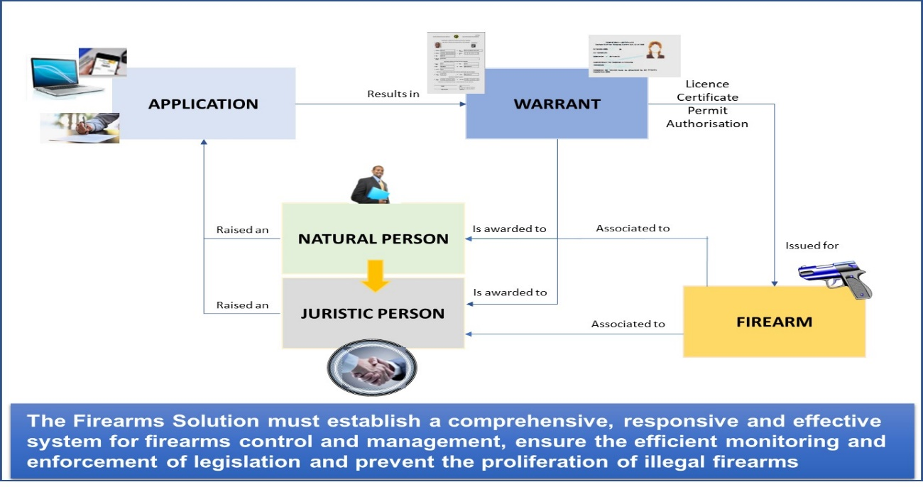
Section: Scope of bid summary
Scope of work
Project phases
Product delivery approach
Delivery address
Customer infrastructure environment

Slide 5
Section: Technical requirement overview
Product Description
Functional components to be developed
    Release 1: Baseline
    Release 2: Warrants
    Release 3: Firearm Administration Components
    Release 4: System Administrative Components and Reports
Technology requirements
Service deliverables
Project governance
Service duration
Project delivery performance metrics

Slide 6
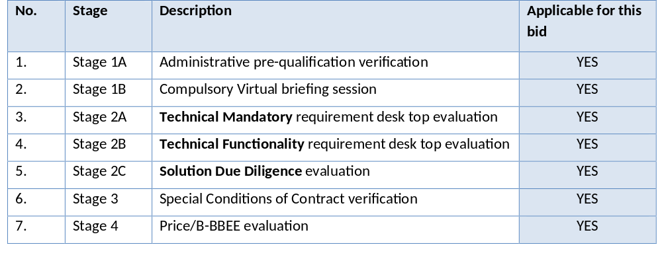
Section: Bid evaluation stages

Slide 7
Annex A.1,2,3, 4 and 5: Summary – 1/2
Administrative pre-qualification
    Verification
    Requirements
Technical mandatory
    Instructions and evaluation criteria
    Technical mandatory requirements
      Bidder experience and capability requirements
      Product or service technical and functional requirements
      Special conditions of service
      Third party risk management assessment
    Declaration of compliance
Technical functionality
    Instruction and evaluation criteria
    Technical functionality requirements
      Technology stack
      Competence to utilise specified technologies
      Achievement of business objectives
      Solution implementation must be POPIA and ISO27001 compliant

Slide 8
Annex A .1,2,3, 4 and 5: Summary – 2/2
Solution due diligence
    Instructions and evaluation criteria
    Due diligence requirements
      High-level architecture diagram and a migration approach
      Project governance and execution
Special conditions of contract
    Instruction
    Special conditions of contract
    Declaration of acceptance
Costing and pricing
    Costing and pricing evaluation
    Costing and pricing conditions
    Declaration of acceptance
  Terms and definitions

Slide 9
Annex B, C, D, E: Summary
  B: Bidder substantiating evidence
    Mandatory requirement evidence
  C: Addendum 1 and declaration
    Product or service technical requirements
  D: Addendum 2 and declaration
    Technology stack
  E: Third-Party risk management assessment
    Instructions
    Evaluation criteria
    Third-party risk assessment
    Third-pry risk management declaration

Slide 10
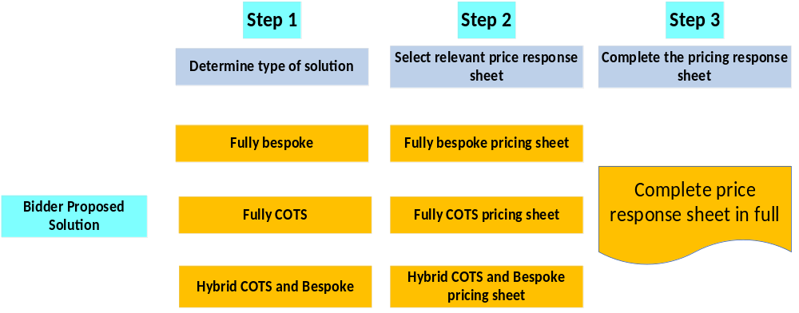
Pricing repose sheets

Slide 11
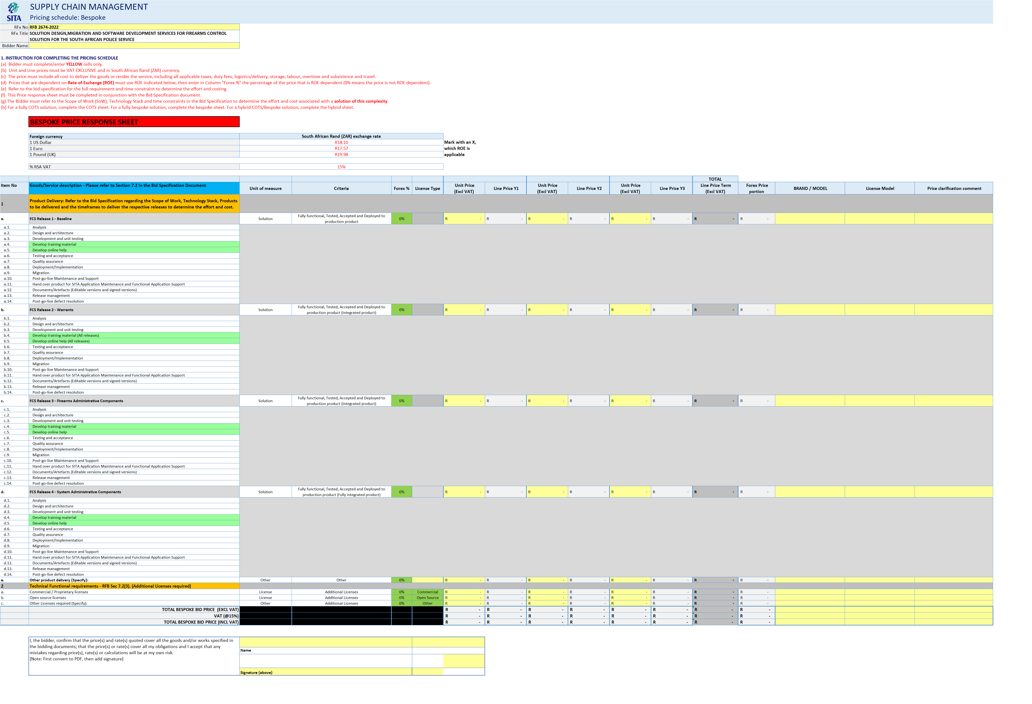
Pricing response sheet

Slide 12
Price response sheets and sections
  Excel Format price response sheets:
    RFB 2674- 2022 Fully Bespoke Solution Price Response Sheet FCS F10
    RFB 2674-2022 Fully COTS Price Response FCS F10
    RFB 2674-2022 Hybrid Solution Price Response FCS F10
  Pricing response sheet sections
    Instruction for completing the price response sheet
    Price response sheet classification
    Foreign currency and VAT
    Item No
    Goods and service description
    Units of measure
    Criteria
    Forex %
    License Type
    Unit Price excluding VAT for years 1,2, and 3
    Line Price Y1,2,3 for years 1,2, and 3
    Total line price
    Forex price portion
    Brand / model
    License model
    Price clarification comment
    Total “bespoke, COTS or hybrid” bid price excluding VAT
    VAT amount
    Total bespoke bid price including VAT

Slide 13
Thank You
Questions

