Slide 1
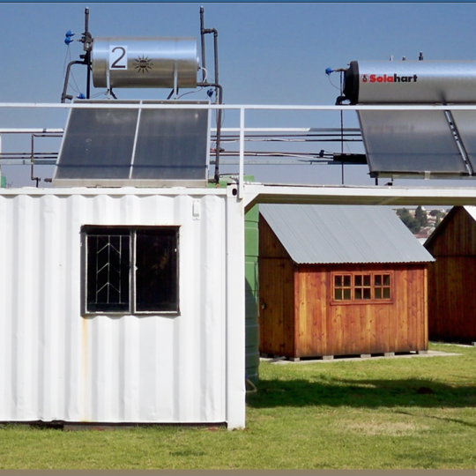
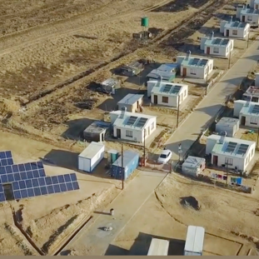
Clarification Meeting for the Supply and Delivery of Branded Personal Protective Equipment (PPE) and Uniform for The Eskom Real Estate Employees as Per Applicable Eskom Specifications on As and When Required Basis for The Period Of 3 Years.
MWP2916CX-R
Presented by: Ms. Tumelo Ramushu
03 April 2025

Slide 2
AGENDA
No. | AGENDA ITEM | RESPONSIBLE PERSON | TIME
1 | WELCOME, INTRODUCTION AND EVACUATION PROCEDURE | Tumelo Ramushu | 10:00 – 10:10
2 | COMMERCIAL PRESENTATION | Tumelo Ramushu | 10:10 – 10:30
3 | TECHNICAL PRESENTATION | Khumbelo / Thantaswa / Khutjo / Nyiko | 10:30 – 11:15
4 | SHEQ PRESENTATION | Lungi / Nkateko / Bongi | 11:15 – 11:30
5 | SDL&I PRESENTATION | Willem | 11:30 – 11:40
6 | Q & A SESSION | All | 11:40 – 12:00

Slide 3
Purpose of the clarification meeting
To assist the Tenderers on the requirements for this tender.
To explain the implications of the evaluation process and the evaluation phases which the tender will be subjected to.
To assist the Tenderers with compiling of the tender documents.
To ensure that the Tenderers understand what they are required to submit.
This is NOT a compulsory clarification meeting.

Slide 4
Details of the Enquiry
Closing Dates is as Follows:
10 April 2025 at 10h00 (South African Standard Time)
Submission venue (Tender box) is as on page 01 of the invitation to tender document
Contract duration will be for a period of three (3) years.
This is a rate based and therefore there will be no reading out of the rates at tender closing.
  Eskom reserves the right to enter into negotiations with any one or more of the respondents.
  Eskom reserves the right to negotiate any aspect that Eskom deems necessary.

Slide 5
Details of the Enquiry
NO LATE TENDERS WILL BE ACCEPTED.
Tender documents may be dropped off prior to the closing date at the Tender office as stipulated in the Invitation to Tender.
It is advisable that you do not leave dropping your tender off at the last minute. This may result in your tender not being received by 10h00 (South African Standard Time) on the closing date which is 10 April 2025 and your tender will be considered late and not accepted.

Slide 6
Eskom Tender Portal
MANDATORY COMMERCIAL DOCUMENTS:
Invitation to Tender and
NEC3 Supply Contract (SC3)
These documents need to be completed and signed accordingly and returned with a quotation in the supplier's company letter-head including the below listed compliance documents:
Valid Letter of Good Standing
Valid BBBEE Certificate/Sworn Affidavit
Valid Tax Clearance
CSD Report downloaded not older than 7 days
SDB 6.2, SBD 6.1, SBD4, SBD 1
PPE Technical Assessment

Slide 7
Eskom Tender Portal
Technical: Return documents as per technical evaluation criteria.
Tenderers are required to submit all the required documents as per the technical evaluation criteria in order for them to be scored for technical which will help them progress to the next phase of evaluation.
Tenderers who do not meet the threshold for functionality scoring will be disqualified and not be evaluated further.
Contractual requirements:
  Safety and Health: Return documents as per OHS requirements.
  Environmental: Return documents as per Environment requirements
  Quality: Return documents as per Quality requirements.

Slide 8
Eskom Tender Portal – Folder to be added
A folder called Addendum will be created for any addendums to this tender including questions and answers.
Please check this folder regularly for any Addendum’s that may be published. Please note that on Page 17 of the Invitation to Tender document there is a Document titled Annexure A “Acknowledgment Form” that must be completed accordingly and returned with the tender.
Please note that this clarification presentation will be loaded only on the same portals that this tender is advertised – which is the Eskom Tender Bulletin and eTender Portal as they will serve as minutes of this clarification meeting.
Please note that questions should always be sent in writing to the email address stipulated in the Invitation to Tender on page 04 which is RamushT@eskom.co.za. Please do not address questions to any Eskom email addresses of persons you may know working for Eskom whether they are employees in the Procurement, Safety, Quality, Technical or SDL&I Sections.

Slide 9
Evaluation process and criteria:
Basic Compliance: Commercial
Basic compliance for this invitation to tender are:
Meet the eligibility criteria for a tenderer
As stipulated on page 04 of the invitation to tender, The tenderer shall submit an original tender, plus 1 complete hard copy of the original tender at tender submission deadline. Eskom may also require that one (1) additional complete soft copy of the original tender is required in electronic format (USB).
Where a Tenderer does not submit 1 complete hard copy of the original tender at tender submission deadline, the tenderer will be disqualified.
Submit a complete original tender with commercial, technical, SHEQ and SDLI information separated in sections accordingly.
Submit a completely filled-in & signed NEC3 Supply Contract (SC3)
Submission of the tender returnables from page 11 of the invitation to tender as per stipulated deadlines.

Slide 10
Evaluation process and criteria conti……
Tenderers who do not submit mandatory tender returnables as at stipulated deadlines will be disqualified.
Mandatory requirements - Page 14 - 18
Technical requirements - Page 07 - 09
  All Annexures attached to the invitation to tender to be completed accordingly - do not leave blank spaces without providing the information, if not applicable indicate as such.
  Functionality (Technical) – page 07 - 09
  Price and Specific Goals (80/20 principle)
  Objective Criteria – Not Applicable
  Contractual requirements (SHEQ)
  ALL DOCUMENTS TO BE SUBMITTED AT STIPULATED DEADLINES AS PER INVITATION TO TENDER

Slide 11
Commercial Requirements
Tenderers must complete the Non-disclosure agreement (NDA) forms attached, to indicate that none of its personnel have any involvement or interest in Eskom and likewise no Eskom personnel have any involvement or interest in the respondent’s business with regard to this tender.
All costs incurred in the preparation, presentation/demonstration, and submission of your tender response will be for the Tenderer’s account.
All queries to be addressed to the Buyer in writing. No telephone calls will be accepted for queries regarding this tender.
Closing time for all queries is 03 working days prior to tender closing on
10 April 2025 and anything received after this date will not be answered.

Slide 12
Commercial Requirements ….cont
No correction pen (Tippex) is to be used on any page or pages of the documents to be submitted. And tenders may not be written in pencil and must be completed in ink. Failure to comply with this, your tender will be deemed commercially unacceptable.
The information contained in this document is of a confidential nature and may only be used for purpose of responding to this enquiry. This confidentiality clause extends to partners, whom you may decide to involve in preparing a response to this tender.
The tender and any supporting documents submitted as part of your response will become the property of Eskom.

Slide 13
Eskom Tender Portal – Tender Returnables
Please note that the tender documentation should be submitted in the following format:
Please ensure that each part is separated with a file divider from each other as each of the parts are evaluated independently i.e., you should submit an original for each part and one identical copy of each part.
SECTION | ORIGINAL | COPY
PART 1 will comprise of the Commercial Requirements | √ | √
PART 2 will comprise of the Technical Requirements | √ | √
PART 3 will comprise of the SHEQ Requirements | √ | √
PART 4 will comprise of the SDL&I Requirements | √ | √

Slide 14
Binding of Tender Documents
Tenderers must ensure:
Tender documents are tamper proof - to ensure that no pages may be removed or added during the evaluation and handling process.
That the Tender document will be secure throughout the tender handling process.
That the Tender document is reasonably sized and secure - to enable perforation and that the handling process is smooth and efficient.
Tender documents are sealed with binding tape to ensure that the documents are safe to handle as well as tamper proof.

Slide 15
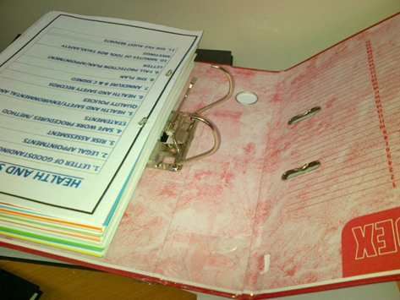
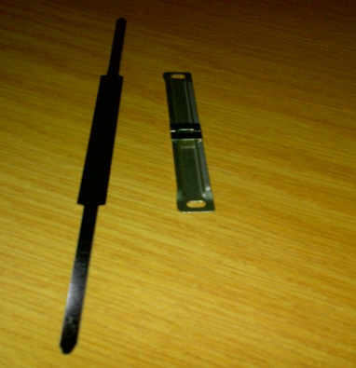
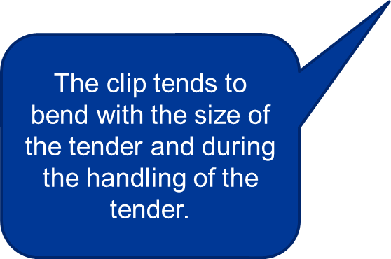
Binding of Tender Documents…cont
Lever Arch Files should not be used:
  Pages may be removed
  Tender Document is not tamper proof
File fasters pose a safety risk when handling tender documents

Slide 16

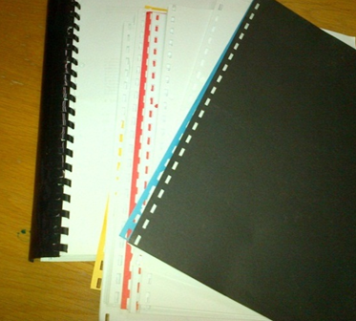

Binding of Tender Documents
Ring binders should not be used:
  Pages may be removed
  Pages tend to come loose from the binding during the stamping and handle process

Slide 17
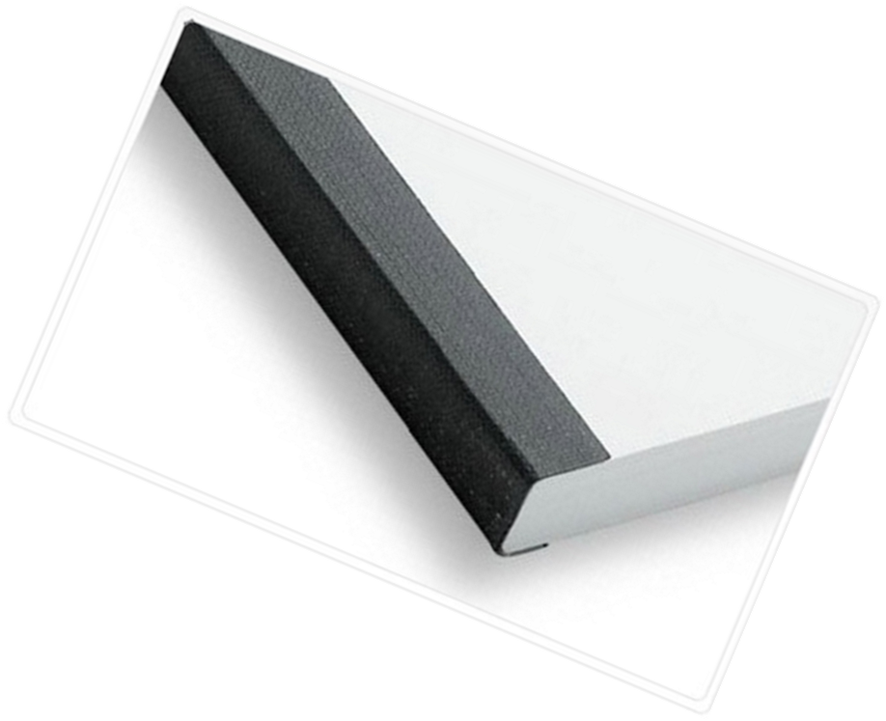


Binding of Tender Documents …. cont
Tamper Proof Binding of Tender Documents

Slide 18

Questions and Answer
    Thank you
Thank You

