Slide 1
RFB Briefing
Presented by: Technical Architecture
Division: Network Technology Strategy and Security (NTSS)
Date: 17 November 2022

Slide 2
Content – SITA Network Architecture
Scope of Work
SITA MPLS network current state
  Layer-3
  Layer-2
New SITA Layer-2 topology (Target Architecture)
End

Slide 3
SCOPE OF WORK
Bidder to provide a detailed Layer-2 transmission design that will interconnect all SITA Switching Centre Point of Presence (POP) country wide on the basis that the transmission network should provide resiliency, scalability, and high availability:
Provide ring/network with Multipoint to multipoint capability.
Bidder to provide full description of the proposed Layer 2 transmission technology platform or product description, indicating bandwidth scalability. Technologies such as Metro-Ethernet; DWDM etc.
Bidders to provide pricing for a High Availability solution based on the following:
    99.95% service availability SLA for the entire SITA core network.
Current bandwidth requirement for national ring is 10Gbps (1+1) per POP and Regional ring is 10Gbps (1+1) per POP throughout the entire Layer-2 transmission solution but must be upgradable up to 100 Gbps for National and Regional Rings on as and when requested basis.
Maintenance and Support of the Layer-2 transmission connectivity solution for the duration of the contract.

Slide 4
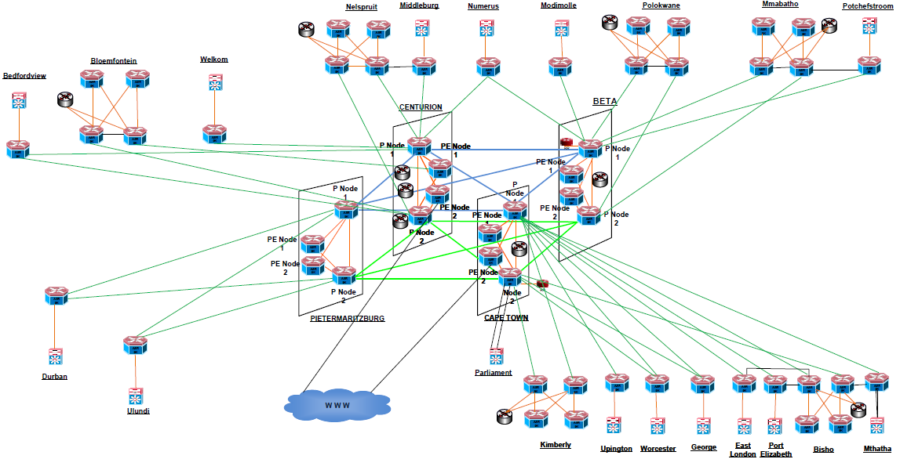
SITA MPLS network architecture
Old architecture
Not scalable
Lack of Redundancy

Slide 5
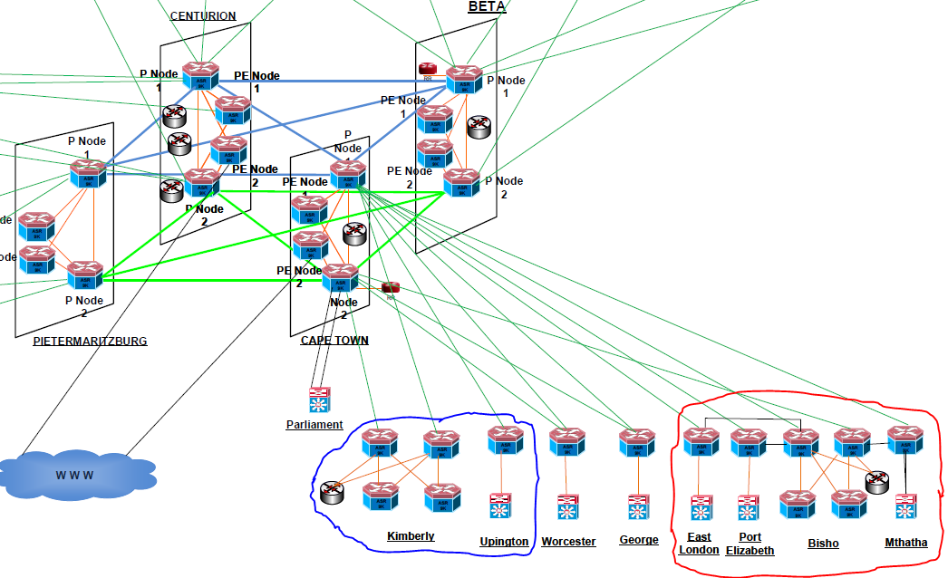
Current Layer-2 topology (Single Point of failure)
Cape Town PoP is Single Point of Failure for three Provinces.
EC
NC
Notes:
Cape Town has an Internet breakout and provinces that connect to it are at risk of being isolated should Cape Town fail.
The Western Cape Provincial Government also doesn’t have an alternative route to the NGN without Cape Town.

Slide 6
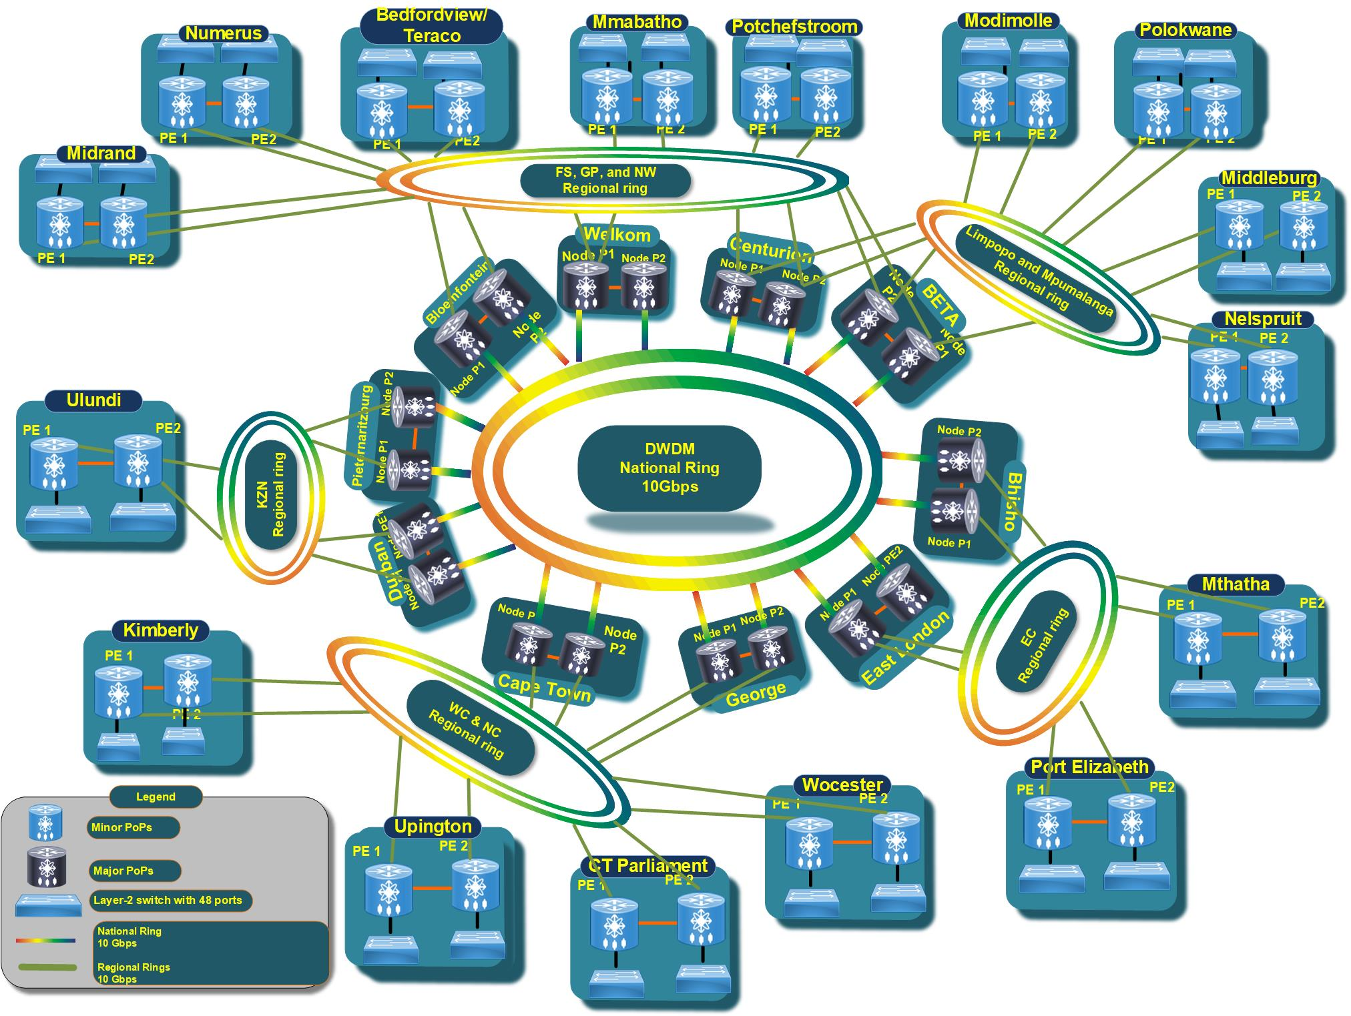
Target Architecture
Complete elimination of Single Point of Failures.
Scalable
We tried to follow the South African government three-tier system of National, Provincial and Local government.

Slide 7
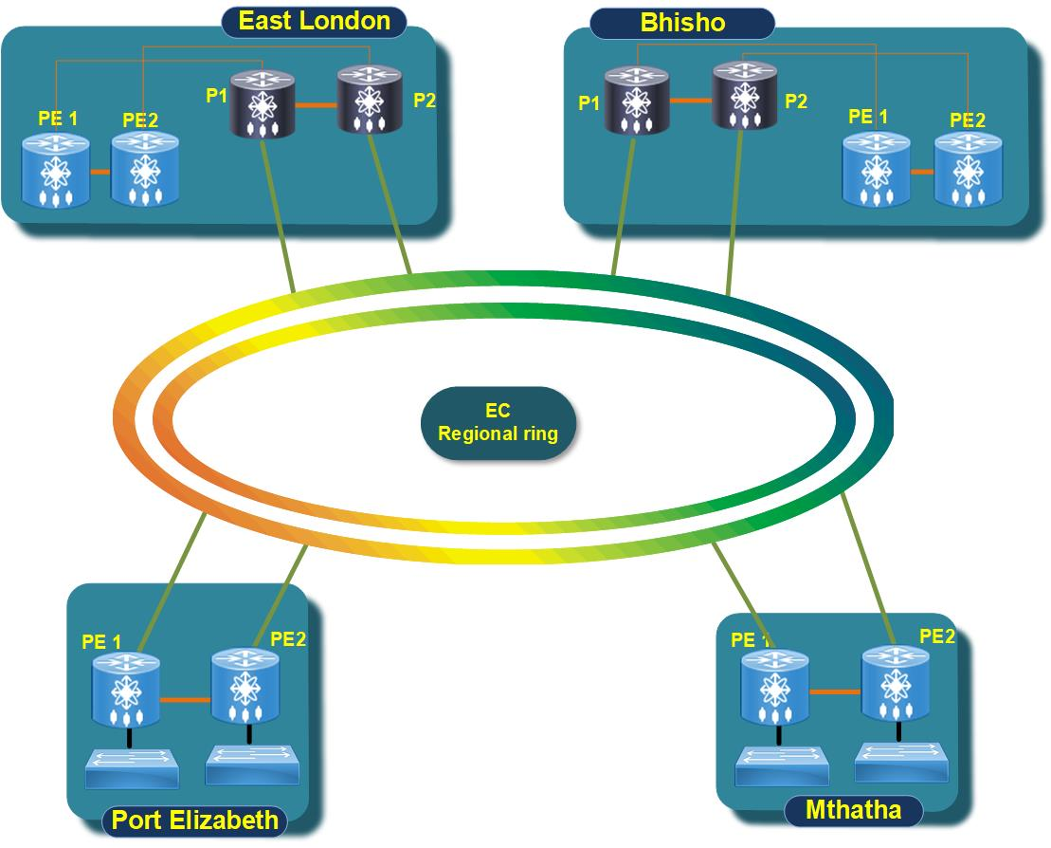
Regional Ring
Each SITA POP to have diverse connections to the Transmission Ring.

Slide 8
Questions?

