Slide 1
DESCRIPTION: SUPPLY OF MATERIAL AND THE CONSTRUCTION OF STORM WATER & ENVIRONMNETAL SYSTEMS AT SALDANHA TERMINAL AT THE TRANSNET PORT TERMINALS (TPT), BULK TERMINAL SALDANHA (BTS) FOR A PERIOD OF TWELVE MONTHS (12).
12 March 2025

Slide 2
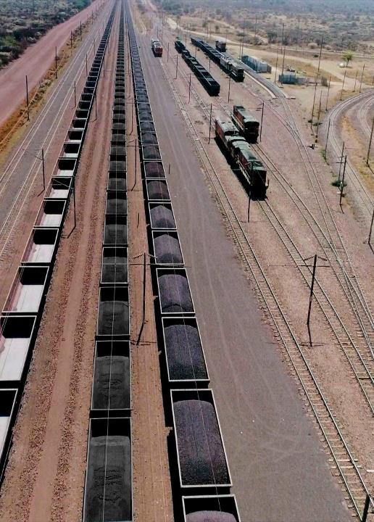
AGENDA
Agenda Point | Time Allocated | Presenter
Welcome, Introduction and Rules | 1 minute | Nontando Mnguni
Session rules of engagement | 5 minutes | Nontando Mnguni
Procurement process briefing | 10 minutes | Nontando Mnguni
Supplier Development | 5 minutes | Lungelo Manci
Technical Scope & requirements | 20 minutes | Marks Pita
Questions and closing | 10 minutes | Nontando /Marks
2

Slide 3
Works information
SESSION RULES OF ENGAGEMENT (1/2)
This briefing session is Compulsory
Bidders are requested to remain for the entire duration of the briefing session as important information pertaining to the RFP will be presented.
An approximate time allocation of 2 +- hour.
An opportunity for question clarifications will be provided after the briefing session.

Slide 4
SESSION RULES OF ENGAGEMENT (2/2)
Any additional clarification questions hereafter will only be accepted by TPT until 16h00 on Friday, 21 March 2025.
Responses to clarification questions will be loaded onto the e-tenders management portal and National Treasury.
All communication subsequent to this briefing session must only be directed to Nontando Mnguni Nontando.Mnguni@transnet.net
A copy of this presentation will be provided to all bidders whose attendance has been confirmed by Transnet and loaded onto the Transnet e-tenders portal and National Treasury

Slide 5
TENDER PROCESS: CONTENTS OF THE RFP
The tender documents issued by the employer comprise:
The Tender
Part T1: Tendering procedures
T1.1 Tender Notice and Invitation to Tender
T1.2 Tender data
Part T2: Returnable documents
T2.1 List of Returnable Documents
T2.2 Returnable Schedules
The Contract
Part C1: Agreements and contract data
C1.1 Forms of offer and acceptance
C1.2 Contract data (part 1 & 2)
Part C2: Pricing data
C2.1 Pricing Instructions
C2.2 Activity Schedule
Part C3: Scope of work
C3.1 Scope of Services
Part C4: Site Information

Slide 6
All Returnable schedules must be completed and signed, and required documents submitted.
Submit all mandatory Returnables.
The following documents are also to be submitted along with the tender submission:
Valid Tax Pin or Tax Clearance Certificate
Valid B-BBEE Certificate
Proof of registration on the Central Supplier Database
Submit a tendered price in the form of offer and acceptance which is fixed and firm for the duration of 12 weeks.

Slide 7


EVALUATION METHODOLOGY
Step 1
Step 2
Step 3
Step 6
Step 7
MINIMUM THRESHOLDS
Step 4
Step 5
Administrative
responsiveness
Substantive
responsiveness
Weighted
scoring / 100***
Functionality/ technical**
Returnable documents/ schedules
Pre-qualification
60 points
Minimum Threshold
Post tender negotiation with preferred bidder [2nd and
Price (90)
B-BBEE scorecard (10)
3rd
ranked
Selection of the preferred bidder.
(Objective criterion to justify award to someone other than the highest ranked bidder must have been stated in the bid documents and can be used at this stage, if applicable)
Award of business and conclusion of contract
bidders (if required) in a sequential and not simultaneous manner] if pricing is not market-related
Step 2: Preferential Procurement prequalification criteria that only one or more of the following may participate:
WEIGHTED SCORE
Technical / Functional criteria & weightings must be stipulated in the tender document

Slide 8
Evaluation Methodology
Step One: Administrative responsiveness
Whether the bid has been lodged on time.
Whether all Returnable Documents and/or schedules were completed and returned by the closing date and time.
Verify the validity of all Returnable Documents.
It is very important for bidders to submit documents which are signed and filled in correctly.

Slide 9
Evaluation Methodology
Step Two: Substantive responsiveness
Whether any general pre-qualification criteria set by Transnet, have been met. i.e., Compliance to the eligibility criteria – compulsory briefing .
Whether the Bid contains a Financial offer.
Whether the Bid materially complies with the scope and/or specification given
Whether the compulsory briefing session was attended
Whether the Proof/Confirmation of 8 CE or higher Class of Work registration with CIDB) was submitted.

Slide 10
Evaluation Methodology
Step Three: Technical Evaluation
Minimum Threshold of 60% for Technical Criteria and Functional Requirements. Technical shall be scored in accordance with the following returnable:
T2.2-03 Evaluation Schedule: Management and CV’s
T2.2-04 Evaluation Schedule: Quality Management
T2.2-05 Evaluation Schedule: Previous experience
T2.2-06 Evaluation Schedule: Environmental Management
T2.2-07 Evaluation Schedule: Method Statement
T2.2-08 Evaluation Schedule: Programme
The evaluation criteria is discussed in detail in the Technical presentation .

Slide 11
EVALUATION METHODOLOGY
Step Four: Price Criteria and B-BBEE
Only bidders who have met or exceeded the pre-determined threshold will progress to Step 5
Points will be allocated as follows:
  Price Criteria (90); and
  B-BBEE (10)

Slide 12
EVALUATION METHODOLOGY
Step Five: Post Tender Negotiations
Bidders are to note that Transnet may not award a contract if the price offered is not market-related. In this regard, Transnet reserves the right to engage in PTN with the view to achieving a market-related price or to cancel the tender. Negotiations will be done in a sequential manner i.e.:
-first negotiate with the highest ranked bidder or cancel the bid, should such negotiations fail
-negotiate with the 2nd and 3rd ranked bidders (if required) in a sequential manner.
In the event of any bidder being notified of such short-listed/preferred bidder status, his/her bid, as well as any subsequent negotiated best and final offers (BAFO), will automatically be deemed to remain valid during the negotiation period and until the ultimate award of business.
Should Transnet conduct post tender negotiations, bidders will be requested to provide their best and final offers to Transnet based on such negotiations. Where a market related price has been achieved through negotiation, the contract will be awarded to the successful bidder(s).

Slide 13
EVALUATION METHODOLOGY
Step Six : Objective Criteria
Transnet reserves the right to award the business to the highest scoring bidder/s unless objective criteria justify the award to another bidder. The RFP will state that Transnet may apply the following objective criteria to the bid process:
Geographical location;
all Risks identified during a risk assessment exercise/probity check (which may be conducted by an authorised third party) that would be done to assess all risks, including but not limited to:
  the financial stability of the bidder based on key ratio analysis, which would include, but not be limited to Efficiency, Profitability, Financial Risk, Liquidity, Acid Test, and Solvency;
  a due diligence to assess functional capability and capacity. This could include a site visit;
  A commercial relationship with a Domestic Prominent Influential Person (DPIP) or Foreign Prominent Public Official (FPPO) or an entity of which such person or official is the beneficial owner; and
  Reputational and Brand risks

Slide 14
EVALUATION METHODOLOGY
Step Seven: Award of business and conclusion of contract
Immediately after approval to award the contract has been received, the successful or preferred bidder(s) will be informed of the acceptance of his/their Bid by way of a Letter of Award. Thereafter the final contract will be concluded with the successful Respondent(s).
A final contract will be concluded and entered into with the successful Bidder at the acceptance of a letter of award by the Respondent.

Slide 15
NEC ECC APPLICABLE CLAUSES
B: Priced contract with bill of quantities
W1: Dispute resolution procedure
X2: Changes in the law
X7: Delay damages
X13: Performance Bond
X18: Limitation of liability
Z1: Local Production and Content Obligations
Z2: Additional Clauses relating to joint venture
Z4: Protection of Personal Information Act
Z5: Collusion in the Construction Industry
Z6: Additional obligations in respect of Termination
Z7: Right Reserved by the Employer to Conduct Vetting through SSA
Z8: Additional Clause Relating to Collusion in the Construction Industry
Z9: Protection of Personal Information Act
Z10: Anti-corruption, TPT Indemnity

Slide 16
CLOSING DATE AND TIME
Closing date and time: 10:00am on Monday, 31 March 2025
Location: Transnet e-Tender Submission Portal: www.transnet.net

