Slide 1
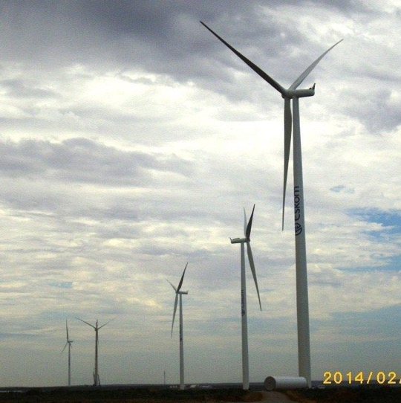
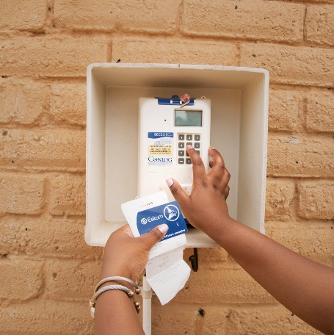
Non-Compulsory Clarification meeting
Presented by: Maropene Leshabana
29 July 2025

Slide 2
Content
1. Tender Submission
2. Basic Compliance
3.Requirements
4. Questions & Answers

Slide 3
Tender Submission
Tender number: E1600DXMP
Issue date: 21 July 2025
Closing date and time: 27 August 2025 at 10h00 a.m
Tender validity period: 90 days from the closing date and time
The tender shall be for the whole of the contract.
Tenders are to be submitted electronically via Eskom E- tendering site by the stipulated closing date and time. Please note it is the responsibility of the supplier to ensure that the tender submission is submitted before the closing time.
Note: No late tenders will be accepted

Slide 4
Tender Submission
The tenderer must upload the tender via Eskom Tender bulletin site on the Eskom E-tendering page. The documents need to be upload under the folder Technical, Commercial, Financial, and other.
All documents need to be submitted in a PDF format (The limit is 50MB per file and total submission of 900MB per submissions). The price list needs to be submitted in PDF and a copy in excel format.
No Zip/condense files can be uploaded
No hard copy will be accepted
If for some reason you resubmit your tender, then the latest version of the tender submitted will only be accepted and all previous submission/s will be null and void.
Please ensure that the submission status is indicated as complete.
Supplier Help Manual guide and video can be found on Eskom E-Tendering page.

Slide 5
Basic Compliance
Basic compliance with this Invitation to Tender requires a tenderer to meet all the following requirements:
Meet the eligibility criteria for a tenderer
For Electronic Tender Submissions:
The tenderer must upload the tender via Eskom Tender bulletin site on the Eskom E- tendering page. The documents need to be upload under the folder Technical, Commercial, Financial, and other.
All documents need to be submitted in a PDF format (The limit is 50MB per file and total submission of 900MB per submissions). The price list needs to be submitted in PDF and a copy in excel format. No Zip/condense files can be uploaded. No hard copy will be accepted.
If for some reason you resubmit your tender, then the latest version of the tender submitted will only be accepted and all previous submission/s will be null and void.
3. Submission of the mandatory commercial tender returnables as at stipulated deadlines.
For E-Tendering, a tenderer’s failure to have submitted/uploaded tender documents will render the tender non-responsive.

Slide 6
Mandatory requirements
The following are the Commercial mandatory returnable to be submitted at tender closing:
Returnable required at Tender closing (Disqualifiable)
Basic compliance
Completed NEC3 Engineering Construction Contract (ECC3)
Annexure E- CPA for local goods and services
NOTE: These returnables are required to be fully completed, signed (if required on the returnable) and submitted with the tender at Tender closing date and time. If not fully completed, signed (if required on the returnable) and/or submitted by tender closing, the tenderer will be disqualified.

Slide 7
Commercial returnables
These returnables are mandatory for evaluation and therefore required at tender closing time and date. These will not be requested by the Procurement Practitioner; however, the tenderer will not be disqualified but score zero.
SBD 6.1- Preference Points Claim Form in terms of PPPFA 2022 regulations (Annexure H)
Proof of compliance to the stipulated Specific goals i.e., BBB-EE certificate or Sworn affidavit.
Non-disqualifiable returnables are required to be fully completed, signed (if required on the returnable) and submitted with Tender at Tender closing date and time; however, if not submitted by Tender closing, or submitted with incomplete information or without a required signature, the Procurement Practitioner will, in writing, request the tenderer to submit the returnable within 5 working days. If the returnable is not fully completed, signed if required and/or received by the Procurement Practitioner within 5 working days of the request, the tenderer will be disqualified.

Slide 8
Commercial Statutory Documents
Valid B-BBEE Certificates / Sworn Affidavits
Tax Compliance Status (TCS) e-filing PIN from SARS
Valid Original certificate of good standing or proof of application issued by the relevant body.
Proof of National Treasury Central Supplier Database registration (CSD) that has a tax compliant status at award.
To the extent that the tenderer falls within the definition of a “designated Employer” as contemplated in the Employment Equity Act 55 of 1998, the tenderer is required to furnish the Employer with proof of compliance with the Employment Equity Act, including proof of submission of the Employment Equity report to the Department of Labour. (South African tenderers only).

Slide 9


Questions and Answer?

