Slide 1
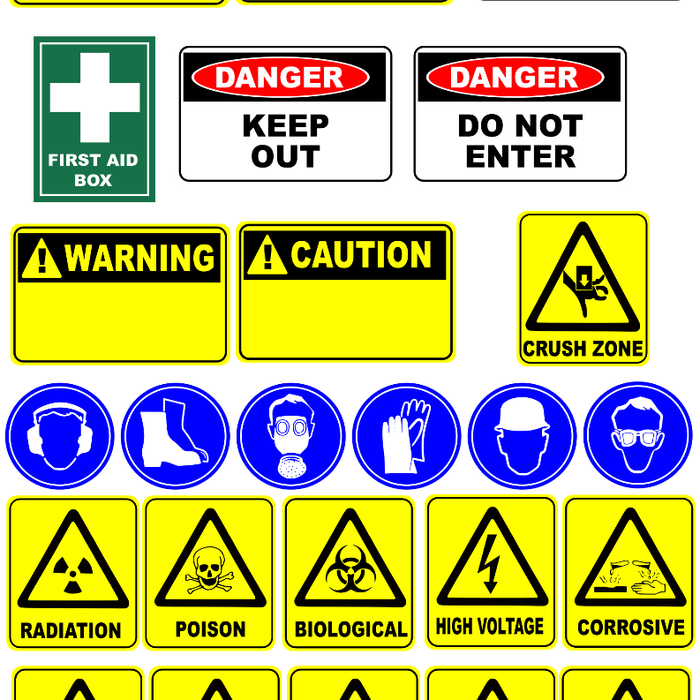

The Provision of 24/7 Armed Close Protection Officers on “as and when” required basis for the period of three (3) years.
LUNGILE MLOYI
10 June 2026
This Photo by Unknown Author is licensed under CC BY-NC-ND
This Photo by Unknown Author is licensed under CC BY-NC-ND

Slide 2
SHE Clarification
As part of Eskom’s Supplier Management System, it is a requirement for all suppliers who wish to undertake work for Eskom to undergo an occupational safety, health and environment (SHE) evaluation process.
Requirements
Explanation
1.Acknowledgement of Eskom’s rules and requirements (Annexure B)
  Ensure that all applicable rules and requirements are referenced in this form in order for the supplier to acknowledge and comply with them. Ensure that this completed form is included in the enquiry procurement package. To be signed and submitted by the tenderer.
2.Health & Safety Plan
Means a site, activity or project documented plan in accordance with the clients SHE requirements. The plan must be scope or project based. The plan must reflect an organised system (method statements, processes, resources etc) which the supplier will comply with and enforce to manage the SHE risk during the lifecycle of the project.
3. Costing for SHE
The tenderer should submit costing for SHE management activities.
SHE costing must reflect the amount of funds that will be allocated for SHE when the project commences (This is a breakdown of the bulk SHE costing in the bill of quantities) and it should be based on the scope of work and the associated risk. The items to be included are not limited to the following:
PPE, SHE training, First aid equipment, Safety signs, safety campaigns or interventions, Medical examinations etc.
2

Slide 3
SHE Clarification
As part of Eskom’s Supplier Management System, it is a requirement for all suppliers who wish to undertake work for Eskom to undergo an occupational safety, health and environment (SHE) evaluation process.
Requirements
Explanation
4. Baseline Risk Assessment
Refers to the SHE hazards/aspect and risks/impact identified and assessed before the inception of a new project/contract and commencement of operations. The baseline risk assessment shall include both routine and non-routine tasks.
  The methodology used for the risk assessment must be provided together with the BRA. All risk assessments provided must be scope/project and site specific.
5. Valid letter of good standing (LoGs)
Registration with the Compensation Commissioner (COID) or a licensed mutual company or an equivalent of it (for international bidders). If a company has only one employee (CEO, owner), the supplier shall submit an insurance letter that covers accidental death and disability to the value of R500 000 as a minimum.
For joint ventures (JV) LoGs for all companies in the JV must be submitted.
6. SHEQ Policy
A statement of intention by the employer which provides a framework for setting SHEQ objectives to improve SHEQ performance and also emphasises management commitment to employees’ wellbeing and duty of care to the environment.
7. SHE Competency
  A person who, in respect to the work that has to be done, has the required training, knowledge and experience, and, where applicable, qualifications made under the Act. relevant to that work or task. Provided that where appropriate qualifications and training are registered in terms of the provisions of the National Qualifications Framework Act, No 67 of 2008, those qualifications and training must be regarded as the required qualifications and training and is familiar with the Act and applicable regulations
3

Slide 4


QUESTIONS!!!

