Slide 1






Clarifications: The provision of Framework agreement for Land surveying and professional surveying services.
SDL&I Evaluations
13 September 2022
Rudzani Tshikungulu

Slide 2

We have a mandate to contribute positively to the development of the country
Our mandate is to achieve maximum and sustainable local development impact through leveraging Eskom’s procurement spend in a manner that allows flexibility within the business in order to accommodate government local development initiatives and policies

Slide 3
Supplier Development & Localization (SD&L) measures impact along these key performance areas
Key performance area
Definition
  Skills development
  Increasing the skill base (number and skill level) of South African workers in areas relevant to the energy sector and where there is a national scarcity of skills
  Local content
  Utilisation of Eskom and suppliers’ spend to develop South African based suppliers relevant to the energy sector (focusing primarily on BBB-EE and Black Owned suppliers)
  Industrialisation
  Utilisation of Eskom and suppliers’ spend to foster the establishment of new competitive industries in the energy sector
Job creation and Employment
  Creation of new jobs by suppliers as a direct result of Eskom business
  Supplier development
  Providing a platform to develop emerging suppliers, and further opportunities for national and international suppliers
3

Slide 4
PPPFA – Pre-qualification Criteria
Not Applicable
.

Slide 5
Evaluation criteria
The 80:20 or 90:10 rule will apply in this project:
B-BBEE = 20-10
Price = 80-90
.

Slide 6
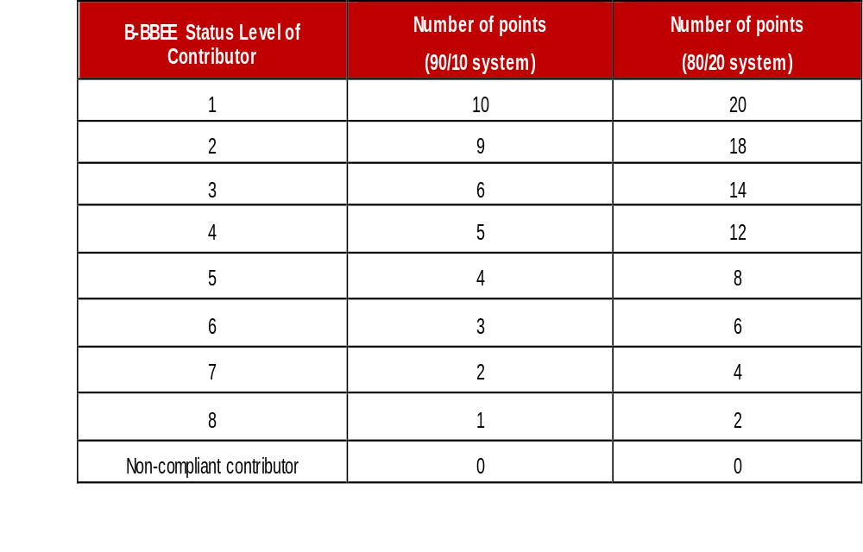
Preference Points B-BBEE

Slide 7

B-BBEE requirements
The certificate must be valid.
Verification Agency must be SANAS accredited.
There should be a logo of SANAS on the certificate.
QSEs and EMEs – Sworn affidavit is acceptable

Slide 8
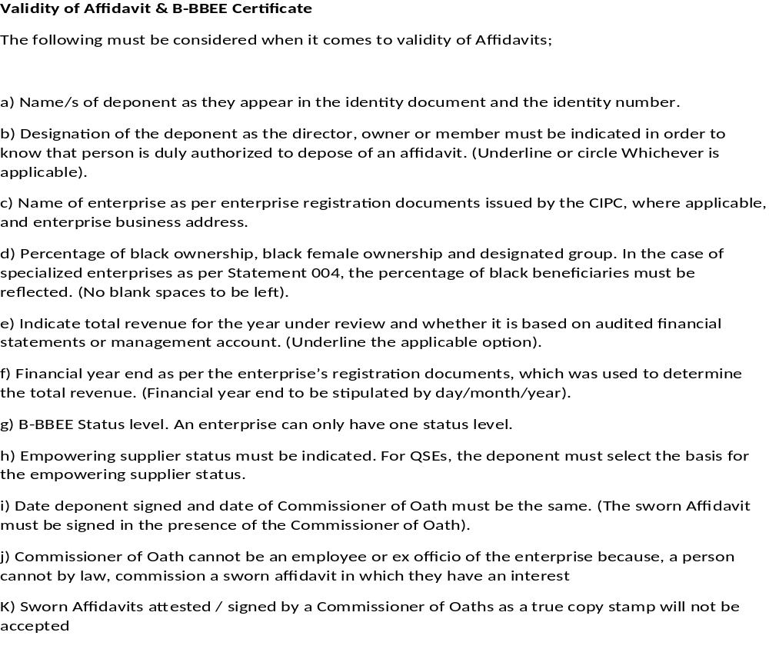
Validity of Affidavit

Slide 9
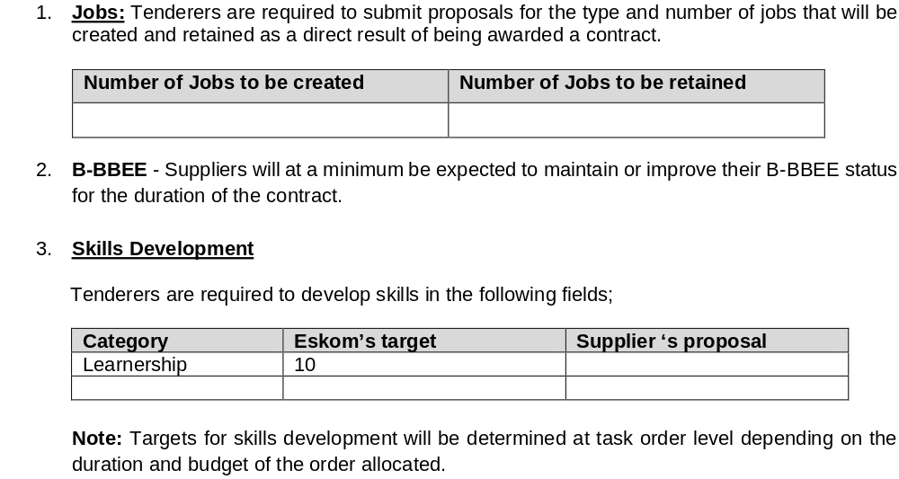
SDL&I - Letter of Undertaking
.

Slide 10
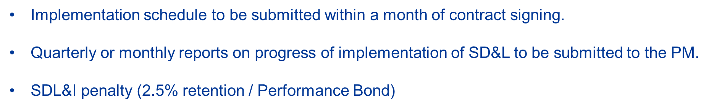
Monitoring and Reporting
.

Slide 11

Thank You
Notes:
11

