Slide 1
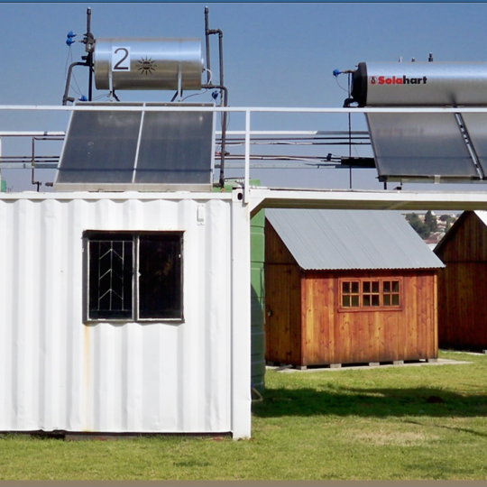
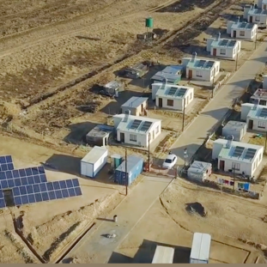
Renewable Hydrogen Facility:
Clarification Meeting: E1256CXMWP
May 2025

Slide 2
Content
Location
Scope – Functional
Scope – Contractors
Tender Documentation
To engineer, procure and construct a water electrolysis hydrogen generation plant, which must be integrated with the existing renewable power plant for “Green H2 Production” at ERIC Rosherville

Slide 3
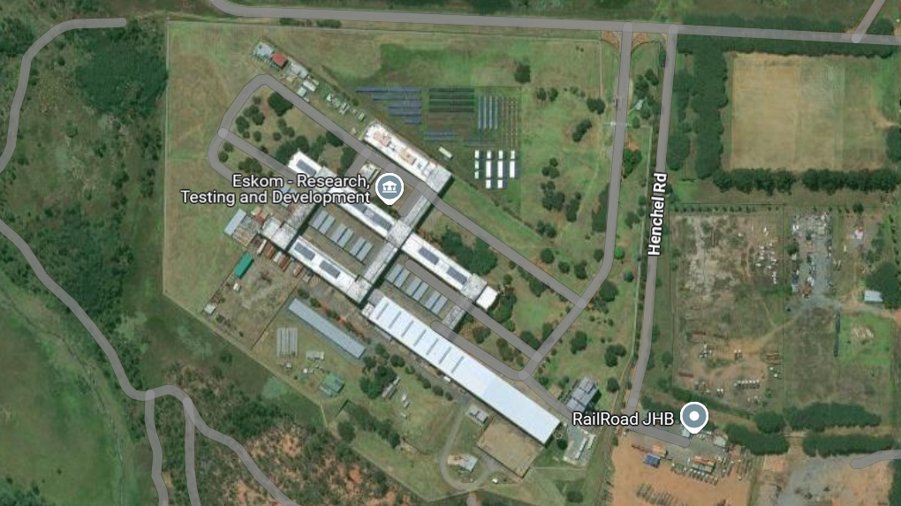
400 KW PV Plant
RHF
NW Substation
2.2 MWh BESS

Slide 4
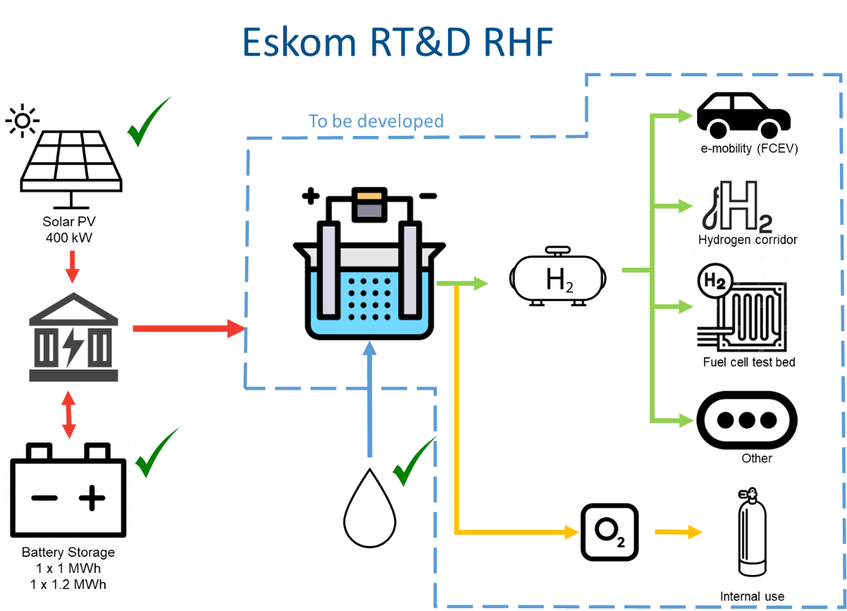
Scope - Functional
Electrolyser Technology:
Proton Exchange Membrane (PEM) or Anion Exchange Membrane (AEM)
Pressurised Alkaline Electrolyser
Operational Spec’s
Maximum power 50kW
Hydrogen Production: 24 kg / day
Hydrogen Purity: 99.9% purity
System Pressure: 27 Bar
Maximum Storage 80m³
Operational and Monitoring Requirements:
Operate on variable load
Monitoring for research

Slide 5
Scope – Contractors Scope
Eskom to supply
Contractors Scope
Single unit supplied by electrolyser manufacturer
Potable water for operations
Oxygen is vented
Demin water plant for electrolyser
Electrolyser(s): Upper total limit 50 kW (output of approximately. 24kg/day)
Electrolyser in container
Dryer for electrolyser
400kW Solar Plant
H2 end use application off site
400kW Solar Plant
NW substation Electrical Connection
Hydrogen Storage Tanks
3 x 24 m³ at electrolyser operating pressure
2.2MW BESS
2.2MW BESS
End-use container with Tap in Points
Water supply for Fire System
Remote Monitoring of operational conditions
Fire Detection system
Control Room
Gas Line
Electricity
Water
C&I

Slide 6
Tender Document
Scope:
Annexure A_Technical Specification for Renewable Hydrogen Facility
Annexure B_240-56227413 Hydrogen System Standard
Tender Evaluation:
240-RT&D-783 Tender Returnable Schedule
Mandatory Technical Evaluation Criteria for RHF
Qualitative Technical Evaluation Criteria for RHF
240-115583001 LV switchgear Technical schedule A and B (Documents to be completed and submitted with other technical returnable:)
240-RT&D-782 Technical Schedule for RHF (Documents to be completed and submitted with other technical returnable)
Costing:
QS_045 – Renewable Hydrogen Facility – Typical Activity Schedule March 2025 (To be used as a guide when developing contractors activity schedule
NEC:
CI I ECC3_Hydrogen Facility_29042025

Slide 7
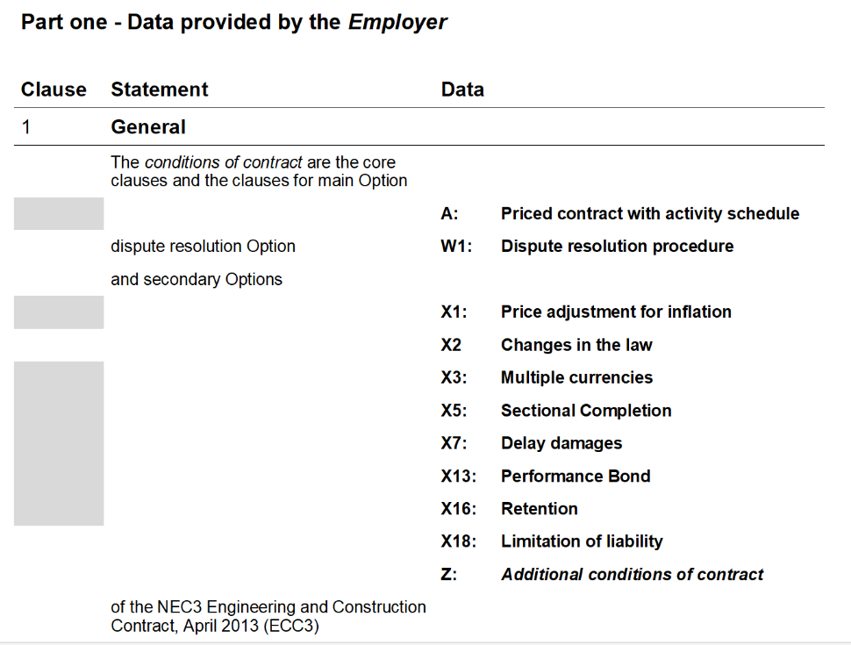
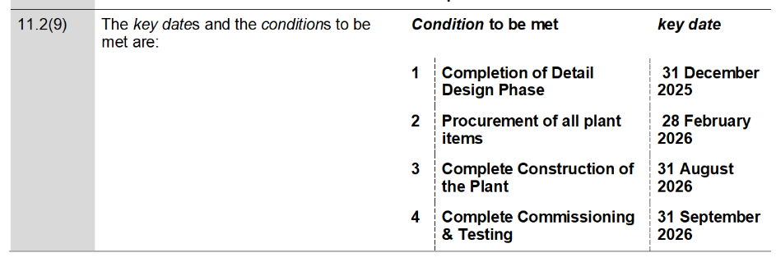
NEC ECC

Slide 8
Questions

