Slide 1
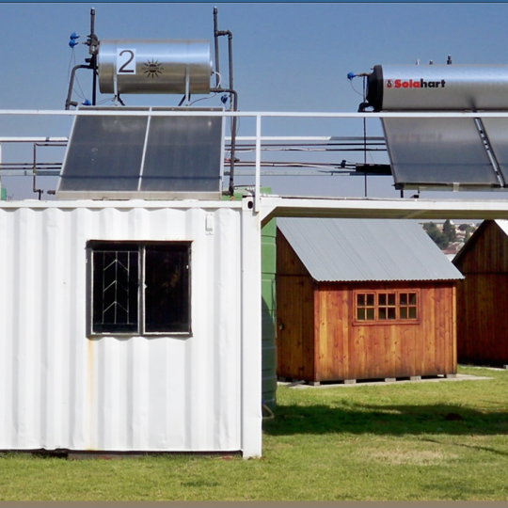
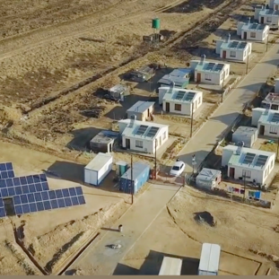
Central East Cluster SHE Criteria (SPU Meter Reading)
October 2026
Prepared by : Mxolisi Xaba
^{October 2026}

Slide 2
Eskom Values
Our values are the principles that we believe must guide our conduct, the way we work and the nature of our relationship with all stakeholders, internal and external
Eskom will strive to ensure
zero harm to its employees, contractors, the public and
the natural environment
Z – Zero Harm
I – Integrity
I – Innovation
S – Sinobuntu (we are humane, caring)
C – Customer Satisfaction
E – Excellence
To be acknowledged by all
for exceptional standards, performance and professionalism
Honesty of purpose, disciplined conduct, and respect for people
A commitment to deliver products and services that meet our customers’ needs; and to strive to exceed their expectations
Value-adding creativity focused
on results. Leading through excellence in innovation
Caring
“Powering our Province of Legends through Zero Harm – Beware Be Safe Be Alive2"

Slide 3
Eskom’s strategic perspective
VISION
Low cost good investment
A green energy company
The best company to work for
Having satisfied customers
Significant regional player
Offering electricity to all
Zero-harm to people and the environment
A trusted company globally
A top five performing utility

Slide 4

Life-Saving Rules

Slide 5
List of requirements
1. Is the acknowledgement form for Eskom's rules and requirements (in Annexure B) signed and submitted by the tenderer?
- to be sign by the CEO or Director of the company/supplier
- and by both witnesses

Slide 6
List of requirements
2. Health and Safety plan (Review date & signed by CEO/MD)
-Incident Management – how incidents are managed
-SHE Communication – SHE communication system in plan
-Emergency Management – how emergencies are managed
-Substance Abuse Management – how to deal with substance abuse
Must be sign/approved by top Management

Slide 7
List of requirement
3. Baseline risk assessments (Review date and approved by CEO/MD)
-Risk factors and controls to be included to the SHE Plan
- brief outline the hazards, risks and control measures

Slide 8
List of requirements
4. Valid Letter of Good Standing (COID, RMA, FEMA)
Valid

Slide 9
List of requirements
5. SHE policy
-Signed by CEO/Director and have a review date

Slide 10
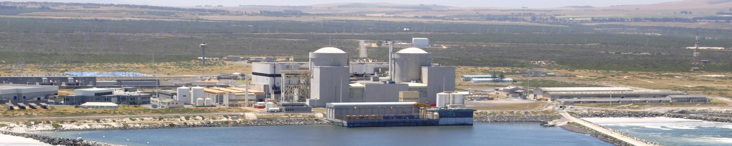
THANK YOU

