Slide 1
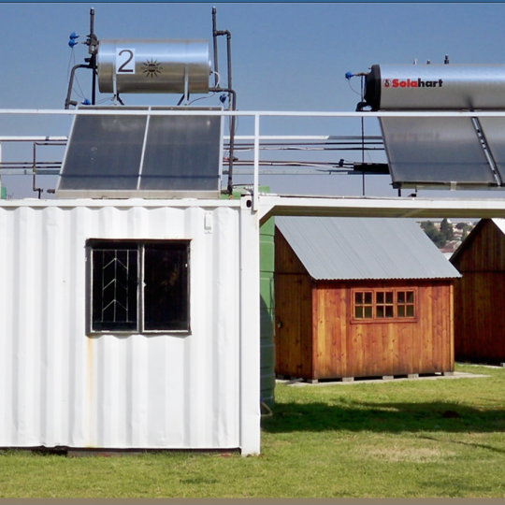
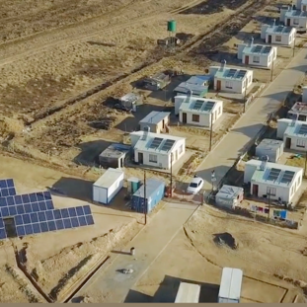
Provision of Asset Performance Management Tool for a period of 7 years
Mbulelo Mncengani
05 May 2025

Slide 2
Agenda for clarification
1 | Welcome of Attendees | Mbulelo Mncengani
2 | Objective of the Session | Mbulelo Mncengani
3 | Technical | Lerato/ Muzi/ Mapula etc
4 | Pricing | Lerato/Isaac
5 | Safety | Pumeza Mabunda
6 | Quality | Lesego Garegae
7 | Supplier Development, Localisation & Industrialisation | Rojane Qacha
8 | Commercial Information | Mbulelo Mncengani
9 | Closure | Mbulelo Mncengani
1
1
Welcome of Attendees

Slide 3

REQUEST FOR PROPOSAL (RFP)

Slide 4

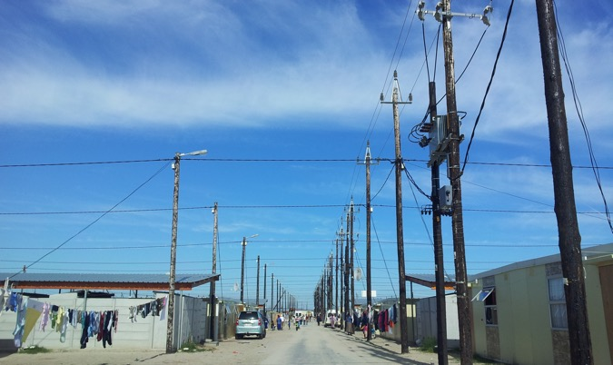
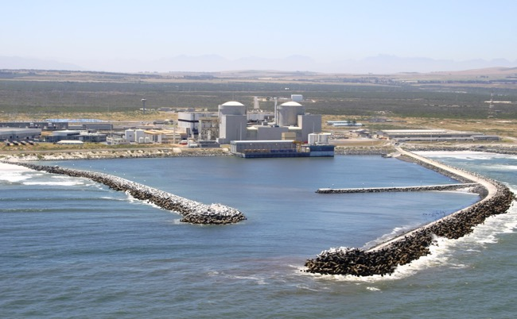
TECHNICAL

Slide 5

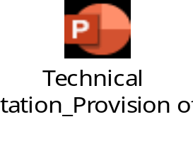

TECHNICAL REQUIREMENTS

Slide 6
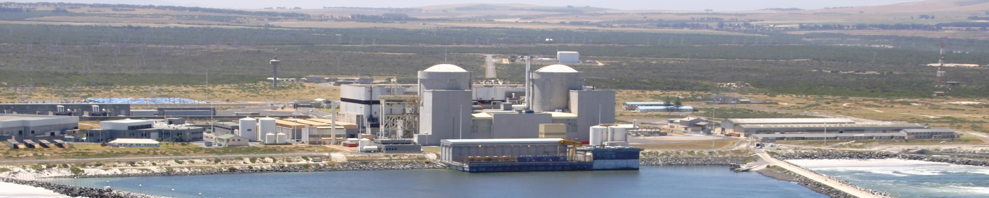
PRICING

Slide 7
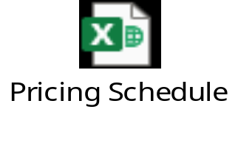
PRICING

Slide 8
SAFETY HEALTH AND ENVIRONMENT

Slide 9
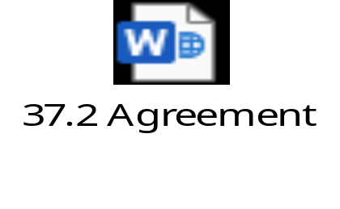
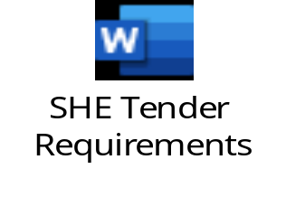

Safety Health Environment

Slide 10
QUALITY

Slide 11





QUALITY REQUIREMENTS

Slide 12
SUPPLIER DEVELOPMENT LOCALISATION AND INDUSTRIALISATION

Slide 13
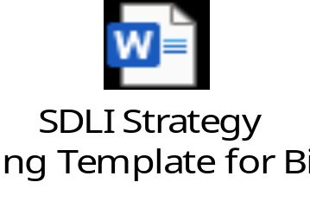
SDLI

Slide 14
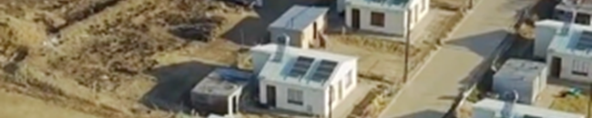
COMMERCIAL

Slide 15
Commercial requirements
Tender documents should be clearly as follows:
E1154CXMWP
Provision of Asset Performance Management Tool for a period of 7 years
Tender submission link: https://etendering.eskom.co.za

Slide 16
Commercial requirements
Closing date: 30 May 2025
Closing Time: 10:00 am (Standard South African Time)
(No late submissions will be accepted)
Only electronic submissions required.
  Single point of contact is Mbulelo Mncengani (E-mail: MncengMS@eskom.co.za)

Slide 17
Commercial requirements
  Evaluation will be as follows:
  The following Five (5) steps will be applied during the evaluation of this tender.
      Step 1: Basic compliance;
      Step 2: Mandatory documents;
      Step 3: Functionality
      Step 4: Pricing
      Step 5:Contractual criteria
        Quality
        Safety
          Audited Financial Statements
        SDL &I

Slide 18
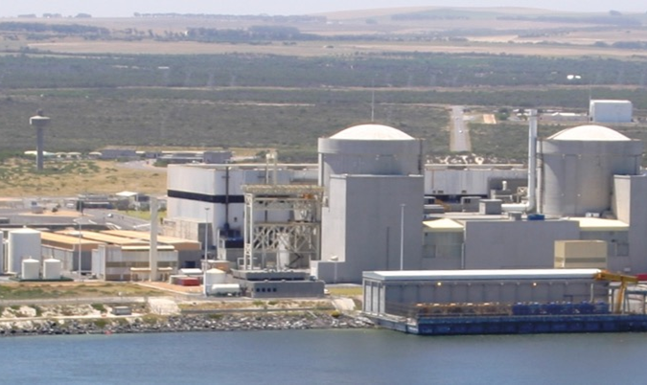
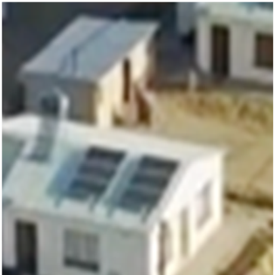
Conclusion

