Slide 1

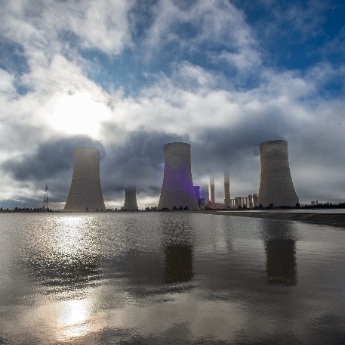
Non-Compulsory Tender Clarification Meeting
Enquiry No: E1558GXPOUR
For the: Guide Vanes Journal Refurbishment
For: Vanderkloof Hydro Electric Power Station
Over a Period: 12 months
Presented by: Christelle Stuart
Date : 12 February 2026

Slide 2
Agenda
Item | Topic Discussion
1. | Welcome
2. | Safety and Emergency Evacuation Procedure
3. | Declaration of Interest
4. | Introductions
5. | Agenda
6. | Commercial
7. | NEC
8. | Technical
9. | Contractual Requirements
10. | Questions

Slide 3
Commercial Requirements
Deadline for Tender Submission :
Tuesday, 04 March 2026 at 10h00 (South African Standard Time)
Tenders to be submitted online via Eskom E-Tendering Platform.
https://www.eskom.co.za/tenders/
E-Tendering Help Manual for Suppliers forms part of tender pack
Deadline for Clarification Questions:
5 working days prior to tender closing
Process for Submitting Clarification Questions :
Clarification questions must be made in writing and send to the Buyer, Christelle Stuart via e-mail Stuartcj@eskom.co.za and is to reference the enquiry number and description.
Clarification questions will be recorded and uploaded on the same platforms where the Tender Documents have been loaded (i.e., National Treasury Tender Portal and Eskom E-Tendering Website.)
Eskom’s Right to Accept or Reject a Tender:
The tender is to be for the whole of the contract.

Slide 4
Commercial Requirements
Eligibility of a Tender:
Refer item 2.1 of the Invitation To Tender (ITT)
This includes but is not limited to:
Tenderers MAY NOT submit more than one tender, either individually or as a partner in a joint venture (JV) or consortium.
Eskom will disqualify tenderers that are found not to have met the eligibility criteria.
Alternative Tenders:
Alternative tenders are allowed but must include a Main Tender that meet’s Eskom evaluation criteria(s). Both the Main and the Alternative offers will be evaluated using the evaluation criteria(s).
Pricing:
For e-tendering the price schedule needs to be submitted in PDF (signed).
This will form part of the NEC that is to be submitted fully completed and signed.
A Quote submitted on a company letterhead will not be accepted. The tenderer will be disqualified if the pricing schedule is not part of the NEC/Extracted frrom the NEC in the exact same format in PDF as the NEC.

Slide 5
Commercial Requirements
Mandatory Returnables:
Mandatory returnables MUST be submitted by tender closing.
Evaluation of Price and Specific Goals:
Prices will be scored out of 80 points.
Specific goals will be scored out of 20 points in accordance with the PPPFA.
NEC:
The Engineering and Construction Short Contract will apply.
Refer to pages 13-18 of the ITT for guidance on submission deadlines.

Slide 6
Technical Evaluation Criteria
The Technical Evaluation Criteria applicable for this Tender Enquiry No. E1558GXPOUR is outlined in Annexure T(issued with this tender) and stipulated under section 3.13 of the invitation to tender document.

Slide 7
Contractual Requirements
Mandatory Contractual Requirement:
Proof of CSD Number/ Registration
Safety(Annexure Q)
The following documents will be required as part of SHE Tender returnables:
The tender enquiry must be accompanied by a specific project base line risk assessment, SHE specification, Annexure B (Acknowledgement of SHE rules and requirements) and the applicable Annexure C (Annexure C1 - High risk): SHE tender evaluation and scoring card).
Annexure B must be returned with the supplier’s tender document whereas Annexure C1 provides guidance to suppliers on the minimum SHE evaluation which will be used for the specific tender (the appropriate annexure C will be selected prior to issuing the enquiry).
Only the SHE criteria sent out with the tender enquiry will be evaluated. The SHE professional will conduct the OHS evaluation.

Slide 8
Contractual Requirements Continued
Quality(Annexure R)
The requirements that may be applicable to the tenders are as follows:
• Category 3 quality criteria listing all returnables.
• Category 3 form A for section E of the criteria.
• CQP and QCP templates for section C & D respectively.
• Supplier QM specification (QM 58) for reference only.
SDL&I:
SDL&I Undertaking has been issued with the invitation to tender as Annexure P(SDL&I) Strategy Setting Report.
Financial Due Diligence:
Evaluation of the Financial reports / statements may be requested prior contract award to determine if the tenderer is of a financial risk to Eskom.

Slide 9
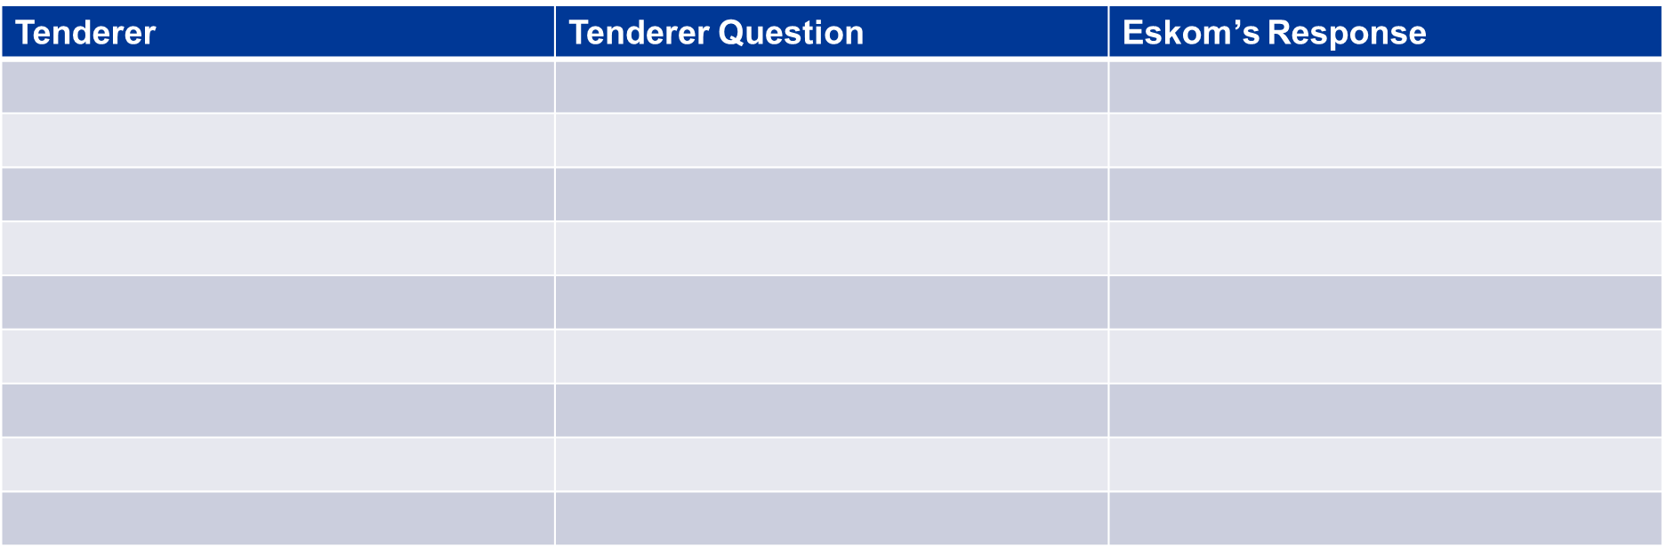
Questions

Slide 10


End of Commercial Presentation
Thank you

