Slide 1

FOR THE PROVISION OF PERSONAL PROTECTIVE EQUIPMENT (PPE) FOR TRANSNET SOC LTD. (REG 1990/000900/30) OPERATING AS TRANSNET PORT TERMINALS (HEREINAFTER REFERRED TO AS "TPT") AT SALDANHA TERMINALS FOR A PERIOD OF THIRTY-SIX (36) MONTHS ON AN AS AND WHEN REQUIRED BASIS.
RFP NO: TPT/2026/02/0078/1343/RFP – ICLM HQ 985/TPT
Presented by: Mvelo Bekwa
Date: 24 March 2026
1

Slide 2

CONTENTS
01 | Welcoming
02 | Safety Briefing
03 | Introduction : TPT Team
04 | Tender Process : Mvelo Bekwa
05 | Enterprise Supplier Development : Lungelo Manci
06 | Scope of Works : Takalani Siliga
07 | Technical Requirements : Takalani Siliga
08 | Pricing Schedule : Takalani Siliga
09 | Closure
2

Slide 3
INTRODUCTION : TPT TEAM
Mvelo Bekwa – Chief Administrator: Buyer
Takalani Siliga – SHEQ Officer
Ebrahim Jacobs – Engineering Manager
Lungelo Manci – Chief Administrator: Supplier Development

Slide 4
BRIEFING SESSION
This RFP briefing session is non-compulsory.
Bidders are requested to remain for the entire duration of the briefing session.
An approximate time allocation of two hours.
An opportunity for clarification questions will be provided at the end of each session.
All questions will be recorded, and the answers will be consolidated and forwarded to all bidders who have provided their contact information and loaded onto the e-tender portal. Any additional clarification questions hereafter will only be accepted by TPT until 04:00 PM on Thursday, 26 March 2026.
All communication subsequent to this briefing session must only be directed to Mvelo Bekwa on Mvelo.Bekwa@transnet.net.
After the closing date of the RFP, a Respondent may only communicate with Mvelo Bekwa, email Mvelo.Bekwa@transnet.net on any matter relating to its RFP Proposal.

Slide 5
IMPORTANT DATES
Issue Date : 18 March 2026
Briefing Session Date : 24 March 2026 @ 11:00am
Request for Clarification Deadline : 26 March 2026 @ 04:00pm
Closing Date : 02 April 2026 @ 12:00pm

Slide 6
RFP DOWNLOADING
  This RFP may be downloaded directly from National Treasury’s e-Tender Publication Portal at www.etenders.gov.za free of charge.
  To download RFP document and its Annexures:
      Click on “Tender Opportunities”;
      Select “Advertised Tenders”;
      In the “Department” box, select Transnet SOC Ltd
  Once the tender has been located in the list, click on the ‘Tender documents” tab and process to download all uploaded documents.
  The RFP may also be downloaded from the Transnet Portal at https://esupplierportal.transnet.net/portal/.

Slide 7
BID SUBMISSION
The Transnet Digital Procurement System (TDPS) Supplier Submission Portal can be accessed as follows:
Log on to the Transnet eSupplier website/Portal (https://esupplierportal.transnet.net/portal/);
Click on “SIGN IN/REGISTER – to register new bidder information and ensure that all (must fill in all mandatory information is completed) OR;
to sign in if already registered;
Click on “ADVERTISED TENDERS” to view advertised tenders;
Toggle (click to switch) the “Log an Intent” button in order to be able to activate the submission of a bid;
Respondents are to submit bid documents by uploading them onto the system against each tender selected. A Bidder can upload 30mb per upload and multiple uploads are permitted.
Each company must register its own profile using its company details and use the corresponding registered profile to log an intent to bid as well as submitting any bid;

Slide 8
BID SUBMISSION CONTINUED….
The Transnet Digital Procurement System (TDPS) Supplier Submission Portal can be accessed as follows:
Transnet will not accept a bid or will disqualify a bidder who submits a bid in the Transnet e-tender submission through another bidders’/Company’s profile. In other words, each bidder must register the intent to bid and submit its bid through its own profile under the same company name that will eventually bid for the tender. No company shall submit a bid on behalf of another company regardless of the company being a subsidiary or holding company;
In case of a Joint Venture, any of the parties/companies to the Joint Venture may use its registered profile to submit a bid on behalf of the Joint Venture
No late submissions will be accepted. A detailed bidder guide can be found on the Transnet Portal transnetetenders.azurewebsites.net.
**NO HAND DELIVERED COPY WILL BE ACCEPTED.

Slide 9
RFP TEMPLATE
SECTION 1 : SBD1 FORM
SECTION 2 : NOTICE TO BIDDERS
SECTION 3 : EVALUATION METHODOLOGY, CRITERIA AND RETURNABLE DOCUMENTS
SECTION 4 : PRICING SCHEDULE FORM – ANNEXURE F (MANDATORY)
SECTION 5 : RFP DECLARATION CERTIFICATE OF ACQUAINTANCE & BREACH OF LAW FORM WITH RFP
SECTION 6 : SPECIFIC GOALS POINTS CLAIM FORM
SECTION 7 : CERTIFICATE OF ATTENDANCE OF NON-COMPULSORY RFP BRIEFING
SECTION 8 : PROTECTION OF PERSONAL INFORMATION

Slide 10
RFP ANNEXURES
ANNEXURE A : SCOPE OF WORK & BRAND APPLICATION GUIDE ON PPE
ANNEXURE B : LOCAL CONTENT DECLARATION
ANNEXURE C : LOCAL CONTENT DECLARATION (SUMMARY SCHEDULE)
ANNEXURE D : IMPORTED CONTENT DECLARATION
ANNEXURE E : LOCAL CONTENT DECLARATION
ANNEXURE F : PRICING SCHEDULE
ANNEXURE G : TECHNICAL EVALUATION CRITERIA
APPENDIX 1 : QUALITY REQUIREMENTS (ELIGIBILITY)
APPENDIX 2 : PREVIOUS WORK EXPERIENCE
APPENDIX 3 : RETURN POLICY
APPENDIX 4 : WARRANTY

Slide 11
RFP ANNEXURE CONTINUED….
ANNEXURE H : MASTER AGREEMENT
ANNEXURE I : SCHEDULE 1 – SCHEDULE OF REQUIREMENTS
ANNEXURE J : TRANSNET GENERAL BID CONDITIONS
ANNEXURE K : NON-DISCLOSURE AGREEMENT
ANNEXURE L : SUPPLIER INTEGRITY PACT

Slide 12
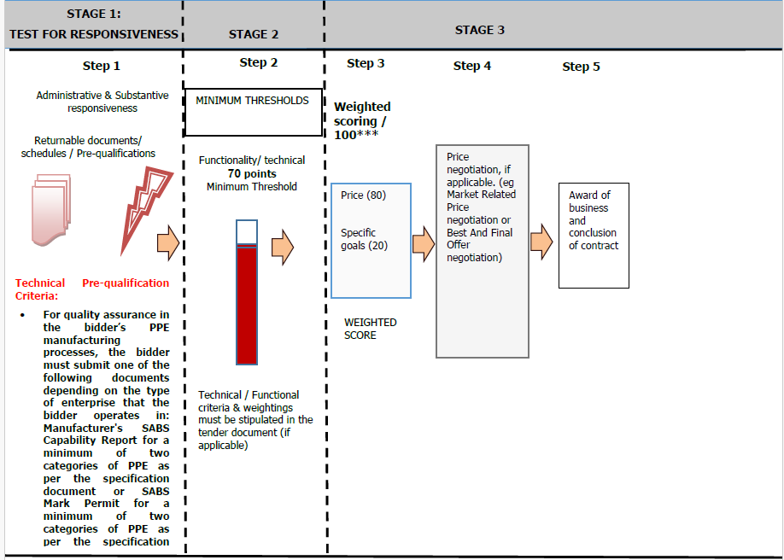
TENDER EVALUATION PROCESS

Slide 13
TENDER EVALUATION PROCESS
Stage 1 : Administrative & Substantive Responsiveness - Mandatory Returnable
Failure to provide all these Mandatory Returnable Documents at the Closing Date and time of this RFP will result in a Respondent’s disqualification
Mandatory returnable documents | Submitted [Yes/No]
Section 4 : Pricing Schedule – Annexure F
TECHNICAL ELIGIBILITY For quality assurance in the bidder’s PPE manufacturing processes, the bidder must submit one of the following documents depending on the type of enterprise that the bidder operates in: Manufacturer's SABS Capability Report for a minimum of two categories of PPE as per the specification document or SABS Mark Permit for a minimum of two categories of PPE as per the specification document.

Slide 14
TENDER EVALUATION PROCESS
Stage 1 : Administrative & Substantive Responsiveness – Returnable for scoring
Returnable document used for scoring | Submitted [Yes/No]
Valid proof of Respondent’s compliance to Specific Goal requirements stipulated in Section 6 of this RFP (Valid B-BBEE certificate or Sworn- Affidavit as per DTIC guidelines)
Regional Procurement
Local Content and Production (SDB 6.2 Annexure B, Annexure C, Annexure D & Annexure E)
Previous Work experience Bidders must submit reference letters on official client letterhead confirming three (3) years’ experience, which may have been accumulated from multiple contracts. These letters will verify the bidder’s experience and contract value, requiring a minimum of three (3) cumulative years of experience with a total contract value of R2 million, specifically in the provision of PPE within the past five (5) years.
Return/Exchange Policy Bidder to exchange defective PPE within seven (7) days upon receipt of a notification. Bidders must submit their Return/Exchange Policy.
Warranty Bidder must have a minimum warranty of twelve (12) months on the PPE. The bidder must submit warranty for the PPE.

Slide 15
TENDER EVALUATION PROCESS
Stage 1 : Administrative & Substantive Responsiveness – Essential Returnable Documents
Essential returnable documents | Submitted [Yes/No]
In the case of Joint Ventures, a copy of the Joint Venture Agreement or written confirmation of the intention to enter into a Joint Venture Agreement
Latest Financial Statements signed by your Accounting Officer or latest Audited Financial Statements plus 2 previous years (3 years)
SECTION 1 : SBD1 Form
SECTION 5 : RFP Declaration Certificate of Acquaintance and Breach of Law Form with RFP
SECTION 6 : Specific Goals Points Claim Form
SECTION 8 : Protection Of Personal Information

Slide 16
TENDER EVALUATION PROCESS
Stage 2 : Technical Evaluations
Bidders must go through each technical evaluation to understand the requirements.
The minimum qualifying threshold is 70 points.
More detailed to be presented by Technical

Slide 17
AWARD STRATEGY
TRANSNET INTENDS TO STRICTLY AWARD ONE (1) SUPPLIER.

Slide 18
Closing of the RFP
CLOSING OF TENDER
The RFP will officially close on Thursday, 02 April 2026 at 12:00pm via the etender’s website (https://esupplierportal.transnet.net/portal/)
Bidders should ensure that electronic bid submissions are submitted at least a day before the closing date and bidders should not wait for the last hour before the deadline to submit. This is to enable them to timeously address issues which they may encounter due to internet speed, bandwidth or the size of the number of uploads being submitted. Transnet will not be held liable for any challenges experienced by bidders as a result of their own technical challenges.
Should you encounter system glitches on uploading documents, kindly take a screenshot and forward it to Mvelo.Bekwa@transnet.net timeously to allow the e-tender portal team to assist you accordingly.
If the bidder fails to upload documents on or before the closing date, no alternative means (by email, fax, or physical submission) will be accepted.

Slide 19
Bidders to note the following:
TPT does not bind itself to accept any Bid.
TPT can withdraw the RFP in whole or in part, or award the business in whole or in part, or not at all.
All Bidders who wish to do business with Transnet must be registered in the Central Supplier Database (CSD) which can be accessed online via www.csd.gov.za
Transnet will only pay the market related price.

Slide 20
Thank you

