Slide 1
Contract SANRAL N.001-192-2018/1NSC for Nominated Sub-Contract for the Design, Build, Operations and Maintenance of the Toll System for the Operations and Maintenance of N1 South and R30 Toll Plazas on National Route N1 and R30
6 February 2023 at 11:00

Slide 2

Agenda
Description of the project
Scope of work
Programme
Tender
Plaza visits
Housekeeping
Questions

Slide 3
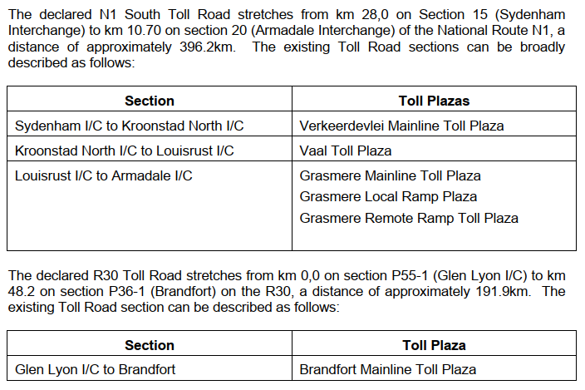
1. Description of the project
N1 South and R30 Toll Road

Slide 4
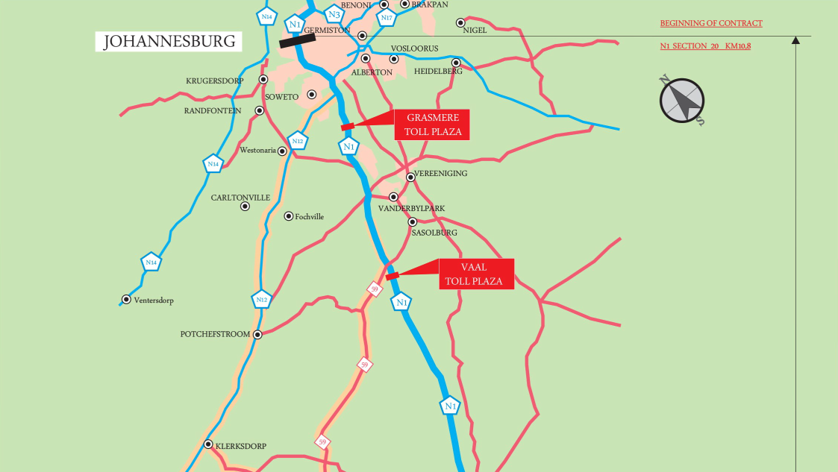
1. Description of the project

Slide 5
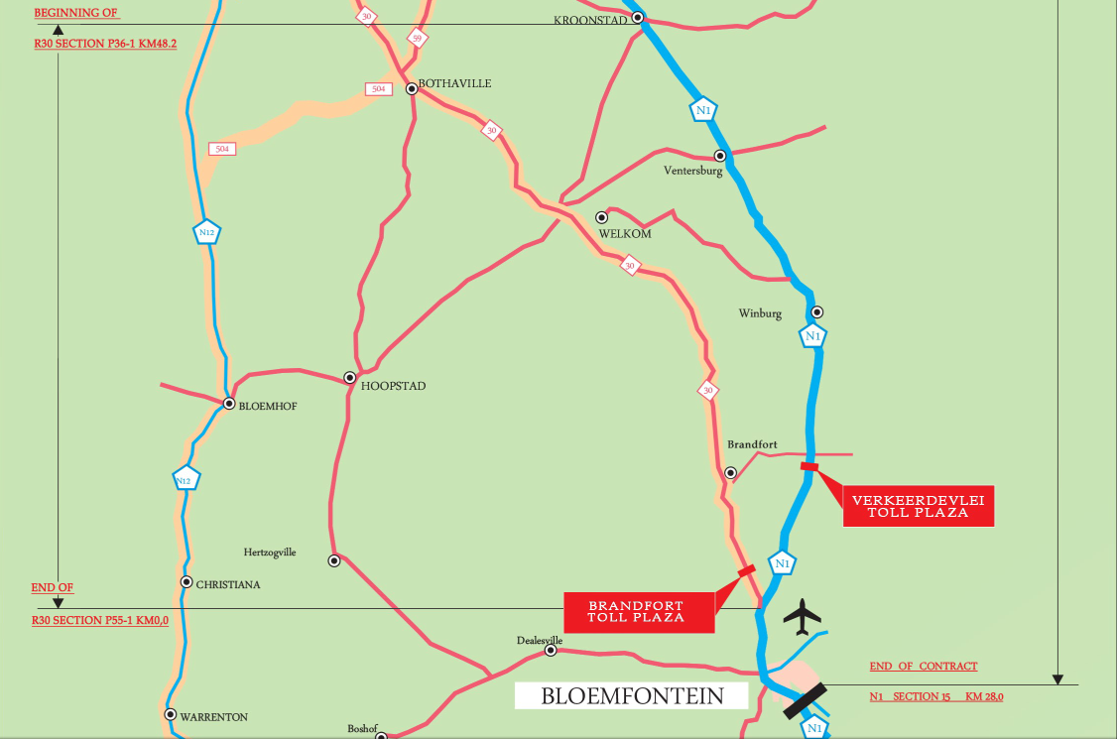
1. Description of the project

Slide 6
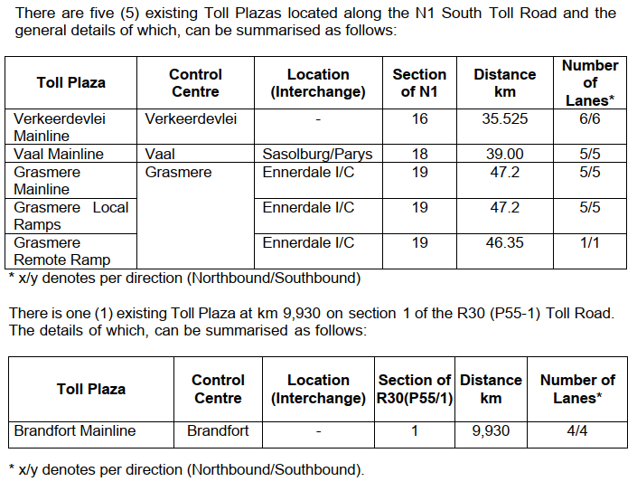
1. Description of the project
Toll plazas

Slide 7
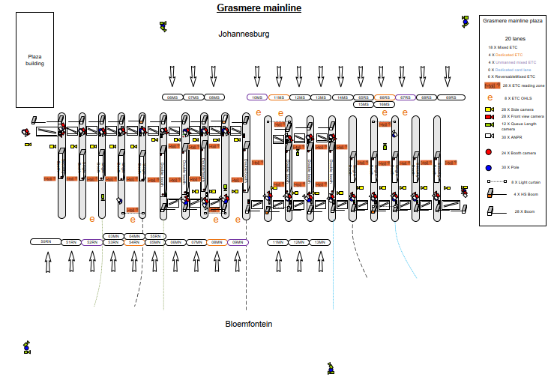
1. Description of the project
Toll plaza lane layouts (future) (Grasmere mainline and local ramps)

Slide 8
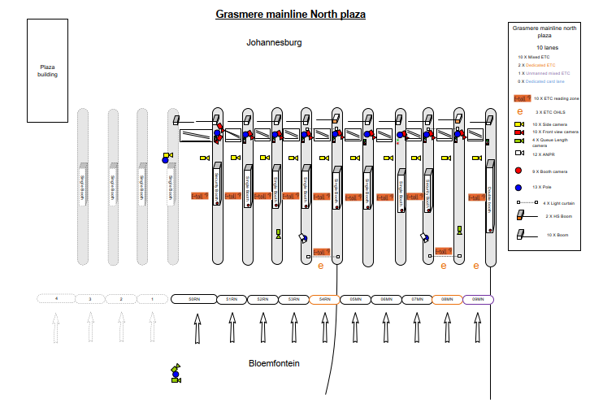
1. Description of the project
Toll plaza lane layouts (future) (Grasmere mainline and local ramps)

Slide 9
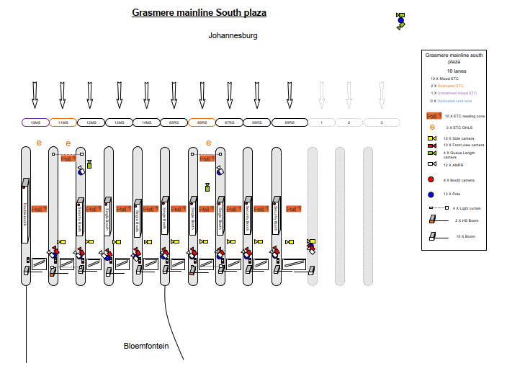
1. Description of the project
Toll plaza lane layouts (future) (Grasmere mainline and local ramps)

Slide 10
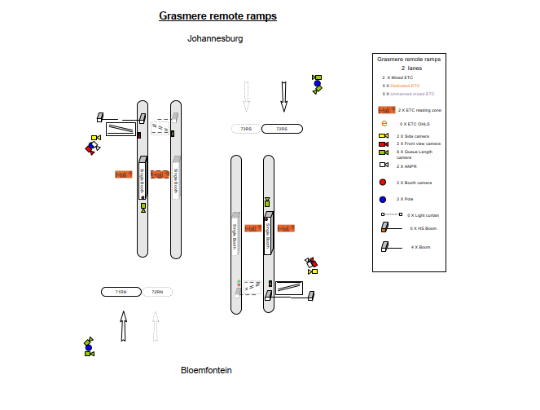
1. Description of the project
Toll plaza lane layouts (future) (Grasmere remote ramps)

Slide 11
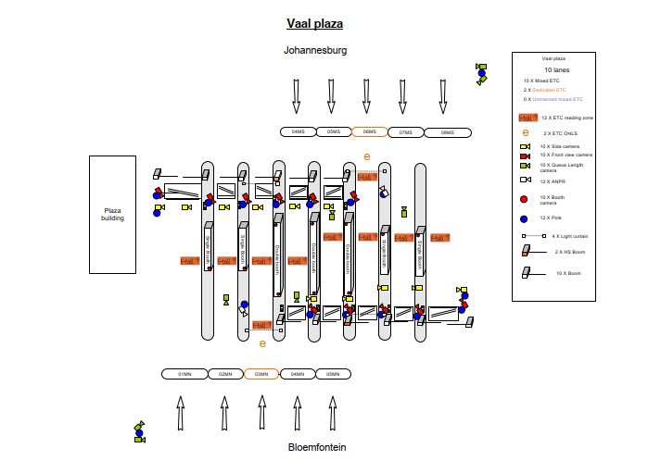
1. Description of the project
Toll plaza lane layouts (future) (Vaal)

Slide 12
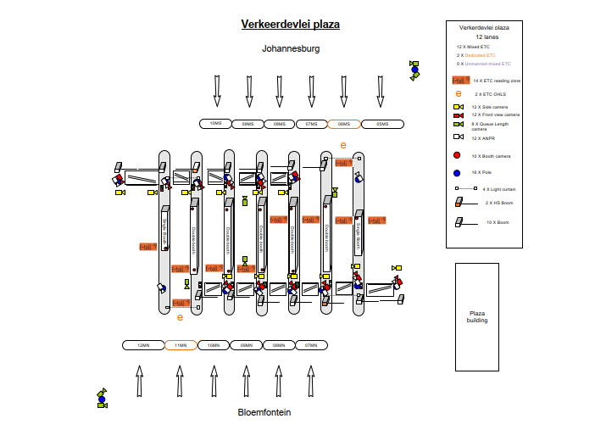
1. Description of the project
Toll plaza lane layouts (future) (Verkeerdevlei)

Slide 13
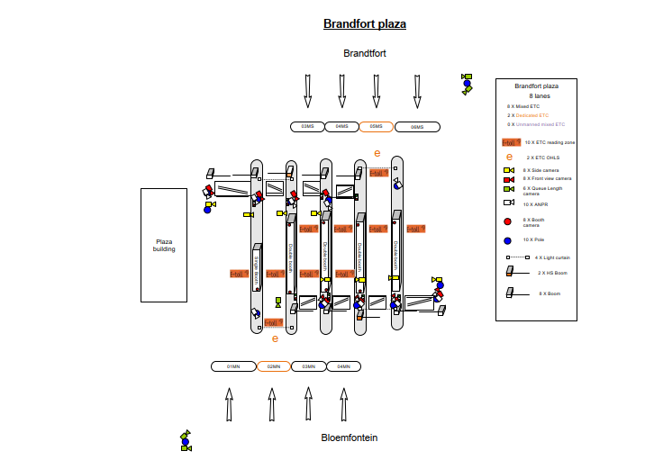
1. Description of the project
Toll plaza lane layouts (future) (Brandfort)

Slide 14
2. Scope of work
General
Continuation with current toll system initially; implement DB
Assets
  Provision, installation and maintenance of Employer’s Facilities and Permanent DB (toll system related)
  Provide and maintain Contractor’s Facilities and equipment (toll system related)
Involvement of Targeted Enterprise

Slide 15
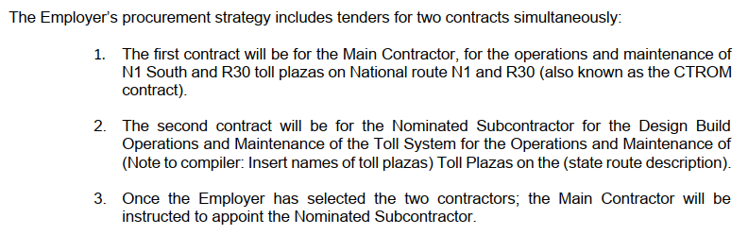
2. Scope of work
Associated contracts and terminology

Slide 16
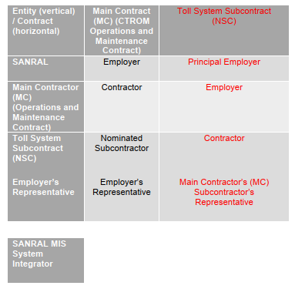
2. Scope of work
Associated contracts and terminology

Slide 17
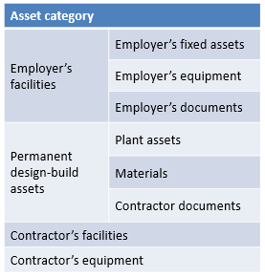
2. Scope of work
Assets
Employers Facility (fixed assets, equipment, documents)
  Contractor responsible for day-to-day maintenance.
  Contractor to repair these assets and cost to be recovered from the Employer on 3 quotations system.
Permanent Design-Build Assets (plant assets, material, Contract documents)
  Contractor to maintain, repair, replace, upgrade, provide or dispose of these assets.
  Contractors’ Facility and Equipment
Contractor facilities and Contractor equipment
Existing Asset Register listing all the assets were provided in Part C4 of Volume 4.

Slide 18
2. Scope of work
Split of risk – Form D13
Form D13 defines a Risk Transfer Model, i.e., split of risk between Contractor and NSC
  MC responsible for NSC management
  Operator will operate and have access to health monitoring data and VGS audit tool
  NSC will maintain and upgrade, and ensure toll system optimal performance and KPI compliance
  Data variance is handled by Payment Methodology (V2B7a), including AVC detection and classification issues
  Responsibility to ensure optimal system performance both MC and NSC, focused on early detection
  Health monitoring and statistical performance assessment
  Configuration control ensure that NSC do not modify system (Changes reported by health monitoring system)
  MC supply help desk, ERS and stock control
  NSC supply spares, maintain and keep spares above minimal levels. Replenish at end of contract.
NSC carries main risk related to toll system aspects. However, Contractor carries a small portion of risk, as Contractor remains responsible for overall management of NSC.

Slide 19
2. Scope of work
Toll system (Design build sections – V3B1: C1.2.3 APPENDIX 1 and Table 5-1: System upgrades)
Maintenance of legacy system (S1) – 6 Months
Establishment upgrades (S2) – 18 Months
Upgrade/ replacement of equipment (S3.1 to S3.9) – 18 Months (Commissioning of sections of the Works)
Interface to the SANRAL MIS (S3 and S4) – 6 Months
SANRAL Toll System (S5) – 6 Months
End of contract upgrades

Slide 20
2. Scope of work
Toll collection lane equipment
Standard 2010 system with enhancements including:
  TCH interface (PGW not on site, via route and GORT fibre)
  Dedicated ETC lanes (Reversible and switchable to mixed mode) (e-sign for dedicated and tag only lanes)
  Contactless bank card (EMV) processing (PCI compatible) readers). Proof before roll-out.
  ANPR: Pilot followed by deployment
  VGS audit role:
    Incident and missing/duplicate transaction
    AVC count accuracy
    Concession/Discount verification (ANPR/VLN discrepancies)
  Health monitoring (Response by NSC, with or without MC reporting) and configuration control
  PCI level 2 merchant implementation
SANRAL MIS interface (Basic TCH type interface) and further enhancements
SANRAL toll System (Assessment, selection, pilot and roll-out) [SANRAL access to source code]

Slide 21
2. Scope of work
TCH interface
Move TCH PGW to OPS level at a plaza on the route (S2, establishment)
Utilize National and GORT fibre networks

Slide 22
2. Scope of work
Employer’s MIS and Toll System
Employers MIS Interface (DB S4) – 6 Months
  Basic
  Full (WA)
SANRAL toll system procurement process (Tendered rates)
  Assessment of NSC systems
  Selection of system to be deployed and access to source code (for use or to own fully)
    Test and evaluation phase (In parallel on selected routes)
    Central NSC contract (Use tendered rates per route)
    Development and test environment Pilot deployment (parallel deployment) at a site
  Route roll-out and decommissioning of NSC system
SANRAL Toll System NSC provide system and support (Procurement models)

Slide 23
2. Scope of work
ITIS
Interface with ITIS

Slide 24
2. Scope of work
Involvement of Targeted Enterprise
Requirement to involve Targeted Enterprise (TE) (30% of contract value)

Slide 25
2. Scope of work
KPIs
The Performance Measurements are detailed in Volume 2 Book 6a.
See Clause C3.2.6 from page C3-173 onwards for modifications.
These modifications are in line with the consolidated KPI Model agreed on the National Performance Review Committee (NPRC).

Slide 26
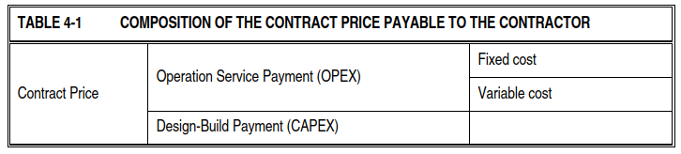
2. Scope of work
Payment methodology
Fixed and Variable Cost Payment Mechanism will be used in this contract.
Schedule of Payments/Cost Matrix consist of 2 schedules:
  Schedule A – Operation Service Period (OPEX).
  Schedule B – Design-Build Period (CAPEX).
  Schedule D – Stakeholder, community, Targeted labour, Targeted Enterprises

Slide 27
3. Programme
Tender
Submission of Form A1.1 24 January 2023
Tenderers meeting 6 February 2023
Last day for questions by Tenderers 8 February 2023 (Closing date minus 12 working days)
Last day for Employer Addenda 10 February 2023 (Closing date minus 10 working days)
Closing date 24 February 2023
Start of operations service period 1 June 2023

Slide 28
3. Programme
Project
Effective date Date of Letter of Acceptance
Commencement date Date of Commencement meeting
Access to site for establishment 6 weeks before start of services
Provision of Performance Bond 28 days after letter of acceptance
Start of operations service period and DB period 1 June 2023
Operation service period 6 years
Design-Build period 3 years

Slide 29
3. Programme
Sections
Operations service period (6 years)
  Section 1: Operations using Legacy toll system, or Contractor’s toll system
  Section 2: Operations using the Employer’s MIS

Slide 30
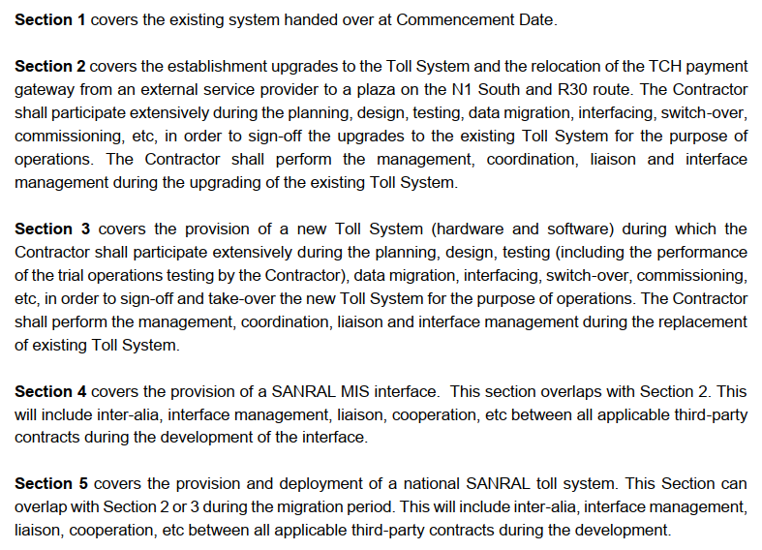
3. Programme
Sections
Design-build period (3 years)
  Maintenance of legacy system (S1) – 6 Months
  Establishment upgrades (S2) – 18 Months
  Upgrade/ replacement of equipment (S3.1 to S3.9) – 18 Months (Commissioning of sections of the Works)
  Interface to the SANRAL MIS (S3 and S4) – 6 Months
  SANRAL Toll System (S5) – 6 Months

Slide 31
4. Tender
Addressed in procurement presentation

Slide 32
5. Plaza visits
Visits to the Toll Plaza (Grasmere) to be conducted after tender meeting.
Visit to all plazas can be arranged through the Employer’s Agent (ProcurementER7@sanral.co.za).

Slide 33
6. Housekeeping
Attendance register
Form A1

Slide 34
7. Questions
All questions to be formally submitted to: ProcurementER7@sanral.co.za
Also opportunity for questions at tender briefing session

