Slide 1






EAAB
DEM-04254-Y5Q7
Digital Procurement(Wave 01)
LAD
Support/Approval Required
Presented By : Charles Malaka
30 May 2022

Slide 2
Background
    The Digital Procurement initiative has been established by Group Commercial/Procurement, on behalf of Eskom Holdings Ltd, in order to assist the business to address all the challenges currently being experienced especially with regards to Procurement, Sourcing and SCM activities across Eskom as a whole. The primary objective is to eliminate all operational inefficiencies across Procurement and Supply Chain Management business landscape.
    The scope of Wave 01 will cover the following requirements,
      The creation and tracking of Procurement strategies including the tracking of procurement plans.
      The creation of Purchase Requisitions and or Purchase Orders.
      Electronic Auctioning including asset disposals via auctions (investment recovery management).
      Electronic Tendering including issuing, evaluations, tender office management and reporting.
      Integration to external supplier databases (e.g., Central Supplier Database for the National Treasury) and probity check solutions.
      Integration with external portals to publish tenders.
      Supplier Life Cycle Management.
      Contract Administration including Contract Price Adjustments
      Document management
      Integration to existing systems to enable the above functionality
      Professional services for the implementation of the proposed solution including integration services.
      Training for the new solution including documentation.
      Reporting development (over and above standard reports).

Slide 3
Executive Summary
Decisions required
LAD Support/Approval
Main Section
The submission forms part of Digital Procurement Program that seeks to digitalise the Procurement & Supply Chain Management Processes from end-to-end. That is, from the creation of a PR(Purchase Request) to PO(Purchase Order), to Issuing the Enquiry to the Market, down to Evaluations, Negotiations and finally, the Award.
The Program will also cover areas such as Integrated Demand Forecasting and Supply Planning, Contract Administration, Supplier Development, Localisation and Industrialisation and Investment Recovery Management.
RISKS, ISSUES AND DEPENDENCIES
Risk(s) Failure to digitalise and automate the P&SCM processes will perpetuate the current operational deficiencies and that could further escalate the operational expenses. Issues None. Dependencies None.
ARCHITECTURE PRINCIPLES TO BE EXEMPTED
None
H
X
Approvals/ Support already obtained:
Urgency
Prioritised Demand | SCOT (supported) | ADR | OT/IT Collaboration | EAB
N/A | N/A | 0 | N/A | TBD
2022/09/22
L
L
H
Value

Slide 4
Submission History
Topic
Content and current status
Previous approvals (Internal and External)
Meeting Date | Meeting | Stage Gate | Rev. | Status
12 April 2021 | DMC1 | BRS | 0 | Approved
30 August 2021 | ADR | AGA | 0 | Approved
30 August 2021 | ADR | SoAW | 0 | Supported
06 September 2021 | EARC | SoAW | 0 | Approved
30 May 2022 | EEAB | LAD | 0 | This Submission
Minutes
  Links to the Minutes
  ADR
  EAB
  EARC

Slide 5
Digital Procurement Programme Implementation Approach
Wave 1
eTendering
eAuction (including reverse)
Supplier Lifecycle Management (only for PO generation)
Contract Administration
Contract Price Adjustment
Tender Bulletins
External database integration
Probity checks
Basic document management functionality
Investment recovery management
Requirements in RFP1 for Solution 1
Wave 2 (a)
Supplier Development and Localisation (the rest of the Supplier Lifecycle Management scope)
Wave 2 (b)
Contract Management
Extensive document management and integration
Requirements in RFP2 for Solution 2
Wave 3
Integrated Demand Forecasting
Requirements in RFP3 for Solution 3
Wave 4
Shipping Warehouse and Haulage Management
Requirements RFP4 for Solution 4
Wave 5
External Market Price Verification
Requirements RFP5 for Solution 5

Slide 6
Integrated Demand Planning and Forecasting
Supplier Development and Localisation
Contract Administration
Procurement Management
Shipping, Warehouse and Haulage Management
Investment Recovery Management
ESKOM SUPPLY CHAIN MANAGEMENT
Index
Combination of SAP and in-house solutions (SharePoint etc.)
Manual solutions

Slide 7
Digital Procurement Programme Scope Overview
Integrated Demand Forecasting
eAuction
Contract Management
Shipping Warehouse and Haulage Management
Supplier Lifecycle Management
Market Price Verification
Contract Administration
Investment Recovery
eTendering
Probity Checks
Tender Bulletins
Document Management
Inventory Management
Material Management
Index
Existing Solution (e.g., SAP, integration need)
New functionality required
Partial solution in place, additional functionality required

Slide 8
Digital Procurement Programme Scope Overview – Wave01
Integrated Demand Forecasting
eAuction
Contract Management
Shipping Warehouse and Haulage Management
Supplier Lifecycle Management
Market Price Verification
Contract Administration
Investment Recovery
eTendering
Probity Checks
Tender Bulletins
Document Management
Inventory Management
Material Management
Index
Existing Solution (e.g., SAP, integration need)
New functionality required
Partial solution in place, additional functionality required
Wave 01

Slide 9
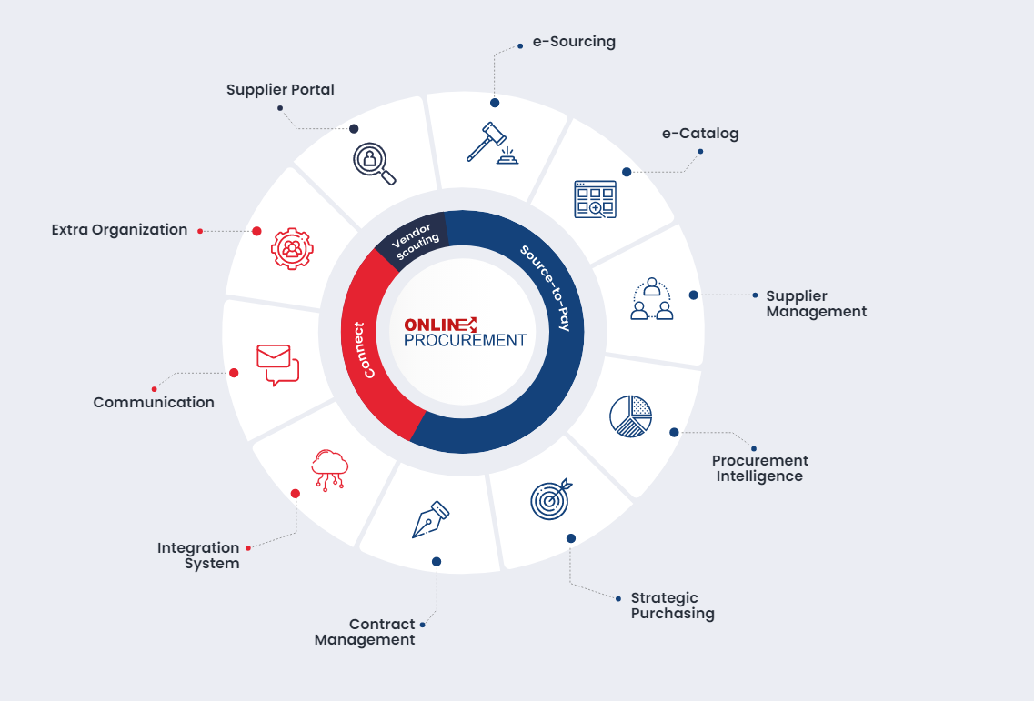
eProcurement Solution Package

Slide 10


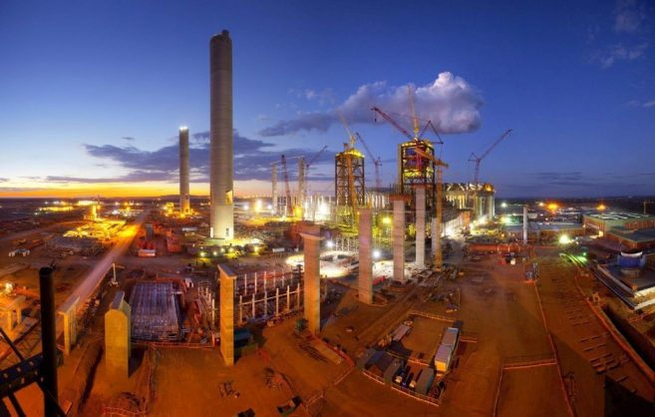

Business Architecture

Slide 11
Integrated Demand Planning and Forecasting
Supplier Development and Localisation
Contract Administration
Procurement Management
Shipping, Warehouse and Haulage Management
Investment Recovery Management
ESKOM SUPPLY CHAIN MANAGEMENT
Index
Combination of SAP and in-house solutions (SharePoint etc.)
Manual solutions
BAU Project
AIDC/Bar Coding
Future Wave(s)
Wave 01

Slide 12
P&SCM Value Chain Model – Digital Procurement/AIDC Initiatives
Demand Forecasting
Procurement (Acquisition)
Core Capabilities
Supplier Management
Investment Discovery Disposal
Logistics Management
Legend
Procurement Annual Plan and Reporting
Procurement Mechanisms
Inventory Management and Control
Warehousing
Contract Management and Administration
Investment Recovery Strategy
Digital Procurement
AIDC
GRC
Demand Forecasting and Supply Planning
Market Engagement: Supplier Selection and Contracting
Asset Management
Goods Receipt Storage and Issuing
Supplier Relationship Management
Disposal Mechanisms
Human Resource
Quality Management
Supplier Development Localisation & Industrialisation (SDL&I)
Strategic and Critical Spares
CSD
Integration
Documents and Records Management
P&SCM Strategy and Business Plan
Managing and Monitoring Risk, Governance and Compliance
Quality Assurance and Control
Induction and Training
Performance Management and Business Intelligence
Enabling Capabilities

Slide 13
Information Architecture

Slide 14
Digital Procurement - Context Diagram
SAP MM
Purchase Request/
Purchase Order/Contracts
Digital Procurement
Microsoft Exchange
eMail Communication
SAP EHS
SHEQ Information
SAP QIM
Tender Evaluations
C-Max
Quality and Incidents Information
Tender Bulletin Website
Tender Publications/Advertising
Open Text
Documents/Records
TOM
Records of Tender Enquiry Transactions
DTI
Commodity Reporting
SAM
Supplier Analysis Model
CIDB
eTendering (Interim)
Publish Tenders – Civil Construction/ Award Information
Receipt of Tender Submissions
iGRC
Vendor/Supplier Registration
Governance Risk &
Compliance Information
Vendor Registration Portal
eAuction
CSD
Supplier Information Verification
Asset Disposal
Probity Checks Solution
CSD – Central Supplier Database
DTI – Department of Trade and Industry
CIDB – Construction Industry Development Board
Supplier Integrity Verification
Std
Dig
Ext

Slide 15
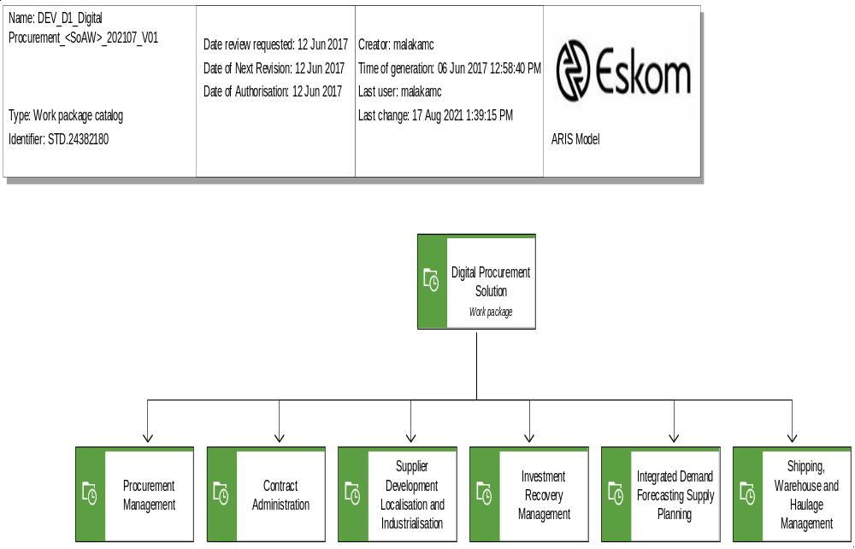
Work Package Catalog

Slide 16
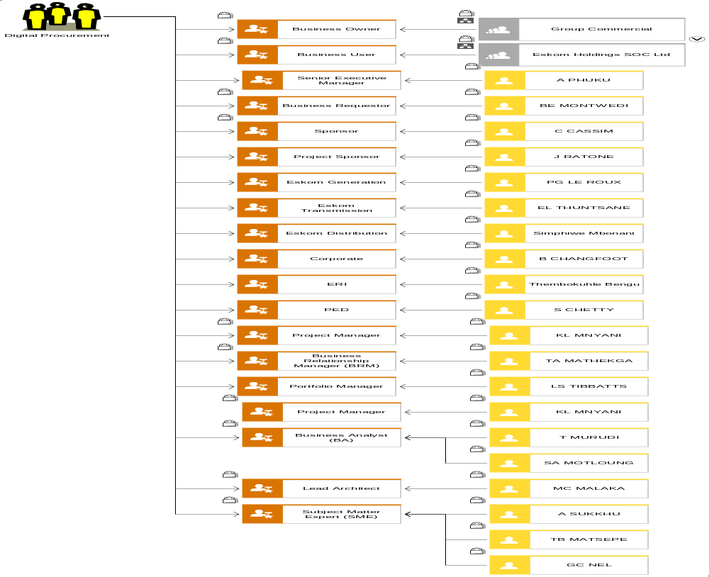
Stakeholder Analysis Diagram

Slide 17
Application Architecture

Slide 18
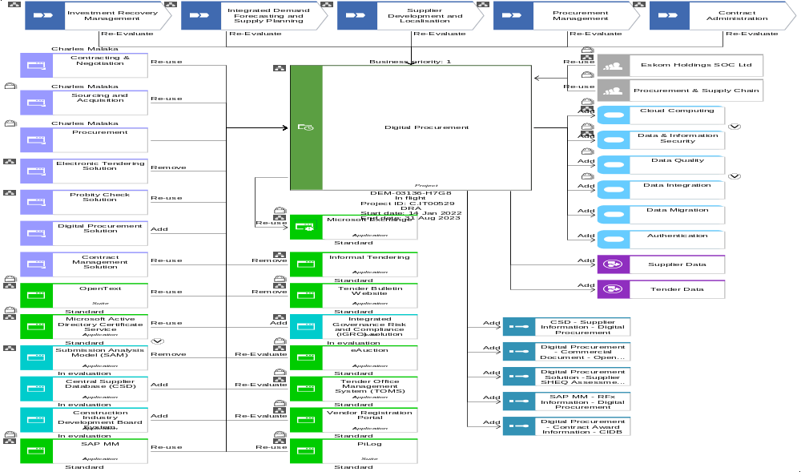
Work package scope diagram

Slide 19
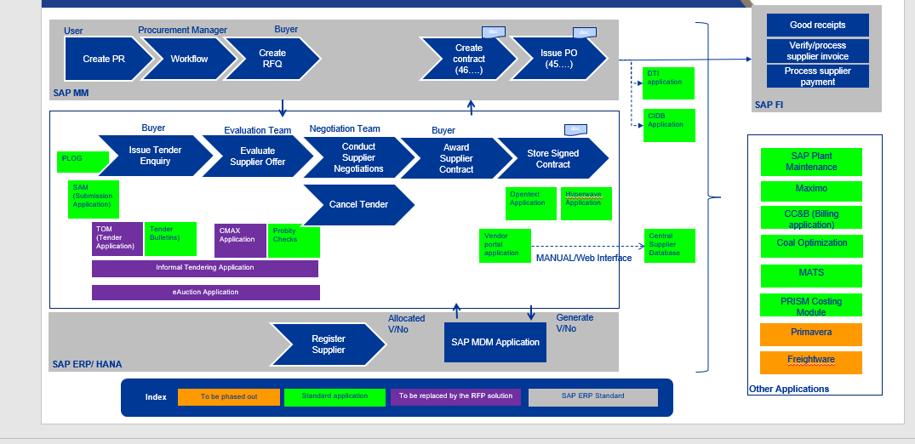
Systems Landscape – AS IS

Slide 20
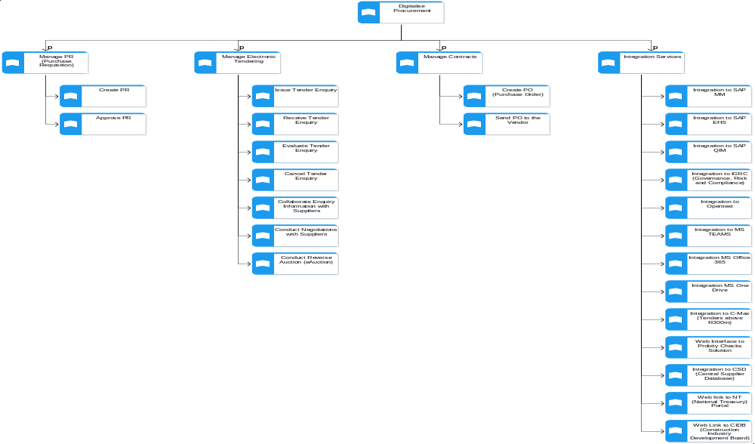
Application Function Decomposition

Slide 21
Data Architecture

Slide 22
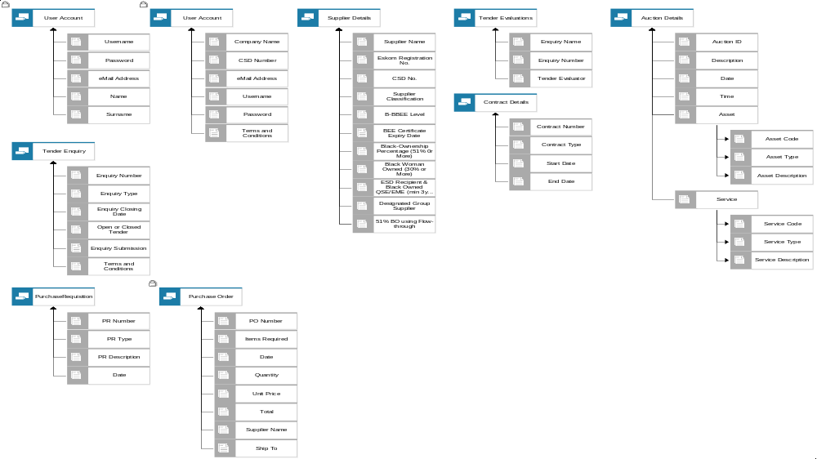
Data Catalog

Slide 23
Integration Architecture

Slide 24
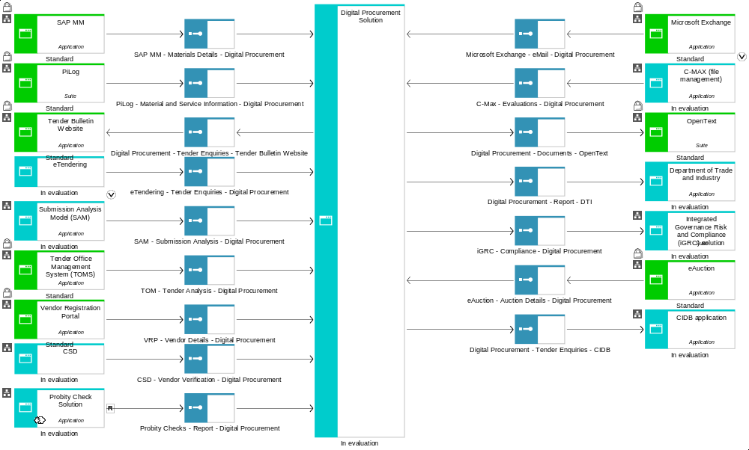
Application Communication Diagram

Slide 25


External facing integration pattern
Firewall 1
Firewall 2
Connectivity
Public DMZ
Corporate Lan
OpenText
External
IBM DataPower Appliances
IDG
Oracle Fusion
iGRC
F5
F5
C-Max
SAP PO
SAP Universe
Notes:
Notes :
Firewall 1: 2 physical firewalls devices that are configured to have a number of DMZ
Firewall 2: 2 physical firewalls devices that are configured to have a number of DMZ
Future changes
External NAM to be moved to Firewall 1- Authorisation DMZ ( NAM and SSPR) to be linked to this firewall
Corporate LAN: To move items that are in the corporate LAN into Firewall 2 – eg . Databade DMZ

Slide 26
Technology Architecture

Slide 27
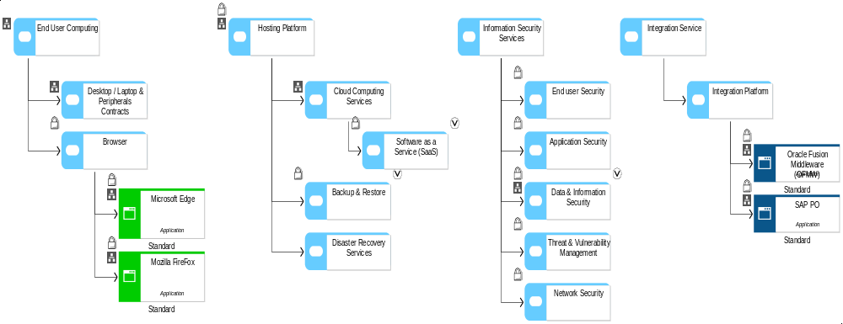
Technology Portfolio Catalog

Slide 28
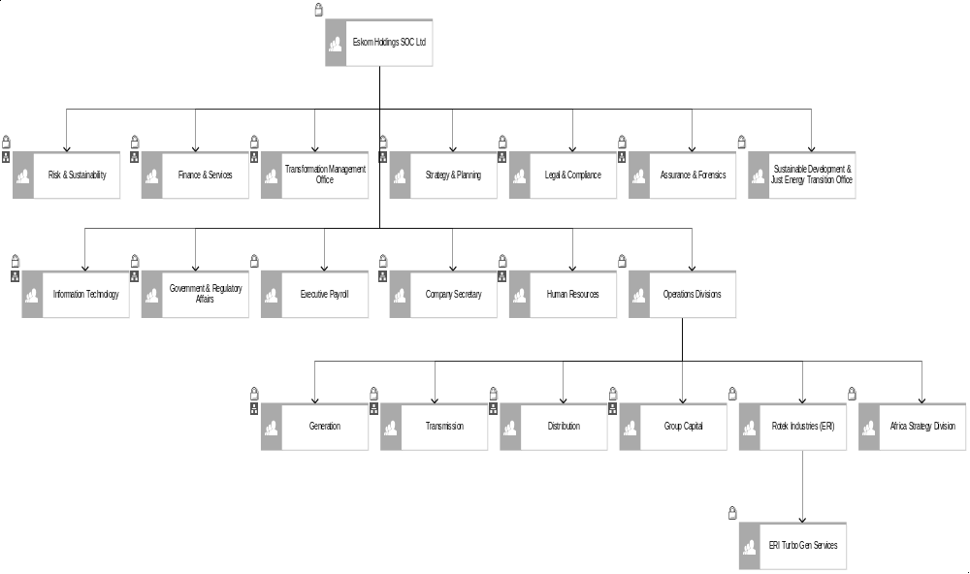
User Location Diagram

Slide 29
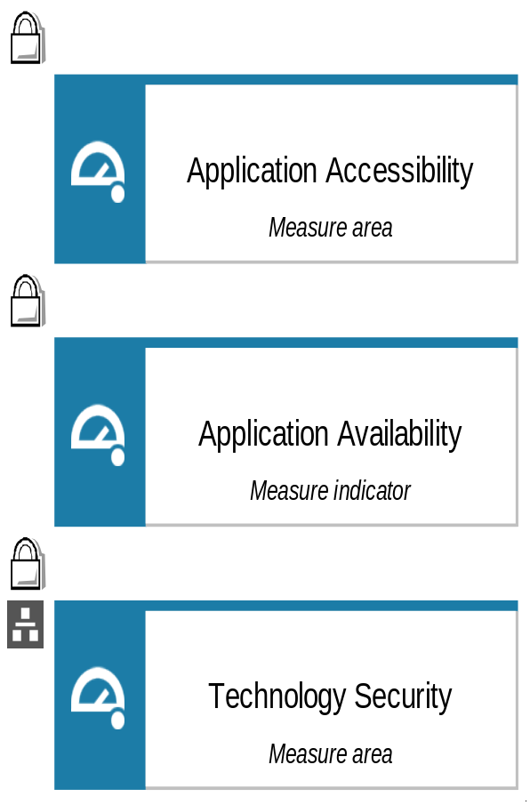
Measure Catalog

Slide 30
Security Architecture

Slide 31
eProcurement Solution Package

Slide 32

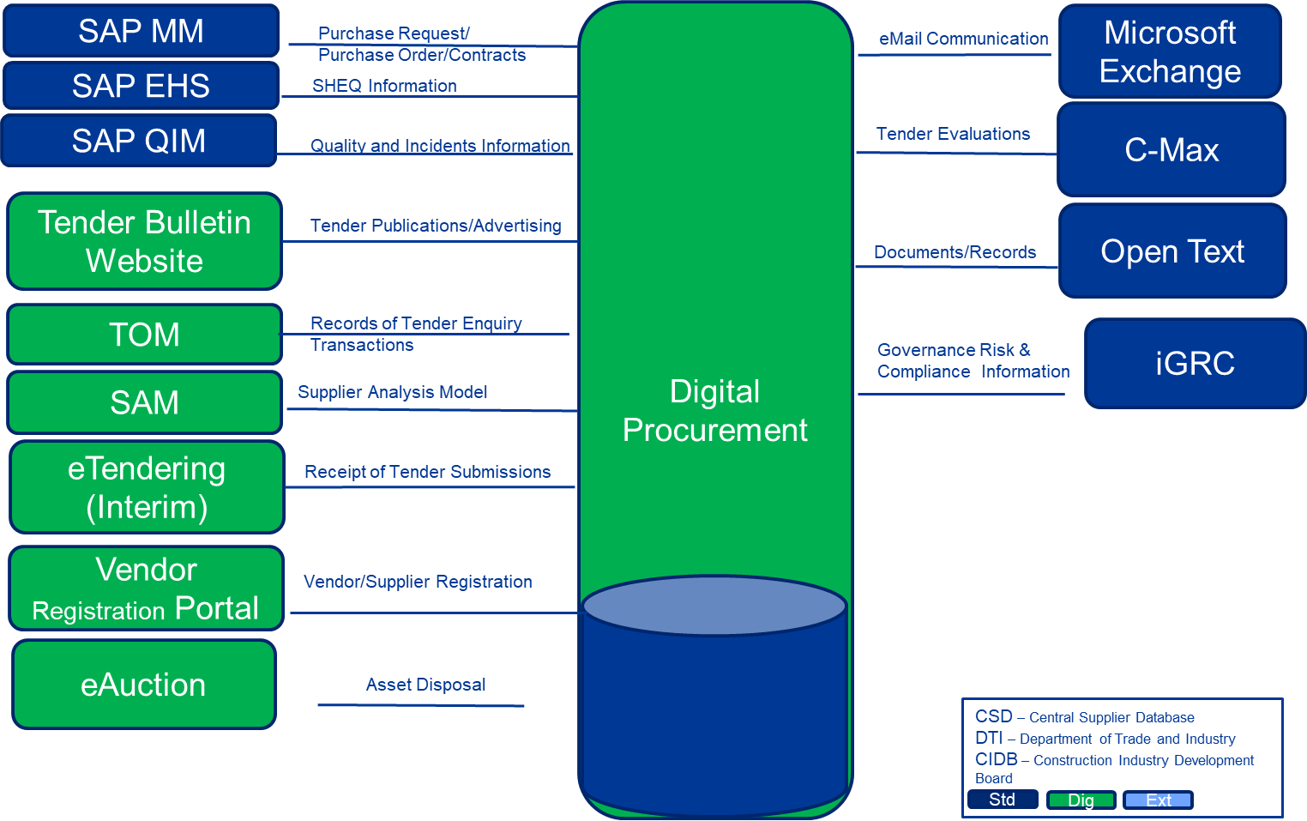


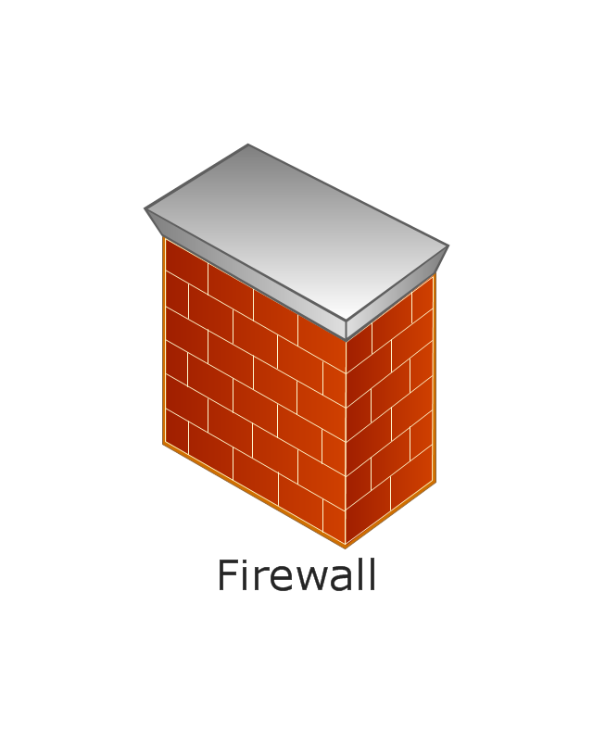

Logical Architecture Model
On-Prem
External User
Cloud
Tender Evaluations
Azure Federated Services
Cloud Integration Services
CSD
CIDB
SDL&I (Supplier Development Localisation &Industrialisation)
DTI
CPA (Contract Price Adjustment)
Probity Checks

Slide 33
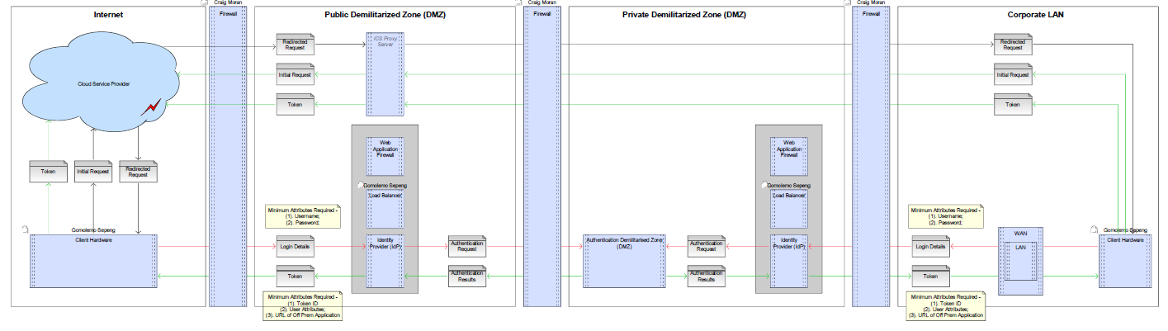
(Oauth2 and) SAML2 Federation Authentication for Off- Prem Web Applications
Preferred:
SAML2 authentication mechanism
TLS1.3 security protocol for encryption
Notes:
Notes :
Firewall 1: 2 physical firewalls devices that are configured to have a number of DMZ
Firewall 2: 2 physical firewalls devices that are configured to have a number of DMZ
Future changes
External NAM to be moved to Firewall 1- Authorisation DMZ ( NAM and SSPR) to be linked to this firewall
Corporate LAN: To move items that are in the corporate LAN into Firewall 2 – eg . Databade DMZ

Slide 34
Oauth2 and SAML2 Federation Authentication for Off- Prem Web Applications, cont.
Flow for accessing Cloud based application from Corp. LAN
I-1. User accesses Cloud based application via ICS Proxy server
I-2. ICS Proxy server forwards request to Cloud Application
I-3. Cloud application redirects the request to Eskom Internal IdP via ICS Proxy server
I-4. ICS Proxy Server forwards redirect to client
I-5. Client connects to Internal IdP and submits Username and Password
I-6. The Internal IdP then forwards the authentication request to one of the configured Authentication sources
and the authentication result is returned to the Internal IdP
I-7. The External IdP returns a token with user attributes and the redirect URL of the Cloud Application
I-8. The user agent forwards the token to the Cloud application via the ICS Proxy Server
I-9. ICS Proxy forwards the token to the Cloud application and access is granted using the token
Flow for accessing Cloud based application from
E-1. User accesses Cloud based application
E-2. Cloud application redirects the request to Eskom External IdP
E-3. Client connects to External IdP and submits Username and Password
E-4. The External IdP then forwards the authentication request to one of the configured Authentication
sources and the authentication result is returned to the External IdP
E-5. The External IdP returns a token with user attributes and the redirect URL of the Cloud Application
E-6. The User agent connects to the Cloud application with the token and access is granted

Slide 35
Project Name: Digital Procurement (Wave 01)
SAP BWS NO: |  |  | Relevant Landscape | Procurement & Supply Chain Management | Review Stage | LAD
Business analyst |  | Tendamudzimu Murudi and Simangele Motloung | Division | Finance/Procurement | Assessing Architect and Peer Reviewer | Charles Malaka/Xolani Mntungwa/Elmarie v/d Merwe/Craig Moran/Shaun Solomon
High Level Overview and Key Objectives |  | The Digital Procurement initiative has been established by Group Commercial/Procurement, on behalf of Eskom Holdings Ltd, in order to assist the business to address all the challenges currently being experienced especially with regards to Procurement, Sourcing and SCM activities across Eskom as a whole. The primary objective is to eliminate all operational inefficiencies across Procurement and Supply Chain Management business landscape.
Domains | Business Architecture | The solution is envisaged to unlock operational efficiency by enabling digitalization and automation of business procurement processes. Policy review will be required to enable services such as full online tendering and evaluation. To include future Eskom subsidiaries in the business model. All processes will be considered for re-evaluation due to potential impact which may be introduced by the new technology services.
 | Business Information Architecture | Eskom to ensure that relevant legislative regulations such as POPIA are adhered to, especially with regards to Supplier Information.
 | Data/Object Architecture | All the respective data elements/entities will be identified and defined in the next phase(s).
 | Integration Architecture | All interfaces have been identified and details will be defined in the next phase(s).
 | Application Architecture | All the legacy applications such as SAM, TOM, Tender Bulletin Website, Informal Tendering, eAuction etc. will be replaced or re-evaluated to ascertain their respective fitness for purpose.
 | Security Architecture | The solution/application to ensure the enforcement of Eskom information security policy, principles, standards and guidelines.
 | Technology Architecture | Details about technology & infrastructure services to follow in the next phase(s).
General
Recommendations |  | Recommended for Approval.

Slide 36
Thank-You
Q&A

