Slide 1
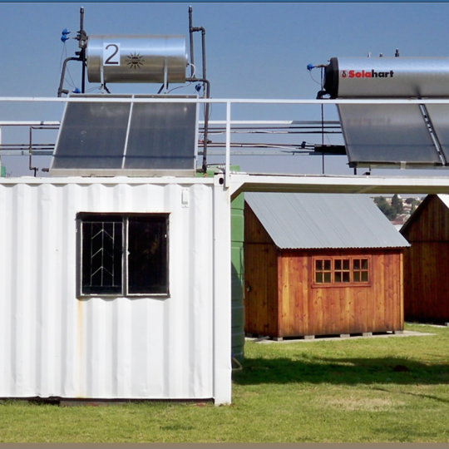
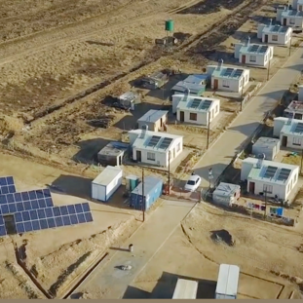
Security Services Clarification Meeting
Lerato Mapane
10/02/2026

Slide 2
PART A (OHS requirements) and
Part B (Tender returnables)

Slide 3
PART A

Slide 4
Risk Categories
In terms of 32-726 Contract and Contractor OHS Management Standard ,Safety requirements are categorized into 3 risk categories such as:
  Low Risk
  Medium Risk
  High Risk
CCTV installation falls on medium category.
  The following documentation is therefore required:

Slide 5
1. Annexure B: Acknowledgement Form for Eskom OHS legal and other requirements
Annexure B form.
  Shall be signed by the Owner/CEO/MD and 2 witnesses.

Slide 6
2. OHS Baseline Risk Assessment
Identification, assessment, and management of OHS risks related to the scope of work.
The methodology used for the risk assessment must be provided together with the BRA
Risks should be inline with the scope of work .

Slide 7
3. Occupational Health & Safety Plan (OHS) Plan
Must address the project scope of work OHS risk(s) and aligned with the health and safety specification

Slide 8
4. Costing for Health and Safety management
The costing must be based on the overall scope of work/service to be performed.
The scope of work and the risk assessment may serve as a guideline.

Slide 9
5. OHS Policy
The submitted policy must comply to OHS Act Section 7
An employer to prepare a written statement concerning the protection of the health and safety of his employees at work, including a description of his organization and arrangements for carrying out and reviewing that policy.
Shall be signed by the Owner / CEO of the company.
The acronym used shall be as per the OHS Act section 16.1 CEO

Slide 10
PART B Tender Returnables

Slide 11
Safety Tender Returnable
Annexure B Health and Safety plan/OHS manual Baseline OHS risk assessment Valid letter of good standing or equivalent (LOGs) OHS policy (must be signed)

Slide 12
Conclusion

