Slide 1
Supplier Engagement
SHEQS Requirements
@ 27 May 2022
Presenter: Geoffrey Small

Slide 2
Content
Objective
ISO 45001:2018; ISO 14001:2015; ISO 9001:2015
SHEQS winning Formula towards Excellence
Performance Evaluation
SHEQS Strategy Objectives, Initiatives and Actions
2021 – 2026 FY
Improvement

Slide 3
Objective
Transmission Projects Delivery (TPD) is committed to ensure SHEQS and Welfare of its Employees and Contractors who may be affected by Eskom’s operations, inclusive to provide a conducive Environment and deliver Quality projects and products/services.
This presentation is to engage the Contractors/Suppliers in terms SHEQS during the enquiry, contract award and execution stages of the projects and products/services.
Communicate and collaborate with Contractors/Suppliers, and all stakeholders by entrenching Eskom’s value of Zero Harm.
Note:
  Contractual requirements are not mandatory to a tender process (i.e. SHEQS, etc), BUT legal & other requirements do apply (Observe Annexures in the tender, acknowledgment and submission thereof)
  Where SHEQS is included as part of the tender process, risk must justify inclusion e.g. supply and deliver, R2.5 m contract.

Slide 4
SHEQS Strategy Objectives, Initiatives and Actions
2021 – 2026 FY
  Reduce the impact of workplace injuries and ill health from a lost-time injury rate (LTIR) tolerance level of 0,30 to 0,24;
  Improve communication, consultation, and involvement by 10% on OHS processes throughout all levels in the organization;
  Ensure that 90% of the workforce understand and proactively and effectively control OHS risks, thereby building a good safety culture in the organization;
  Reduce contractor-related incidents by 30% with more focus on minimizing the level of risk exposure from the current performance.
  TPD Mandate
  To support the Transmission network availability and reliability through the development and execution of expansion, new build and refurbishment projects.
  Continue to reduce Eskom’s environmental footprint by enhancing environmental performance and delivery;
  Guide the Eskom of tomorrow from an environmental perspective that leads to Eskom being recognized as an environmentally responsible and sustainable organization;
Toolkit to drive “Zero Harm & Excellence”
1
Occ Health & Safety
Environment
2
  Reduce crime incidents and occurrences through resilient operations, implementing effective and robust crime prevention strategies and effective investigations.
  Establish an fully integrated Security Business Intelligence capability
  Establish an integrated Cyber-crime detection and prevention capability
  Maintain organizational resilience through incident management and recovery, including business continuity and sustainability
Make SHEQS
Personal
  Achieve “Zero Defects by 31 March 2023;
  Instill a culture of continuous improvement by 31 March 2023
3
Quality
Security
4

Slide 5
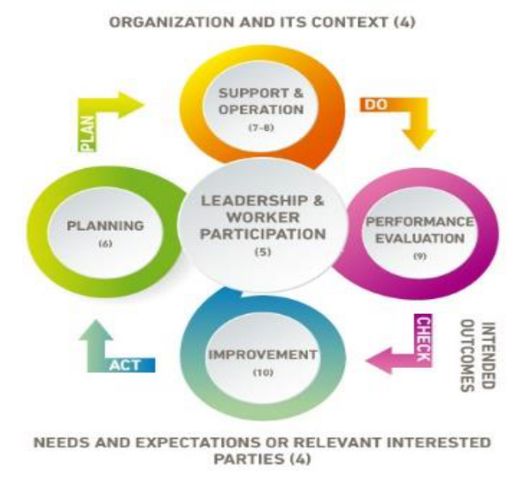
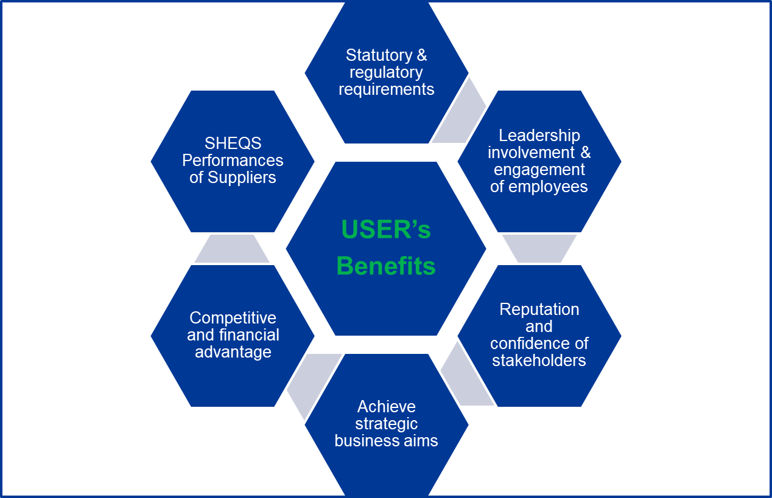

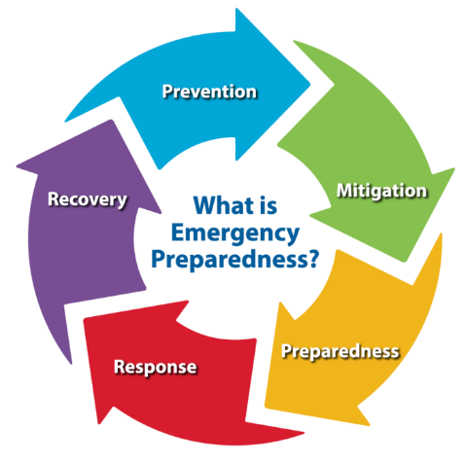
ISO 45001:2018; ISO 14001:2015; ISO 9001:2015
Operational planning and control – considering Life-cycle perspective
Establish, implement, control and maintain processes needed to meet SHEQS requirements and implement actions identified (Safety Plan, TRA, EMP, QCP/ITP, method statements, safe work procedures, procedure for sourcing or procurement of products or services, project execution, etc. )
Emergency preparedness & response
Establish, implement and maintain processes needed to prepare for and respond to potential emergency situations (Stability Plans, Security Plans, Safety Incidents, wildlife interactions, harsh weather conditions, seismic events, fires, chemical spills)

Slide 6



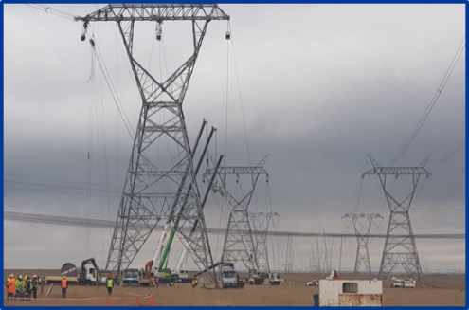
TPD SHEQS winning Formula towards Excellence
Risks managed through proper Leadership, Organization, Stakeholder engagement and partnerships
TPD management always prioritize the health, safety, and welfare of employees, contractors, members of the public, and anyone affected by Eskom activities.
Ensure cycle of continual improvement in tracking and monitoring of SHEQS is maintained
Conduct inspections and audits, and measure the effectiveness of the SHEQS systems
Certification and recertification systems
Make SHEQS Personal
Where we are now
1
Connecting
&
Communicating
2
3
4
Commitment
&
Compliance
Competence
Continual
Improvement
Raise SHEQS awareness, and encourage individual employee commitment,
Talk to the hearts of the people.
Revive Zero Harm
Hold regular stakeholder engagements, contractor forums
communicate to all employees and contractors the recommendations emanating from incident investigations.
SHEQS competencies in terms of qualifications (education), experience, and ability to apply in the job (at all levels)
Verify competency of contractor employees prior to contract award and throughout the project execution
Good SHEQS leadership (all management levels)
Powering
South Africa's
Growth

Slide 7
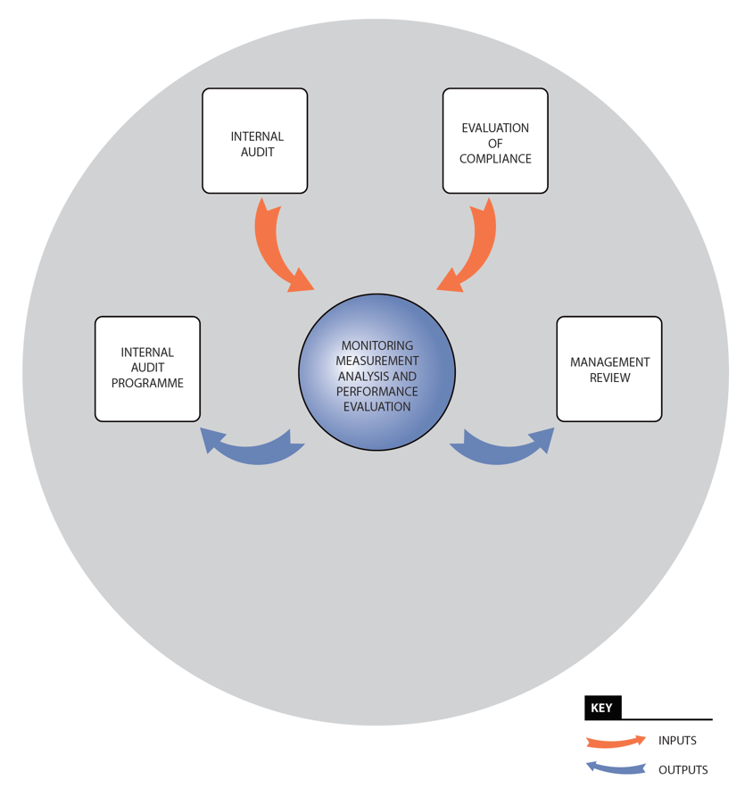
Performance Evaluation
Internal audits – to conform with Eskom Tx. Requirements, STD requirements > implemented and maintained
What needs to be monitored?
What methods?
Criteria against which the organisation will evaluate….
Determine when the results from monitoring and measurement be analysed & evaluated.
Calibration of monitoring Equipment.
Frequency for the evaluation of compliance.
Establish – internal audit programme
Management Review of SHEQS on a defined intervals (monthly, quarterly and annually – depending on levels). BUs conduct MR – annually. Consideration is made on status on actions, changes in significant aspects, risks & opportunities, extent to which SHEQS objectives have been met, NCs and CAs, Monitoring and measurements results among others.
MR Outputs – continuing suitability, adequacy and effectiveness, decision related to CI opportunities, opportunities to improve implications on organisation strategic directions etc.

Slide 8

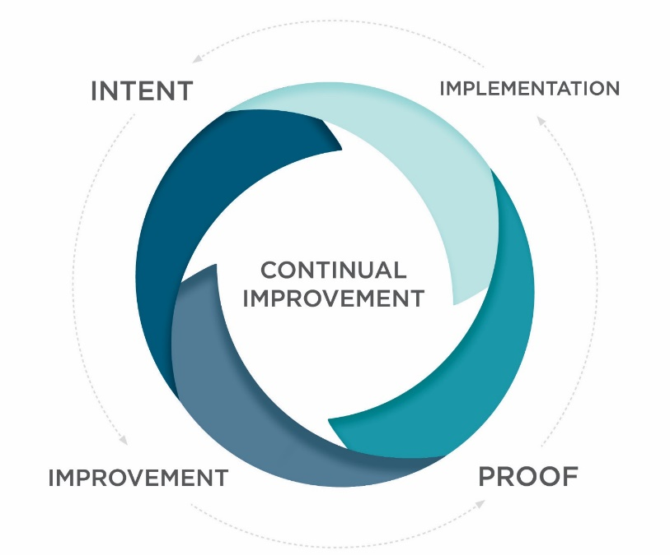
Improvement
Post Contract Award
Non-conformance Management (NCR)
React by taking actions to control and correct (CORRECTIVE ACTION), review the NC, determine the causes, implement action, review effectiveness and make changes if necessary
Appropriate corrective action to the significance of the effects of NCR
…continually improve the suitability, adequacy & effectiveness of the SHEQS to enhance environmental performance

Slide 9


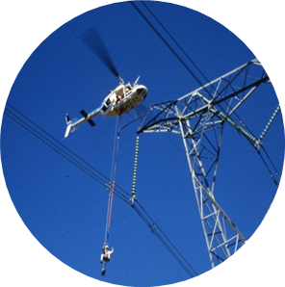


Insert image here
Insert image here

