Slide 1
BRIEFING SESSION PRESENTATION FOR:
ERACMM-PRC-48399
FOR THE SUPPLY, DELIVERY AND INSTALL OF HANDRAILING FOR BRIDGES BETWEEN
ELUBANA AND IDONDOTHA UNDER DEPOT ENGINEERING OF RICHARDS BAY
30 October 2025
1

Slide 2
B-BBEE
B-BBEE Definition:
Broad-Based Black Economic (B-BBEE) means the economic empowerment of all black people including women, workers, youth, people living with disabilities and people living in rural areas through diverse but integrated socio-economic strategies.
Purpose:
To increase the number of black people that manage, own and control enterprises and productive assets.
To facilitate ownership and management of enterprises and productive assets by communities, workers, cooperatives and other collective enterprises
To achieve an equitable representation in all occupational categories and levels in the workforce
To procure from large, medium and small sized black owned enterprises
To increase investment in enterprises and communities that are owned and managed by black people
A valid B-BBEE certificate for LE company’s OR an Affidavit for QSE and EME’s is required
B-BBEE Amended Codes Principles
  Enhanced the recognition status of black owned EMEs and QSEs
  An EME that is 100% owned by black people qualifies as a level 1 contributor;
  An EME that is more than 51% owned by black people qualifies as a level 2 contributor;
  No verification requirements for EMEs; EME to obtain a Sworn affidavit or a CIPC Certificate

Slide 3
PREFERENTIAL PROCUREMENT REGULATIONS 2022
PPPFA provides for a preference points system in terms of which contracts below a prescribed value be evaluated on the basis that 20 out of 100 possible points must be allocated to “specific goals” and 80 points allocated to price.
For contracts above a prescribed value, 10 out of 100 possible points must be allocated to “specific goals”, and 90 points allocated to price
The applicable preference point system as envisaged
The specific goal in the invitation to submit the tender for which a point may be awarded, and the number of points that will be awarded to each goal, and proof of the claim for such goal .
Bidders who do not submit B-BBEE Status Level Verification Certificates or applicable affidavit copy will be deemed as non-compliant contributors to B-BBEE will score zero for preference points .
This also applies to Bidders who submit letters or expired certificates indicating that their B-BBEE status is in the process of being verified. Where a B-BBEE certificate is to be used for scoring purposes only, such letters indicating that their B-BBEE status is in the process of being verified or expired certificates are submitted, bidders will be scored zero for preference points.

Slide 4
Joint Venture
In 2019 DTI released amendments to the Codes of Good Practice. Joint Ventures are referred to in Revised Code 000, Statement 000: General Principles
As per paragraph 7 of Amended Code Series 000, Statement 000 of the Codes of Good Practice, unincorporated joint ventures are required to compile a consolidated verification certificate. A consolidated verification certificate will consolidate the verified compliance data of joint venture partners if those Measured Entities were a single Measured Entity.
A JV will require its own Broad-Based Black Economic Empowerment (B-BBEE) certificate if they would like to tender or enter into a contract that requires a B-BBEE Certificate.
A trust, consortium or joint venture (including unincorporated consortia and joint ventures) must submit a consolidated B-BBEE Status Level verification certificate for every separate bid.
A tenderer failing to submit proof of B-BBEE status level of contributor or is a non-compliant contributor to B-BBEE may not be disqualified but may only score points out of 90 for price and (b) scores 0 points applying the 90/10 principle . Refer PPPFA No. 40553 for more info on preference point.
Note the following:
• A consolidated verification certificate is required.
• The consolidation is based on the weighting as defined in the joint venture agreement.
• The respective scores are weighted according to their proportionate share in the joint venture.
• A joint venture certificate is valid for 12 months and only applicable to a specific project.
Eligibility of a Joint Venture
Joint Ventures are required to compile a consolidated verification certificate. A consolidated verification certificate will consolidate the verified compliance data of joint venture partners in accordance .

Slide 5
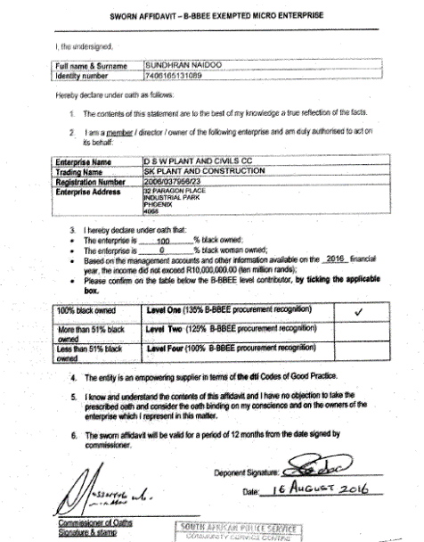
VALID SWORN AFFIDAVIT
  Failure to adhere to the following:
Make a selection on item2.(stating whether you are director or owner)
State Full Financial Year
Deponent signature
Commissioner of oaths signature and dates will render the Sworn Affidavit invalid
Name of respondent and enterprise details
Select whether you are director owner or memberer you
State the full
Financial Year (DD/MM/YY)
Annual Total Revenue and Level of Black Ownership and Black Women Ownership
B-BBEE Status Level based on Black Ownership
FUL NAME, BUSINESS ADDRESS AND STATE DESIGNATION
DATE BY BOTH DEPONENT AND COMMISSIONER OF OATH MUST BE THE SAME
Commissioner of Oath signature and stamp were applicable
Deponent signature and date
Certification Signature and/or Stamp

Slide 6
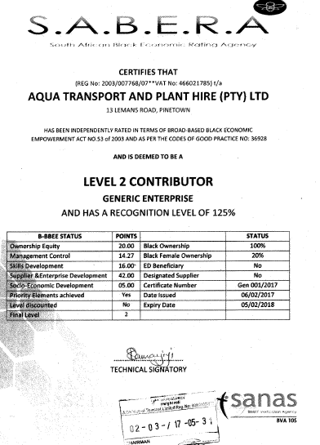
VALID B-BBEE CERETIFICATE
Example:
VALID B-BBEE
Enterprise Name
(Cross referenced to Tax Clearance Certificate &
Enterprise Registration No.)
COMPANY NAME
a
BBBEE level based on QSE/LE (Generic status)
a
Elements verified
Validity Period
a
Accreditation agency and BVA Number

Slide 7
SPECIFIC GOALS POINTS ALLOCATION
7

Slide 8
EVALUATIONS & MAXIMUM POINTS 80/20
Specific Goals | Points Allocated
B-BBEE LEVEL 1 OR 2 | 5
Entities that are at least 50% Black Youth Owned Entities | 5
Local Content and Production Steel Products for construction (Handrails) designated at 100% • Fully completed declared and signed local content annexures C D and E will score full 5 points • Incomplete submitted blank or not submitted local content annexures C D and E will score zero points. Incase an exemption letter is required, exemption process for bidders to follow when contacting the DTIC is attached on slides 14 and 15 | 5
EME /QSE entities that are at least 51% black owned | 5
Non-Compliant and/or B-BBEE Level 3-8 contributors | 0

Slide 9
SPECIFIC GOALS EVIDENCE
Specific Goals | Acceptable Evidence
B-BBEE | B-BBEE Certificate / Sworn- Affidavit / B-BBEE CIPC Certificate (in case of JV, a consolidated scorecard will be accepted) as per DTIC guideline
Local Content and Production Steel Products for construction (Handrails) designated at 100% • Fully completed declared and signed local content annexures C D and E will score full 5 points • Incomplete submitted blank or not submitted local content annexures C D and E will score zero points. Incase an exemption letter is required, exemption process for bidders to follow when contacting the DTIC is attached on slides 14 and 15 | Fully completed, declared, and signed Returnable local content annexures C D and E for the Steel Sector DTIC Exemption letter (if applicable)
EME /QSE entities that are at least 51% black owned | B-BBEE Certificate / Sworn- Affidavit / B-BBEE CIPC Certificate (in case of JV, a consolidated scorecard will be accepted) as per DTIC guideline
Entities that are at least 50% Black Youth Owned Entities | Certified ID copy and B-BBEE Certificate / Sworn- Affidavit / B-BBEE CIPC Certificate (in case of JV, a consolidated scorecard will be accepted) as per DTIC guideline

Slide 10
LOCAL CONTENT AND PRODUCTION
10

Slide 11
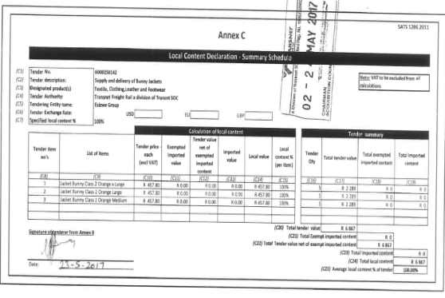
EXAMPLE OF A FULLY COMPLETED ANNEXURE C

Slide 12
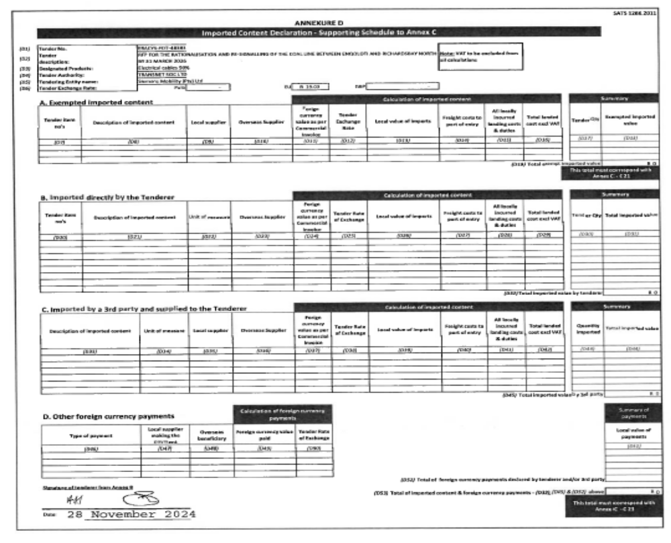

Slide 13
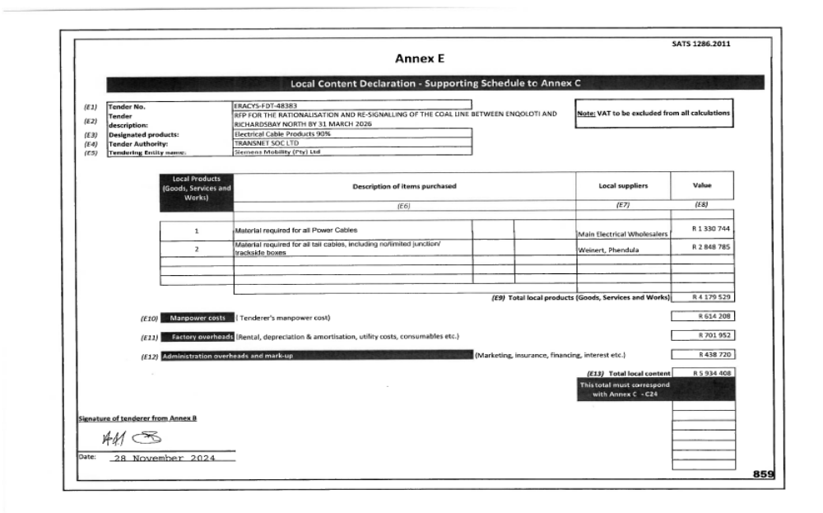

Slide 14
THE DTIC EXEMPTION PROCESS
The exemption process that the dtic follows is that if there is a particular designated product and the minimum threshold for local content cannot be met for various reasons, bidders must apply for exemption (when the tender is still open, before closing date). After checking with the industry, the dtic will then decide whether or not to grant an exemption. This is per tender.
The exemption request must be on the bidding company’s signed letter-head and cover the following:
• The procuring entity/government department/state owned company,
• Tender/bid number,
• Closing date,
• Item(s) for which the exemption is being requested for,
• Description of the goods, services or works for which the requested exemption item will be used for and the local content that can be met,
• Reason(s) for the request.
• Attach specification issued by the procuring entity

Slide 15
THE DTIC EXEMPTION PROCESS continued…
Supporting letters from local manufacturers/sub-suppliers (if applicable)
Please note that it takes 3-5 working days for the dtic to process exemption letters and no requests for exemptions will be considered after the tender has closed.
The request should be addressed to the attention of:
Dr. Tebogo Makube
Chief Director: Industrial Procurement Unit
The Department of Trade and Industry
Private Bag X84,
Pretoria,
Gauteng,
0001
The request should be forwarded through email to Dr Makube on TMakube@thedtic.gov.za and copy Ms Matidza (CMatidza@thedtic.gov.za).

Slide 16
THANK YOU

