Slide 1


REQUEST FOR TENDER (RFT) FOR APPOINTMENT OF CONTRACTORS FOR THE RENEWAL AND REFURBISHMENT OF WHEEL-SETS ON AN “AS AND WHEN BASIS” FOR THE ROLLING STOCK FLEET FOR PRASA RAIL
HO/PT/ENG/(RM)/185/05/2021;
Presenters: Agnes Sekhuthe and Maggie RD Marema
Agnes Sekhuthe/Motiwa Ndebele 28 September 2021 @ 11h00

Slide 2
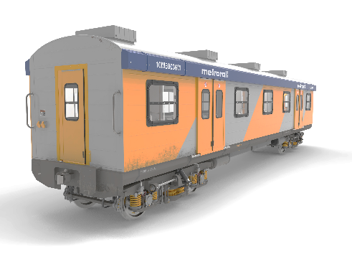
BACKGROUND
PRASA Rail has a national fleet of 4398 coaches (comprised of Motor and Trailer Coaches), 124 locomotives and 1524 long distance coaches that requires safety critical components such as the wheels on an “as and when” basis for any overhauling or wheels replacements.
The mentioned wheels are there to improve and sustain the availability of a train set and the safety of commuters.
The current fleet is dependent upon the availability of wheels for both Metrorail and MLPS. This highlights the criticality of ensuring the availability and reliability of wheelsets are there to help in the planned maintenance process within the depots.
The availability of wheelsets that are maintained through re-profiling and wheel replacements aids with the change outs process at the depots during maintenance.

Slide 3
AGENDA - CONTENT
1. SUPPLY CHAIN REQUIREMENTS
  CONTACT DETAILS
  Evaluation Criteria
  Stage 1 compliance requirements
  Stage 2 technical/functional requirements
  Stage 3 pricing and b-Bbee
  BID SUBMISSION PROPOSAL FORMAT
  TENDER CLOSING DETAILS
TECHNICAL REQUIREMENTS
  BACKGROUND
  INTRODUCTION
  SCHEMATIC DIAGRAM FOR THE SECTION
  SCOPE OF WORK
  EXTENT OF SCOPE
  TECHNICAL EVALUATION

Slide 4
SCM Requirements
CONTACT DETAILS
Ms. Agnes Sekhuthe
Email address: asekhuthe@prasa.com and copy Ms Rosemary Moagi
Email address: rmoagi@prasa.com
BIDDER QUERIES MUST BE POPULATED IN ANNEXURE 2 - RFP Clarification FORM

Slide 5
SCM Requirements - Evaluation Criteria
Evaluation criteria | Weighting
Stage 1: Compliance Requirements
Stage 2: Technical / Functionality Requirements
Technical | Threshold of 70%
Stage 3: Pricing and BBBEE
BBBEE | 20 or 10 points
Price | 80 or 90 points
TOTAL | 100

Slide 6
SCM Requirements - Stage 1A- Mandatory Requirements
No. | Description of Requirement
a) | Completion of ALL RFP documentation (includes ALL declarations and Commissioner of Oath signatures required)
b) | Signed Joint Venture, Consortium Agreement or Partnering Agreement (whichever is applicable)
c) | The National Industrial Participation Programme Form (SBD5) must be completed and duly signed and returned with your Proposal
d) | The Declaration Certificate Local Content (SBD 6.2 and Annexure C) must be completed and duly signed and returned with your Proposal
e) | Signed Joint Venture, Consortium Agreement or Partnering Agreement (whichever is applicable)

Slide 7
SCM Requirements - Stage 1B- Mandatory Requirements
No. | Description of requirement
a) | Region and Asset Selection: Bidders are required to select the Rotating machine/s and the specific region/s they are tendering for by completing 4G.
b) | Maintenance Support Tools and Equipment Bidders should submit their Maintenance Support Tools and Equipment serial numbers and model type The Bidders must complete Annexure 4H.
c) | Outsourcing compliance: Should a bidder decide to outsource any of the work required in the refurbishment process, this subcontracting work will be subjected to the same technical evaluation and accreditation protocol as the main bidder. Any outsourcing should not exceed more than 30% of the SOW. The Bidders must write a commitment letter, signed by an authorized person, stating the nature of work and its related % work that is sub-contracted. Annexure 4I must be completed by the Bidders.

Slide 8
SCM Requirements - Stage 1C – Basic Compliance Requirements
If you do not submit the following basic compliance documents and should an award be made, these basic compliance documents must be made available within 7 working days, failing which the award will be recalled.
No. | Description of requirement
a) | Letter of Good Standing: COID
b) | Supply SARS Status Pin
c) | Company registration documents
d) | Certified copies of Directors’ ID documents not later than three (3) months
e) | CSD supplier registration number
f) | UIF Proof of Registration

Slide 9
SCM Requirements - Stage 2: Technical/Functionality
ITEM | CRITERIA | WEIGHT
1 | Company Experience | 40
1.1 | Wheelsets refurbishment type and years’ experience. | 20
1.2 | Combined total refurbishment rand value exposure for the Wheelsets orders in the last 5 years | 20
2 | Experience and Qualification of Key Staff | 30
3 | Refurbishment Implementation Approach and Methodology | 30
3.1 | Technical approach/methodology that is aligned to the scope/ highlight the risk(s) and mitigation measure associated per Wheel-sets type | 20
3.2 | ISO 9001 Accredited | 10
 | TOTAL | 100

Slide 10

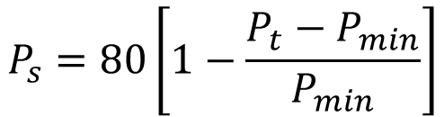
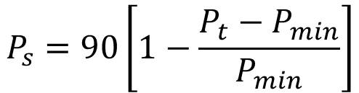
SCM Requirements - Stage 3: Pricing and B-BBEE
The following formula shall be used by the Bid Evaluation Committee to score potential bidders on pricing:
$$P_{s}=90\left[1−\frac{P_{t}−P_{min}}{P_{min}}\right]$$
$$P_{s}=80\left[1−\frac{P_{t}−P_{min}}{P_{min}}\right]$$
Note:
Pricing Evaluation:
Only Bidders who have achieved the 70% threshold for Technical
evaluation will be evaluated for the Price component which is 90 or 80 points of the Evaluation Criteria.
BEE Evaluation:
The BBBEE com
ponent evaluation is 10 or 20 points of the evaluation
criteria. Bidders will be awarded points based on the level of their BBBEE as per their
BBBEE Certificate issued by an accredited agency approved by SANAS

Slide 11
SCM Requirements - Stage 3: Pricing and B-BBEE
Calculation of points for B-BBEE-RATINGS
B-BBEE STATUS LEVEL OF CONTRIBUTOR | NUMBER OF POINTS (80/20 SYSTEM) BELOW R50 MILLION | NUMBER OF POINTS (90/10 SYSTEM) ABOVE R50 MILLION
1 | 20 | 10
2 | 18 | 9
3 | 14 | 8
4 | 12 | 5
5 | 8 | 4
6 | 6 | 3
7 | 4 | 2
8 | 2 | 1
Non-Compliant Contributor | 0 | 0
NB: Bidders must submit proof of their B-BBEE status level. Bidders failing to submit proof of their B-BBEE status level or are non-compliant may not be disqualified and will score 0 points.

Slide 12
SCM Requirements – Bid submission proposal format
Submit the tender as an original plus 1 copy and an 2 (two) electronic versions for (one in Volume 1 for Stage 1 and 2 evaluations + 1 in Volume 2 for pricing and BBBEE evaluations) which must be contained in CDs or Memory Cards clearly marked in the Bidders name as stated in the RFT and provide an English translation for documentation submitted in a language other than English. Tenders may not be written in pencil but must be completed in black ink.

Slide 13
SCM Requirements – Bid submission proposal format
Submission of Tender documents
Volume 1 – Compliance and Technical proposal
Volume 2 – Financial/Commercial/Pricing Proposal
NB: Please ensure that your Tender Proposal is submitted in 2 parcels clearly labelled with the Bidders name as follows:
Parcel/Envelope/Box Number 1 – Compliance and Technical Proposal
Parcel/Envelope/Box Number 2 – Commercial Proposal which includes your pricing

Slide 14
KEY MILESTONE | TIMELINE
Tender Advert | 17 November 2021
Briefing Session | 23 November 2021 @ 13h00
Questions from Bidders | 29 November 2021
Responses to Bidders | 03 December 2021
Tender Close | 14 December 2021 @ 12h00

Slide 15
Tender Closing Details
Place for tenders : Umjantshi House, 30 Wolmarans Street, Braamfontein, in Johannesburg
There will be a tender proposal submission register which has to be completed by all the bidders depositing the tenders
Bidders who submit their proposals through Courier Services must ensure that their packages are clearly labelled with the bidder’s name outside the package so that PRASA and the courier service driver is able to complete the submission register properly

Slide 16
TECHNICAL REQUIREMENTS

Slide 17

Outline
BACKGROUND
INTRODUCTION
SCOPE OF WORK
TECHNICAL EVALUATION

Slide 18
BACKGROUND
Types of Wheels
The wheels in PRASA Rail are comprised of the following type of wheels:
5M2AR: Wheels for Motor Coaches (with Oil Sleeve Bearings)
5M2A: Wheels for Motor Coaches (with Cannon Box Bearings)
R6: Trailer Coach Wheels
8M: Wheels for Motorised Trailers and Non-motorised Coaches
Electric Locomotive Wheels: Wheels for Electrical Locomotives
GM & GE Class Diesel Wheels: Wheels for Diesel Locomotives

Slide 19
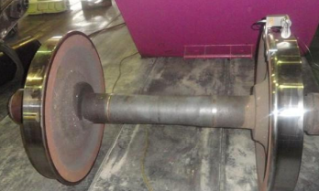

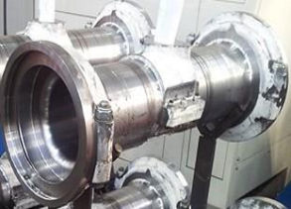
BACKGROUND
Pictures of Wheels
R6 wheel
Locomotive wheel
R6 Cannon Box

Slide 20
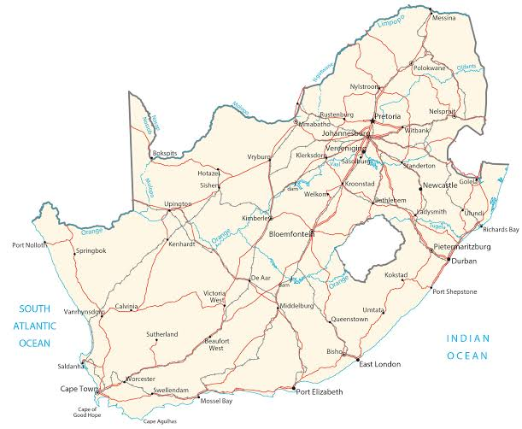
BACKGROUND
National Footprint
Gauteng North - 1 main depot (Wolmerton Depot )
The PRASA’s Rolling Stock depots have a national footprint and are located in the following regions:
Gauteng South - 2 main depots ((Braamfontein Metro Rail and Braamfontein Mainline Passenger Services (MLPS))
Eastern Cape - 2 small depots (East London Depot and Port Elizabeth Depot)
Kwa Zulu Natal – 3 main depots (Springfield, Bayhead, Durban MLPS)
Western Cape - 3 main depots (Salt River, Culemborg and Bedford West Depot)

Slide 21
INTRODUCTION
The desired outcome of this project is to appoint a panel of wheels service providers for maximum of 3 years on an as and when contract for replacement, renewal and refurbishment of wheel sets.
The scope of work covers the entire refurbishment process from collection of components from depots to delivery and incoming inspection in accordance to the PRASA quality processes/guidelines.

Slide 22
EXTENT OF SCOPE OF WORK
The scope of work for this project shall entail the following activities:
Collection
of
wheelsets
Creation
of the
Worklists
Approval
of the
Scope of
work
Approval
of the
Quotation
Preliminary-Approval of Work
Post-Work:
Quality Assurance function
Final Delivery of the components
The wheels will be ready for collection by the Service provider at the depot including the delivery after refurbishment is completed. The depots will issue a Job Card to the Service provider with the nature of failure recorded and the Job card will be signed by both the depot and Service provider. The Service provider will transport the component to their workshop to execute maintenance.
The component will be visual inspected, pre-tested, stripped, cleaned, re-inspected (e.g. measurements taken, etc.) and quoted.
This is to create a worklist of the components to be repaired or replaced during refurbishment and/or overhaul.
The scope of work must be rejected or approved by a PRASA representative (Quality Assurer and/or Engineer) before work commences.
A respective PRASA representative (a Maintenance Support Manager/ Components Manager – in accordance with PRASA delegation of Authority) will approve the quotation based on size and value of scope of work. A Purchase Requisition and Purchase Order will be created in SAP system. The P.O will be sent to the Service provider to proceed with the repair/ refurbishment/ replacement work.
At certain holding points a PRASA Quality Assurer will approve/reject work done guided by a checklist before final assembly or when re-profiling is completed.
Final Approval: After the wheelsets are repaired during light repairs or assembled during heavy maintenance, final functional verification will take place during that holding point and a PRASA representative (Quality Assurer) will be present to witness the verification of the work done. Once the wheelsets conform to specification, both the contractor and the Q.A will approve the work done.
Once the component is delivered back to the PRASA depot, a delivery note is signed by a PRASA representative and the goods are received in order. The invoice and all supporting documents are issued to PRASA. PRASA will then initiate the payment of the work done.

Slide 23
SCOPE OF WORK: Detailed Description
This is typically applicable to all Wheelsets based on the scope of work below:
Standard Work
Additional work
Clean Wheel-set for inspection
Inspect, Test, Size and quote (complete wheel-set including canon box where applicable)
Remove & Replace bearings (axle end bearings)
Non-Destructive Test Wheel & Axle- Magnetic Particle Inspection (MPI) Test) on the axle surfaces & bearing seats.
Ultrasonic Test (Rim areas of wheelset)
Non-Destructive Test Gear Wheel - MPI Test
Remove and Replace Tyre (re-tyre)
Recondition Wheel-Centre
Remove and Replace Solid Wheel
Re-profile Old Tyre/Solid Wheel
Profile New Tyre/Solid Wheel
Remove & Replace Wheel on Gear End (Drive) side
Remove & Replace Resilient Wheel Gear
Remove & Replace Wheel on Non Gear End
Convert Solid Wheel to Tyre
Recondition old Axle (Center Portion)
Repair axle centre hole (centre bore)
Dalic Plate Axle End (Bearing Seats)
Remove & Replace Resilient Bushes & Pins
Remove, Repair & replace Cannon box (bearings)
Convert Journal type axle to APF including adaptor
Building a Complete New Wheel-set (tyred)
Spin Test Wheel-set
Re-machined Axle (axle modification)
Remove and Replace Tyre (retyre) Including Welding of Hub

Slide 24
SCOPE OF WORK: Detailed Description
This is typically applicable to all Wheelsets based on the scope of work below:
Material (New or Reconditioned Parts)
New tyre bored to size
New Gibson ring
Old Gibson ring
New Wheel Resilient Gear
Re-profiled/Reconditioned Resilient Gear
Supply New Wheel-Centre
New Axle machined to size
New resilient bushes
New Resilient pins
New Cannon Box
Reconditioned Cannon Box
New axle end bearings
Reconditioned bearings
Remanufactured bearings
New Adaptors (for bearings)
Suspension Bearings (White metal SKF type)
Cannon box Bearings (Drive End) Timken Labyrinth
Cannon box Bearings (Non Drive End) Timken Abutment ring
New Resilient Gear Wheel Centre (Spider)
Stud Taper Shank - Cannon Box - 5E1 & 5M2A 066066701
Stop Cannon Box
Spacer ring 5M2A
Screw Cap

Slide 25
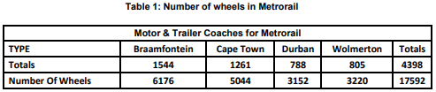
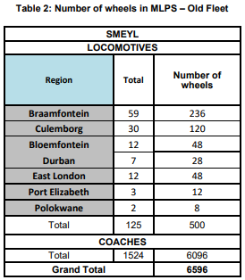
SCOPE OF WORK: Quantity Estimates
Below is a table of the Number of wheels that are currently installed to all Motor Coaches,
Trailer Coaches and Locomotives. There are currently 24188 wheels in Rolling Stock.

Slide 26
SCOPE OF WORK SUMMARY
Number of Contractors To Be Appointed:
The total number of required service providers is based on the available fleet of wheelsets. The number of wheelsets that require repairs/refurbishment nationally is 0.2% (which is 500 wheels) of the total fleet (182581) per month. This consumption is taken from an average monthly.
The analysis for the required number of contractors is based on the local market analysis through the Wheels maintenance consumption of the previous numbers of Wheel-sets repaired by the industry and the quantities of the total number of the Wheel-sets components of the fleet.
The table below depicts the split through various regions (The Table will be shared with the market) and given the local market analysis performed, there is a need of a maximum total number of 20 Service providers to refurbish PRASA’s Wheelsets over a period of 3 years.

Slide 27
  EVALUATION: TECHNICAL/FUNCTIONALITY
Stage 1:
Stage 1A- Mandatory Requirements
Stage 1B – Technical Mandatory Requirements
Stage 1C – Basic Compliance Requirements – Already Described
Stage 2A: Technical / Functionality Requirements:
The Technical or Functionality criteria must be guided by the refurbishment scope of works and area of focus. Bidders responded would firstly be evaluated on functionality. The minimum score for functionality is 70% and the bidder/s who scores below this minimum shall not be considered for further evaluation in terms of the preference point system.
Stage 3: Price and BBBEE

Slide 28
  EVALUATION: TECHNICAL/FUNCTIONALITY
Table 9.2.2.2: Detail Scoring Methodology: Technical / Functionality Evaluation Criteria
No | Evaluation Criteria | Weight | Criteria Breakdown | Maximum Score | Scoring Criteria | Portfolio of Evidence
1 | Company Experience: Wheelsets refurbishment experience | 40 | 1.1 Indicate Wheelsets refurbishment type and years’ experience. | 20 | 0 = No submission / irrelevant information 1 = 2 years and below 2 = Above 2 - 3 years 3 = Above 3 – 4 years 4 = Above 4 – 5 years 5 = Above 5 Years | Proof of previous appointment letters or Purchase Orders with Reference letters that have Client’s contact details are to be submitted.
 |  |  | 1.2 Indicate combined total refurbishment rand value exposure for the Wheelsets orders in a period of maximum 5 years | 20 | 0 = No submission or irrelevant information 1 = R2 million and below 2 = Above R2 - R3 million 3 = Above R3 – R4 million 4 = Above R4 – 5 million 5 = Above R5 million | Proof of previous appointment letters or Purchase Orders with Reference letters that have Client’s contact details are to be submitted.

Slide 29
  EVALUATION: TECHNICAL/FUNCTIONALITY
Table 9.2.2.2: Detail Scoring Methodology: Technical / Functionality Evaluation Criteria
No | Evaluation Criteria | Weight | Criteria Breakdown | Maximum Score | Scoring Criteria | Portfolio of Evidence
2 | Experience and Qualification of Key Staff With Minimum of 5 years post qualification experience | 30 | Availability of Experienced and Qualified Human Capital Resources 1. Electrical Fitter / Electrician (Trade certificate) 2. Armature Winder (Trade certificate) 3. Fitter and Turner (Trade certificate) 4. Quality Assurer (minimum National Diploma Certificate) 5. Safety Officer (Safety Qualification Certificate) | 30 | 0 = No submission / not related / inadequate experience 1= Submitted 1 Qualification with relevant experience 2 = Submitted 2 Qualifications with relevant experience 3 = Submitted 3 Qualifications with relevant experience 4 = Submitted 4 Qualifications with relevant experience 5 = Submitted All Qualifications with relevant experience. | Proof of qualified personnel with Curriculum Vitae (CV) reflecting a minimum of 5 years post qualification relevant experience.

Slide 30
  EVALUATION: TECHNICAL/FUNCTIONALITY
Table 9.2.2.2: Detail Scoring Methodology: Technical / Functionality Evaluation Criteria
No | Evaluation Criteria | Weight | Criteria Breakdown | Maximum Score | Scoring Criteria | Portfolio of Evidence
3 | Refurbishment Implementation Approach and Methodology | 30 | Provide detailed technical approach/ methodology that is aligned to the scope/ highlight the risk(s) and mitigation measure associated per Rotating machine type as choice of selection. Ten (10) Areas of Focus should be as listed below: Workshop Layout, Process flow control, Skills, Safety, Risk, Environmental compliances, Scrap management, Tools, Procurement Process, and Place of Work | 20 | 0 = No submission 1 = Provided Inadequate / unrelated methodology 2 = Provided a generic technical approach project methodology 3 = Provided only 1-3 Areas of Focus in detailed technical approach and methodology that is aligned to the scope of work 4 = Provided 4-7 Areas of Focus in detailed technical approach and methodology that is aligned to the scope. 5 = Provided 8-10 Areas of Focus in detailed technical approach and methodology that is aligned to the scope of work. | Proof of detailed technical approach and methodology.

Slide 31
  EVALUATION: TECHNICAL/FUNCTIONALITY
Table 9.2.2.2: Detail Scoring Methodology: Technical / Functionality Evaluation Criteria
No | Evaluation Criteria | Weight | Criteria Breakdown | Maximum Score | Scoring Criteria | Portfolio of Evidence
3 | Refurbishment Implementation Approach and Methodology | 30 | Quality Management System (QMS) / ISO 9001 Accredited | 10 | 0 = No submission / unrelated information submitted 3 = Provided a QMS Plan 4 = Provided a QMS and proof of ISO 9001 certificate application in progress. 5 = Proof of ISO 9001 certificate | Proof having a QMS with Company letterheads must be submitted. Proof of an ISO 9001 certificate or in a process of being accredited by any certified body for ISO 9001 certification

Slide 32
  EVALUATION: TECHNICAL/FUNCTIONALITY
Stage 2B- Site/Workshop Visit Requirements
The shortlisted contractors that meet the minimum requirements (70% threshold) will be subjected to verification of capacity and capability, before the contract is awarded, by being audited in line with PRASA Audit Protocol (i.e. Suppliers Technical Accreditation Protocol). Refer to Annexure F.
Contractors are required to stipulate the Wheel sets they are tendering for. Refer to Annexure A. During the workshop visit, the selected choice of type of Wheel-set/s and Regions will be taken into consideration

Slide 33
THANK YOU

