Slide 1
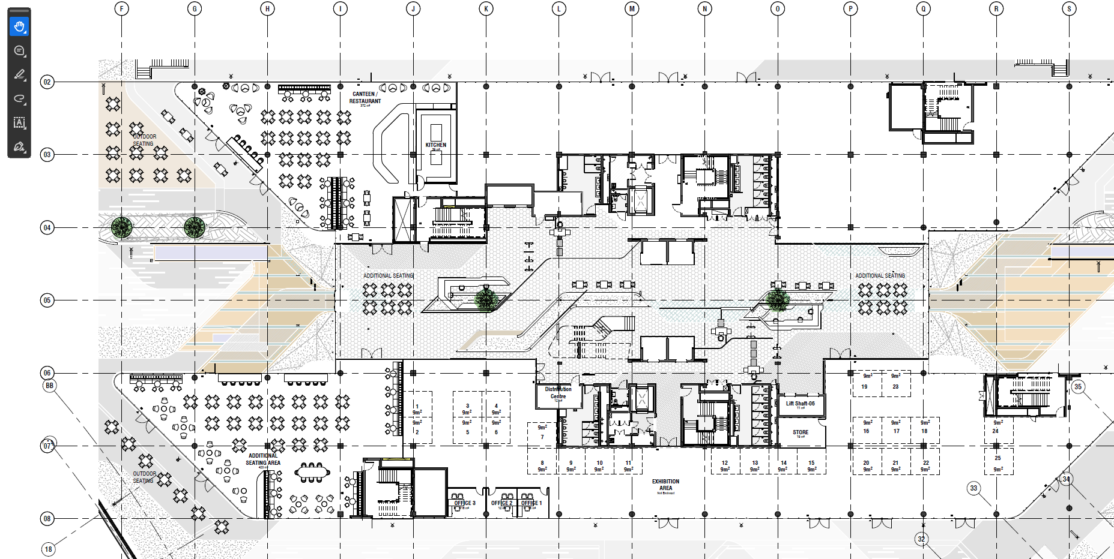
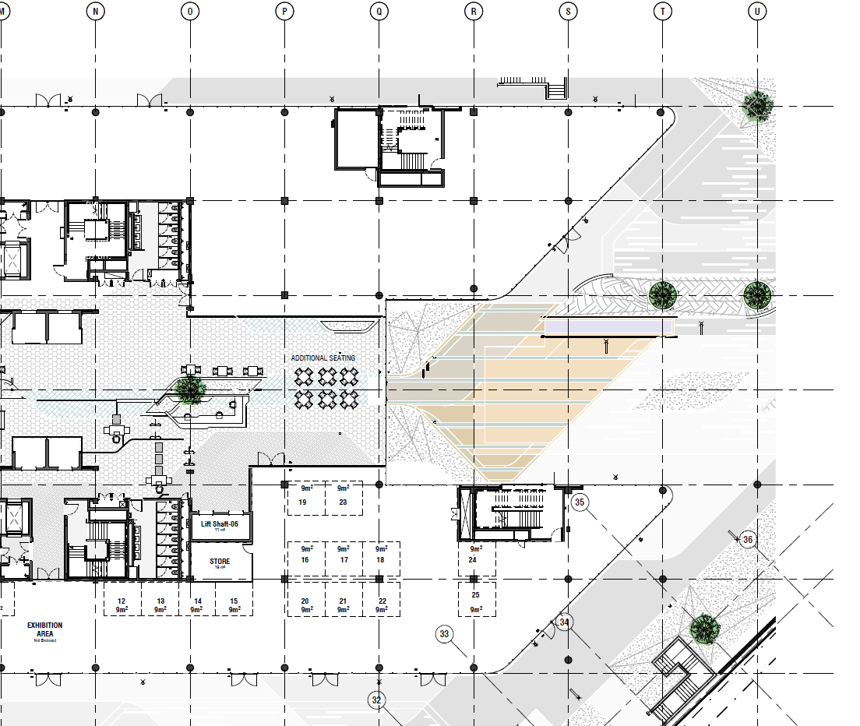
ACSA Innovation Centre
EXISTING ATRIUM / RECEPTION
ZONE 1
ZONE 3
ZONE 2

Slide 2
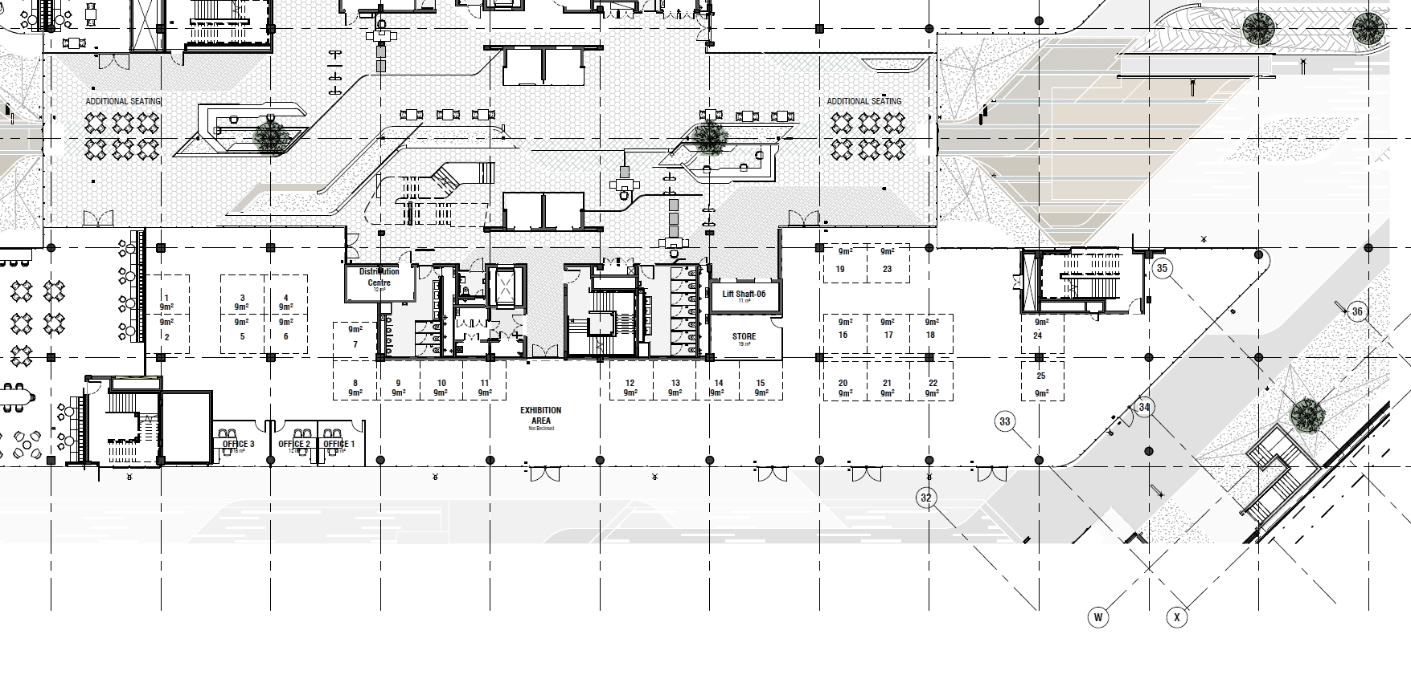
EXISTING ATRIUM / RECEPTION
ZONE 1
406 sqm
ZONE 3
585 sqm
ZONE 2
166 sqm
ACSA Innovation Centre
Objective: To design and plan a dynamic, Innovation Centre for Airports Company South Africa (ACSA) that showcases technological advancements, enhancements within the passenger journey, and provides collaborative workspaces. The innovation centre will function as a living lab for innovation, demonstration, and incubation.
Zone 1: Exhibition & Simulation Zone
Zone 2: Main Reception & Waiting Area
Zone 3: Collaboration & Support Zone

Slide 3
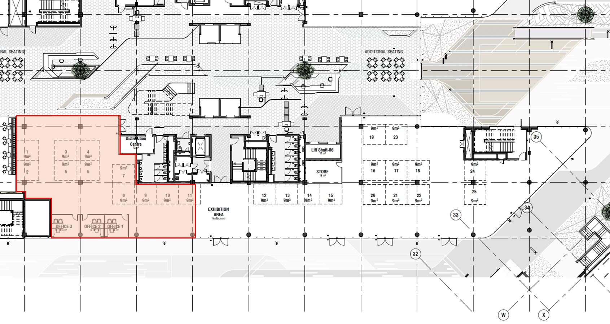
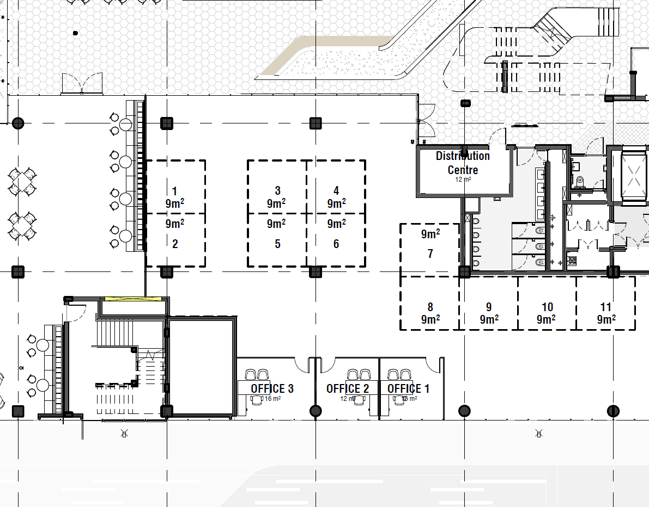
ZONE 1 - Exhibition & Simulation Zone
Approximate Area: 406 sqm
Primary Function: To serve as a dynamic, flexible exhibition and live-testing environment for showcasing and validating innovative airport technologies and passenger journey solutions.
Detailed Description: This zone is conceived as a large, open-plan "living lab." Its core purpose is to provide a fully adaptable space that can be rapidly reconfigured to host evolving exhibitions, simulate real-world airport environments, and facilitate hands-on interaction with new technologies
Key Features:
  Airport Experience Simulation: The zone will feature a robust, grid-based power and data infrastructure across the floor and ceiling, enabling the seamless setup and reconfiguration of authentic airport environments. Key passenger touchpoints—such as check-in, security screening, and boarding gates—can be simulated to test and demonstrate new processes and technologies in a controlled, mock-live setting.
  Integrated Sandbox Environment: A central feature of this zone is a dedicated "Sandbox" area. This includes a large-format, multi-screen display wall and interaction system designed specifically for demonstrating and stress-testing new software, operational systems, and user interfaces without impacting live airport operations.
  Interactive Exhibition & Strategic Planning Hub: The space will incorporate dedicated areas for interactive demonstrations, featuring operational self-service kiosks, smart security scanners, and automated boarding gates. A central, interactive table will act as a strategic planning tool, allowing users to explore and manipulate 3D models of ACSA's current airport infrastructure and future master plans.
  Reconfigurable Furniture & Layout: All furniture, display units, and partitioning within the zone will be mobile and modular on locking casters. This ensures the space can be effortlessly transformed to support various layouts, from guided exhibition tours to large-scale technology showcases or networking events.
Exhibition & Simulation Zone 406 sqm

Slide 4
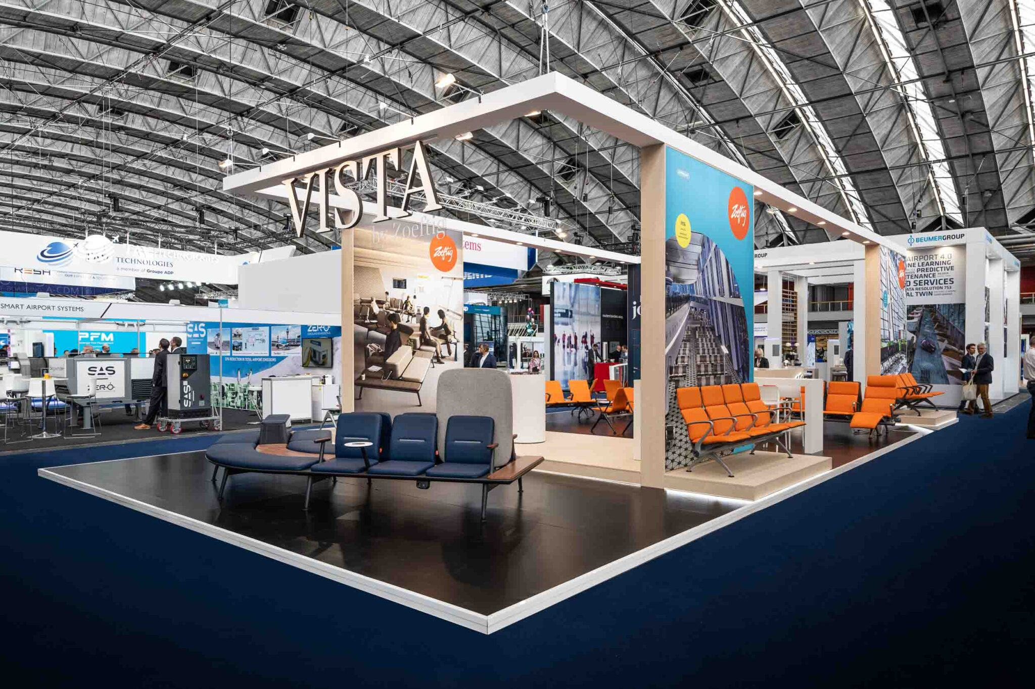
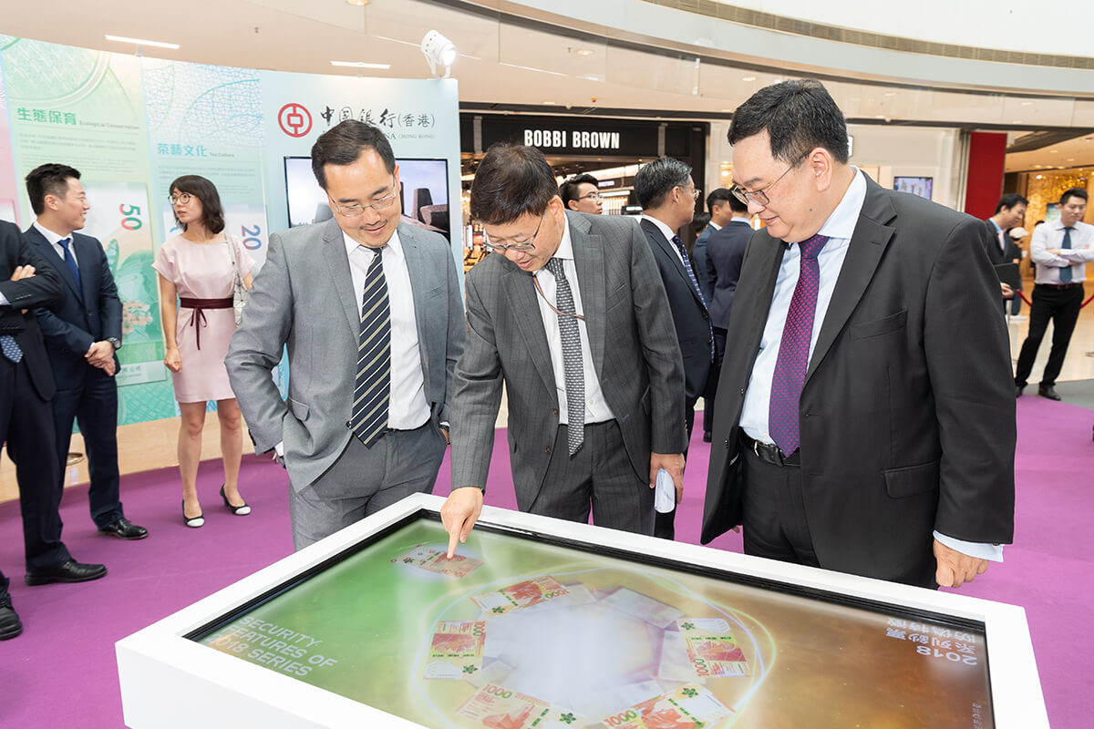
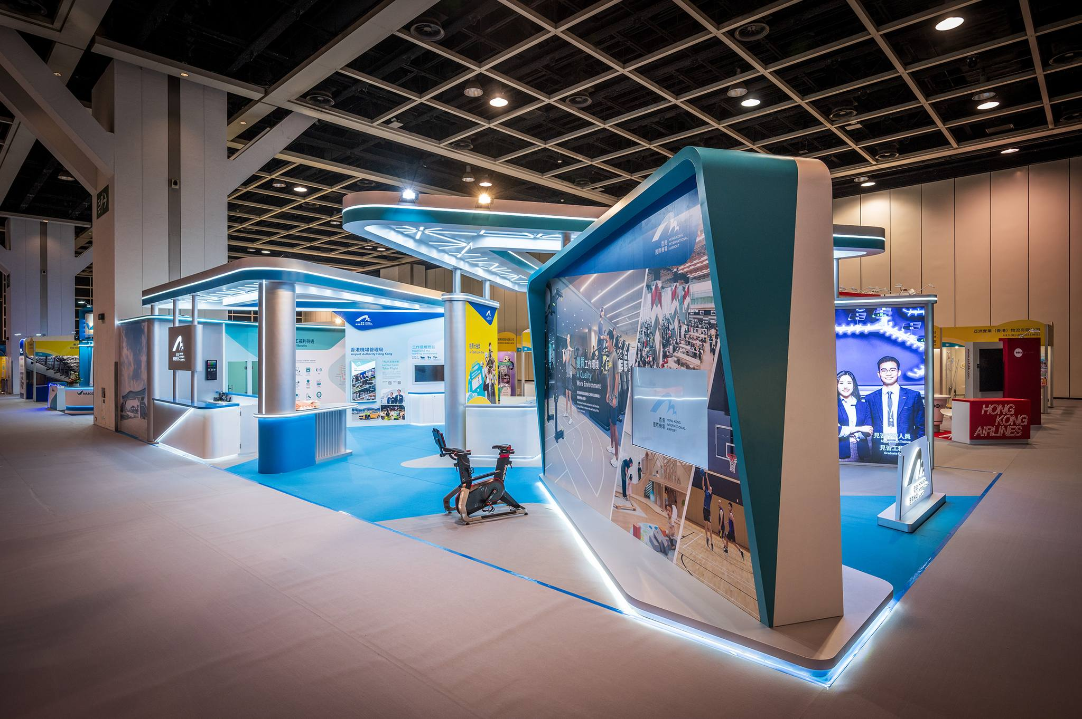
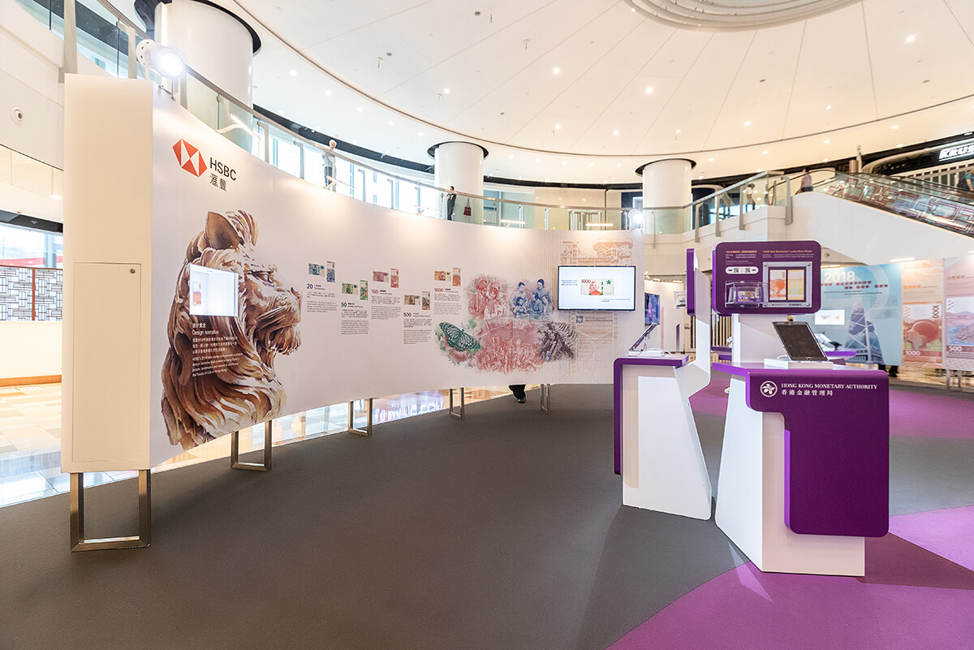
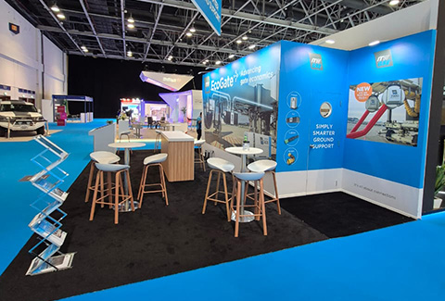
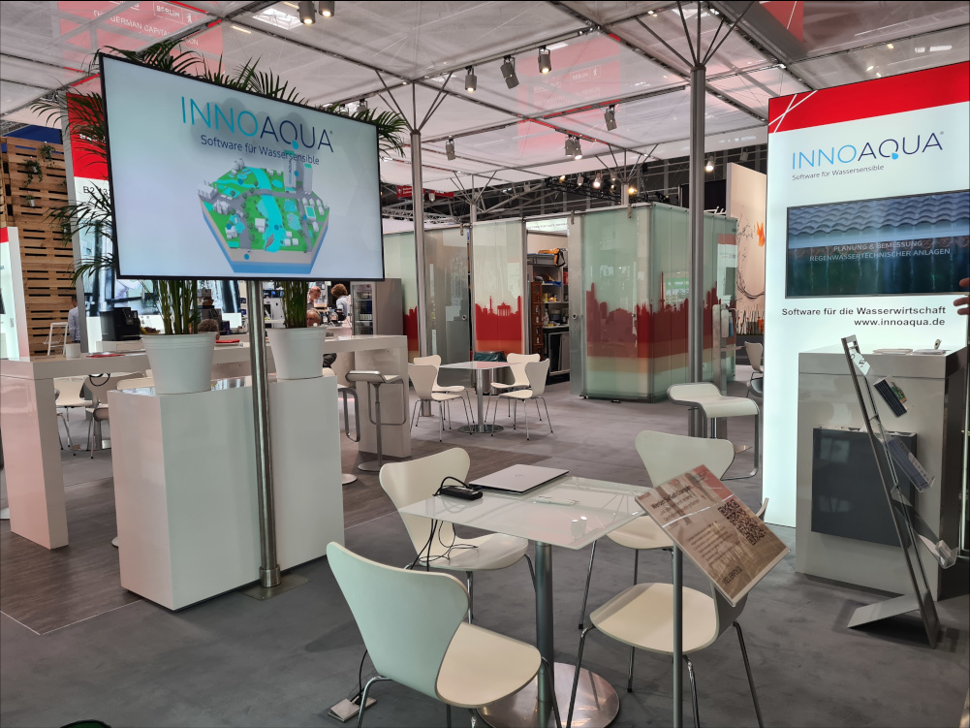
ZONE 1 - Exhibition & Simulation Zone

Slide 5
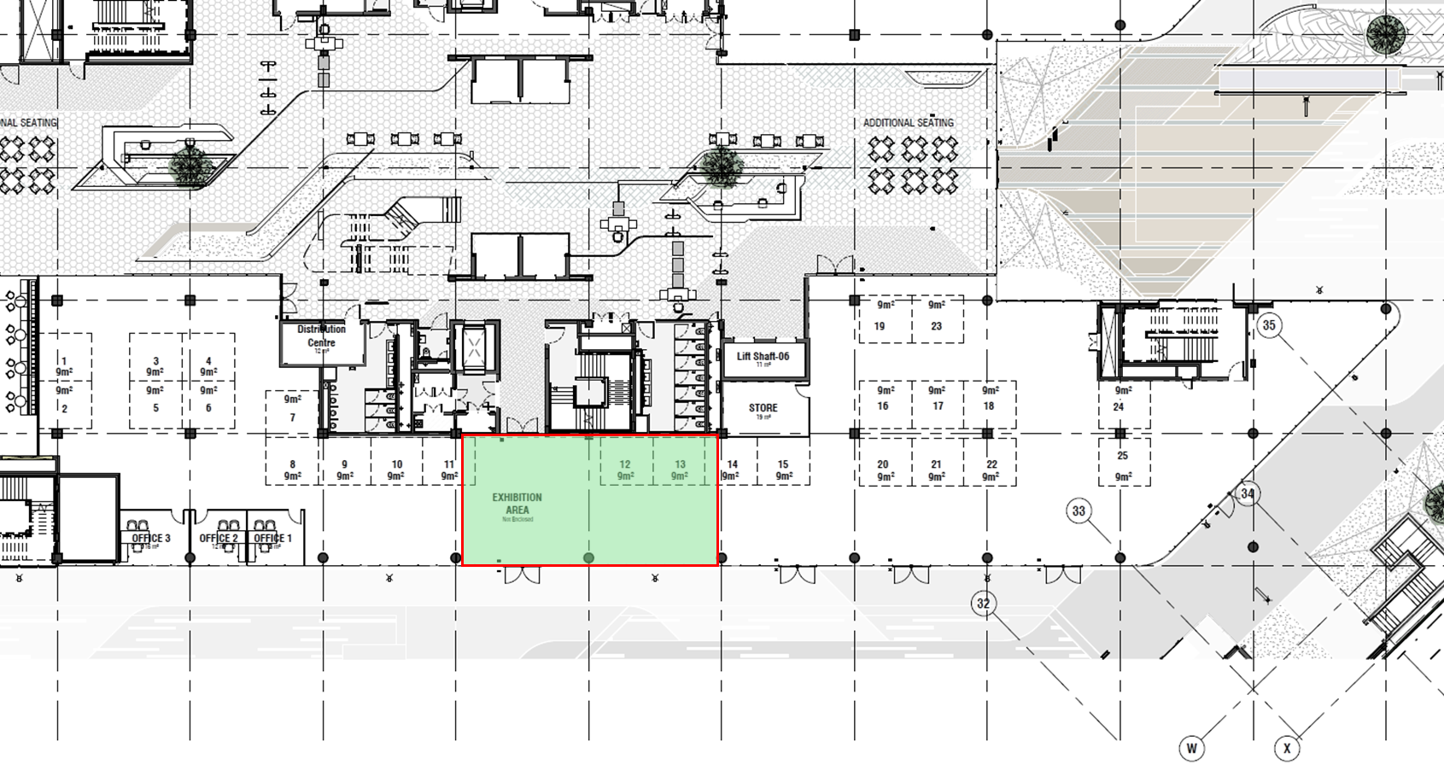
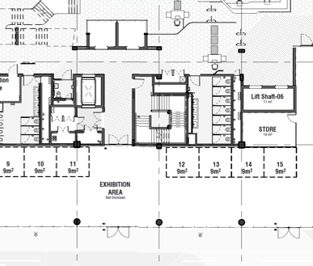
ZONE 2 - Reception / Waiting Area
Approximate Area: 166 sqm
Primary Function: To function as the primary welcoming, orientation, and controlled circulation nexus for the entire Innovation Centre, managing the flow of guests between the two main wings and the external patio.
Detailed Description:
This zone serves as the "front door" and first impression of the ACSA Innovation Centre. It is designed to be a bright, inviting, and highly functional space that efficiently manages visitor logistics. Upon arrival, guests are greeted and processed at the reception desk, after which they are seamlessly directed towards their destination—either the Exhibition & Simulation Zone (Zone 1) or the Collaboration & Support Zone (Zone 3).
Key Features & Components:
Branded Reception & Welcome Point: A prominent, professionally staffed reception desk that embodies the ACSA brand identity. This will be the central point for guest registration, security badging (if required), and initial welcome.
Strategic Circulation Control: The hub is strategically positioned to control and direct foot traffic. It provides clear and controlled access to both Zone 1 (Exhibition & Simulation) and Zone 3 (Collaboration & Support), ensuring a secure and organized flow of visitors.
Patio Access Point: The zone includes a direct and clearly marked secondary exit leading to the outdoor patio, which forms the pedestrian link to Building C. This integration promotes connectivity between the two buildings for events and spill-over usage.
Orientation & Wayfinding: The space will feature intuitive digital and static wayfinding signage to help guests easily identify and proceed to their intended destination, whether it's an exhibition, a meeting, or the coffee shop.
EXISTING ATRIUM / RECEPTION
Reception / Waiting Area
166 sqm
Access to Exhibition Zone
Access to Collaboration & Support Zone
Access to Block C

Slide 6
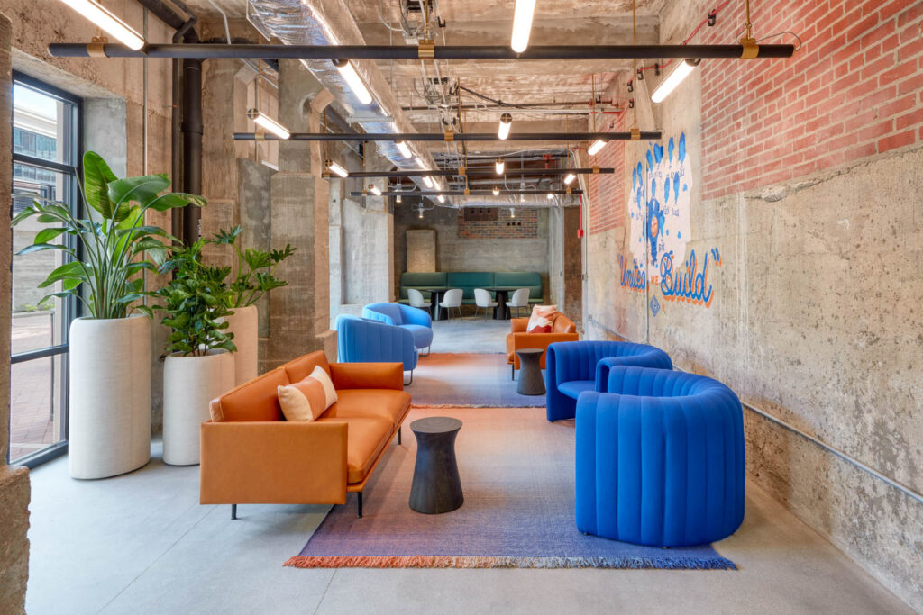
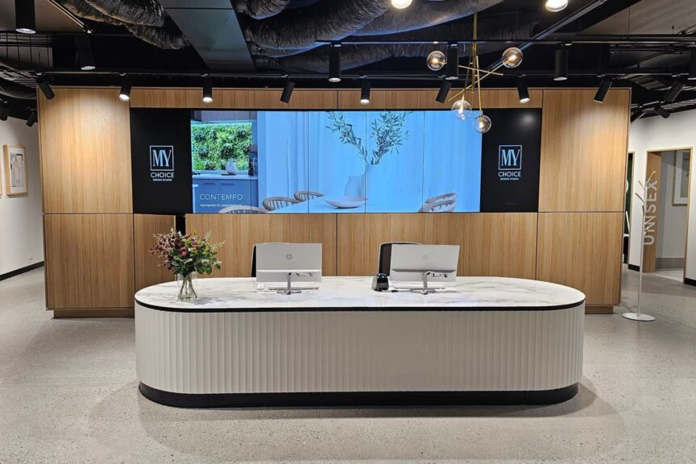
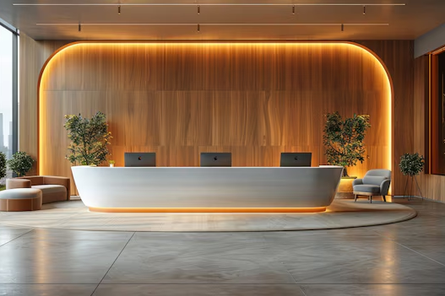
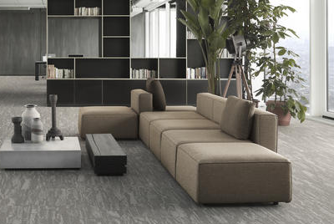
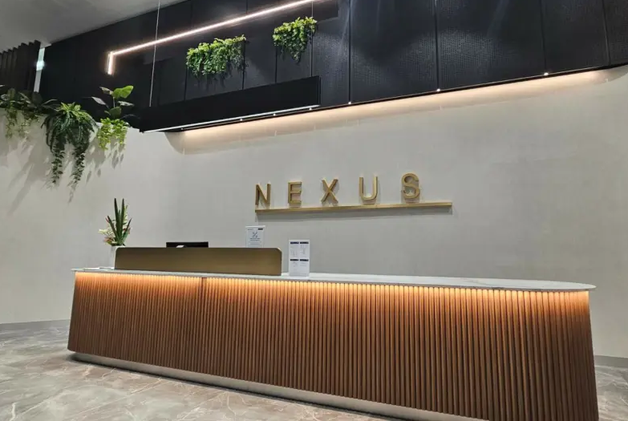
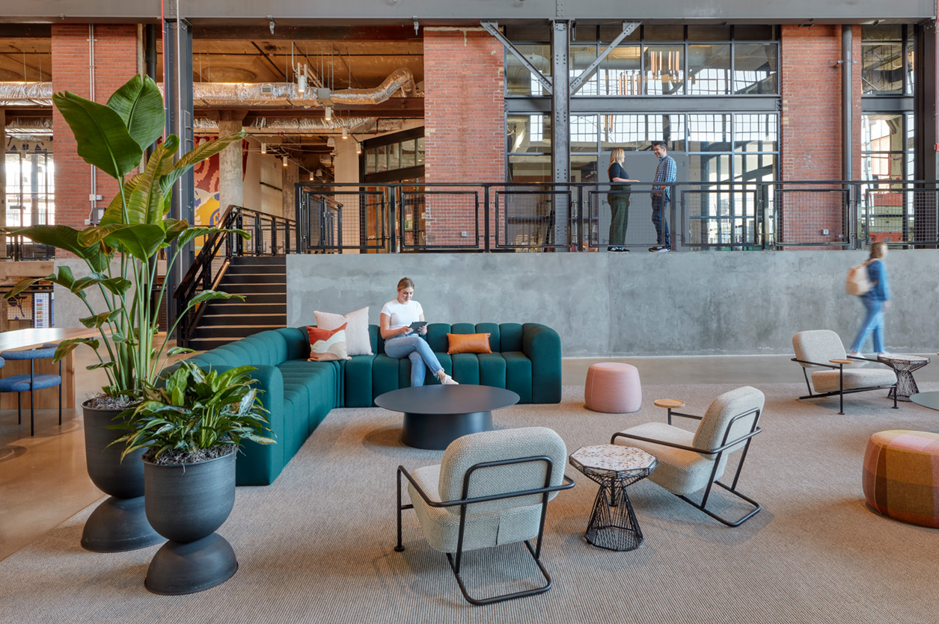
ZONE 2 - Reception / Waiting Area

Slide 7
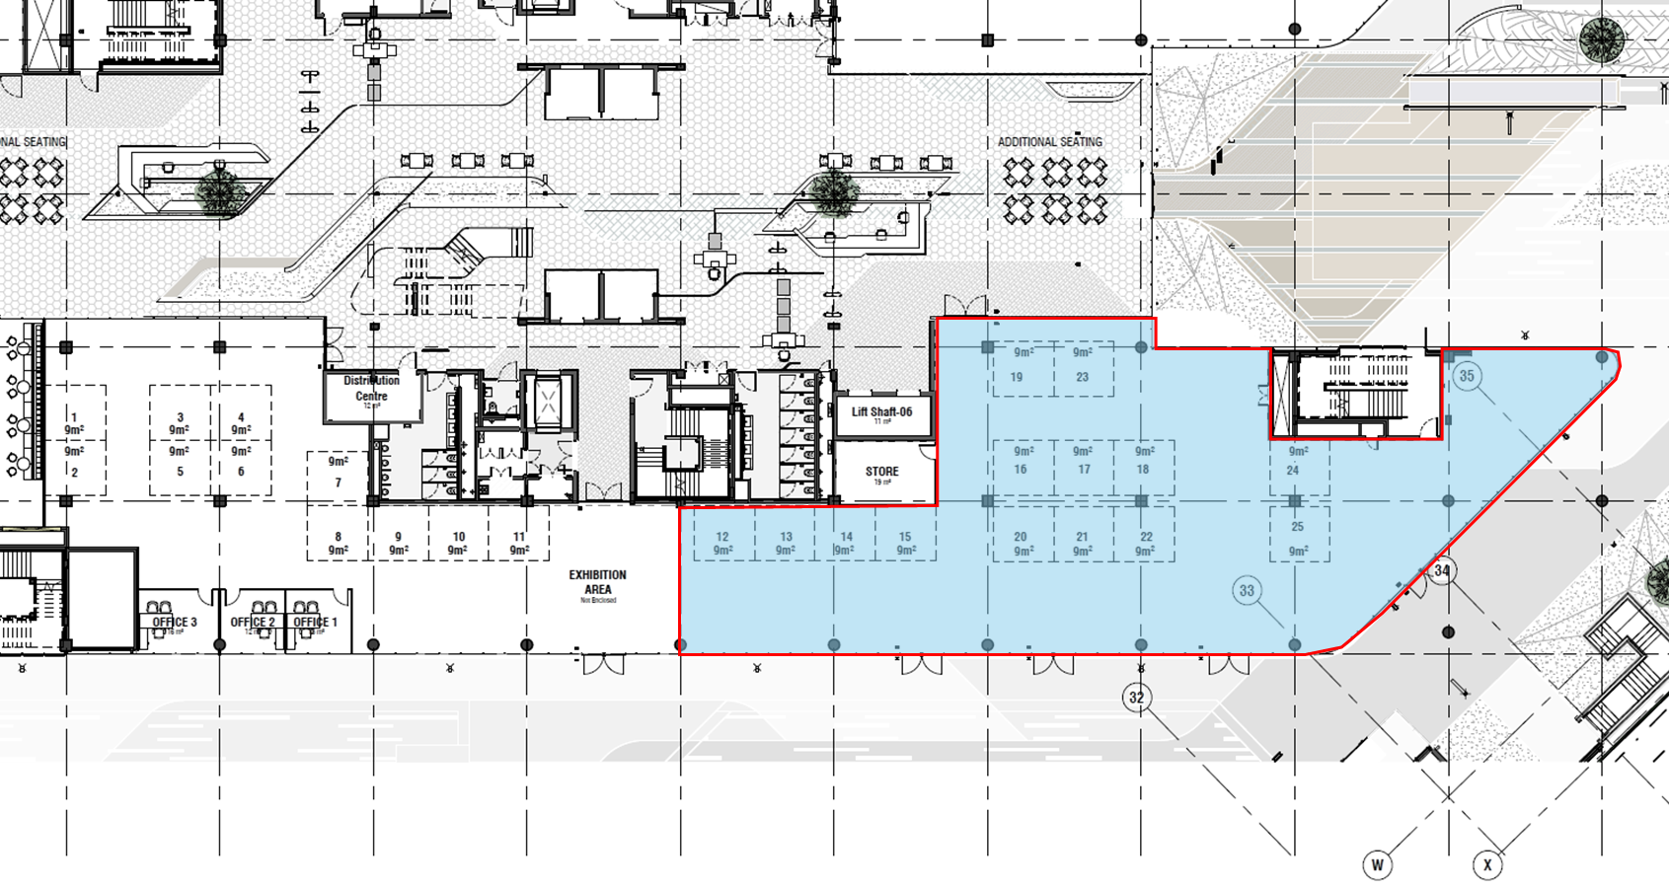
Approximate Area: 530 sqm
Primary Function: To provide a dynamic, adaptable environment that actively fosters innovation through a diverse mix of collaborative spaces, focused work areas, and social interaction points.
Detailed Description: This zone is the "engine room" of the Innovation Centre, dedicated to the process of ideation and collaboration. It moves beyond a standard office to offer a series of interconnected, flexible spaces that can be configured to support the entire innovation lifecycle—from initial brainstorming and team collaboration to deep, focused work and informal knowledge sharing. The design philosophy is "activity-based working," providing the right setting for every task.
Key Features & Components:
Modular Project Spaces: A series of bookable team rooms and project pods equipped with modular furniture and sound-dampening partitions. These spaces can be configured in multiple layouts (theatre, boardroom, workshop) or opened up to create larger collaboration areas for bigger teams or cross-functional workshops.
Focus & Deep Work Pods: A variety of small, enclosed booths and quiet corners, acoustically treated to allow for individual concentration or private phone calls, providing respite from the collaborative buzz.
Central Coffee Shop & Social Heart: A vibrant coffee shop with comfortable seating. This area is designed for informal networking, serendipitous encounters, and casual breakout sessions, fostering a community feel. The seating flows directly onto the outdoor patio.
Agile Open Plan Workspace: An open-plan hot-desking area with a mix of seating options (height-adjustable desks, lounge chairs) to support individuals and small teams who need a flexible base for the day.
Advanced Collaboration Rooms: Several larger, technology-enabled meeting rooms (including a 100 sqm boardroom) featuring interactive whiteboards, seamless video conferencing, and presentation tools to support intensive brainstorming and decision-making sessions.
Support Office: A dedicated, enclosed office for the Innovation Centre management team to oversee operations and provide support.
ACSA intends on leasing approximately 65m² to a coffee retailer within the first quarter of 2026. This area is marked by
ACSA requests that bidders not utilise this area for permanent fixtures (moveable furniture only).
Zone 3: Collaboration & Support Zone
ZONE 3
530 sqm

Slide 8
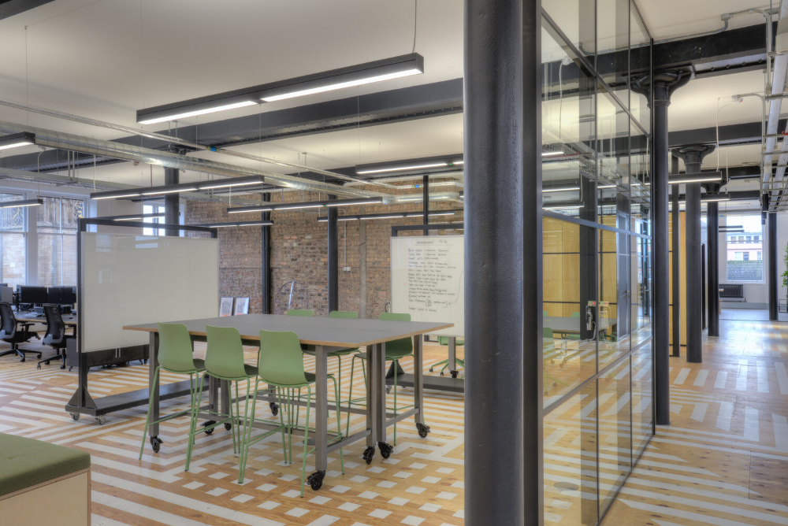
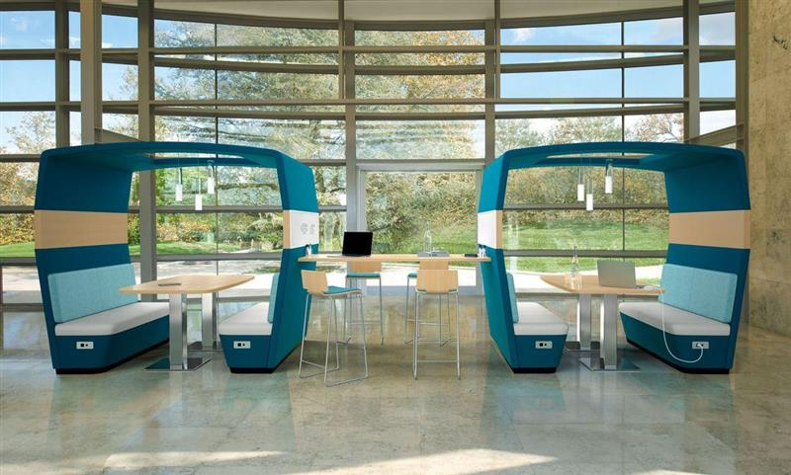
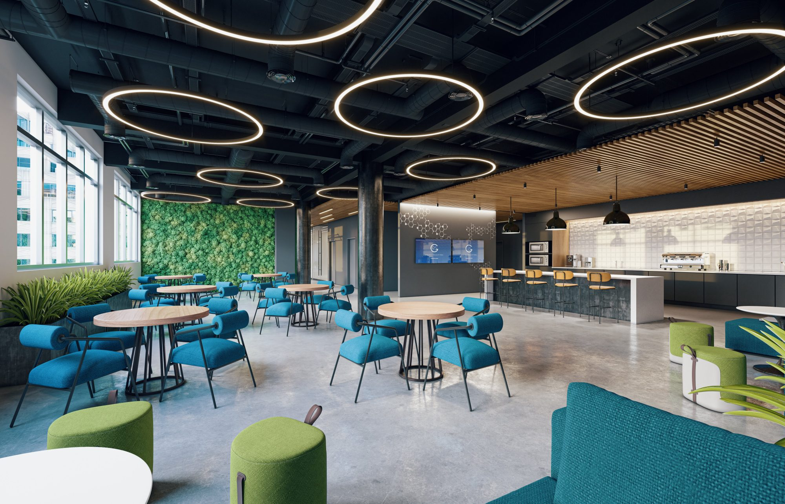
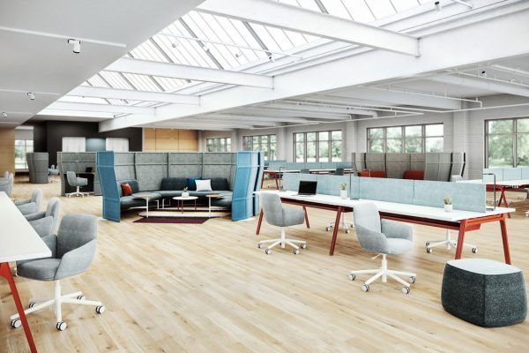
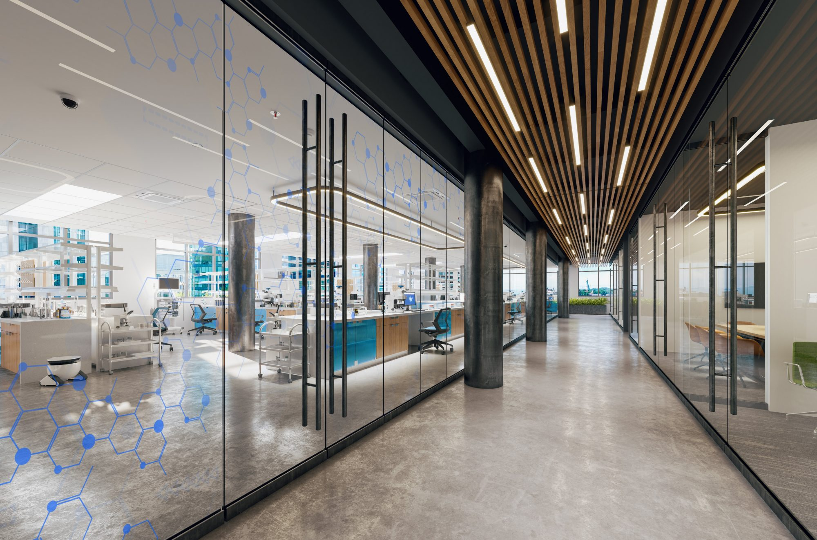
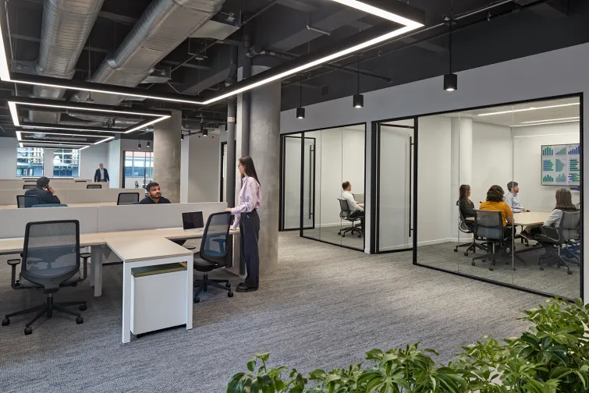
Zone 3: Collaboration & Support Zone

