Slide 1
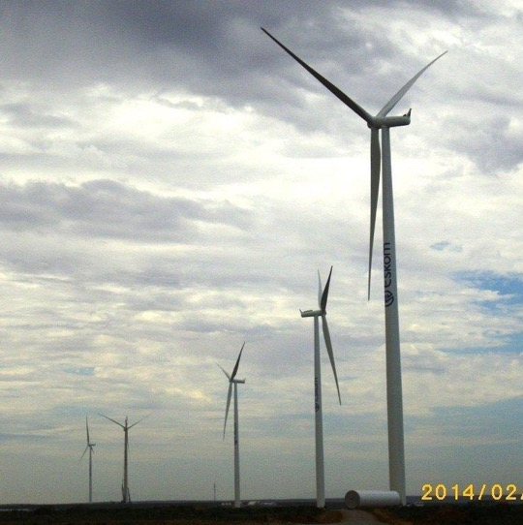
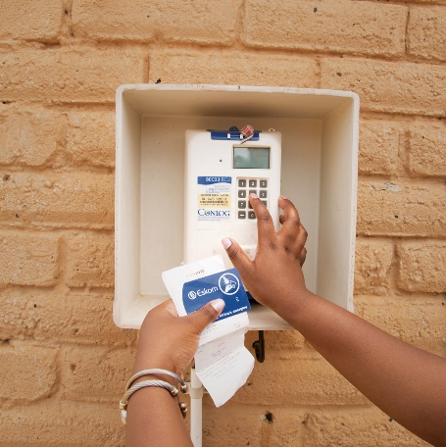
Commercial Clarification Presentation:
E3302DXKZNOU
The establishment of an enabling agreement with a panel of 20 service providers for the provision of auditing capturing, disconnections and replacement of prepaid, faulty and tampered meters with smart meters for the Central East Cluster (KZN and Free State Operating Unit) on an as and when required basis, for a period of thirty – six (36) months
Seela Pillay
14th August 2026

Slide 2
Agenda
Welcome | Seela Pillay
Safety | Seela Pillay
Commercial | Seela Pillay
Technical | Lwazi Nzama
Environment | Benito Williams
Safety | Mxolisi Xaba
SDL&I | Derna Edmund/ Gwen Alexander
Quality | Khelinah Dhlamini
Closure | Seela Pillay

Slide 3
E3302DXKZNOU –Purpose of the clarification meeting
To assist the Service Providers on the requirements for this tender
Is to explain the implications of the evaluation process and the evaluation phases which the tender will be subjected to.
To assist the Tenderers on how to compile the tender documents
This is NOT a compulsory clarification meeting
All clarifications and questions with answers will be published on the Eskom Tender Bulletin and the National Treasury Website. No individual emails will be sent to the tendering companies
To inform all Service Providers that queries must ONLY be addressed in writing to the buyer Seela Pillay – Email Address – seela.pillay@eskom.co.za

Slide 4
E3302DXKZNOU –Tender Information
Enquiry Number: E3302DXKZNOU
Closing Date: 04 September 2026 at 10H00 AM
Contract duration will be 36 months.
Tender Validity Period: 6 months from the closing date
Tenders are to be submitted electronically via Eskom E-tendering site by the stipulated date and time.
NO LATE TENDERS WILL BE ACCEPTED. Only tenders submitted at the correct closing time will be accepted
No hardcopies will be accepted
The closing time for clarification of queries is five (5) days before the deadline for tender submission.
Tenderers are encouraged to continuously check the bulletins for the latest updates or addendums during the tender process.

Slide 5
E3302DXKZNOU - Tender Information
All relevant documentation for this tender has been be uploaded onto:
Eskom Tender Bulletin
National Treasury E-Tender Portal
The documents need to be uploaded under the following folders:
  Section 1 - Commercial
  Section 2 - Technical
  Section 3 - SDL & I
  Section 4- Quality
  Section 5- Safety
  Section 6 - Environmental

Slide 6
E3302DXKZNOU - Tender Information
All documents need to be submitted in a PDF and Excel format (The limit is 500 megabytes per file and total submission of 4 gigabytes per submissions). The price list needs to be submitted in PDF and a copy in excel format
No Zip/condense files can be uploaded
If for some reason you resubmit your tender, then the latest version of the tender submitted will only be accepted and all previous submission/s will be null and void.
Please ensure that the submission status is indicated as complete
Supplier Help Manual guide and video can be found on Eskom E-Tendering page
Feedback on successful / non-successful tenderers will be communicated at the end of the process.
Regret letters will be uploaded on the tender portals.

Slide 7
E3302DXKZNOU - Tender Information
Basic Compliance and Mandatory Evaluation
Basic Compliance (As per page 8 of the invitation to tender)
Technical Folder – Folder 2 on the Eskom Tender Portal. Tenderers who do not meet the 80% threshold for functionality scoring will be disqualified
Functionality:
Contractual Requirements
Mandatory Tender Returnable (As per page 9 of the invitation to tender):
Financial
Safety
Quality
Proposal of Rates
Preference Points Scoring System (ranking of tenderers)
As per Item 3.18 on page 12 of the invitation:
Environment

Slide 8
E3302DXKZNOU - How the Tender Evaluation will proceed
Step 1: Basic Compliance Mandatory Evaluation
All responses to the tender enquiry will be evaluated for overall compliance to the conditions of tender and test for responsiveness
Commercial Mandatory Returnable (Disqualifiable)
These returnables are required to be submitted with the tender at Tender closing date and time. If not submitted by tender closing the tender must be disqualified.
Meet the eligibility criteria for a tenderer
Acceptance of the terms and conditions of the NEC3 Term Services Contract (TSC) and fully priced BOQ.
All tenders are to be submitted electronically via Eskom E-Tendering.

Slide 9
E3302DXKZNOU - How the Tender Evaluation will Proceed
Commercial Mandatory Returnable (Non - Disqualifiable)
These returnable are also required to be fully completed, signed and submitted with Tender at Tender closing date and time, however, if not submitted by Tender closing, the Procurement Practitioners will request in writing the outstanding returnable to be submitted within 5 working days. If the requested returnable (s) are not fully completed, signed and/or received by the Procurement Practitioner within 5 working days of the request; the tender will be disqualified.
Annexure A - Authorisation Form.
Annexure B - Acknowledgement form.
Annexure C - Tenderer’s particulars form.
Annexure D - Integrity Declaration form.
Fully complete and sign the SBD 1 Invitation to bid form in the invitation to tender
Fully complete and sign the SBD 6.1 Preference claim form in the invitation to tender
Fully complete and sign the SBD 4 Bidders Disclosure form in the invitation to tender
E-Tenderers E-Tendering Training Acknowledgement Form to be fully completed and signed in its entirety and submitted at tender closing
Tax Evaluation Questionnaire valuation (questionnaire to determine whether a company, close corporation(CC) or Trust is a personal service provider for purposes of PAYE

Slide 10
E3302DXKZNOU - How the Tender Evaluation will Proceed
Commercial Mandatory Returnable Required Prior to Contract Award (Non - Disqualifiable)
The requested returnable (s) are required to be received by the Procurement Practitioner upon request by contract award; failure to provide the document will deem the tender non-responsive.
CSD Registration – Companies are required to provide a valid CSD (MAAA……) number.

Slide 11
E3302DXKZNOU - How the Tender Evaluation will Proceed
ONLY COMPANIES THAT PASS
ALL THE STAGE 1
REQUIREMENTS WILL
PROCEED TO THE NEXT STAGE (Technical)

Slide 12
E3302DXKZNOU - How the Tender Evaluation will Proceed
STAGE 2 : FUNCTIONALITY EVALUATION
It is to be noted that these requirements can be found in the Technical Folder – Folder 2 on the Eskom Tender Portal.
There is an 80% threshold required in order to be deemed compliant in terms of functionality to proceed to the next stage of the evaluation.
Tenderers who do not meet the threshold will be disqualified at this point and will not move on to the next stage of the evaluation.

Slide 13
E3302DXKZNOU - How the Tender Evaluation will Proceed
ONLY COMPANIES THAT PASS ALL THE STAGE 2 REQUIREMENTS WILL PROCEED TO THE NEXT STAGE (EVALUATION OF RATES)

Slide 14
E3302DXKZNOU - How the Tender Evaluation will Proceed
STAGE 3 – EVALUATION OF RATES
The rates offered by Technically compliant tenderers will be evaluated
Tenderers will be ranked for price out of 80 Points
Every item of the BOQ must be priced.
Rates must be fair, reasonable and market related.

Slide 15
E3302DXKZNOU - How the Tender Evaluation will Proceed
STAGE 4 : RANKING OF SUPPLIERS
Evaluation of Specific Goals
Specific goals will be scored out of 20 points in accordance with PPPFA.
If a tenderer fails to meet Specific goals and submit proof, the tenderer will not be disqualified. However, be awarded 80 points for price and will score 0 points for Specific goals (out of 20)
Note: Failure on the part of the supplier to submit supporting documents/proof of specific goals for purposes of evaluation and scoring by tender closing will not result in disqualification (if tenderer is otherwise deemed to be responsive/acceptable in all other aspects). The tenderer will, however, be scored zero for Specific goals for purposes of PPPFA scoring and ranking.
Eskom will then add the score from Pricing and Specific goals together and rank the Tenderers from the highest to the lowest.

Slide 16
E3302DXKZNOU - How the Tender Evaluation will Proceed
ONLY THE TOP RANKED COMPANIES WILL PROCEED TO THE NEXT STAGE:
STAGE 5 EVALUATION OF SAFETY, QUALITY AND ENVIRONMENTAL

Slide 17
E3302DXKZNOU - How the Tender Evaluation will Proceed
STAGE 5 EVALUATION OF SAFETY, QUALITY AND ENVIRONMENT
The contractual requirements stated in the tender are not required for scoring but are prerequisites for contract award. The contract will not be awarded until these requirements are met.
TO BE PRESENTED BY THE RELEVANT LEADS
Contractual requirements entail the following sections:
Safety Requirements;
Environmental Requirements;
Quality Requirements; and

Slide 18
E3302DXKZNOU - How the Tender Evaluation will Proceed
THIS IS VERY IMPORTANT TO NOTE:
The top ranked Tenderers identified in terms of the 80/20 preferential point scoring will be evaluated for SHEQ.
Should contractors not pass the initial evaluation they will be advised of their shortcomings and have 7 days in which to correct their shortcomings. Failure to correct the shortcomings within the stipulated time period will result in the contractor being deemed unacceptable in terms of their contractual requirements and will not be considered for the contract.
It is important to submit the SHEQ criteria at Tender Closing and try and get your SHEQ criteria 100% compliant upfront.

Slide 19
E3302DXKZNOU - Final Stage
Once all evaluations are completed, the results will be finalised only the top ranked tenderers will be identified and recommendation will be submitted to the Procurement Tender Committee for approval.
Once approval has been obtained the rates will be proposed to the tenderers, if the rates are accepted, the contracts will be concluded and in the event that the rates are not accepted the reasons for non-acceptance will be solicited and presented to the DAA and based on the reasons provided a feedback will be presented to DAA and a revised mandate will be requested in order to enter into negotiations with the tenderers

Slide 20
E3302DXKZNOU - General
All presentations will serve as minutes and will be loaded to the bulletins.
All questions raised at this clarification meeting and those emailed to the Buyer will be posted to Eskom’s tender bulletin and National Treasury’s e-portal. Answers will also be posted to the same platforms.
Vendors without an Eskom Vendor Number may submit a tender.
Please note that Vendor Management (For companies with no vendor number) evaluations will still need to be done prior to the company being able to sign a contract. Only once all the required evaluations are done and passed successfully will the company be able to sign the contract and legible to receive work.

Slide 21
E3302DXKZNOU - General
All tendering companies will be subjected to the same evaluation criteria. Do not assume that because you have worked for Eskom prior to this, the Eskom team will know your company and know whether you have the necessary requirements in order to perform the required scope. In the functionality stage of the evaluation Eskom will ONLY evaluate what documents you provide in the tender submission.
Service Providers are encouraged to ensure they double check their documents before submitting/uploading their tender
Service Providers are to ensure tender document meets all the requirements for the Tender.
Service Providers are encouraged to submit their tender documents before the closing date and not wait to submit on the day of tender closing.
This is not a compulsory meeting and therefore companies not at the clarification meeting are permitted to submit tenders.

Slide 22
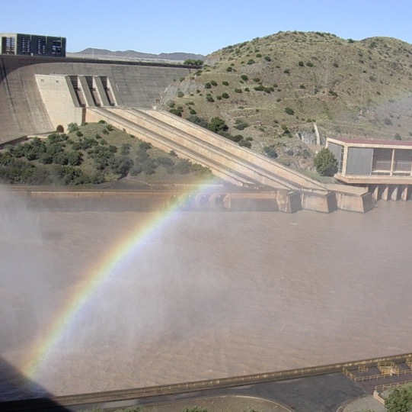

Conclusion

