Slide 1
REQUEST FOR BIDS FOR THE PROVISION OF COMMUNICATIONS AND PR MANAGEMENT SERVICES FOR A PERIOD NOT EXCEEDING 3 YEARS AT AIRPORTS COMPANY SOUTH AFRICA.
COR7834/2025

Slide 2
1| Opening and Welcome
4| Tender Evaluation Criteria
2| Key Dates & Instructions
5| Price and Preference
3| Background and Scope of
Works
6| Attendance Register and
Questions

Slide 3
2. Key dates & instructions
Key Dates:
Closing Date for Enquires: 12 June 2025 @ 12:00PM
Closing Date for Submission: 27 June 2025 @ 12:00PM
Briefing session register:
Please stay until the end of the session so that you can be marked off on the register. This is important as attendance to this session is a Mandatory requirement.
Tender Submission Instructions:
Tender Box C at OR Tambo International Airport , ACSA offices 3rd floor, will be open from the 25th of June 2025 @ 10:00am to the 27th of June 2025 @ 12:00pm.
No bids will be accepted after closing time
Key Information:
Can those in attendance assist whoever will be compiling a response to this tender.
Bidders can form partnerships/JV/consortium for this tender, if you do, you need:
  Joint BBBEE certificate
  The partnerships/JV/consortium needs to register for VAT with SARS
An addendum will be published regarding a slight change to the evaluation criteria

Slide 4
3. Background and Scope of Works
BACKGROUND
Airports Company South Africa (ACSA) is a leading airport operator in the African aviation industry, managing nine airports across South Africa, including three major international airports: O.R. Tambo International, Cape Town International, and King Shaka International. ACSA provides world-class airport infrastructure, promoting tourism, facilitating socio-economic growth, and preserving the environment.
Vision: To be the most sought-after partner in the world for the provision of airport management solutions by 2030.
Mission: To acquire, develop and manage world-class airports and related businesses for the benefit of all our stakeholders and the socio-economic development of South Africa.
Values: PRIDE: Passion – Results – Integrity – Diversity – Excellence.
Value Proposition: Connecting people to people, places, dreams and opportunities.
ACSA is seeking a 360-degree Communications and PR management service provider that can support its strategic objectives and enhance its reputation. The ideal partner will understand the dynamic nature of the aviation industry and provide 24/7 support to ensure effective communication across all channels.

Slide 5
3. Background and Scope of Works
SCOPE OF WORK
NUMBER | DESCRIPTION OR DELIVERABLE | FREQUENCY | DELIVERY DATE | REVERTS
STRATEGY DEVELOPMENT
 | Research across 9 airports including Stakeholder surveys (to assess appropriate messaging, messengers, and channels) | Once per annum | Winning bidder will be notified | X4
2. | Facilitate the revision and review of the ACSA integrated (internal, external, and digital) communications strategy | Once per annum | Winning bidder will be notified | X4
3. | Develop multichannel targeted monthly communication campaign/content plans | 1 campaign plan x 12 Ad-hoc campaign plans x12 | Winning bidder will be notified | X3
4. | Develop the ACSA Crisis Management strategy | Develop: Once-off Review: Once per annum | Winning bidder will be notified | Develop: X4 Review: X 3
5. | Develop the media playbook with divisional workshops and inputs. | Once per annum | Winning bidder will be notified of the delivery date | Develop: X4 Review: X 3

Slide 6
3. Background and Scope of Works
NUMBER | DESCRIPTION OR DELIVERABLE | FREQUENCY | DELIVERY DATE | REVERTS
POLICY MANAGEMENT
6. | Assist in the review and or redrafting of all Communications policies and procedures. | Once per annum (as requested) | Winning bidder will be notified | X3
REPORTING & RECOMMENDATIONS
 | Monthly report & recommendations | Monthly | 3rd of each new month by no later than 12h00pm | X3
8. | Quarterly report & recommendations | Quarterly (1 April – 30th June; 1st July – 30th Sept; 1st Oct – 31st Dec; 1st Jan – 31st March) | 5th of each new quarter, no later than 12h00pm. | X3
9 | Annual report & recommendations | Annually | Due 8th April each year. | X4
10. | Closeout report & recommendations | Report required after a specific campaign/activation/crisis or significant incident. | After a specific campaign/activation/crisis or significant incident. | X3
11. | Daily media analysis meeting | Daily | Daily | N/A

Slide 7
3. Background and Scope of Works
NUMBER |  | DESCRIPTION OR DELIVERABLE | FREQUENCY |  | DELIVERY DATE | REVERTS
REPUTATION MANAGEMENT
12. | Draft speaker notes (narrative and or PPT format), to be drafted against a briefing document/specification or an activation request. | Draft speaker notes (narrative and or PPT format), to be drafted against a briefing document/specification or an activation request. | 25 per annum | 25 per annum | Winning bidder will be notified | Winning bidder will be notified | X3
13. | Thought Leadership: Research and develop a thought leadership programme based on unique insights. Op-eds and articles for publication in relevant media outlets (paid or earned) Blog/ LinkedIn Articles, | Thought Leadership: Research and develop a thought leadership programme based on unique insights. Op-eds and articles for publication in relevant media outlets (paid or earned) Blog/ LinkedIn Articles, | 24 per annum | 24 per annum | Winning bidder will be notified | Winning bidder will be notified | X3
14. | Crisis Response: 24/7/365 availability, develop response strategies to specific crisis experienced within ACSA. Position ACSA positively and assist in managing the media narrative. | Crisis Response: 24/7/365 availability, develop response strategies to specific crisis experienced within ACSA. Position ACSA positively and assist in managing the media narrative. | As and when a significant incident occurs. | As and when a significant incident occurs. | Draft holding statement within 30 minutes of incident occurring; final version within 1 hour of incident occurring (proviso: proper information of incident is provided). | Draft holding statement within 30 minutes of incident occurring; final version within 1 hour of incident occurring (proviso: proper information of incident is provided). | X3
15. | Media Distribution: Develop a detailed disaggregated (segmented) ACSA media database and distribution list. Database is owned by ACSA. | Media Distribution: Develop a detailed disaggregated (segmented) ACSA media database and distribution list. Database is owned by ACSA. | Immediately after being awarded the contract. Updated Monthly. | Immediately after being awarded the contract. Updated Monthly. | Monthly reports (3rd of each month) | Monthly reports (3rd of each month)

Slide 8
3. Background and Scope of Works
NUMBER |  | DESCRIPTION OR DELIVERABLE |  | FREQUENCY | DELIVERY DATE |  | REVERTS
REPUTATION MANAGEMENT
16. | Internal Design, layout & Content Creation: Newsflash Staff Engagement Platform Internal Magazine Staff Emailers Presentations Communications Collateral | Internal Design, layout & Content Creation: Newsflash Staff Engagement Platform Internal Magazine Staff Emailers Presentations Communications Collateral | Newsflash- once a week Staff Engagement Platform- daily Internal Magazine- monthly Staff Emailers- daily Presentations- as and when required Communications Collateral - daily | Newsflash- once a week Staff Engagement Platform- daily Internal Magazine- monthly Staff Emailers- daily Presentations- as and when required Communications Collateral - daily | Winning bidder will be notified | Winning bidder will be notified | X3 of each | X3 of each
17. | External Design, Layout, Print & Content Creation: Advertorials Media Invitations Radio Campaigns Advertising Ad hoc collateral | External Design, Layout, Print & Content Creation: Advertorials Media Invitations Radio Campaigns Advertising Ad hoc collateral | Advertorials- as and when required Media Invitations- as and when required Radio Campaigns- as and when required Advertising- as and when required Ad hoc collateral – as and when required | Advertorials- as and when required Media Invitations- as and when required Radio Campaigns- as and when required Advertising- as and when required Ad hoc collateral – as and when required | Winning bidder will be notified | Winning bidder will be notified

Slide 9
3. Background and Scope of Works
NUMBER | DESCRIPTION OR DELIVERABLE | FREQUENCY | DELIVERY DATE | REVERTS
REPUTATION MANAGEMENT
18. | Digital Design, layout & Content Creation: Social media content Website content updates Mobile App content updates LinkedIn Blog/Articles ACSA Podcast Community management Digital Media event support Influencer strategy Search Engine Opmtised copywriting Social & Digital Marketing | Social media content- 2 posts daily Website content updates- quarterly updates and as and when required Mobile App content updates- quarterly updates and as and when required LinkedIn Blog- monthly ACSA Podcast- monthly Community management- 24/7/365 Digital Media event support- as and when required Develop & implement campaign aligned Influencer strategy SEO optimized copywriting- monthly Social & Digital Marketing - Support overall business and brand marketing with social and digital strategies and campaigns | Winning bidder will be notified

Slide 10
3. Background and Scope of Works
NUMBER | 22.DESCRIPTION OR DELIVERABLE | FREQUENCY | DELIVERY DATE | REVERTS
REPUTATION MANAGEMENT
19. | Creative content production (animation, infographics/illustrations and videos) | Animation- 4 per annum Infographics / illustrations- 12 per annum Videos- 12 per annum | Winning bidder will be notified
20. | Media Relations Networking & Relationship building: Introduce the communications team to various journalists quarterly | Quarterly | Winning bidder will be notified | X3
21. | Media Training & Coaching: Conduct media training for identified staff. | x12 training sessions Refresher: Ad-hoc basis | Winning bidder will be notified | X3
22. | Value Add: Offer additional services that can provide additional publicity / reputation management and communications opportunities for ACSA | Winning bidder will be notified | Winning bidder will be notified | X3

Slide 11
3. Background and Scope of Works
NUMBER | DESCRIPTION OR DELIVERABLE | FREQUENCY | DELIVERY DATE | REVERTS
REPUTATION MANAGEMENT
23. | Media briefings management: Coordinate press briefings once per month. These are held at ACSA head office as well as the nine airports rotationally. This includes developing the media pack for the day, agenda as well as invited to media. Tier 1 media expected at all briefings as well as community media. Product launches (as and when) Media tours (with each media briefing) Post briefing close out reports | Media briefings x12 | Winning bidder will be notified and the reports due 72 hours after the event. | X3
Administration
24. | Editing & Proofreading | As and when required

Slide 12
3. Background and Scope of Works
NUMBER | DESCRIPTION OR DELIVERABLE
Resource requirements
 | ACCOUNT MANAGER Role Overview: The Account Manager will serve as the primary liaison between ACSA and the appointed service provider, ensuring smooth communication, strategic alignment, and execution of all social media and digital strategies, internal, and external communication initiatives. Key Responsibilities: Act as the central point of contact between ACSA and the service provider Oversee the execution of communications, PR and social media and digital strategies Ensure timely delivery of projects, campaigns, and deliverables Conduct weekly status meetings and provide regular reports on campaign performance Manage client and service provider relationship and expectations Collaborate with ACSA’s internal teams to align communications with business goals Coordinate crisis communication responses when necessary

Slide 13
3. Background and Scope of Works
NUMBER | DESCRIPTION OR DELIVERABLE
Resource requirements
 | ACCOUNT MANAGER Skills & Experience Required: Strong project management and client relationship skills Experience in corporate communications, PR, social media and digital strategies Excellent organizational and problem-solving abilities Minimum 5–7 years of experience in account management within a communications, media and/PR role Minimum NQF 6-7 level qualification
26. | GRAPHIC DESIGNER Role Overview: The Graphic Designer will be responsible for producing visually compelling designs for internal, external, social media, website, and mobile app content, ensuring consistency with ACSA’s CI and brand identity.

Slide 14
3. Background and Scope of Works
NUMBER | DESCRIPTION OR DELIVERABLE
Resource requirements
26. | GRAPHIC DESIGNER Key Responsibilities: Create high-quality graphics, layouts, and designs for social media, website, internal and external communication materials Understanding of UX/UI design principles and best practices for website and mobile app optimisation Design presentations, infographics, and reports to support corporate messaging Develop visual assets for internal and external communication campaigns, events including posters, invitations, brochures, and signage Work closely with internal teams to align visuals with messaging Produce high-quality video content, and animated content including interviews, behind-the-scenes footage, and campaign storytelling. Edit, photography and videography to enhance digital storytelling Ensure all designs adhere to ACSA’s CI and branding guidelines.

Slide 15
3. Background and Scope of Works
NUMBER | DESCRIPTION OR DELIVERABLE
Resource requirements
26. | GRAPHIC DESIGNER Skills & Experience Required: Proficiency in Adobe Creative Suite (Photoshop, Illustrator, InDesign, Premiere Pro, After Effects). Strong portfolio showcasing a mix of internal, external and social media designs Ability to design engaging visuals for social media and internal & external communications campaigns. Minimum 3–5 years of experience in graphic design.
27. | WRITER Role Overview: The writer will be responsible for crafting compelling content for both internal audiences (employees) and external audiences (passengers, stakeholders, and media).

Slide 16
3. Background and Scope of Works
NUMBER | DESCRIPTION OR DELIVERABLE
Resource requirements
27. | WRITER Key Responsibilities: Write, edit, and proofread press releases, articles, newsletters, and speeches. Develop engaging thought leadership content for ACSA Support media relations by crafting press statements and responses Draft and edit ACSA employee communication materials Ensure consistency in messaging, tone, and brand voice across all written content Skills & Experience Required: Strong writing, editing, and storytelling skills Ability to write for different formats (corporate communications and media) Experience in corporate writing, and or journalism Minimum 5 years of professional writing experience

Slide 17
3. Background and Scope of Works
NUMBER | DESCRIPTION OR DELIVERABLE | FREQUENCY | DELIVERY DATE | REVERTS
Resource requirements
28. | MEDIA STRATEGIST Role Overview: The Media Strategist will be responsible for planning, executing, and optimizing media strategies across print, online and broadcast channels to enhance ACSA’s visibility and engagement. Key Responsibilities: Develop and implement data-driven media strategies for ACSA campaigns Identify the most effective media channels (print, online and broadcast channels) for specific campaigns Work closely with the social media content teams to align and optimize media placements and audience targeting Track and analyze media general sentiment, media campaign performance and adjust strategies as needed Build relationships with media partners to maximize exposure Ensure that all media placements align with ACSA’s corporate communication objectives Coordinate crisis communication responses when necessary Skills & Experience Required: Strong understanding of media buying, audience segmentation, and performance metrics (sentiment, share of voice, etc) Experience with media advertising and traditional media placements Minimum of 5 years in media strategy and planning

Slide 18
3. Background and Scope of Works
NUMBER | DESCRIPTION OR DELIVERABLE
Resource requirements
29. | SOCIAL MEDIA, CONTENT & MULTIMEDIA SPECIALIST Role Overview: The social media, Content and Multimedia Specialist will be responsible for managing ACSA’s social media presence while also handling content creation, including video production, graphic design, and photography. This role ensures a dynamic and engaging digital presence through high-quality content and strategic audience engagement. Key Responsibilities: Develop and execute social media strategies aligned with ACSA’s brand objectives Manage and engage with audiences across Facebook, X, Instagram, TikTok, and LinkedIn Monitor and respond to customer inquiries, complaints, and comments in real time Create and schedule engaging content, including posts, stories, reels, and videos Produce high-quality video content, and animated content including interviews, behind-the-scenes footage, and campaign storytelling. Manage photography and visual assets to enhance digital storytelling. Implement influencer collaborations and digital campaigns to drive reach. Track performance analytics and provide insights for optimization

Slide 19
3. Background and Scope of Works
NUMBER | DESCRIPTION OR DELIVERABLE | FREQUENCY | DELIVERY DATE | REVERTS
Resource requirements
29. | SOCIAL MEDIA, CONTENT & MULTIMEDIA SPECIALIST Skills & Experience: Minimum 5 years’ experience in social media management, content creation, and multimedia production Strong understanding of social media algorithms, trends, and engagement tactics Excellent copywriting and content creation skills Proficiency in Adobe Creative Suite (Photoshop, Premiere Pro, After Effects, Illustrator). Strong video production and editing skills Experience in photography and digital asset management. Experience in crisis communication and online reputation management. Strong analytical skills to interpret data and optimize strategies Coordinate crisis communication responses when necessary

Slide 20
4. Tender evaluation criterIA
Mandatory
Registration and Attendance to Compulsory Briefing Session
A fully completed and compliant Pricing Schedule (SBD3.3)
Functionality
Points allocated for Functionality shall be evaluated in accordance with the criteria as listed below. An overall minimum threshold of 76 points out of 95 must be achieved for the tender to be eligible for further evaluation on Price and Preference (80/20 split). Bidders who also fail to achieve the minimum score per criteria will be disqualified and not be eligible for further evaluations.
An addendum will be issued for the sentence crossed out.
The minimum threshold for this tender is 76 points out of 95
Do not provide links or QR codes in response to the evaluation criteria

Slide 21
4. Tender evaluation criteria…
EVALUATION CRITERIA | MAX
COMPANY EXPERIENCE - DIGITAL COMMUNICATION Bidders are required to demonstrate their Digital communication experience by providing the details of a minimum of 1 digital communication project they have previously worked on. Recreate and update the below table (table 1.1) for the project worked on in response to this requirement: The requirements for table 1.1 were not met in full for any projects= 0 points The requirements for table 1.1 were met in full for 1 project= 2 points The requirements for table 1.1 were met in full for 2 projects= 4 points The requirements for table 1.1 were met in full for above 2 projects= 6 points | 6
Label your responses clearly
Complete the table in full
Provide a copy of a reference letter
Complete separate table for each project
Ensure that it is clear that the project is for Digital Comms
TABLE 1.1 REQUIREMENTS
Client Name
Client Brief (details of what client required)
Duration to complete brief
Outcomes (details of how you met the brief)
*** Provide Reference letter for project

Slide 22
4. Tender evaluation criteria…
EVALUATION CRITERIA | MAX
COMPANY EXPERIENCE - INTERNAL COMMUNICATION Bidders are required to demonstrate their Internal communication experience by providing the details of a minimum of 1 Internal communication project they have previously worked on. Recreate and update the below table (table 2.1) for the project worked on in response to this requirement: The requirements for table 2.1 were not met in full for any projects= 0 points The requirements for table 2.1 were met in full for 1 project= 2 points The requirements for table 2.1 were met in full for 2 projects= 4 points The requirements for table 2.1 were met in full for above 2 projects= 6 points | 6
Label your responses clearly
Complete the table in full
Provide a copy of a reference letter
Complete separate table for each project
Ensure that it is clear that the project is for Internal Comms
TABLE 2.1 REQUIREMENTS
Client Name
Client Brief (details of what client required)
Duration to complete brief
Outcomes (details of how you met the brief)
Provide Reference letter for project

Slide 23
4. Tender evaluation criteria…
EVALUATION CRITERIA | MAX
COMPANY EXPERIENCE - EXTERNAL COMMUNICATION Bidders are required to demonstrate their External communication experience by providing the details of a minimum of 1 External communication project they have previously worked on. Recreate and update the below table (table 3.1) for the project worked on in response to this requirement: The requirements for table 3.1 were not met in full for any projects= 0 points The requirements for table 3.1 were met in full for 1 project= 2 points The requirements for table 3.1 were met in full for 2 projects= 4 points The requirements for table 3.1 were met in full for above 2 projects= 6 points | 6
Label your responses clearly
Complete the table in full
Provide a copy of a reference letter
Complete separate table for each project
Ensure that it is clear that the project is for Internal Comms
TABLE 3.1 REQUIREMENTS
Client Name
Client Brief (details of what client required)
Duration to complete brief
Outcomes (details of how you met the brief)
Provide Reference letter with letterhead and official company stamp confirming work done to client satisfaction

Slide 24
4. Tender evaluation criteria…
EVALUATION CRITERIA |  | MAX
4. | DEMONSTRATION Bidders are expected to demonstrate their creativity in meeting the below brief. This requirement is purely to illustrate your creativity and no additional documents, pictures etc will be given to the bidders in response to the below brief. Client Brief ACSA is celebrating its 32nd birthday in July 2025. They are looking for a 360-degree communications plan that showcases a digital, internal and external communication element. The bidders are expected to create a campaign which highlights ACSA’s evolution, its commitment to innovation, and its role in connecting South Africa to the world. The campaign should focus on ACSA’s achievements over the years, its impact on the economy and local communities, and its future vision as a key player in the global aviation and tourism industry. The campaign should highlight key tactics and efforts to increase brand sentiment, increase media impressions, increase employee engagement and awareness. Objectives Celebrate ACSA's Legacy Promote Innovation and Sustainability Strengthen Brand Image (increase brand sentiment and media impressions) Engage Stakeholders (include media interviews and other forms of engagement)
Requirement 4.1 to 4.3 must respond to this brief.
Demonstrate your creativity in response to this brief

Slide 25
4. Tender evaluation criteria…
EVALUATION CRITERIA |  | MAX
4.1 | INTERNAL COMMUNICATION DEMONSTRATION For internal communications demonstrations please provide the following (provide softcopy version of content) in line with the above client brief: Content piece types: Email newsletters Posters or banners or digital screens Social platforms (Microsoft VIVA Engage, MS Teams, WhatsApp groups) Internal digital magazine Video messages No submissions of content pieces = 0 points Bidder demonstrated 1 content piece in Internal Comms = 2 points Bidder demonstrated 2 content pieces in Internal Comms = 4 points Bidder demonstrated 3 content pieces in Internal Comms = 6 points Bidder demonstrated 4 content pieces in Internal Comms = 8 points Bidder demonstrated 5 content pieces in Internal Comms = 10 points | 10
Provide soft copies on a USB device
Do not provide links or QR codes in response to the criteria.
You will receive points in line with the number of content piece types you submit
Label your responses clearly

Slide 26
4. Tender evaluation criteria…
EVALUATION CRITERIA | MAX
DIGITAL COMMUNICATION DEMONSTRATION For digital communications please provide the following (provide softcopy version of content) in line with the above client brief: Content piece types: Social Media Strategy Document Content calendar Sample creative assets (post captions with hashtag and designs, and/or infographics). No submissions of content pieces = 0 points Bidder demonstrated 1 content piece in digital comms = 2 points Bidder demonstrated 2 content pieces in digital comms = 4 points Bidder demonstrated 3 content pieces in digital comms = 6 points |  | 6
Provide soft copies on a USB device
Do not provide links or QR codes in response to the criteria.
You will receive points in line with the number of content piece types you submit
Label your responses clearly

Slide 27
4. Tender evaluation criteria…
EVALUATION CRITERIA | MAX
EXTERNAL COMMUNICATION DEMONSTRATION For external communications please provide the following (provide softcopy version of content) in line with the above client brief: Content piece types: Media Release Thought Pieces/Editorials Write-up of Proposed media campaign (include high-impact segments for television and/or radio) No submissions of content pieces = 0 points Bidder demonstrated 1 content piece in external comms = 2 points Bidder demonstrated 2 content pieces in external comms = 4 points Bidder demonstrated 3 content pieces in external comms = 6 points | 6
Provide soft copies on a USB device
Do not provide links or QR codes in response to the criteria.
You will receive points in line with the number of content piece types you submit
Label your responses clearly

Slide 28
4. Tender evaluation criteria…
EVALUATION CRITERIA |  | MAX
5. | RESOURCE EXPERIENCE Provide the full CV (e.g. one you would use to apply for employment) of each resource which demonstrates: Employment history (Role in each organisation, Duties for each role, Duration of each role) Academic history Certifications Skills and competencies etc. Demonstrate how resource meets the competencies requested in the scope Provide one dedicated resource per position. Resources cannot be mapped to more than one role.
This requirement is where most bidders fail, please pay attention to what you are submitting
Submit a full CV- we need to know the resources we will be working with
Remember we are evaluating specific experience, therefore, ensure that the CV demonstrates the required experience by listing not only the job title but the description of responsibilities
Provide a different resource per requirement
Label your response clearly- provide an organogram matching the resources provided to the roles required for evaluations

Slide 29
4. Tender evaluation criteria…
EVALUATION CRITERIA | MAX
ACCOUNT MANAGER Provide the details of one resource with a minimum of 5 years’ experience in account management within a communications or media and/or PR role. This resource must have a minimum NQF 6 level qualification. CV demonstrates less than the 5 years required experience and/or qualification is less than NQF level 6 = 0 points CV demonstrates the 5 years required experience and qualification is NQF level 6 = 5 points CV demonstrates more than 5 years required experience and qualification is higher than NQF level 6 = 10 points |  | 10
Provide CV and copy of qualification for only 1 resource
Ensure that experience in account management within a communications or media and/or PR role is clear on CV
Start and end dates for each role are important to determine the number of years experience

Slide 30
4. Tender evaluation criteria…
EVALUATION CRITERIA |  | MAX
5.2. | GRAPHIC DESIGNER Provide the details of one resource with a minimum 3 years of experience in graphic design. Provide a portfolio of evidence showcasing a softcopy mix of internal, external and social media designs.
5.2.1 | EXPERIENCE CV demonstrates less than the 3 years required experience = 0 points CV demonstrates the 3 years required experience = 2 points CV demonstrates more than the 3 years required experience = 5 points | 5
Provide CV and POE for only 1 resource
Ensure that Graphic design experience is clear on CV
Start and end dates for each role are important to determine the number of years experience

Slide 31
4. Tender evaluation criteria…
EVALUATION CRITERIA |  | MAX
5.2.2 | PORTFOLIO OF EVIDENCE POE to include briefs for a minimum of 3 different content piece types and their artwork. The content piece types provided should be from 3 different clients. Content piece types: Email newsletters Posters or banners or digital screens Social platforms (Microsoft VIVA Engage, MS Teams, WhatsApp groups) Internal digital magazine Video messages No submissions of content pieces = 0 points Bidder demonstrates 1 graphic design content piece= 2 points Bidder demonstrates 2 graphic design content pieces= 4 points Bidder demonstrates 3 graphic design content pieces= 6 points Bidder demonstrates 4 graphic design content pieces= 8 points Bidder demonstrates 5 graphic design content pieces= 10 points | 10
Provide soft copy of POE on a USB device
Do not provide links or QR codes in response to the criteria.
You will receive points in line with the number of content piece types you submit
Label your responses clearly

Slide 32
4. Tender evaluation criteria…
EVALUATION CRITERIA |  | MAX
5.3. | WRITER Provide the details of one resource with a minimum 5 years of professional writing experience in corporate writing, and or journalism. CV demonstrates less than the 5 years required experience = 0 CV demonstrates the 5 years required experience = 5 points CV demonstrates more than the 5 years required experience = 10 points | 10
Provide CV for only 1 resource
Ensure that professional writing experience in corporate witing and or journalism is clear on CV
Start and end dates for each role are important to determine the number of years experience

Slide 33
4. Tender evaluation criteria…
EVALUATION CRITERIA |  | MAX
5.4. | MEDIA STRATEGIST Provide the details of one resource with a minimum of 5 years’ experience in media strategy and planning. CV demonstrates less than the 5 years required experience = 0 points CV demonstrates the 5 years required experience = 5 points CV demonstrates more than the 5 years required experience = 10 points | 10
Provide CV for only 1 resource
Ensure that media strategy an planning experience is clear on CV
Start and end dates for each role are important to determine the number of years experience

Slide 34
4. Tender evaluation criteria…
EVALUATION CRITERIA |  | MAX
5.6. | SOCIAL MEDIA, CONTENT & MULTIMEDIA SPECIALIST Provide the details of one resource with a minimum 5 years’ experience in social media management and content creation, and multimedia production. CV demonstrates less than the 5 years required experience = 0 points CV demonstrates the 5 years required experience = 5 points CV demonstrates more than the 5 years required experience = 10 points | 10
Provide CV for only 1 resource
Ensure that (i)social media management, (ii) content creating and (iii) multimedia production experience is clear on CV
Start and end dates for each role are important to determine the number of years experience

Slide 35
5. Price and preference
PRICE (80) –SBD3.3
All prices must be in Rands excluding Vat.
Bidders must only price in accordance with the below table, failure to do so may lead to a disqualification.
The mark-up and retainer amounts are fixed for the duration of the contract.
The monthly retainer quoted should exclude the following ad hoc costs:
  Media Buying
  Animation and videography
  Printing costs
  Social media boosting
  International News Syndication
  Disbursements will be reimbursed at actual cost. The successful bidder will be required to provide proof of expenses in order to be reimbursed. All travel arrangements must be pre-approved by ACSA.
Bidders may apply a mark-up for Ad hoc costs sourced from a third party. Bidders will be required to provide the invoice received from any third party to determine that the correct markup has been applied.
COST ITEM | R (Excl. VAT)
Monthly Retainer for services based on the entire scope of work | R
Mark-up for third party ad hoc services | %

Slide 36
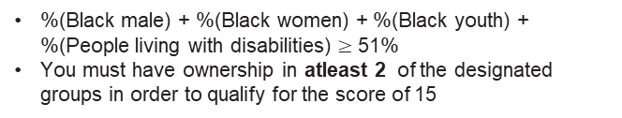
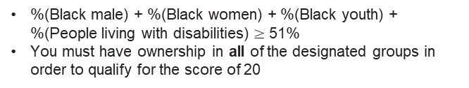
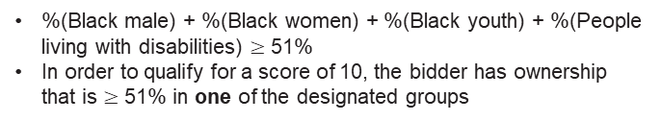
5. Price and preference
PREFERENCE (20)
ACSA will score specific goals out of 20 in accordance with the PPP Regulations 2022/2023.
Specific Goals | Score
 | 10
51% owned by Black male and Black women and Black youth and People living with disabilities | 20
51% owned by Black male or Black women or Black youth or People living with disabilities (at least two of the above designated groups must achieved) | 15
51% owned by Black male or Black women or Black youth or People living with disabilities | 10
Less than 51% owned by Black male, Black women, Black youth, People living with disabilities | 5
Other | 0
%(Black male) + %(Black women) + %(Black youth) + %(People living with disabilities) $≥$ 51%
You must have ownership in all of the designated groups in order to qualify for the score of 20
%(Black male) + %(Black women) + %(Black youth) + %(People living with disabilities) $≥$ 51%
You must have ownership in atleast 2 of the designated groups in order to qualify for the score of 15
%(Black male) + %(Black women) + %(Black youth) + %(People living with disabilities) $≥$ 51%
In order to qualify for a score of 10, the bidder has ownership that is $≥$ 51% in one of the designated groups
%(Black male) + %(Black women) + %(Black youth) + %(People living with disabilities) < 51%
Any % ownership in groups other than those stated in this table

Slide 37

5. Price and preference
PREFERENCE
In order to determine your preference score, bidders are required to provide a BEE Certificate (issued by a Verification Agency accredited by SANAS) and Scorecard or BBBEE QSE/EME sworn Affidavit including scorecard
E.g.

Slide 38
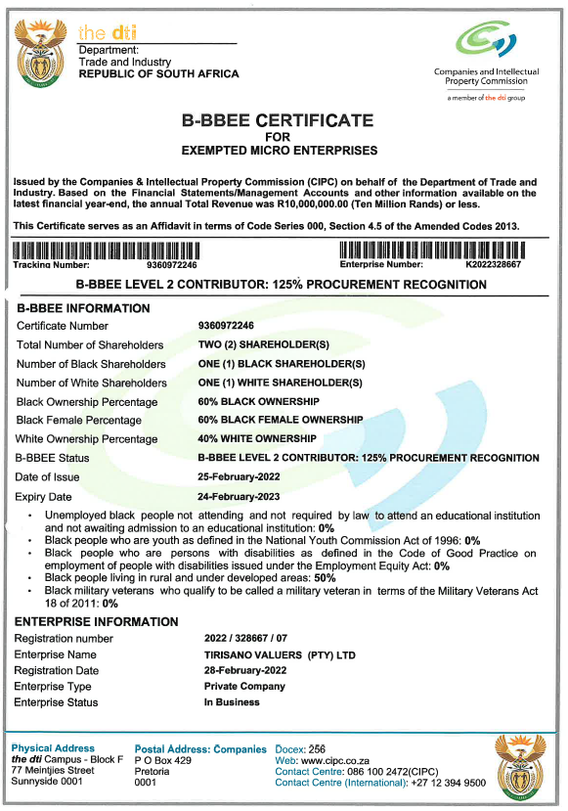
5. Price and preference

Slide 39
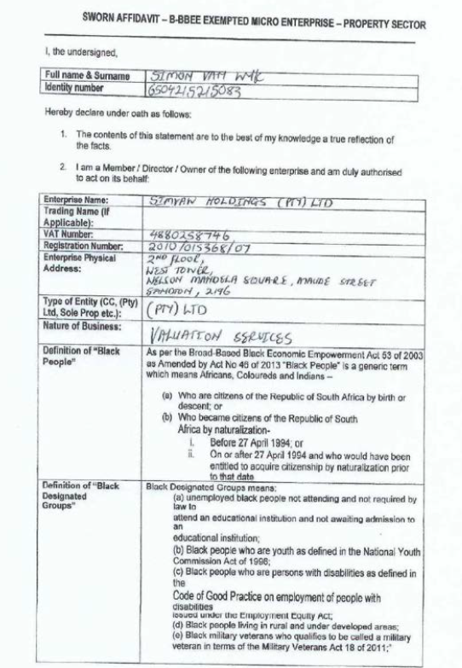
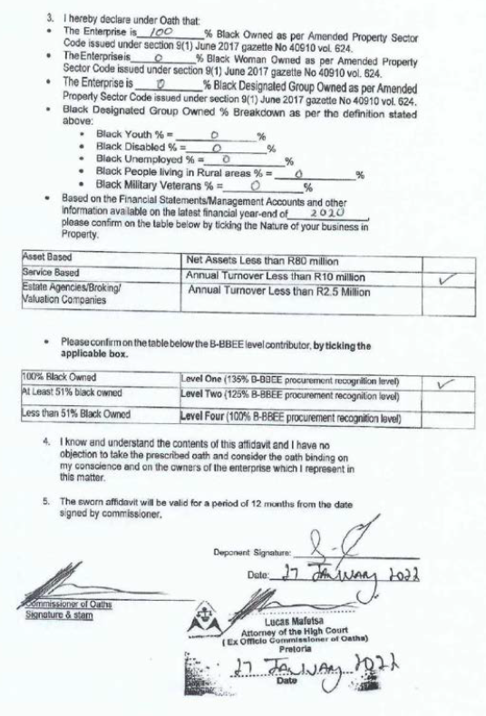
5. Price and preference

Slide 40
6. ATTENDANCE REGISTER & QUESTIONS

