Slide 1
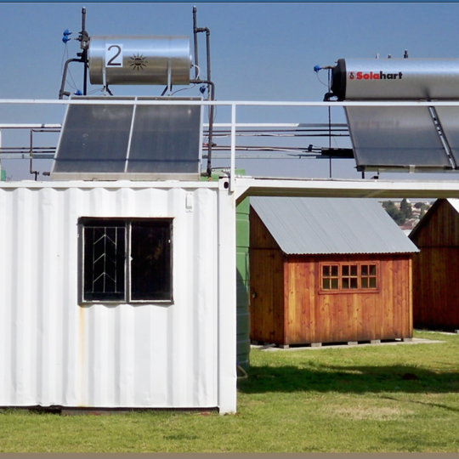
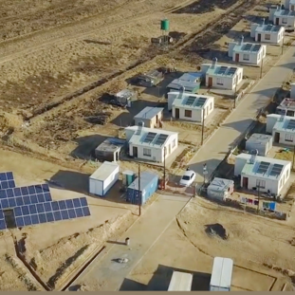
Environmental Requirements for Contractors and Suppliers Working for Matimba Power Station

Slide 2
Background
Matimba is ISO 14001 certified, and its mandate is to maintain the certification through its life cycle.
For Matimba to generate power without harming people and the environment, some of the risk that Matimba carries has been transferred to the contractors. Therefore, it is imperative that contractors and suppliers working for Matimba comply with environmental requirements.
Matimba has appointed more than 50 contractors on site, and each contractor has its specific duty to fulfil as per their scope of work.
Matimba also has 10 departments which must be audited and checked if they comply to the system, and the proof of audits to be kept/documented.
Since Matimba is ISO 14001 certified, all contractors and suppliers appointed to work for Matimba are expected to adopt the standard and comply to its requirements.
It was previously identified that when contracts are placed, provision of the contractor Environmental Officer is always overlooked and that resulted in high-risk environmental impacts.
Furthermore, the Environmental department has recently re-assessed the environmental evaluation criteria to amend the medium and high-risk activities and also cover low risk activities/contracts.

Slide 3
Proposal
The proposed amended activities are classified as follows:
Low risk activity - these are activities that will have a minimal impact on the environment e.g., once-off deliveries and will not require an appointment of the Environmental Officer however documents such as the Environmental Policy, Method Statement, Aspect & Impact (A&I) register will need to be submitted to the Environmental department for evaluation and approval.
Medium risk activity - these are activities that have a potential to impact on the environment and will require an Environmental Coordinator/Rep to be appointed with a basic environmental training i.e., Introduction to Environmental Management System (EMS). These are operational contracts that are 1 to 2 years e.g., cleaning contracts. The following documents are to submitted for evaluation and approval; the Environmental Policy, Method Statement (MS), A&I Register, Environmental Management Plan (EMP), Spillage Procedure and Waste Management Plan (WMP).

Slide 4
Proposal cont…
High risk activity - this involves direct impact to land/water/air/flora/fauna/natural resources and requires environmental licensing or permitting to perform these activities’ and the impact can result to an environmental pollution or contamination that will require rehabilitation and aftercare management, these are operational contracts that are 3 years or more e.g., work undertaken in terms the Environmental Authorisation. The requirements are as follows:
Appointment of the Environmental Officer with at least three (3) years related environmental management experience with Qualification (i.e., National Diploma/Degree/Btech in Environmental Management).
The Environmental Policy, Method Statement (MS), A&I Register, EMP (EMP), Spillage Procedure, WMP, Emergency Preparedness & Response Plan (EPRP) and a list of Hazardous & Chemical Substances.
Note: Contractors shall ensure that funds are allocated for the implementation of environmental requirements.

Slide 5
Risk Category
High Risk Activity
Works which may include but not limited to the following: Installation and maintenance of equipment e.g. transformers Excavation work Blasting Scaffolding Building and modification of infrastructure Civil work which entails construction and maintenance of roads, storage facilities for waste, fuel, oil, vehicles and hazardous substances. Work undertaken in terms of environmental authorisations, e.g. EIA approvals, Waste Use Licenses and/or Atmospheric Emission Licenses. | Maintenance work Ashing, including emergency ashing Coal lashing PF leaks Boiler maintenance Transformer maintenance Refurbishment Cleaning of dams Work undertaken in terms of environmental authorisations, e.g. EIA approvals, Water Use Licences, Waste Use Licences, or Atmospheric Emission Licences Vegetation management Tree felling Bush clearing Gardening or landscaping | Transportation Ash and Coal transportation Haz-chemical and dangerous goods transportation Waste disposal (including hazardous waste and medical waste) Other works Cleaning up of spills and site rehabilitation (depending on scale/scope of work) Working with asbestos material Working with radioactive materials Working in or adjacent to environmentally protected or environmentally sensitive areas, e.g. nature reserves, wetlands, water courses, etc.

Slide 6
Risk Category
Medium Risk Activity
Vehicle maintenance Transportation of goods (low-risk loads) Emergency services Fire and emergency equipment maintenance Technical consulting (done on any of the Eskom sites) Cleaning services (offices, ablution facilities etc.) Supply, delivery and maintenance of electronic equipment
Vehicle maintenance
Transportation of goods (low-risk loads)
Emergency services

Slide 7
Risk Category
Low Risk Activity
Labour broking or providing staff (admin/office-based) Supply, transportation and delivery Consumables and other miscellaneous items Stationery and printing Catering Any scope of work that includes delivery or collection to any of the Eskom premises or sites Services (only where the services are performed or rendered on Eskom premises or sites) Consulting and auditing (admin-based) Training and coaching/mentoring Event management (consulting, planning and logistics)

Slide 8
Benefits
Reduce the number of incidents that occur, which can cost Eskom through liability.
Improve the Environmental Management System.
Save time and resources.
Reduce the risks of non-compliance to the business’ legal obligations.
Lowering business costs through reducing resource consumption and waste production.

Slide 9
Technical Evaluation Links
..\..\..\..\..\..\7.5 Documented Information\7.5.3 Control of documented information\Supplier Evaluations\Copy of Technical Environmental Evaluation Report _High Risk Activity.xlsx..\..\..\..\..\..\
7.5 Documented Information\7.5.3 Control of documented information\Supplier Evaluations\Copy of Technical Environmental Evaluation Report _Medium Risk Activity.xlsx..\..\..\..\..\..\
7.5 Documented Information\7.5.3 Control of documented information\Supplier Evaluations\Copy of Technical Environmental Evaluation Report _Low Risk Activity.xlsx

Slide 10


Thank you

