Slide 1


Technical Clarification _ Environmental Services Provider Tender
28 October 2025

Slide 2
Background
Eskom‘s business has impact on the environment both positively and negatively
Eskom’s aim to reduce its environmental footprint. In so doing it minimise negative environmental impact and reputational implications.
Certified in terms of ISO 14001 and the Policy governs principles and rules to fulfil Eskom’s commitment to people and the environment
Group Capital Division (GCD) key roles - construction and refurbishment of infrastructure
  New built
  Ash Disposal Facilities (ADFs)
  Gas facilities
  Pump Storage Schemes
  Battery Storages
  etc
Environmental Permits & licenses

Slide 3
Scope of work
NB//Detailed Scope of Work attached with the tender, for more information
Environmental Services Provider to integrate with the GCD teams to provide environmental management and compliance services for infrastructure construction projects across GCD.
Service provider to ensure that all environmental aspects of construction activities are managed in full compliance with South African environmental legislation, permit conditions, and best industry practices.
Environmental management services required are in two main categories namely: Generalised and Specialised services
A task order based approach - each task order will contain a specific scope of work for the provision of services.
Focus on skills and knowledge transfer

Slide 4
Scope of work Continue…
Service provider is expected to
Assist with the review, gap analysis and recommendations to ensure environmental compliance with all applicable legislation, including but not limited to the National Environmental Management Act (NEMA), National Water Act, and relevant municipal by-laws.
Development and Implementation of an Environmental Management system that is ISO 14001 certifiable.
Assist GCD teams to mitigate environmental impacts during construction activities.
Support GCD in achieving environmental sustainability and regulatory compliance objectives.
Assist in maintaining good relationships with local communities and stakeholders through proper environmental management.

Slide 5
Scope of work Continue…
Service provider is required to have knowledge and expertise in the following field
Coal Fired Technologies.
Hydro and Pumped Storage Technology.
Open or Combined Cycle Gas Turbines Technology.
Heat Recovery Steam Generator Power Technology.
Renewables Technologies.
Energy Storage Technologies.
Emissions Abatement Technologies.

Slide 6
Scope of work Continue…
Civil and structural design applicable to specific Technologies.
Power Transmission and Distribution engineering, technologies for infrastructure development and execution and associated works.
Marine Environmental adherence.
Commercial Property.
Gas Power Generation Technologies.
Pipelining technologies (water, gas etc.).
Mining Technology and developments.
Existing building infrastructure refurbishment enhancement and modernisation.
IT/OT.
Nuclear.

Slide 7
Scope of work Continue…
Generalised and Specialist services:
Specialist services – such as Contaminated land studies, Dust falls out monitoring, Aquatic ecology.
Generalised services - Assessments and Audits such as
    Environmental impact assessment.
    Environmental and Social Impact Assessment
    Basic assessment.
    EMPr Audits
    WUL Audits
    ISO 14001 audits

Slide 8
Scope of work – Key required resources
Environmental Managers.
Master environmental specialists (technical).
Chief/Senior environmental advisors (technical).
Attorneys with specialisation in environmental issues

Slide 9
Deliverables
The Service Provider shall provide the following deliverables, at minimum:
Environmental Management Plans.
Environmental Impact Assessments.
Environmental Authorisations.
Environmental Compliance Audit Reports (monthly or as agreed).
Specialist Environmental Reports to support Licensing.
Environmental Monitoring Reports.
Incident and Non-Compliance Reports.
Waste Management Logs and Disposal Certificates.
Training Attendance Records and Materials.

Slide 10
Technical Tender returnables – Mandatory criteria
Non-negotiable baseline requirements. In order for a bid to proceed to the function evaluation, the bid must obtain all "yes" for the Mandatory criteria, should the bid obtain a "no" it will not proceed to the functional evaluation round.
Criteria | Source of evidence
Must have placed qualified Environmetal skilled resources in a minimum of six of the specified technologies outlined in the scope of work, from 2019 to current. | Reference Letter on a the client's company letter head confirming:
 | a) Contract number and completion date
a) Coal Fired Technologies | b) Scope of work (High level relevant to listed technologies
b) Hydro and Pumped Storage Technology | c) was the scope successfully completed
c) Open or Combined Cycle Gas Turbines Technology | d) work was executed in the period from 2019 to current
d) Heat Recovery Steam Generator Power Technology | e) Letter to be signed and dated.
 | f) reference contact details to be on the letter.
e) Renewables Technologies
f) Energy Storage Technologies
h) Emissions Abatement Technologies (Carbon Capture, Low Nox burners, etc)
i) Power Transmission and Distribution engineering, technologies for infrastructure development and execution and associated works
j) Marine Environmental
k) Commercial Property
l) Gas Power Generation Technologies
m) Pipelining technologies (water, gas etc.)
o) Mining Technology and developments
p) Existing building infrastructure refurbishment enhancement and modernisation.

Slide 11
Technical Tender returnables – Mandatory criteria
Criteria | Source of evidence
Have a local registered presence in South Africa | Provide proof of CIPC number registration such as
 | a)CoR 14.3 b) CoR 14.1 c) Memorandum of incorporation d) CoR 9.4
Have a local office in South Africa | a) Copy of valid lease agreement
 | b) Current Utility bill in the company's name
Evidence of scalable multidisciplinary resource pool and mobilisation of critical skills. | Bidder to provide the following proof
 | a) References demonstrating successful delivery of the full spectrum of project environmental services. (Min 2) . From 2019 to current
 | b) Documentation of scalable resource pools; examples of rapid mobilisation for large/complex projects.
 | c) Evidence of active talent sourcing, onboarding, and step by step process for mobilisation including timelines; examples of deploying both generalist and specialist talent

Slide 12


Technical Tender returnables – Functional criteria

Slide 13
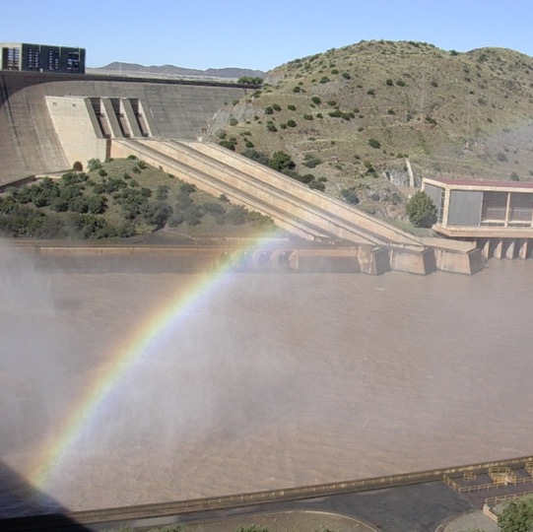

Conclusion

