Slide 1
HOAC-VAR-52627
REQUEST FOR PROPOSAL (RFP) FOR THE SUPPLY AND DELIVERY OF
CORPORATE UNIFORM CLOTHING TO TRANSNET RAIL INFRASTRUCTURE
MANAGER AND CORPORATE SECURITY UNIFORM TO TRANSNET SOC
OPERATING DIVISIONS ON AN “AS AND WHEN REQUIRED BASIS” FOR A
PERIOD OF FIVE (05) YEARS.
Date: 15 October 2025
Time: 10:00am
1

Slide 2
Content
Discussion Presenters
Welcome Brenda Baloyi
Safety Briefing Lerothodi Moramang
Introduction Brenda Baloyi
Ground rules Brenda Baloyi
RFP timelines Brenda Baloyi
Scope of work Cor du_Plooy
Evaluation Criteria Brenda Baloyi
Specific Goals Lindokuhle Qangule

Slide 3
Ground Rules
Attendees are to ensure that their speakers are on mute
RFP document will not be issued in this meeting
Late comers will be allowed however information will not be repeated for their benefit.
Questions will be allowed by raising a hand after every section of the presentation –Procurement, Technical and Specific Goals
The meeting is recorded, minutes and presentation will be published on NT e-tender portal.
Attendees are required to remain for the entire briefing session as important information pertaining to the RFP will be presented.

Slide 4
RFP Timelines
Timelines
ISSUE DATE: 07 October 2025
Briefing Session: 15 October 2025 10:00 AM
Clarification deadline 18 November 2025 16:00 ( Page 9 of the RFP document)
Closing Date: 25 November 2025
Closing Time: 10:00 AM
Closing address Via electronic tender submission system
Bid Validity Period: 14 August 2026
Each company must register its profile using its company details and use the corresponding registered profile to log an intent to bid as well as submitting any bid. (Page 7 of the RFP document)

Slide 5
Technical Points
Bidders are to note the following clauses 3, 4 and 5 under section 3.
Clause 3: Scope of Requirements
Bidders have an option to choose the category which they are tendering for. Bidders must price all items on the selected category.
Clause 4: Technical Requirements
Bidders will be required to submit a complete (all pages and valid) South African National Accreditation System (SANAS) Accredited Manufacturing Capability Report with the bid documents. The report must make reference to each of the specific clothing items being tendered for.
In the event that the bidder is not the actual manufacturer, the bidder will be disqualified and will not progress to further stages of the bid adjudication.
Clause 5: Special Conditions

Slide 6
Technical Points
Clause 5: Special Conditions
5.3 Pre-Assessment samples are not required at the tendering stage. The preferred bidder will be required to submit samples within 30 days of acceptance. The preferred bidder will be required to submit two samples of different sizes e.g., size 87 and 102. In the event of non-garment items (socks, caps, badges belts, neck ties & scarfs) two of each different item to be submitted. When the samples are approved, one sealed sample will be returned for reference purpose. It will also be required that a QA report accompany the samples
Samples must be fully compliant i.e., Logo requitements and Labelling requirements. Specification 286.21 (LAB) In the event of Category 6 -10, the item number must be displayed on the packaging.
For those who are not acquainted with the Transnet items, please note each different size (garments / shoes) do have a different item number; therefore, must be aligned accordingly.

Slide 7
Technical Points
Clause 5: Special Conditions
The successful bidder will be allowed to borrow samples.
Samples can be viewed by appointment at Warehouse 762 Langlaagte.
Also, as a reminder, take note of the garment and bulk packaging requirements of Transnet. (Specification 286.21 (PAC)
Note: Categories 7 (catalogue item 52 & 53) & Category 9 (Catalogue item 40 & 41) These are Security items, the color is Black and not Blue as per the description.

Slide 8
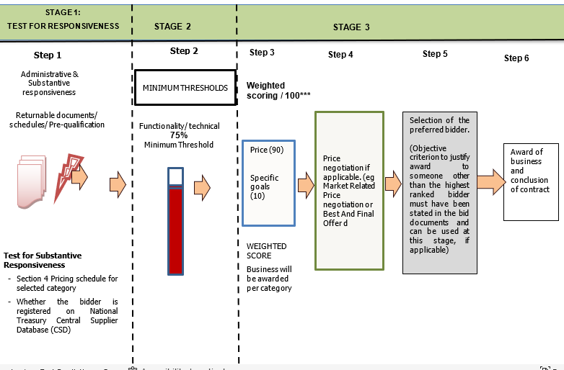
Evaluation Methodology

Slide 9
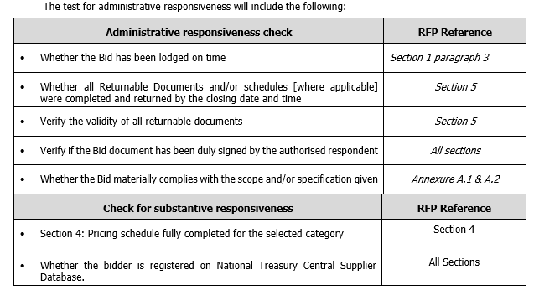
  STEP ONE: Test for Administrative and Substantive Responsiveness

Slide 10
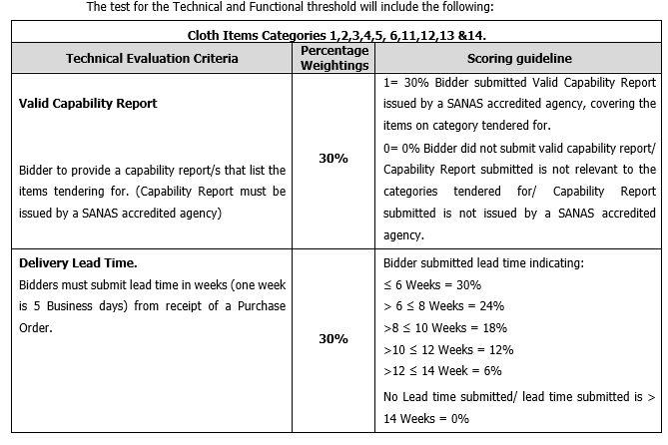
  STEP TWO: Minimum Threshold 75% for Technical Criteria

Slide 11
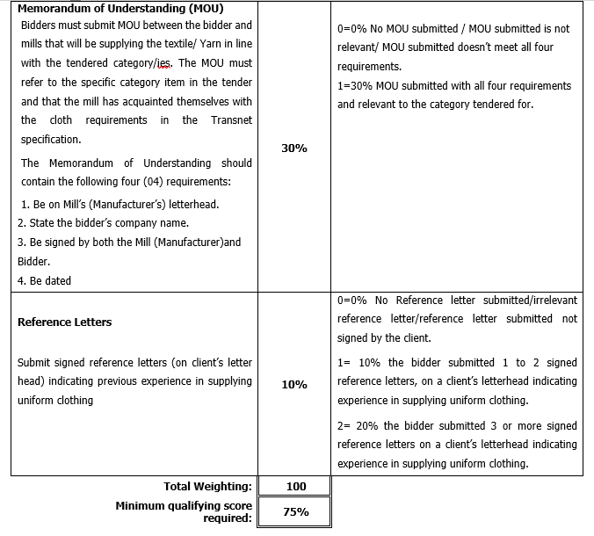
  STEP TWO: Minimum Threshold 75% for Technical Criteria

Slide 12
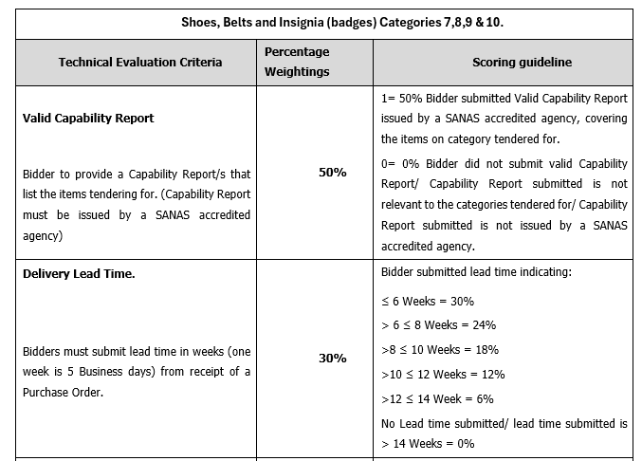
  STEP TWO: Minimum Threshold 75% for Technical Criteria

Slide 13
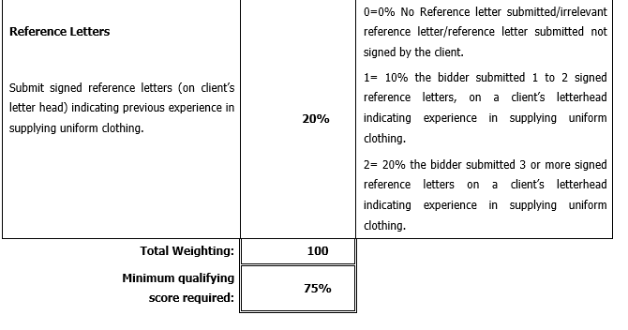
  STEP TWO: Minimum Threshold 75% for Technical Criteria

Slide 14
Pricing Schedule
NB: Bidders have the option to choose which category/s they want to tender for; bidders can choose to bid for all categories. All items per category on the price schedule(s) must be priced for and failure to do so will result in bidders to being disqualified for the specific category.

Slide 15
Returnable Documents
MANDATORY RETURNABLE DOCUMENTS | SUBMITTED [Yes/No]
SECTION 4: Pricing and Delivery Schedules completed in full for the tendered category

Slide 16
Returnable Documents
RETURNABLE DOCUMENTS USED FOR SCORING | SUBMITTED [Yes or No]
ANNEXURE B – Declaration Certificate for Local Production and Content [SBD6.2] (SBD6.2 must be completed and submitted even if a complete Local Content exemption letter from DTI has been obtained)
ANNEXURE C – Local Content Declaration: Summary Schedule (Annexure C must be completed and submitted even if a complete Local Content exemption letter from DTI has been obtained)
B-BBEE Certificate / Sworn- Affidavit / B-BBEE CIPC Certificate (in case of JV, a consolidated scorecard will be accepted) as per DTIC guideline
Delivery lead time
Valid Manufacturing Capability report issued SANAS approved accreditation agency (In line with the category tendered for)
Reference letters
Memorandum of Understanding (MOU)
SECTION 10: Job-Creation Schedule

Slide 17
Returnable Documents
ESSENTIAL RETURNABLE DOCUMENTS & SCHEDULES | SUBMITTED [Yes or No]
In the case of Joint Ventures, a copy of the Joint Venture Agreement or written confirmation of the intention to enter into a Joint Venture Agreement
Latest Financial Statements signed by your Accounting Officer or latest Audited Financial Statements plus 2 previous years
SECTION 1: SBD1 Form
SECTION 5 : Proposal Form and List of Returnable documents
SECTION 6 : Certificate Of Acquaintance with RFP, Terms & Conditions & Applicable Documents
SECTION 7 : RFP Declaration and Breach of Law Form
SECTION 9 : B-BBEE Preference Claim Form
SECTION 11: Protection of Personal Information
ANNEXURE D – Imported Content Declaration: Supporting Schedule to Annexure C
ANNEXURE E – Local Content Declaration: Supporting Schedule to Annexure C
ANNEXURE A.1: CORPORATE UNIFORM CLOTHING SPECIFICATIONS AND CATALOGUE
ANNEXURE A.2: CORPORATE SECURITY UNIFORM SPECIFICATIONS AND CATALOGUE

Slide 18
Returnable Documents
ESSENTIAL RETURNABLE DOCUMENTS & SCHEDULES | SUBMITTED [Yes or No]
ANNEXURE D: IMPORTED CONTENT DECLARATION - SUPPORTING SCHEDULE TO ANNEX C
ANNEXURE E: LOCAL CONTENT DECLARATION - SUPPORTING SCHEDULE TO ANNEX C
ANNEXURE G: TRANSNET’S GENERAL BID CONDITIONS
ANNEXURE H: MASTER AGREEMENT
ANNEXURE I: TRANSNET’S SUPPLIER INTEGRITY PACT
ANNEXURE J: NON-DISCLOSURE AGREEMENT
Valid letter of good standing from the department of labour.
CSD registration report
Tax Clearance Certificate or electronic access PIN obtained from SARS’s new Tax Compliance Status (TCS) system [Consortia / Joint Ventures must submit a separate Tax Clearance Certificate for each party]

Slide 19
QUESTIONS?

Slide 20
THANK YOU

