Slide 1
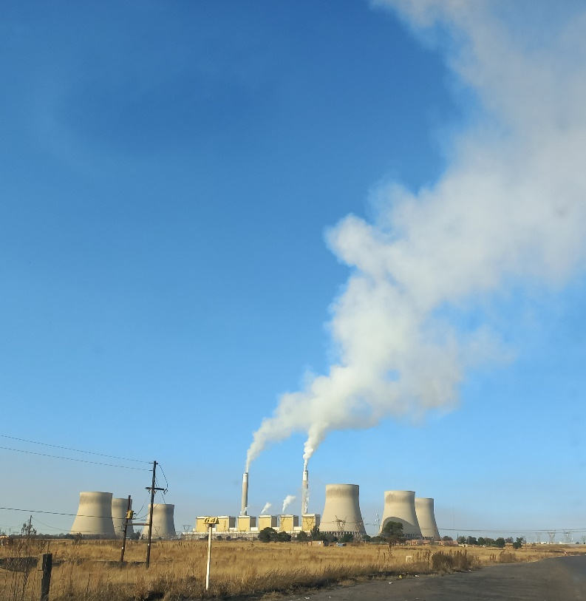
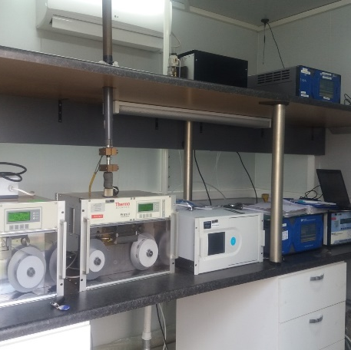
Tender clarification- Monitoring hut
RT&D
November 2025

Slide 2
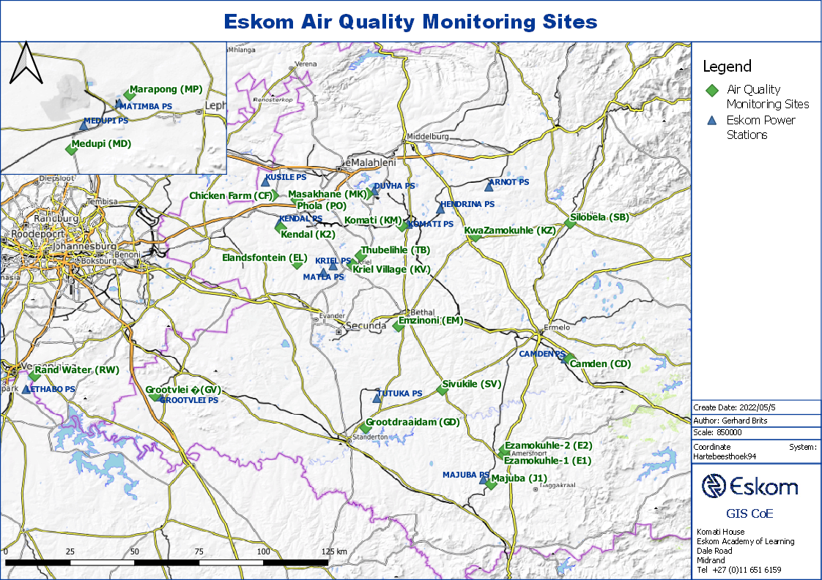
ESKOM AQ MONITORING NETWORK

Slide 3
Description
  Brand new build AQM hut {3m (breadth) x 4m (length) x 2.5m (Height)} and a door.
  Fully electrified hut with UPS Distribution board (DB board) (10 plugs) and RAW/MAINS Distribution board (DB board) (10 plugs) with Certificate of Compliance (COC). Output power for plugs must be 220Vac.
  Two outside sport lights (one in front and one at the back) and inside fluorescent tube lights.
  Two Bench tops for Analyser instruments (No rack mount).
  Fully installed and functional tests done, 24000Btu Air conditioner (work to be completed when the hut is sited)
  Portable fire extinguisher suitable for the hut
  Step ladder and fall protection roof racks
The hut must be delivered fully completed with the components (complete sample manifold with six ¼ inch inlets) and equipment required installed. Therefore, ready to use shelter.

Slide 4
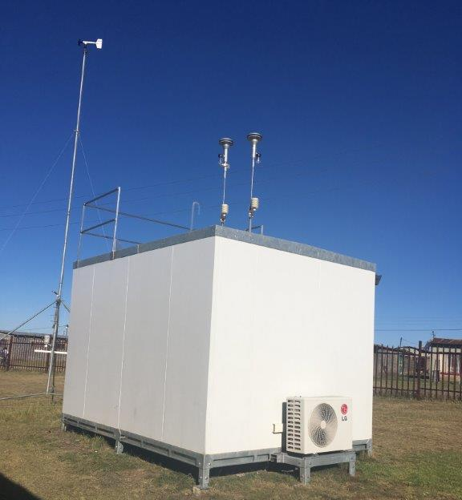
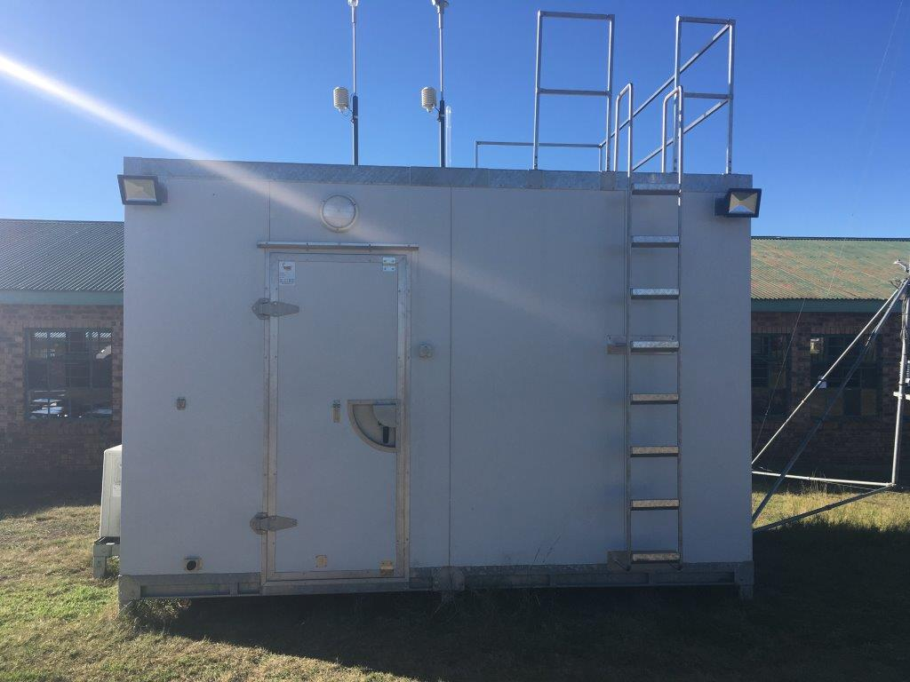
AIR QUALITY MONITORING SHELTER
Front
Rear/side

Slide 5

AIR QUALITY MONITORING EQUIPMENT

Slide 6

AIR QUALITY MONITORING EQUIPMENT

Slide 7
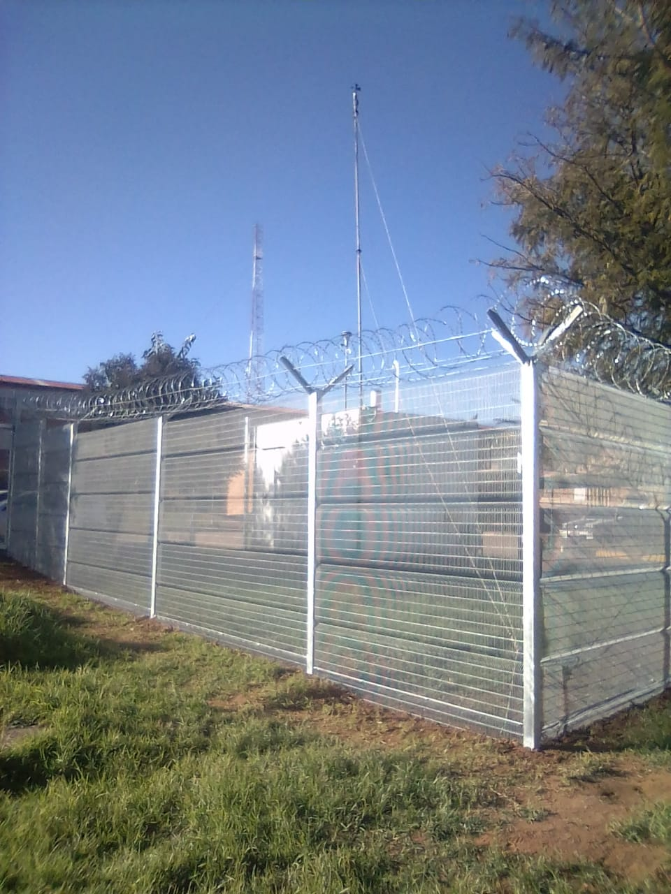
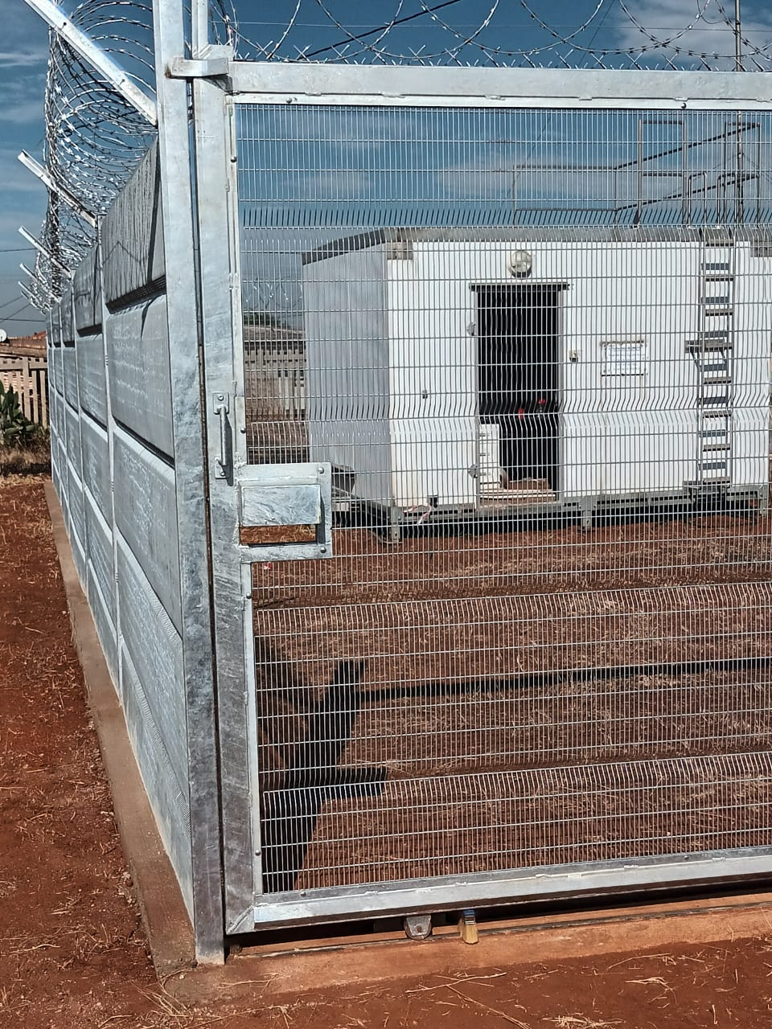
High Mesh Fence with Overhang

Slide 8
Technical evaluation strategy
Submit the brochure/brochures and pictures of the monitoring hut including associated features -60%
Guarantee-15%
References of previous work/ supplies of monitoring huts-25%

Slide 9
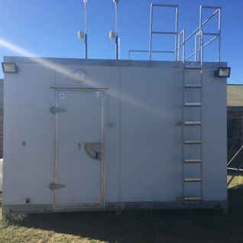
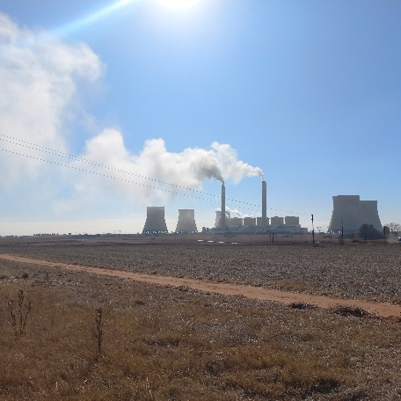
End

