Slide 1
NON-COMPULSORY VITUAL BRIEFING (on-line) SESSION FOR THE ESTABLISHEMENT OF AN APPROVED LIST OF SERVICE PROVIDERS FOR THE PROVISION OF LEGAL SERVICES ON AN “AS AND WHEN” REQUIRED BASIS, FOR A PERIOD OF FIVE (5) YEARS. TCC/2024/05/0001/65599/RFP
DATE: 23 May 2025
Notes:
Growth and Reinvent

Slide 2
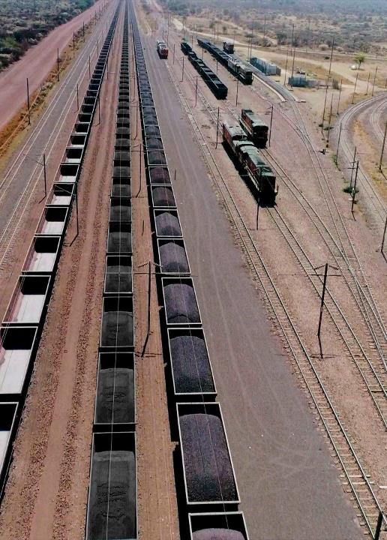
Agenda
Slide No.
Topic
Presenter
3
Welcome and Introduction
Busi Chabalala
4 - 6
Key Points to Highlight and General Information
Lerato Ramoyada/Vukosi Chauke
7 - 8
Scope of Services
Tendani Mphaphuli
9 - 12
B-BBEE Requirements
Sikhonzele Gqaleni
13 -18
Evaluation Methodology
Busi Chabalala/ Lerato Ramoyada
19
Technical Evaluation
Tendani Mphaphuli
20 - 21
Commercial Requirements
Tshephisho Mahloana
22- 24
Continuity of the Evaluation Process stage 5, 6 and 7
Busi Chabalala
2

Slide 3
Welcome, Introduction and Safety Briefing
Team
Welcome the bidders
Transnet attendee to briefly introduce themselves
Safety Briefing
General Disclaimer: Respondents will be given an opportunity to ask questions at the end.
All verbal questions must be put in writing on the RFP Clarification form (Section 8) and Transnet will provide a written response. No verbal feedback must be construed as binding until in writing.

Slide 4
Key Points - General (1/2)
Please note the following submission requirements, but not limited to:
The RFP and all the supporting documents may still be downloaded directly from National Treasury’s e-Tender Publication Portal at www.etenders.gov.za and Transnet website, free of charge.
Respondents who wish to respond to this RFP as a Joint Venture [JV] or consortium with B-BBEE entities, must state their intention to do so in their RFP submission. Such respondents must also submit a signed JV or consortium agreement between the parties clearly stating the percentage [%] split of business and the associated responsibilities of each party.
The RFP closes punctually at 12:00 PM on 17 June 2025. Respondents must ensure that bids are uploaded timeously onto the system.
The Respondents that submits a bid must be the same as the Respondents that submitted an intent to log a bid, failing which it will result in disqualification.
Bid validity period is 180 Business Days from Closing Date.
Respondents RFP proposal must sign documents [sign, stamp and date the bottom of each page] before uploading them on the system. The person or persons signing the submission must be legally authorised by the respondent to do so.
Respondents must register on the National Treasury’s Central Supplier Database (CSD) prior to submitting/uploading their bids. Business may not be awarded to a Respondent who has failed to register on the CSD, only foreign suppliers with no local registered entity need not register on the CSD.

Slide 5
Key Points - General (2/2)
Communication relating to this RFP:
  After the briefing session, should Respondents have more questions, RFP Clarification Request Form (Section 8) should be submitted onto the system, and sent to Busi.chabalala@transnet.net and copy lerato.Ramoyada@transnet.net before or on 02 June 2025.
  In the interest of fairness and transparency, Transnet’s response to such a query will be published on the National Treasury e-tender portal and Transnet website.
  Respondents are required to ensure that all clarification questions are sent to Transnet before the clarification closing date and time in order to allow Transnet sufficient time to respond to all clarification questions.
  It is prohibited for Respondents to attempt, either directly or indirectly, to canvass any officer or employee of Transnet in respect of this RFP between the closing date and the date of the award of the business.
  Respondents found to be in collusion with one another will be automatically disqualified and restricted from doing business with organs of state for a specified period.
  Transnet will publish the outcome of this RFP in the National Treasury e-tender portal and Transnet website with 10 days after the award has been finalised. Respondents are required to check the National Treasury e-tender Portal and Transnet website for the results of the tender process

Slide 6
Key Points: PROPOSAL SUBMISSION
Transnet has implemented a new electronic tender submission system, the e-Tender Submission Portal, in line with the overall Transnet digitalization strategy where suppliers can view advertised tenders, register their information, log their intent to respond to bids and upload their bid proposals/responses on to the system.
The Transnet e-Tender Submission Portal can be accessed as follows:
Log on to the Transnet eTenders management platform website/ Portal (transnetetenders.azurewebsites.net)
Click on “ADVERTISED TENDERS” to view advertised tenders.
Click on “SIGN IN/REGISTER –to register new bidder information and ensure that all mandatory information is completed) OR.
to sign in if already registered.
Toggle (click to switch) the “Log an Intent” button to submit a bid.
Submit bid documents by uploading them into the system against each tender selected.
Respondents are to submit bid documents by uploading them onto the Transnet system against each tender selected. A Bidder can upload 30mb per upload and multiple uploads are permitted.
Bidders should ensure that electronic bid submissions are submitted at least a day before the closing date and bidders should not wait for the last hour before the deadline to submit. This is to enable them to timeously address issues which they may encounter due to internet speed, bandwidth, or the size of the number of uploads being submitted. Transnet will not be held liable for any challenges experienced by bidders because of their own technical challenges.
No late submissions will be accepted. The bidder guide can be found on the Transnet Portal transnetetenders.azurewebsites.net.
Each company must register its own profile using its company details and use the corresponding registered profile to log an intent to bid as well as submitting any bid.

Slide 7
Scope of Requirements
Annexure A1:
select the relevant area(s) of Legal Disciplines that your firm wishes to tender for.
Areas of Legal Disciplines | Tick (Category tendering for)
1. Labour Law
2. Litigation (Including Dispute Resolution)
3. Litigation in the Special Tribunal and civil recovery litigation
4. Public Policy and Regulatory Law
5. Commercial Law, Contractual Law
6. Constitutional and Administrative law
7. Legal due diligence
8. Project Finance
9. Rail Reform
10. Maritime Law and Marine Insurance Law
11. Environmental Law
12. Insurance Law
13. Property / Conveyancing Law
14. Aviation Law
15. Competition Law
16. Copyright and Intellectual Property Law
17. Construction Law (NEC3 Contracts)
18. Media Law
19. Tax law, Customs & Excise Duties
20. Public & Private International Law
21. Collections and Collection Management

Slide 8
Scope of Requirements
Annexure A of the RFP: Scope of Requirements

Slide 9
B-BBEE Certificate & JV
B-BBEE Certificate & Sworn Affidavit
Generic Certificate issued by SANAS accredited verification agency
QSE Some of their certificate issued by SANAS accredited verification agency
Sworn Affidavit signed by the authorized deponent representative and attested by a Commissioner of Oaths confirming annual turnover and black ownership (only black-owned QSEs - 51% to 100% Black owned)
Sworn affidavits must substantially comply with the format that can be obtained on the DTI’s website at www.dti.gov.za/economic_empowerment/bee_codes.
JOINT VENTURES OR CONSORTIUMS
Respondents who would wish to respond to this RFP as a Joint Venture [JV] or consortium with B-BBEE entities:-
This written confirmation must clearly indicate the percentage [%] split of business and the responsibilities of each party. In such cases, award of business will only take place once a signed copy of a JV or consortium agreement is submitted to Transnet.
Joint venture or Consortium means an association of persons for the purpose of combining their expertise, property, capital, efforts, skill and knowledge in an activity for the execution of a contract.
JV EVALUATIONS
A trust, consortium or joint venture (including unincorporated consortia and joint ventures) must submit a consolidated B-BBEE Status Level verification certificate for every separate bid.
A tenderer failing to submit proof of B-BBEE status level of contributor or is a non-compliant contributor to B-BBEE may not be disqualified, but-
(a) may only score points out of 90 for price; and (b) scores 10 points applying the 90/10 principle . Refer PPPFA No. 40553 for more info on preference point

Slide 10
B-BBEE Level 1-2
The new PPPFA regulations effective 01 April 2017 states that, if feasible, a specific goals can be set to advance certain designated groups by advertising the bid with a with a stipulated minimum B-BBEE status level.
Transnet conducted Market research and identified the B-BBEE Levels of the service providers that could potentially provide Transnet with services:
Therefore, Transnet recognizes this, and it is Transnet’s internal decision to set a minimum B-BBEE Level 2, to continue to support these transformation.
Based on the market research , Transnet will allocate preferential procurements points to B-BBEE level 1 and 2 contributors.

Slide 11
Preferential Procurement Regulations 2022
PPPFA provides for a preference points system in terms of which contracts below a prescribed value be evaluated on the basis that 10/20 out of 100 possible points must be allocated to “specific goals” and 90/80 points allocated to price.
For contracts above a prescribed value, 10/20 out of 100 possible points must be allocated to “specific goals”, and 90/80 points allocated to price
The applicable preference point system as envisaged in the regulations 4, 5, 6 or 7.
The specific goal in the invitation to submit the tender for which a point may be awarded, and the number of points that will be awarded to each goal, and proof of the claim for such goal .
80/20 preference point system for acquisition of goods or services with Rand value equal to or below R50 million
90/10 preference point system for acquisition of goods or services with Rand value above R50 million
Bidders who do not submit B-BBEE Status Level Verification Certificates or applicable affidavit copy will be deemed as non-compliant contributors to B-BBEE will score zero for preference points .
This also applies to Bidders who submit letters or expired certificates indicating that their B-BBEE status is in the process of being verified. Where a B-BBEE certificate is to be used for scoring purposes only, such letters indicating that their B-BBEE status is in the process of being verified or expired certificates are submitted, bidders will be scored zero for preference points.

Slide 12
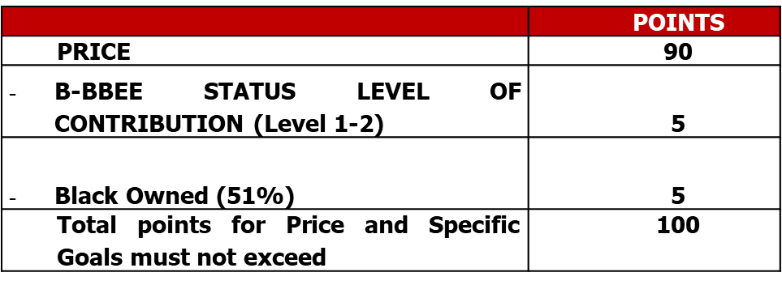
Preferential Procurement Designated Groups
Priority will be given to the specific goals to advance areas or categories of persons or groups who were previous disadvantaged. Through the market analysis done using CSD, google and previous tenders the following specific goals will be applicable for this tender:
Promotion of Broad-Based Black Economic Empowerment Status level 1-2.
Black Owned (51%)

Slide 13
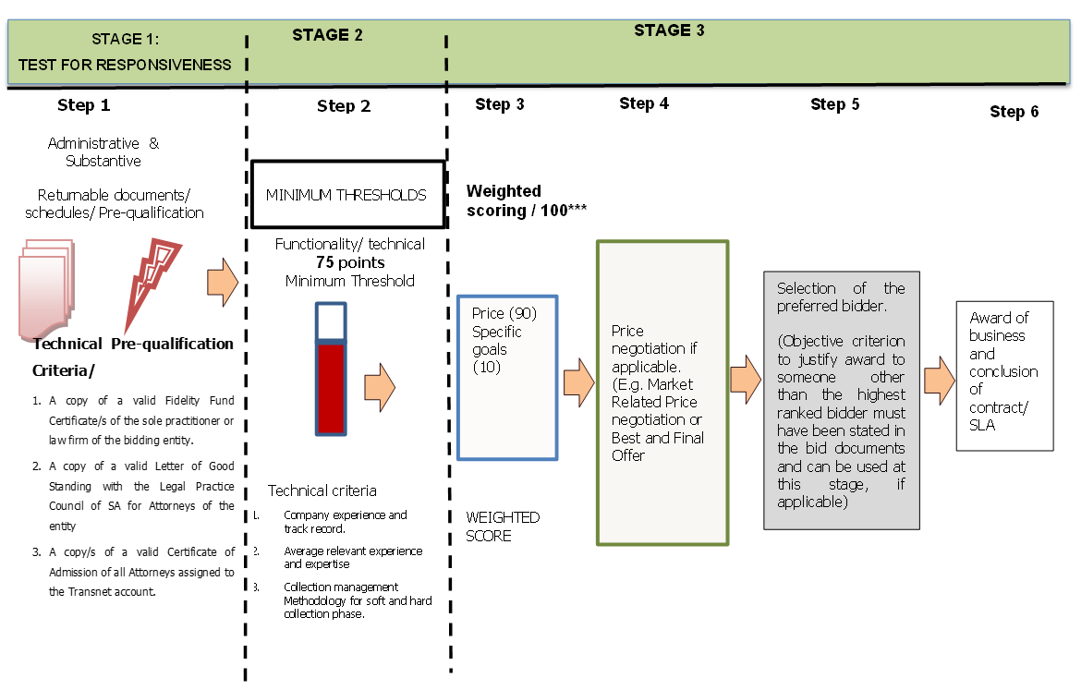
Transnet’s Evaluation Methodology

Slide 14
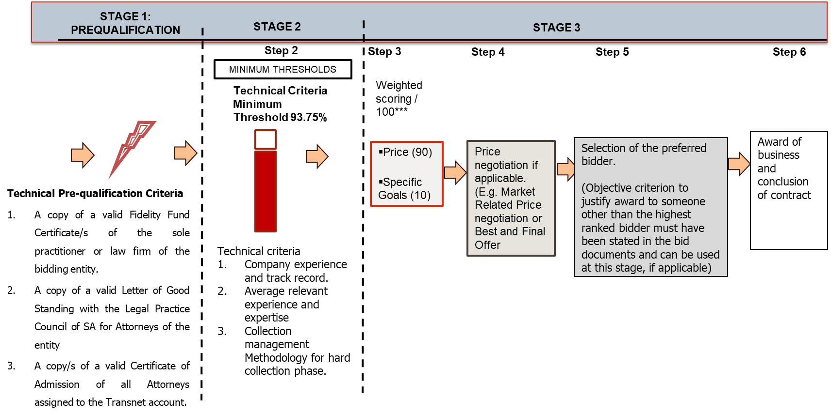
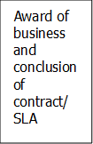
Transnet’s Evaluation Methodology for Collections, Collection Management
Step 1
Administrative & Substantive responsiveness
Returnable documents/ schedules/ Pre-qualification

Slide 15
Step One: Administrative and Substantive Responsiveness
Administrative & Substantive responsiveness check | RFP Reference
Whether the Bid has been lodged on time | Section 1 paragraph 3
Whether all Returnable Documents and/or schedules [where applicable] were completed and returned by the closing date and time | Section 5
Verify the validity of all returnable documents | Section 5
Verify if the Bid document has been duly signed by the authorised respondent | All sections
Whether any general and legislation qualification criteria set by Transnet, have been met | All sections including: Section 2 paragraphs, 2.2, 6, 11.2, General Bid Conditions clause 20
• Whether the Bid contains a priced offer | Annexure C– Pricing Schedule and Section 4
Whether the Bid materially complies with the scope and/or specification given | All Sections
Whether any Technical Pre-qualification Criteria/minimum requirements/legal requirements have been met as follows: A copy of a valid Fidelity Fund Certificate/s of the sole practitioner or law firm of the bidding entity. A copy of a valid Letter of Good Standing with the Legal Practice Council of SA for Attorneys of the entity A copy/s of a valid Certificate of Admission of all Attorneys assigned to the Transnet account. | Annexure A - Scope of Work

Slide 16
Step One: Administrative and Substantive Responsiveness
Step : Procurement conducts evaluations to highlight non-responsive (non-compliant) bids and attempts to obtain outstanding documentation from respondents prior to declaring them non-responsive and eliminating bids
1
Mandatory Returnable Documents | Yes/No
Annexure C: Pricing Schedule
A copy of a valid Fidelity Fund Certificate/s of the sole practitioner or law firm of the bidding entity.
A copy of a valid Letter of Good Standing with the Legal Practice Council of SA for Attorneys of the entity
A copy of a valid Certificate of Admission of all Attorneys assigned to the Transnet account.
Failure to provide all these Mandatory Returnable Documents at the Closing Date and time of this RFP will result in a Respondent’s disqualification.

Slide 17
Step One: Administrative and Substantive Responsiveness
RETURNABLE DOCUMENTS USED FOR SCORING | SUBMITTED [Yes or no]
Respondent’s valid proof of evidence to claim points for compliance with Specific Goals’ requirements as stipulated in Section 9 of this RFP
Reference letter template (for each Area of Discipline tendering for)
Reference letters (for each Area of Discipline tendering for)
Key Personnel/ Team (for each proposed key personnel/team)
CV’s template (for each proposed key personnel/team)
Collection Management Methodology for soft and hard collection phase. (for Collection )

Slide 18
Step One: Administrative and Substantive Responsiveness
ESSENTIAL RETURNABLE DOCUMENTS & SCHEDULES | SUBMITTED [Yes or no]
In the case of Joint Ventures, a copy of the Joint Venture Agreement or written confirmation of the intention to enter into a Joint Venture Agreement
SECTION 1: SBD1 Form
SECTION 4 : Delivery Schedule
SECTION 5 : Proposal Form and List of Returnable documents
SECTION 6 : Certificate Of Acquaintance with RFP, Terms & Conditions & Applicable Documents
SECTION 7 : RFP Declaration and Breach of Law Form
SECTION 9: Specific Goals Points Claims Form
SECTION 10: Job Creation Schedule
SECTION 11: Protection of Personal Information
ANNEXURE A1: LEGAL DISCIPLINES (Bidder to tick for each Area of Disciplines tendering for)
ANNEXURE D: Draft Service Level Agreement
ANNEXURE E: TRANSNET’S General Bid Conditions
ANNEXURE F: TRANSNET’S Supplier Integrity Pact
ANNEXURE G: Non- Disclosure Agreement
ANNEXURE H: Supplier Declaration Form

Slide 19
Step Two: Technical Desktop Evaluation
Technical Evaluation Criteria | Points Weightings | RFP Reference
Company experience and track record of similar projects undertaken for the category of legal services tendering for | 50 | Appendixes 1 to 20 discipline
Average relevant experience and expertise of the team | 50 | Appendixes 1 to 20 discipline
Total Weighting: | 100
Minimum qualifying score required: | 75
Technical Evaluation Criteria | Points Weightings | RFP Reference
Company experience and track record of similar projects undertaken for the category of legal services tendering for | 50 | Appendix 21 for Collections and Collection Management
Average relevant experience and expertise of the team | 50 | Appendix 21 for Collections and Collection Management
Collection management Methodology for hard collection phase. | 25 | Appendix 21 for Collections and Collection Management
Total Weighting: | 125
Minimum qualifying score required: | 93.75

Slide 20
Step Three: Evaluation and Final Weighted Scoring
Transnet will utilise the following formula in its evaluation of Price:
  Where:
  Ps = Score for the Bid under consideration
  Pt = Price of Bid under consideration
  Pmin = Price of lowest acceptable Bid
PS = 90 $\left(1−\frac{Pt−Pmin}{Pmin}\right)$
Respondents are to note that Transnet will round off final Price scores to the nearest 2 (two) decimal places.

Slide 21
Step Four: Weighted Scoring
Broad-Based Black Economic Empowerment criteria [ Weighted score 10 points]
B-BBEE evaluation in the final stages of evaluation and will be based on the Bidders B-BBEE scorecard.
    Minimum B-BBEE Level 1-2 accreditation in new codes required as a B-BBEE minimum level .
    B-BBEE - current scorecard / B-BBEE Preference Points Claims Form B-BBEE - current scorecard / B-BBEE Preference Points Claims Form
Preference points will be awarded to a bidder for attaining the B-BBEE status level of contribution in accordance with the table indicated below:
 | POINTS
PRICE | 90
B-BBEE STATUS LEVEL OF CONTRIBUTION (Level 1-2) | 5
Black Owned (51%) | 5
Total points for Price and Specific Goals must not exceed | 100

Slide 22
Step Five : Post Tender Negotiations (if applicable)
Respondents are to note that Transnet may not award a contract if the price offered is not market-related. In this regard, Transnet reserves the right to engage in PTN with the view to achieving a market-related price or to cancel the tender.
In the event of any Respondent being notified of such short-listed/preferred bidder status, his/her bid, as well as any subsequent negotiated best and final offers (BAFO), will automatically be deemed to remain valid during the negotiation period and until the ultimate award of business.
Should Transnet conduct post tender negotiations, Respondents will be requested to provide their best and final offers to Transnet based on such negotiations. Where a market related price has been achieved through negotiation, the contract will be awarded to the successful Respondent(s).

Slide 23
Step Six : Objective Criteria
Transnet reserves the right to award the business to the highest scoring bidder/s unless objective criteria justify the award to another bidder. The objective criteria Transnet may apply in this bid process include:
  Skills Transfer and Capacity Building for Transnet;
  Impact on Transnet’s Return On Investment;
  all Risks identified during a risk assessment exercise/probity check (which may be conducted by an authorised third party) that would be done to assess all risks, including but not limited to:
  ▪ the financial stability of the bidder based on key ratio analysis, which would include, but not be
  limited to Efficiency, Profitability, Financial Risk, Liquidity, Acid Test, and Solvency.
  Rotation of Suppliers to promote opportunities for other suppliers, by overlooking a supplier that has been awarded business repeatedly overtime in order to benefit other suppliers in the market;
  the tenderer:
  is not under restrictions, or has principals who are under restrictions, preventing participating in the employer’s procurement,
  is not undergoing a process of being restricted by Transnet or other state institution that Transnet may be aware of,
  has the legal capacity to enter into the contract
  complies with the legal requirements, if any, stated in the tender data.

Slide 24
Step Seven : Award of business and conclusion of contract
Immediately after approval to award the contract has been received, the successful bidder(s) will be informed of the acceptance of his/their Bid by way of a Letter of Award. Thereafter the final contract will be concluded with the successful Respondent(s).
A final contract will be concluded and entered into with the successful Bidder at the acceptance of a letter of award by the Respondent.

Slide 25
Questions and Closure
All questions arising from this non- compulsory briefing session must be put in writing on the (Section 8) RFP Clarification Form submitted on the system and sent to busi.chabalala@transnet.net and copy Lerato.Ramoyada@transnet.net before or on 02 June 2025.

Slide 26
Thank you
Theme or title goes here

