Slide 1
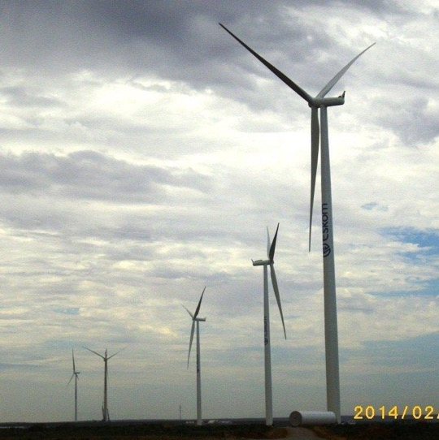
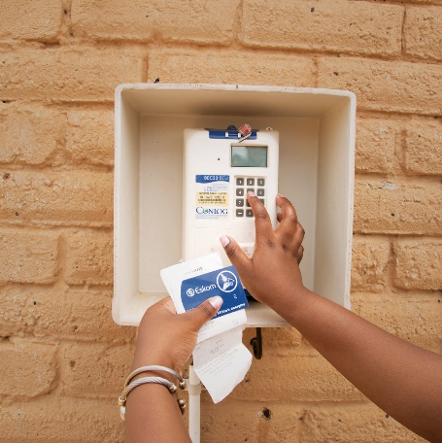
PROVISION OF 24/7 ARMED CLOSE PROTECTION OFFICERS ON “AS AND WHEN” REQUIRED BASIS FOR THE PERIOD OF THREE (3) YEARS.
E1795CXMWPR
ENQUIRY CLARIFICATION
MEETING
Date: 10 June 2026
Presented by: Lebohang Motaung

Slide 2
AGENDA
NO | AGENDA ITEM | RESPONSIBLE PERSON | TIME
1 | WELCOME, INTRODUCTION AND EVACUATION PROCEDURE | Lebohang Motaung/Pam | 10:00 – 10:05
2 | COMMERCIAL PRESENTATION | Lebohang Motaung | 10:05 – 10:10
3 | SUPPLIER DEVELOPMENT, LOCALISATION & INDUSTRIALISATION (SDL&I) | Willem Burger | 10:10 – 10:25
4 | OHS PRESENTATION | Lungile Mloyi(Pam) | 10:25 – 10:35
5 | QUALITY PRESENTATION | Bongi Tshabalala | 10:35 – 10:45
6 | TECHNICAL PRESENTATION | Wayne Cairns | 10:45 – 11:00
7 | Q & A SESSION | All

Slide 3
Session Overview
The session will focus on providing an overview and addressing questions for the tender such as :
Providing clarity on the tender submission process and the returnable documents required
To assist the Tenderers on the requirements for this tender
To explain the evaluation process and the evaluation phases this tender
To assist the Tenderers on how to compile and submit tender documents
To ensure that the Tenderers understand what they are required to submit
Note : this is a non-compulsory clarification meeting

Slide 4
Commercial Process
ADVERTISE INVITATION TO TENDER ON TENDER BULLETIN
(04 June 2026)
TENDER CLOSING
(22 June 2026)
EVALUATION PROCESS
CLARIFICATION
MEETING
(10 June 2026)
POST TENDER CLARIFICATION
CONTRACT AWARD
EXECUTION
NEGOTIATIONS
Cross Functional Team – Checks the Documents

Slide 5
Compliance
The Invitation to Tender is available on Eskom’s Tender Bulletin and NT eTender Portal
Tenderers are advised to visit Eskom website(Tender Bulletin) frequently for updated information.
Last date to submit clarifications: 17 June 2026
  Ensure clarification requests are clear and concise to enable Eskom to provide a comprehensive response;
  Email Address: motaunlo@eskom.co.za
The deadline for tender submission’s is 10H00 on 22 June 2026
  No late submissions will be accepted; and
  Tenders submitted to the email address will not be accepted.

Slide 6
Details of the Enquiry
NO LATE TENDERS WILL BE ACCEPTED.
Tenderer's may submit documents prior to the closing date on the Eskom tender bulleting via link as stipulated in the Invitation to Tender.
It is advisable that you do not leave the submissions of your tender for the last minute. This may result in your tender not being submitted by 10h00 on the closing date (22 June 2026). In that case your tender will be considered late and not accepted.
Tenderer’s must submit files in the respective folders namely:
  Commercial
  Technical
  SHEQ
  Financial/ Other

Slide 7
Eskom Tender Portal
Tender documents are organized in Folders named as follows:
Commercial: Documents in this folder to be completed accordingly and returned with tender including Invitation to tender and NDA
NEC: Completed NEC pricing schedule and contract data, sign and return documents
Technical: Return documents as per technical evaluation criteria attached separately on the technical folder
Contractual requirements:
SDL&I : Return documents as per SDL&I stipulated goals & requirements
Quality: Return documents as per quality evaluation criteria
Safety and Health: Return documents as per safety evaluation criteria
Addendum - including this presentations, questions and answers

Slide 8
Eskom Tender Portal
Please check regularly for any Addendum’s that may be published. Please note that on the Invitation to Tender, there is a Document titled Annexure B “Acknowledgment Form” that must be completed accordingly and returned with the tender
Please note that this clarification presentation will be loaded on the Tender Bulletin as they will serve as minutes of the clarification meeting.
Please also note that questions and answers will be loaded on the Eskom Tender Bulletin.
Please note that questions should always be sent in writing to the email address stipulated in the Invitation to Tender . Please do not address questions to any other Eskom email addresses of persons you may know working for Eskom whether they be employees in the Procurement, Safety, Quality, Technical or SDL&I Sections.

Slide 9
Evaluation process and criteria:
Basic Compliance: Commercial
Basic compliance for this invitation to tender are:
Meet the eligibility criteria for a tenderer
For Electronic Tender Submissions
The tenderer must upload the tender via Eskom Tender bulletin site on the Eskom E- tendering page. The documents need to be upload under the folder Commercial, Financial, SHEQ, Technical and other.
All documents need to be submitted in a PDF and Excel format (The limit is 50MB per file and total submission of 900MB per submissions). The price list needs to be submitted in PDF and a copy in excel format
No Zip/condense files can be uploaded
No hard copy will be accepted
If for some reason you resubmit your tender, then the latest version of the tender submitted will be the only be acceptable submission and all previous submission/s will be null and void.
Please ensure that the submission status is indicated as complete.
Supplier Help Manual guide and can be found on Eskom Tender bulletin page.
Submit a complete tender with commercial, financial , SHEQ and technical information.
Submissions of the tender returnables and the invitation to tender should be as per stipulated deadlines.

Slide 10
Evaluation process and criteria conti……
Tenderers who do not submit mandatory tender returnables as stipulated will be disqualified.
Commercial requirements
Technical requirements
  All Annexures attached to the invitation to tender to be completed accordingly do not leave blank spaces without providing the information if not applicable please indicate as such.
  Functionality (Technical) – Technical requirements
  Price and Specific Goals (80/20 principle)
  Contractual requirements (Safety, Quality and SDL&I)
  ALL DOCUMENTS TO BE SUBMITTED AT STIPULATED DEADLINES AS PER INVITATION TO TENDER

Slide 11
Commercial Requirements
The tenderers must complete the Non-disclosure forms attached, to indicate that none of its personnel have any involvement or interest in Eskom and likewise no Eskom personnel have any involvement or interest in the respondent’s business with regard to this tender.
All costs incurred in the preparation, presentation/demonstration, and submission of your tender response will be for the Tenderer’s account.
All queries to be addressed to the Buyer in writing. No telephone calls will be accepted for queries regarding this tender
Closing time for all queries is 03 working days prior to tender on
17 June 2026.

Slide 12
Commercial Requirements ….cont
The information contained in this document is of a confidential nature and may only be used for purpose of responding to this enquiry. This confidentiality clause extends to partners, whom you may decide to involve in preparing a response to this tender.
The tender and any supporting documents submitted as part of your response will become the property of Eskom.

Slide 13
Eskom Tender Portal – Tender Returnables
Please note that the tender documentation should be submitted in the following format:
Please ensure that each part is separated from each other as each of the parts are evaluated independently
SECTION | SUBMITTED
FOLDER 1 Will comprise of the Commercial & SDL&I Requirements. | 
FOLDER 2 Will comprise of the Technical Requirements. | 
FOLDER 3 Will comprise of the SHEQ Requirements. | 
FOLDER 4 Will comprise of the Financial/ QS/ Bill of Quantity | 

Slide 14
Details of the Enquiry
This is an intentional blank page

Slide 15
B-BBEE
A Certified Copy of a fully completed Sworn Affidavit for either EME or QSE (See key notes below to determine validity),
or
A Certified Copy of B-BBEE Certificate issued by CIPC for EMEs’ only,
or
A Certified Copy of a Valid B-BBEE Certificate issued by a SANAS accredited Verification Agency.

Slide 16
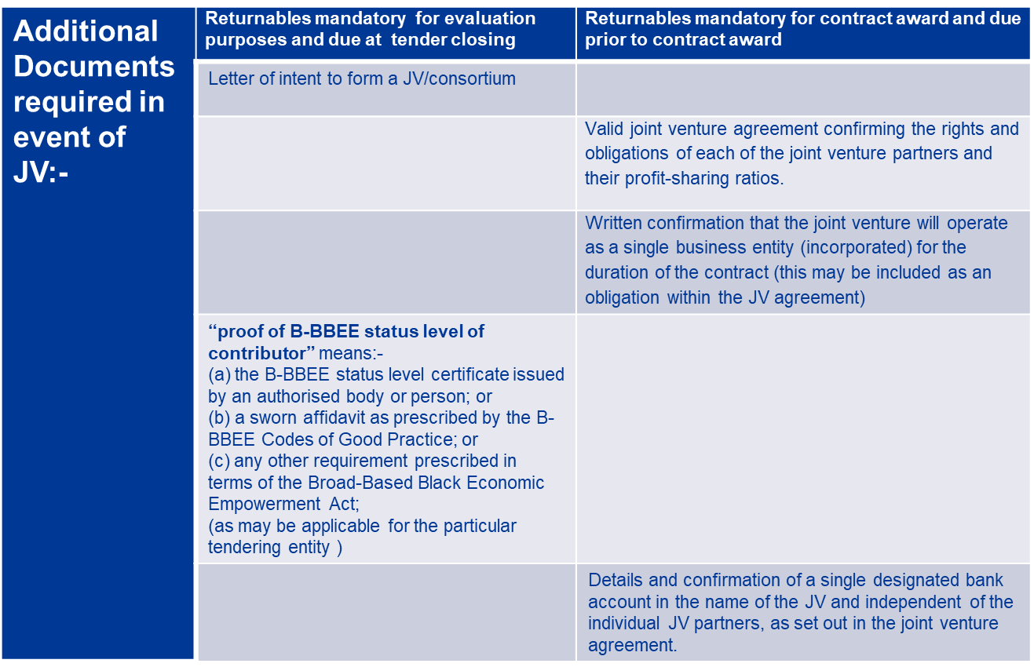
Joint venture requirements

Slide 17
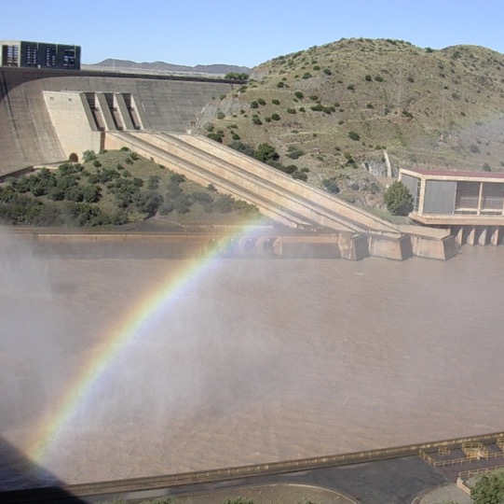

Conclusion

