Slide 1
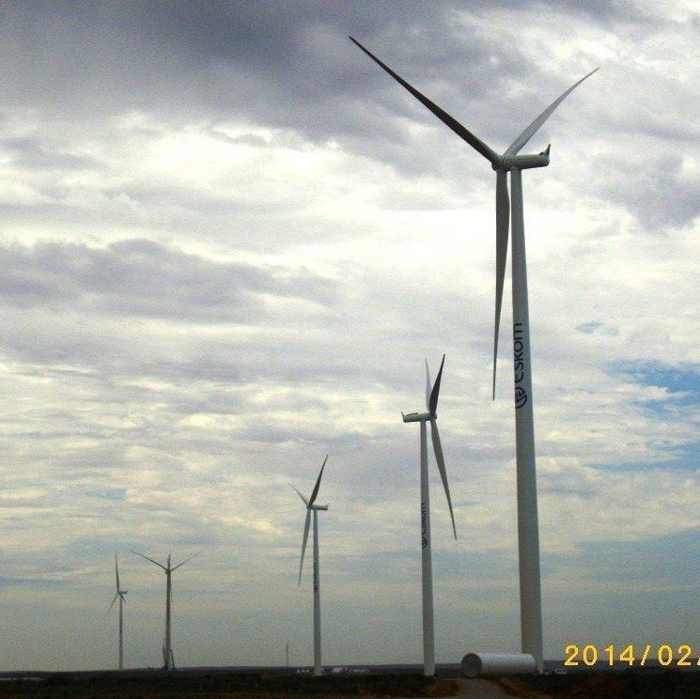
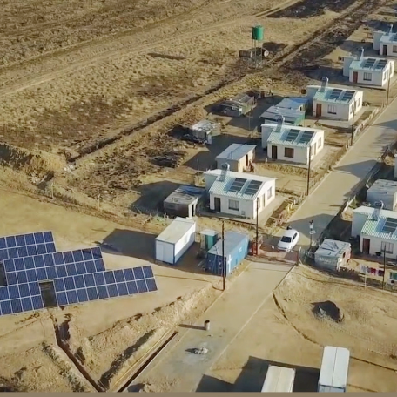
Clarification meeting
Leading change
Leadership Effectiveness Unit
30 May 2025

Slide 2

Context
Against an organisational context of turning around our business while transitioning to a future desired state a fundamental need emerged, i.e., leaders who can effectively implement such a strategy, because organisational transformation resides primarily with them. To this end, a need expressed by both Exco and the Board to reposition leadership development in the organisation was voiced.
An explicit focus is imperative to have leaders who exhibit both the mindset and behaviour to realise this quest because new ways of ‘doing things around here’ (culture), requires new ways of ‘thinking around here’ (mindset).
Against this backdrop the provision of services related to the design and delivery of a x2 day module across all leadership segments: Supervisory, Middle and Senior Managers under the theme of Lead Others _ Leading Change.

Slide 3
Requiring a new way of learning … ‘inside-out’
The conceptual picture …
… translating into programmes …
Personal Characteristics
People Management
Change as a process
Inter
Organisational behaviour
Intra
Know yourself
Inter
Team behaviour
Intra
Transformation
Know others
Inter
Individual
behaviour
Know your
organisation
Intra
Know the world
Process Management
Strategic Management
Leader Academy, 2005

Slide 4





Leadership Brand Pillars
Underpinning our leadership conversations
Leadership Brand Pillars
Eskom Core Values
Zero Harm
Leadership with the heart of a servant
Leadership that creates a learning environment
Leadership that displays good governance
Leadership enacted by disciplined execution
Integrity
Innovation
Reinforcing understanding and conviction with our employees requires an understanding of how employees feel in the organisation
Building skills and capabilities allows for a learning organisation that inspires employees to continuously improve
Reinforcement mechanisms helps decision making with sustainability and governance in mind
Leaders who display a focus for all Eskom values and who Role model this through transparent actions show what disciplined execution means
Sinobuntu
Customer
satisfaction
Excellence
Notes:
IMPORTANT FACTS TO MENTION:
The Leadership Brand pillars are endorsed by the CURRENT Eskom board
The pillars must always be applied within the scope of the Eskom values and it’s definitions as the VALUES are our North Star as guardians
The pillars have a set of behaviours aligned to the Eskom Leadership Competence Framework which informs it
Heart of a servant - Nelson Mandela (South African anti-apartheid activist and politician who served as the first president of South Africa from 1994 to 1999. He was the country's first black head of state and the first elected in a fully representative democratic election.)
Learning Organisation – Wangari Maathai (was a Kenyan social, environmental and a political activist and the first African woman to win the Nobel Peace Prize. founded the Green Belt Movement in 1977 to plant trees across Kenya, alleviate poverty and end conflict.)
Good Governance – Arch Bishop Desmond Tutu (known for his work as an anti-apartheid and human rights activist, for which he received the Nobel Prize for Peace in 1984. In 1995 he was named head of the Truth and Reconciliation Commission, which investigated allegations of human rights abuses during the apartheid era.)
Disciplined execution – Dr Hendrik vd Bijl (South African electrical engineer and industrialist and is regarded as one of the greatest South Africans for his contribution to the country's development, who laid the foundation for the establishment of Escom and Iscor)
Why the Martin Luther King quote: (Martin Luther King Jr. was an American Baptist minister and activist who was one of the most prominent leaders in the civil rights movement from 1955 until his assassination in 1968. His adoption of nonviolent resistance to achieve equal rights for Black Americans earned him the Nobel Peace Prize in 1964. King is remembered for his masterful oratorical skills, most memorably in his "I Have a Dream" speech.)
First get the opinions of the audience on the quote
Make links back to the overall programme – Include FOM modules completed as part of the discussion

Slide 5








Underpinned by key learning principles
Leadership programmes are flexible in nature to allow for continuous review and refinement of process and knowledge components to ensure continuous fit for purpose delivery.
All core leadership programmes, across all segments, will follow the inside-out philosophy. This includes both individual reflective practice as well as collective reflection and learning; to equip leadership to drive the delivery of the organisation strategy with a different mindset.
Inside-out philosophy
Continuous improvement
Best in class partnerships
Sound partnerships with external providers to deepen learning and provide leaders with outside-in experiences of leading leadership effectiveness behavioural practices. Partnership components will be co-designed and delivered in conjunction with Eskom’s Leadership Effectiveness Unit.
Programme measurement
In person development
Evaluate effectiveness of programmes through feedback forms, including application of learning and business impact which forms part of the integrated measurement focus for leadership effectiveness.
It is imperative that sound leadership development programmes are delivered mostly in person, as programmes are focused on driving mindset change and are experiential in nature. However, blended components of virtual and possible AI learning is infused to drive digital fluency. Knowledge components can be delivered virtually / via the e-learning platform.
Development programmes
Programmes are facilitated to create mindset change through experiential learning experiences which could include the utilisation fit for purpose field immersions, crisis simulations and/or innovation labs. All programmes include sound methodologies to drive behaviour change for effective delivery of Eskom’s strategy.

Slide 6
Leading change module intent
INTENT
The focus of this particular module is to deliver a comprehensive learning solution aimed at equipping Eskom leaders with advanced skills to effectively mobilise, implement and steer change. The module need to steer content related the relevant requisite levels of work aimed at the different leadership levels, as per the leadership competence framework:
Supervisory Level: Mobilising change agility for impact
Middle Managers Level: : Implementing Change
Senior Managers Level: Steering Change
OBJECTIVES
Equip Supervisors, Middle Managers and Senior Managers with the skills needed to mobilise, implement and steer change.
Foster a collaborative and cohesive change environment that enhances productivity and morale.
Strengthen communication skills to ensure clear, concise, and effective interactions to drive change within teams.
Enhance the ability of Eskom leaders to address challenges and make informed decisions that benefit teams and the organisation to navigate change.
Instil a culture of continuous change management.

Slide 7

Delivery focus
The module is within the Supervisory, Middle Managers and Senior Managers Architecture, under Lead Others and will be delivered over 2 (two) days respectively as indicated below on the architectures on the next slides.
This module will be delivered within the theme LEAD OTHERS. The lead-in will be lead self and the lead-out will be on focusing on enabling leaders to lead organisation effectively.
The intent is to deliver this module to 1350 Supervisors, 1350 Middle Managers and 300 Senior Managers over the next 5 years.
The final structure and content will be finalised in collaboration with the Eskom Leadership Effectiveness Unit. The ability to seamlessly integrate with other programme modules as an independent solution to be demonstrated.

Slide 8

Supervisory Development Programme (SDP) architecture
Setting the scene
Lead Self
Lead Others
Lead Others
Lead Others
Lead Organisation
Business Impact: 3 months post programme
½ Day
Orientation
1 day
Achieving personal mastery
3 Days
Presentation skills
2 Days
Building High Performance Teams
2 Days
Change Leadership: Mobilising change agility for impact
2 Days
Leading with digital fluency
1 Day
Direction, Alignment & Commitment
1 Day
Programme Synthesis:
Dry run and final presentations
2 Days
Stepping into action learning
2 Days
My role in relation to self (Doughnut of work)
1 Day
Problem Solving & Decision Making
2 Days
Situational leadership
2 Days
Turbo session: Stepping into leadership effectiveness
1 Day
Reflective Session
1/2 Day
Action learning
1/2 Day
Action learning
1/2 Day
Action learning
1/2 Day
Action learning
1/2 Day
Action learning
1 Day
Action Learning Project
Pre-Assessment
26 contact days
Post-Assessment
External partnership delivery
** All programme architectures are in draft format and might still be optimised further

Slide 9
Middle Management Programme (MMP) architecture
Setting the Scene
Lead Self
Lead Others
Lead Others
Lead Organisation
Programme Synthesis:
Dry run and final presentations
2 Days
Business Impact: 3 months post programme
½ Day
Orientation &
Lead in a business environment
1 Day
Achieving personal mastery
3 Days
Situational Leadership
2 Days
Change leadership: Implementing Change
2 Days
Systems Thinking 2 days
Turbo session: Stepping into leadership effectiveness
1 Day
Action learning immersion
1 Day
Leading in a complex environment 1 Day
Stepping into action learning
2 Days
Reflective Session
1 Day
Building High Performance Teams
2 Day
Leading with digital fluency
1 Day
Reflective Session
1 Day
External partnership delivery
Action learning
1/2 Day
Action learning
1/2 Day
Action learning
1/2 Day
Action Learning Project
Pre-Assessment
24 contact days
Post-Assessment

Slide 10
Senior Management Programme (SMP) architecture
Setting the Scene
Lead Self
Lead Others
Lead Organisation
Lead Organisation
Programme Synthesis:
Dry run and final presentations
2 Days
Business Impact: 3 months post programme
½ Day
Orientation &
Lead in a Thinking Environment
1 Day
Achieving personal mastery
3 Days
Building High Performance teams
2 Days
Mobilising impactful execution
2 Days
Leading with digital fluency
1 Day
Setting the Scene
Leading at the peak
Systems Thinking 2 Days
Stepping into grit
1 Day
½ Day
±400 participants
(Snr managers including GM’s & GE’s)
Stepping into action learning
2 Days
Action learning
1 Day
Change Leadership: Steering Change
2 Days
Turbo
session Leadership effectiveness to executive strategy
1 Day
Action learning
1 Day
Reflective Session
1/2 Day
Reflective Session
1/2 Day
Action learning
1/2 Day
External partnership delivery
Action Learning Project
Pre-Assessment
23.5 contact days
Post-Assessment

Slide 11
Scope of work
Foundation | Learning methodology | Facilitation | Expected outcomes
The scope must align with the following design principles: Inside-Out philosophy Leadership brand pillars Eskom’s culture transformation focus Eskom values Levels of work principles Leadership Competency Model Behaviours to be instilled aligned to the safety principles and practices in the business | The learning methodology should have the requisite experiential balance between classroom based and self-directed learning content pieces to drive application of learning. Some virtual components could be built in, should it be fit for purpose In cases where face-to-face learning will be utilised, inclusion of digital learning elements will also be an added advantage. | Facilitators are expected to have in-depth knowledge and experience on the facilitation processes both on virtual and classroom platforms, which includes: Integration of content piece as per the architecture to create a structure and seamless journey for leaders. | Improved leadership capabilities and team performance when dealing with change Improved team cohesion and performance when dealing with change Increased confidence and competence in navigating teams through change

Slide 12
Technical Evaluation Criteria
The threshold on the technical evaluation criteria is 75%. Suppliers would be deemed technically unacceptable if they score less and will thus not be evaluated further.
Criteria | Weight %
Design and development of Leading Change content | 50%
Facilitation and inclusion of number of quality facilitators | 30%
Flexibility to adapt content and process to fit the request | 15%
Project management & logistics | 5%
Total | 100%
The threshold on the technical evaluation criteria is 80%. In cases where service providers score less than 80% they will not be evaluated further.

Slide 13


Conclusion

