Slide 1


Stationery and Consumables Contract
Presented By: Nosipho Kubone
Date: 3 December 2025

Slide 2
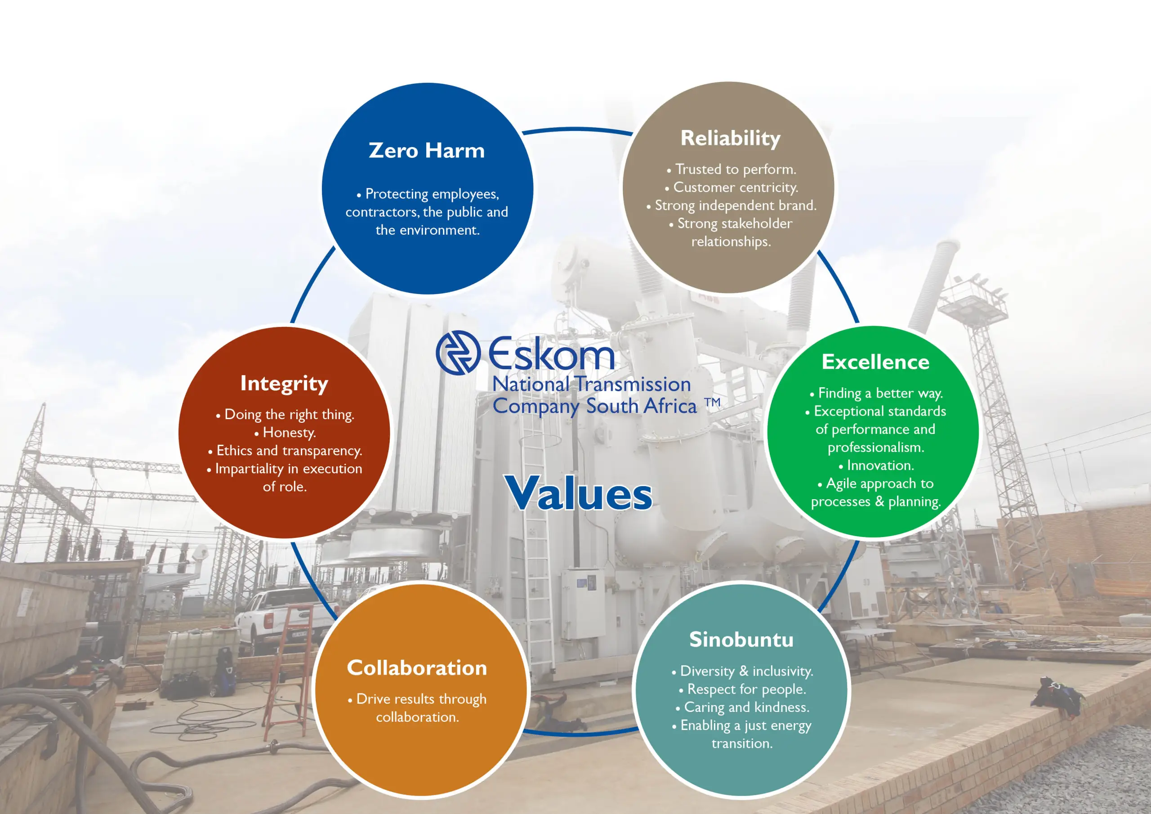
NTCSA Values

Slide 3
Contents
Technical Evaluation Criteria

Slide 4
Stationery and Consumables
The Contract is going to be awarded to two suppliers and will be utilised on an and as when required basis for the duration of the contract which is 3 years.
1 x Inland areas (Newcastle and Ladysmith depot) and 1 x Coastal areas (Westville, Pinetown and Empangeni depot)
Note: Potential tenderers are required to indicate the area they will be tendering for in their tender document. A tenderer that has tendered for all 2 areas and is successful in all, can only be awarded a tender for one area only.
Technical Evaluation comprises of 2 PARTS.
PART A - Mandatory Criteria - Suppliers must achieve 100% pass to be further evaluated in PART B. Supplier failing to score 100% for Part A will be considered as non-responsive and will render the bid disqualified.
PART B - Supplementary Criteria - Supplier must achieve a minimum threshold of 75% for Part B. Supplier failing to score the minimum points for Part B will be considered as non-responsive and will render the bid disqualified. It must be noted that an on-site verification will be conducted to verify the requirements below. In the event that the evidence is not available during the on-site evaluation, points will be reduced accordingly.

Slide 5
Stationery and Consumables
NEC Supply Contract will be applicable for this contract.
Pricelist to be priced in full (100%) with market related rates.
Tendered prices will be evaluated based on the market rates, clarification and cost breakdown may be sort from tenderers during the evaluation where necessary.
Contract Price Adjustment is allowed for on this contract, prices not to be inflated at tender stage.
Please double check your documents for completeness before submitting

Slide 6
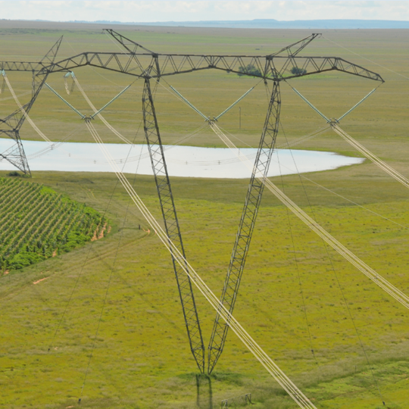
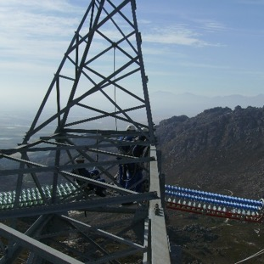
Conclusion

