Slide 1

BRIEFING SESSION PRESENTATION
PRESENTED BY:
Koena Mapotse
Division: OCPO
Date: 19 July 2024 @10H00
RT61-2024: HIRING OF AIRCRAFTS AND HELICOPTERS TO THE STATE FOR A PERIOD OF SIXTY (60) MONTHS

Slide 2
RT61-2024: HIRING OF AIRCRAFTS AND HELICOPTERS TO THE STATE FOR A PERIOD OF SIXTY (60) MONTHS
AGENDA
1. Opening, welcome and Introductions
2. Purpose of the RFP
3. Duration of the Contract
4. Bid Timelines
5. How to access the Tender Document
6. Technical Specification and Scope of Work
7. Evaluation Criteria as per SCC
8 Terms and Conditions
9. SUBMISSION OF BIDS
10. BIDDER DUE DILIGENCE
11. MULTIPLE AWARD
12. TRANSVERSAL CONTRACT PRICE ADJUSTMENT
13. Question and Answers
14. Closure

Slide 3
RT61-2024: HIRING OF AIRCRAFTS AND HELICOPTERS TO THE STATE FOR A PERIOD OF SIXTY (60) MONTHS
1. Opening, welcome and Introductions
Purpose of the RFP
  The purpose of this request for proposal (RFP) is to solicit bids from interested parties (“Respondents”) to enable National Treasury to appoint service provider for hiring of aircrafts and helicopters to the state for a period of sixty (60) months
  The RFP consists of the Special Conditions of contract( SCC), List of Aircraft, GCC, Pricing Schedule and other Standard Bidding Documents ( SBD).
  To obtain market related Price and to ensure that Government benefits from the economics of scale.
3. Duration of Contract - Sixty (60) months

Slide 4
RT61-2024: HIRING OF AIRCRAFTS AND HELICOPTERS TO THE STATE FOR A PERIOD OF SIXTY (60) MONTHS
4. Bid Timelines
ACTIVITY | DUE DATE
RFP Upload on e-Tenders Portal – Tender Document | The tender was advertised on e-Tender Portal & National Treasury website on 10 July 2024.
Non-compulsory briefing session | 19 July 2024 at 10:00 – 11:00 ( Online session: MS Teams) Link to join: Join the meeting now
Bid Validity period | 180 Days from the closing date of the bid
Bid Closing date and Time | 13 August 2024 at 11:00am
Communication channels Deadline for Queries, Question and Answers | Attention: Contract Manager Email: Demand.Acquisition3@treasury.gov.za 02 August 2024 at 16:00

Slide 5
RT61-2024: HIRING OF AIRCRAFTS AND HELICOPTERS TO THE STATE FOR A PERIOD OF SIXTY (60) MONTHS
5. How to Access bid document
  Where bid documents can be obtained:
  National Treasury website
  http://www.treasury.gov.za/divisions/ocpo/ostb/CurrentTenders.aspx
  E-tenders: https://www.etenders.gov.za/

Slide 6
RT61-2024: HIRING OF AIRCRAFTS AND HELICOPTERS TO THE STATE FOR A PERIOD OF SIXTY (60) MONTHS
Technical Specification and Scope of Work
Bidders must be able to provide aircrafts and helicopters to the state for a period of sixty (60) months as per the Technical Specifications. (paragraph 6.5 page 15 to 17 of the Special Conditions of Contract)
All items are supported by detailed specifications. Items must comply with the specification as stated in the bid document of each item.

Slide 7
RT61-2024: HIRING OF AIRCRAFTS AND HELICOPTERS TO THE STATE FOR A PERIOD OF SIXTY (60) MONTHS
Evaluation Criteria as per clause 6 of the SCC
Phase 1 | Phase 2 | Phase 3 | Phase 4
Administrative Requirements | Mandatory Requirements | Technical Requirements | Price and Specific Goals
Compliance with administrative requirements | Compliance with mandatory requirements | Compliance with technical requirements | Bids evaluated in terms of the 90/10 preference system

Slide 8
RT61-2024: HIRING OF AIRCRAFTS AND HELICOPTERS TO THE STATE FOR A PERIOD OF SIXTY (60) MONTHS
Phase 1: Mandatory Requirement
Bidders’ must submit all required documents indicated hereunder with the bid documents at the closing date and time of the bid. During this phase bidders’ responses will be evaluated against the mandatory requirements for compliance
Pricing Schedule
  The pricing schedule (Annexure 2) provided in this bid forms an integral part of the bid document and bidders must ensure that it is completed without changing the structure thereof.
  Bidders are required to submit responsive bids by completing all pricing and item information on the provided pricing schedule (Annexure 2) for the individual items and all required forms.
  Bidder are allowed to submit a maximum of three (3) offers per line item and must clearly indicate the number of offers on the pricing schedule. The 4th offer will not be accepted.
  Bid prices must be inclusive of all costs, and VAT.
  All prices must be in rands and rounded off to two (2) decimal places.
  The pricing schedule (Annexure 2) must not be a scanned PDF but must be submitted in an excel format with a USB.
  The bidder is required to complete, print out and sign the pricing schedule and submit it together with the bid at the closing date and time of the bid.

Slide 9
RT61-2024: HIRING OF AIRCRAFTS AND HELICOPTERS TO THE STATE FOR A PERIOD OF SIXTY (60) MONTHS
Air Operating Certificate/Certificate of Compliance
  Bidder are required to submit a valid air operating certificate from the South African Civil Aviation Authority. It signifies that the airline or operator has met specific safety and operational standards set by the regulatory authority. It also outlines the conditions and limitations under which the operator is authorised to conduct its operations, including the types of aircraft it can operate, the areas it can serve, and the operational procedures it must follow.
  For a foreign air operator certificate, the bidder is required to submit a valid certificate of compliance from the South African Civil Aviation Authority
  In instances where a bidder is leasing aircraft, it is imperative that the bidder submits a valid lease agreement between themselves and the aircraft owner/authorised agent. This agreement serves as a formal contractual arrangement delineating the terms and conditions governing the lease of the aircraft. By presenting such documentation, the bidder demonstrates their capability to utilize the aircraft for commercial purposes, thereby fulfilling the requisite criteria for participation in the bidding process.

Slide 10
RT61-2024: HIRING OF AIRCRAFTS AND HELICOPTERS TO THE STATE FOR A PERIOD OF SIXTY (60) MONTHS
The lease agreement must reflect a minimum of the following:
  Total Contract Value;
  b) Full description of the all the aircrafts offered;
  c) Duration of the lease agreement;
  d) Full description (including business address) of the parties to the lease agreement;
  e) Signed by both parties;
  f) Valid air operating certificate or certificate of compliance ;and
  g) Authorisation Letter (TCD13.2)

Slide 11
RT61-2024: HIRING OF AIRCRAFTS AND HELICOPTERS TO THE STATE FOR A PERIOD OF SIXTY (60) MONTHS
Air Service License for (ASL) Local and/or International Operations
  Bidders are required to submit a valid air service license for domestic and/or international operations at the closing date and time of the bid.
  An Air Service License (ASL) is a legal authorization granted by the relevant aviation authority to an airline or air operator, allowing them to operate scheduled or non-scheduled air services within a specific jurisdiction or internationally. The ASL typically outlines the routes, frequencies, and types of services that the airline is authorised to operate.

Slide 12
RT61-2024: HIRING OF AIRCRAFTS AND HELICOPTERS TO THE STATE FOR A PERIOD OF SIXTY (60) MONTHS
List of Aircrafts
  Bidders are required to submit a fully completed list of aircraft on offer for all relevant services Annexure 3).
  The information provided in the list of aircraft and the pricing schedule must match exactly.
  This includes ensuring that the make (type), model, tail number and any other specifications of the aircraft are consistent between the two documents, as well as ensuring that the prices listed in the pricing schedule accurately reflect the offers made for each aircraft. Non-compliance will invalidate the line item.
Failure to submit any of the above-mentioned documents will invalidate your bid.

Slide 13
RT61-2024: HIRING OF AIRCRAFTS AND HELICOPTERS TO THE STATE FOR A PERIOD OF SIXTY (60) MONTHS
PHASE 2: ADMINISTRATIVE AND LEGISLATIVE REQUIREMENTS
Bidders are required to submit the below documents to comply with the policy to guide uniformity in procurement reform processes in Government as per section 2 of Practice Note No 1 of 2003 regarding bid documentation for supply chain management.
  SBD 1 – Invitation form to bid.
  Proof of Authority – This is a company resolution for the capacity under which this bid is signed as per SBD 1
  SBD 4 – Bidders Disclosure
  SBD 6.1 – Preference points claim form

Slide 14
RT61-2024: HIRING OF AIRCRAFTS AND HELICOPTERS TO THE STATE FOR A PERIOD OF SIXTY (60) MONTHS
  TCD 13 and 13.1 Authorisation Declaration – All bidders must complete the “ Authorisation Declaration” form (TCD 13 and TCD 13.1) for all relevant goods and/or service in full, sign and submit together with the bid response at the closing date and time of the bid.
  Central Supplier Database – A Central Supplier Database report must be submitted.
  Written Confirmation to disclose tax status – It is a requirement that bidders grant a written confirmation when submitting this bid response that SARS may on an ongoing basis during the tenure of the transversal contract disclose the bidder’s tax compliance status and by submitting this bid such confirmation is deemed to have been granted.
Failure to submit the documents above, even after being allowed to submit within the seven calendar days that have lapsed, will invalidate the bid.

Slide 15
RT61-2024: HIRING OF AIRCRAFTS AND HELICOPTERS TO THE STATE FOR A PERIOD OF SIXTY (60) MONTHS
PHASE 3: TECHNICAL SPECIFICATION COMPLIANCE
During this phase, the bidder's response will be evaluated based on the technical requirements for each item offered. Non-compliance with all the evaluation requirements below will result in the disqualification of the relevant line item being evaluated.
TCD 13.2 Authorization Letter
Bidder who is sourcing goods or services from a third party is required to submit an authorisation letter in a third-party letterhead outlining all relevant goods or services. The authorisation letter must include but not limited to the following:
a) List of item(s) number, item description and type of aircraft , tail number and model,
b) Letter must be on a letter head of a third party, dated and signed,
c) Letter must be from the owner of an aircraft or an authorised agent.
d) Letter must not be older than 30 days at the closing date and time of the bid,
e) Have contact person’s name, physical and postal address, telephone, and email details, and
f) All information on the letter must be in English.

Slide 16
RT61-2024: HIRING OF AIRCRAFTS AND HELICOPTERS TO THE STATE FOR A PERIOD OF SIXTY (60) MONTHS
In the case where the authorization letter is issued by an authorised agent, the bidder is required to provide documentary evidence from the aircraft owner attesting to the authorised agent's authorization in addition to the authorization letter. At the time of the bid closing, the letter of undertaking and any supporting documentation must be submitted together with the bid.
The State reserves the right to verify any information supplied by the bidder in the authorisation letter and should the information be found to be false or incorrect, the State will exercise any of the remedies available to it in the bid documents.
The bidder must ensure that all financial and supply arrangements for goods or services have been mutually agreed upon between the bidder and the third party. No agreement between the bidder and the third party will be binding on the State.
Failure to submit a duly completed and signed authorisation letter, with the required annexure(s), in accordance with the above provisions 6.5.2.1 to 6.5.2.2, will invalidate the bid for such goods or services offered.

Slide 17
RT61-2024: HIRING OF AIRCRAFTS AND HELICOPTERS TO THE STATE FOR A PERIOD OF SIXTY (60) MONTHS
Certificate of Registration of each aircraft
Bidders are required to submit a valid aircraft certificate for each aircraft offered at the closing date and time of the bid. This certificate ensures that the aircraft meets safety, performance, and maintenance standards.
Aircraft Maintenance Schedule Certificate OR Certificate of Release to Service
Bidders are required to submit a valid maintenance schedule certificate or certificate of release for each aircraft offered at the closing date and time of the bid.
These documents provide assurance that the aircraft have undergone appropriate maintenance and are in compliance with regulatory requirements, industry standards, and manufacturer recommendations. This helps mitigate the risk of maintenance-related issues, enhances operational safety, and ensures the reliability and airworthiness of the aircraft

Slide 18
RT61-2024: HIRING OF AIRCRAFTS AND HELICOPTERS TO THE STATE FOR A PERIOD OF SIXTY (60) MONTHS
Airworthy Certificate for each aircraft
  Bidders is required to submit valid airworthy certificate for each aircraft offered at the closing date and time of the bid.
  This certificate indicates that the aircraft meets the necessary design, maintenance, and operational standards set by the regulatory authority.
Passenger Legal Liability, Hull, and War Insurance for each aircraft
  Bidders are required to submit a valid insurance schedule for each aircraft, including passenger liability, hull, and war insurance at the closing date and time of the bid.
  This aims to ensure that adequate insurance coverage is in place to protect against potential risks and liabilities associated with the operation of the aircraft. This helps mitigate financial losses, protect passengers and third parties, and ensure compliance with regulatory requirements and industry standards related to aviation insurance.
Failure to submit any of the required provisions will result in the invalidation of the corresponding line item in the bid.

Slide 19
RT61-2024: HIRING OF AIRCRAFTS AND HELICOPTERS TO THE STATE FOR A PERIOD OF SIXTY (60) MONTHS
PHASE 4: PRICE AND SPECIFIC GOALS
Preference Point System
The pricing evaluation will be in terms of regulation 5 of the Preferential Procurement Regulations pertaining to the Preferential Procurement Policy Framework Act, 2000 (Act 5 of 2000), responsive bids will be adjudicated by the State on the 90/10 preference point system.

Slide 20
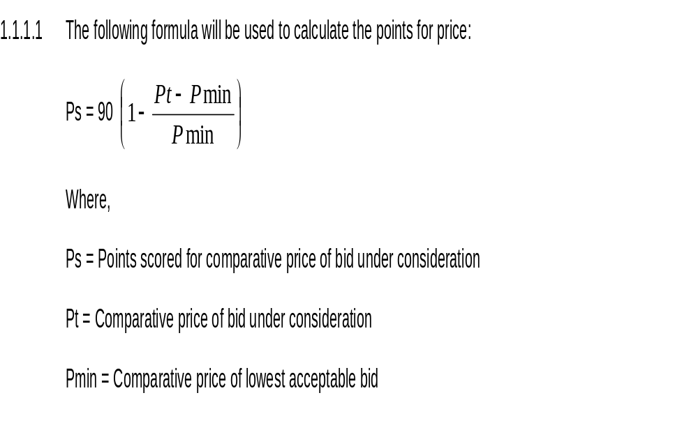
RT61-2024: HIRING OF AIRCRAFTS AND HELICOPTERS TO THE STATE FOR A PERIOD OF SIXTY (60) MONTHS

Slide 21
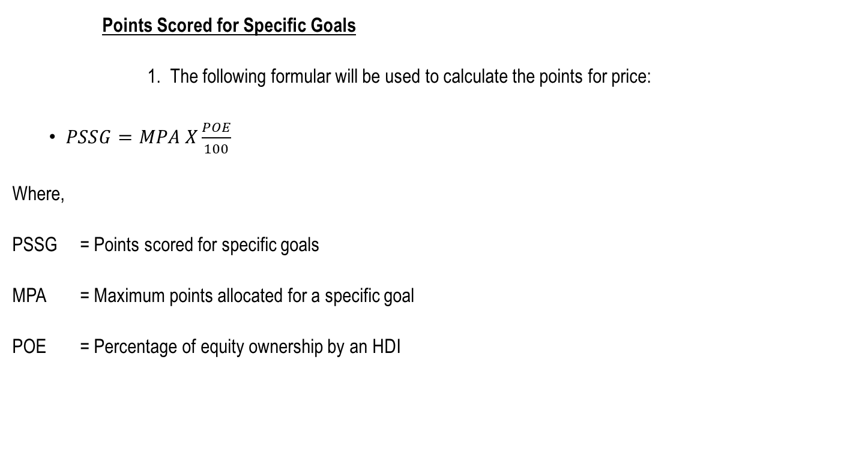
RT61-2024: HIRING OF AIRCRAFTS AND HELICOPTERS TO THE STATE FOR A PERIOD OF SIXTY (60) MONTHS
    Points Scored for Specific Goals
      The following formular will be used to calculate the points for price:
$PSSG=MPA X\frac{POE}{100}$
Where,
PSSG = Points scored for specific goals
MPA = Maximum points allocated for a specific goal
POE = Percentage of equity ownership by an HDI

Slide 22
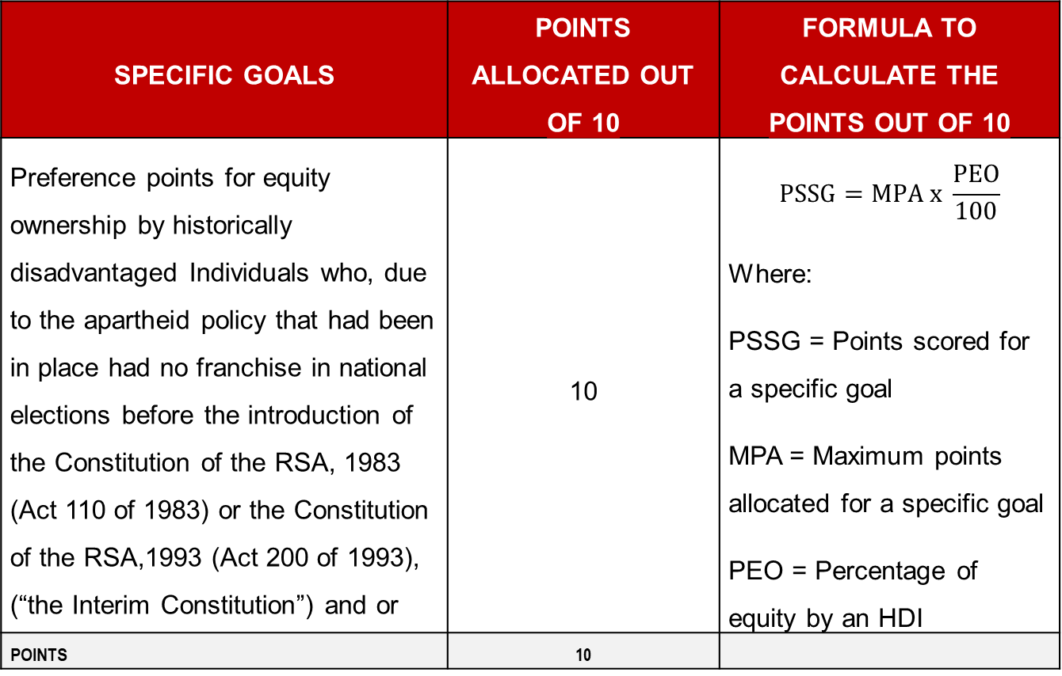
RT61-2024: HIRING OF AIRCRAFTS AND HELICOPTERS TO THE STATE FOR A PERIOD OF SIXTY (60) MONTHS
SPECIFIC GOALS | POINTS ALLOCATED OUT OF 10 | FORMULA TO CALCULATE THE POINTS OUT OF 10
Preference points for equity ownership by historically disadvantaged Individuals who, due to the apartheid policy that had been in place had no franchise in national elections before the introduction of the Constitution of the RSA, 1983 (Act 110 of 1983) or the Constitution of the RSA,1993 (Act 200 of 1993), (“the Interim Constitution”) and or | 10 | $$PSSG=MPA x \frac{PEO}{100}$$ Where: PSSG = Points scored for a specific goal MPA = Maximum points allocated for a specific goal PEO = Percentage of equity by an HDI
POINTS | 10

Slide 23
RT61-2024: HIRING OF AIRCRAFTS AND HELICOPTERS TO THE STATE FOR A PERIOD OF SIXTY (60) MONTHS
8. TERMS AND CONDITIONS
Counter Conditions
Bidders’ attention is drawn to the fact that amendments to any of the bid conditions or setting of counter conditions by bidders may result in the invalidation of such bids.
The National Treasury reserves the right to change or supplement any information or to issue any addendum to this bid before the closing date and time. The National Treasury and its officers, employees and advisors will not be liable in connection with either the exercise of, or failure to exercise this right.
If the National Treasury exercises its right to change or supplement information in terms of the above clause, it may seek amended bid documents from all bidders.

Slide 24
RT61-2024: HIRING OF AIRCRAFTS AND HELICOPTERS TO THE STATE FOR A PERIOD OF SIXTY (60) MONTHS
Fronting
The National Treasury supports the spirit of broad based black economic empowerment and recognizes that real empowerment can only be achieved through individuals and businesses conducting themselves in accordance with the Constitution and in an honest, fair, equitable, transparent, and legally compliant manner. Against this background the National Treasury does not support any form of fronting.

Slide 25
RT61-2024: HIRING OF AIRCRAFTS AND HELICOPTERS TO THE STATE FOR A PERIOD OF SIXTY (60) MONTHS
Right Of Award
The State reserves its following rights -
a) To award the bid in part or in full,
b) Not to make any award in this bid or accept any bids submitted,
c) Request further technical information from any bidder after the closing date,
d) Verify information and documentation of the bidder(s),
e) Not to accept any of the bids submitted,
f) To withdraw or amend any of the bid conditions by notice in writing to all bidders prior to closing of the bid and post award, and
g) If an incorrect award has been made to remedy the matter in any lawful manner it may deem fit.

Slide 26
RT61-2024: HIRING OF AIRCRAFTS AND HELICOPTERS TO THE STATE FOR A PERIOD OF SIXTY (60) MONTHS
9. SUBMISSION OF BIDS
PHYSICAL AND HARDCOPY BID SUBMISSION
Bidders are required to submit hard copies at the National Treasury, 240 Madiba Street, TIC, and Deposit the bid in the tender box.
The hard copy of the bid response will serve as the legal bid document.
Bidders’ attention is drawn to the sequential submission format as per the checklist in Table 1.
Bidders must submit the bid at TIC situated at corner 240 Thabo Sehume and Madiba Streets, Pretoria in the following format:
  One (1) original hard copy
  One (1) memory stick or USB with all the documents on the original hard copy and an Excel version of the pricing schedule. Bidders must ensure that the USB is marked with the bidder’s name.

Slide 27
RT61-2024: HIRING OF AIRCRAFTS AND HELICOPTERS TO THE STATE FOR A PERIOD OF SIXTY (60) MONTHS
All documents on the USB submitted must be an exact copy of the hard copy documents. Any discrepancies between the USB document and the original hard copy, the hard copy will take precedence.
A bid should be submitted in a sealed envelope or sealed suitable cover on which the name and address of the bidder, the bid number and the closing date must be visible.
Submit all bid queries via email to Demand.Acquisition3@treasury.gov.za.

Slide 28
RT61-2024: HIRING OF AIRCRAFTS AND HELICOPTERS TO THE STATE FOR A PERIOD OF SIXTY (60) MONTHS
10. BIDDER DUE DILIGENCE
The State reserves the right to:
Conduct due diligence during the evaluation process to determine the ability of the bidder to honour contractual obligations that might emanate from this tendering process. The due diligence is not only limited to the bidder but to all parties the bidder might have confirmed to do business with for the fulfilment of the contract that might be awarded.
Conduct due diligence prior to final award or at any time during the transversal contract period and this may include pre-announced/ non-announced site visits. During the due diligence process the information submitted by the bidder will be verified and any misrepresentation thereof may disqualify the bid in whole or parts thereof.

Slide 29
RT61-2024: HIRING OF AIRCRAFTS AND HELICOPTERS TO THE STATE FOR A PERIOD OF SIXTY (60) MONTHS
Conduct any evaluation verifications prior to final award or at any time during the transversal term contract period.
Where applicable, through the BEC subject item samples to applicable clinical evaluations, applications, or test at any State facility to verify compliance with the technical specifications. This will be arranged with the bidder.

Slide 30
RT61-2024: HIRING OF AIRCRAFTS AND HELICOPTERS TO THE STATE FOR A PERIOD OF SIXTY (60) MONTHS
11. MULTIPLE AWARD
The State reserves the right to award the same item to more than one (1) bidder to address item availability and compatibility. Due diligence will be applied to ensure that pricing is affordable, market related and aligned to end-user requirements.

Slide 31
RT61-2024: HIRING OF AIRCRAFTS AND HELICOPTERS TO THE STATE FOR A PERIOD OF SIXTY (60) MONTHS
12. TRANSVERSAL CONTRACT PRICE ADJUSTMENT
Adjustment | CPA application to reach the office at the following dates | End Index Date | Dates from which adjusted prices will become effective
1st Adjustment | 1 September 2025 | July 2025 | 1 November 2025
2nd Adjustment | 1 September 2026 | July 2026 | 1 November 2026
3rd Adjustment | 1 September 2027 | July 2027 | 1 November 2027
4th Adjustment | 1 September 2028 | July 2028 | 1 November 2028

Slide 32

RT61-2024: HIRING OF AIRCRAFTS AND HELICOPTERS TO THE STATE FOR A PERIOD OF SIXTY (60) MONTHS

