Slide 1
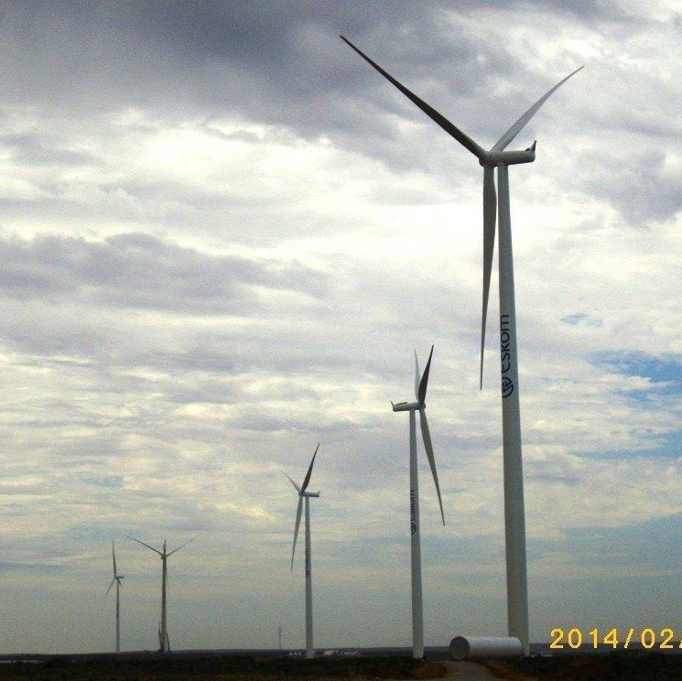
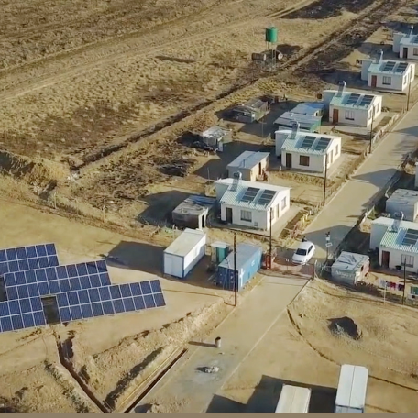
Clarification meeting
Business Driven Action Learning
Leadership Effectiveness Unit
25 April 2025

Slide 2

Context
Against an organisational context of turning around our business while transitioning to a future desired state a fundamental need emerged, i.e., leaders who can effectively implement such a strategy, because organisational transformation resides primarily with them. To this end, a need expressed by both Exco and the Board to reposition leadership development in the organisation was voiced.
An explicit focus is imperative to have leaders who exhibit both the mindset and behaviour to realise this quest because new ways of ‘doing things around here’ (culture), requires new ways of ‘thinking around here’ (mindset).
To respond effectively to such a need, the approach to leadership development is therefore:
characterised by a strategy-aligned needs analysis and development solutions
development solutions that tackle both the mindset and behaviour of such a future-fit leader
and implying that the new learning requires an ‘inside-out’ approach, since the barriers to effectiveness, change and excellence reside fundamentally inside the individual first.

Slide 3
Requiring a new way of learning … ‘inside-out’
The conceptual picture …
… translating into programmes …
Personal Characteristics
People Management
Change as a process
Inter
Organisational behaviour
Intra
Know yourself
Inter
Team behaviour
Intra
Transformation
Know others
Inter
Individual
behaviour
Know your
organisation
Intra
Know the world
Process Management
Strategic Management
Leader Academy, 2005

Slide 4





Leadership Brand Pillars
Underpinning our leadership conversations
Leadership Brand Pillars
Eskom Core Values
Zero Harm
Leadership with the heart of a servant
Leadership that creates a learning environment
Leadership that displays good governance
Leadership enacted by disciplined execution
Integrity
Innovation
Reinforcing understanding and conviction with our employees requires an understanding of how employees feel in the organisation
Building skills and capabilities allows for a learning organisation that inspires employees to continuously improve
Reinforcement mechanisms helps decision making with sustainability and governance in mind
Leaders who display a focus for all Eskom values and who Role model this through transparent actions show what disciplined execution means
Sinobuntu
Customer
satisfaction
Excellence
Notes:
IMPORTANT FACTS TO MENTION:
The Leadership Brand pillars are endorsed by the CURRENT Eskom board
The pillars must always be applied within the scope of the Eskom values and it’s definitions as the VALUES are our North Star as guardians
The pillars have a set of behaviours aligned to the Eskom Leadership Competence Framework which informs it
Heart of a servant - Nelson Mandela (South African anti-apartheid activist and politician who served as the first president of South Africa from 1994 to 1999. He was the country's first black head of state and the first elected in a fully representative democratic election.)
Learning Organisation – Wangari Maathai (was a Kenyan social, environmental and a political activist and the first African woman to win the Nobel Peace Prize. founded the Green Belt Movement in 1977 to plant trees across Kenya, alleviate poverty and end conflict.)
Good Governance – Arch Bishop Desmond Tutu (known for his work as an anti-apartheid and human rights activist, for which he received the Nobel Prize for Peace in 1984. In 1995 he was named head of the Truth and Reconciliation Commission, which investigated allegations of human rights abuses during the apartheid era.)
Disciplined execution – Dr Hendrik vd Bijl (South African electrical engineer and industrialist and is regarded as one of the greatest South Africans for his contribution to the country's development, who laid the foundation for the establishment of Escom and Iscor)
Why the Martin Luther King quote: (Martin Luther King Jr. was an American Baptist minister and activist who was one of the most prominent leaders in the civil rights movement from 1955 until his assassination in 1968. His adoption of nonviolent resistance to achieve equal rights for Black Americans earned him the Nobel Peace Prize in 1964. King is remembered for his masterful oratorical skills, most memorably in his "I Have a Dream" speech.)
First get the opinions of the audience on the quote
Make links back to the overall programme – Include FOM modules completed as part of the discussion

Slide 5








Underpinned by key learning principles
Leadership programmes are flexible in nature to allow for continuous review and refinement of process and knowledge components to ensure continuous fit for purpose delivery.
All core leadership programmes, across all segments, will follow the inside-out philosophy. This includes both individual reflective practice as well as collective reflection and learning; to equip leadership to drive the delivery of the organisation strategy with a different mindset.
Inside-out philosophy
Continuous improvement
Best in class partnerships
Sound partnerships with external providers to deepen learning and provide leaders with outside-in experiences of leading leadership effectiveness behavioural practices. Partnership components will be co-designed and delivered in conjunction with Eskom’s Leadership Effectiveness Unit.
Programme measurement
In person development
Evaluate effectiveness of programmes through feedback forms, including application of learning and business impact which forms part of the integrated measurement focus for leadership effectiveness.
It is imperative that sound leadership development programmes are delivered mostly in person, as programmes are focused on driving mindset change and are experiential in nature. However, blended components of virtual and possible AI learning is infused to drive digital fluency. Knowledge components can be delivered virtually / via the e-learning platform.
Development programmes
Programmes are facilitated to create mindset change through experiential learning experiences which could include the utilisation fit for purpose field immersions, crisis simulations and/or innovation labs. All programmes include sound methodologies to drive behaviour change for effective delivery of Eskom’s strategy.

Slide 6
The Business Driven Action Learning (BDAL) intent
INTENT
Business Driven Action Learning is a key development solution within the Eskom Leadership development portfolio and will drive alignment between business strategy and leadership development.
The aim of delivering Business Driven Action Learning is to unearth solutions to current business challenges whilst infusing the characteristics of the leadership brand.
OBJECTIVES
To provide the knowledge and skills needed to understand, solve and lead complex organisational challenges
To deepen understanding of the challenges relating to the human impact on solving complex problems
To align mindsets and behaviours towards building a culture of accountability and action
To create business impact and ROI by helping the business achieve its results through practice solutions

Slide 7

The focus of the partnership agreement is two-fold
The Service provider must focus on a two-pronged solution:
A: a stand-alone offering in a set format with between 8 – 12 participants at a time, tackling a complex business challenge. (Figure 1)
B: Provision of two days of Action learning. The intension with the two days is to allow for an outside-in in relation to the business challenge topic on day 1 (see encircled day) and to arrange for an immersion on day 2 (see encircled day) with the cohort of 25 participants. The Eskom Leadership Effectiveness Unit will hold the action learning piece in totality and will partner with the service provider to deliver the encircled two days. (Figure 2)

Slide 8
Figure 1: Business Driven Action Learning Programme
er
Business Challenge Work
Leadership Content – Giving & receiving feedback
Orientation
Sponsor Input & participant Q&A
Leadership Content – Creating Direction, Alignment & Commitment
Outside-in
SME or Immersion
Contact time
Team setup
Business Challenge Work
Business Challenge Work
Outside-in
SME or Immersion
Business Challenge Work
1 day
1 day
1 day
1 day
1 day
Sponsor Engagement – Define the business challenge, sponsor role & responsibilities, faculty & sponsor dialogues
Interval
Stream work on business challenge and individual fieldwork on leadership challenge
Recommend business solutions
Ongoing dialogues with sponsor – track implementation of solution
Leadership content – Challenging Assumptions
Outside-in
SME or Immersion
Business Challenge Work
Business Challenge Work
Dry run
Contact time
Business Challenge Work
Final presentation – Sponsor, key stakeholders and ELA
Business Challenge Work
Business Challenge Work
Business Challenge Work
1 day
1 day
1 day
1 day
1 day
All BDAL Elements to be facilitated through external partnerships

Slide 9

Figure 2: Senior Management Programme (SMP) architecture
Setting the Scene
Lead Self
Lead Others
Lead Organisation
Lead Organisation
Programme Synthesis:
Dry run and final presentations
2 Days
Business Impact: 3 months post programme
½ Day
Orientation &
Lead in a Thinking Environment
1 Day
Achieving personal mastery
3 Days
Building High Performance teams
2 Days
Mobilising impactful execution
2 Days
Leading with digital fluency
1 Day
Setting the Scene
Leading at the peak
Systems Thinking 2 Days
Stepping into grit
1 Day
½ Day
±400 participants
(Snr managers including GM’s & GE’s)
Stepping into action learning
2 Days
Action learning
1 Day
Change Leadership: Steering Change
2 Days
Turbo
session Leadership effectiveness to executive strategy
1 Day
Action learning
1 Day
Reflective Session
1/2 Day
Reflective Session
1/2 Day
Action learning
1/2 Day
Action Learning Project
External partnership delivery
Pre-Assessment
23.5 contact days
Post-Assessment

Slide 10
Description of service (1/4)
Part 1:
Delivery of 10 Business Driven Action Learning (BDAL) sets, of 10 days in total, over 5 years.
Anticipating running 2 set per year. Number of delegates per set will be between 8 - 12 participants.
For the purposes of the stand-alone BDAL set the following scope is applicable:
Action learning Facilitation
Facilitators are expected to have in-depth knowledge and experience on the action learning methodology and process.
Their role is to include:
  Integrator on all architectural components to create a seamless journey for participants
  Participate in the overall design and planning of the programme
  Select the appropriate facilitation methods and tools related to the non-interventionist approach to action learning coaching
  Demonstrate professionalism in all working engagements, specifically displaying facilitation expertise
  Ability to challenge mind-sets of participants with thought provoking questions
  Provide continuous feedback to the Eskom programme manager and a final close out report

Slide 11
Description of service (2/4)
Outside-In Network
Utilise appropriate ‘outside-ins’ to bring new ideas to the set from external entities (speakers from both local and international networks across all spheres of business) which may include:
Customers, service providers, best practice companies
Subject matter specialists
Arrange local immersions (relevant to the experiential process and content)
Utilise appropriate Leadership content Leadership Content Network related to:
Global leadership trends
Leading with VUCA prime / BANI
Immunity to change
Leading Self
Leveraging polarities
Sense-making and
Other topical content

Slide 12
Description of service (3/4)
Programme management
The service providers must hold the architecture through:
Sourcing and allocating the action learning facilitators, leadership content, outside-ins
Hosting regular review and feedback sessions
Managing data collection and analysis (evaluations, assessments etc…)
Partnering with the Leadership Effectiveness Unit around logistical requirements
Provide continuous administrative guidance and support
Conditions:
Each element of the scope will have a separate pricing structure
The supplier will provide the services (as defined by the above scope) as and when required by the Leadership Effectiveness unit
Contact days for action learning facilitators will be 10 days
Leadership content and outside-ins will be dependent on the nature of the business challenge
The delivery of the programme will be on Eskom premises (most probably at the Leadership development centre in Midrand)

Slide 13
Description of service (4/4)
Part 2:
Action learning facilitation for 2 days for the Senior Management Programme. This programme consists of 22 days in total, 2 of these days are intended to be held by an external partner. The intension is to deliver the Senior Management Programme to approximately 300 Senior Managers (25 participants per cohort).
Day 1: Outside-In Network: Utilise appropriate ‘outside-ins’ to bring new ideas to the set from external entities (speakers from both local and international networks across all spheres of business) which may include:
  Customers, suppliers, best practice companies
  Subject matter specialists
Day 2: Arrange for a local immersion (relevant to the experiential process and content): The intention is to facilitate an immersion for a full day. The intent is for the group to visit a local entity to enrich their learning experience.

Slide 14
Technical Evaluation Criteria
The threshold on the technical evaluation criteria is 75%. Suppliers would be deemed technically unacceptable if they score less and will thus not be evaluated further.
Criteria | Weight %
Action learning facilitation | 40%
Outside-in networks | 40%
Leadership content network | 15%
Project management & logistics | 5%
Total | 100%
The threshold on the technical evaluation criteria is 80%. In cases where service providers score less than 80% they will not be evaluated further.

Slide 15


Conclusion

