Slide 1


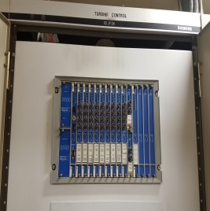
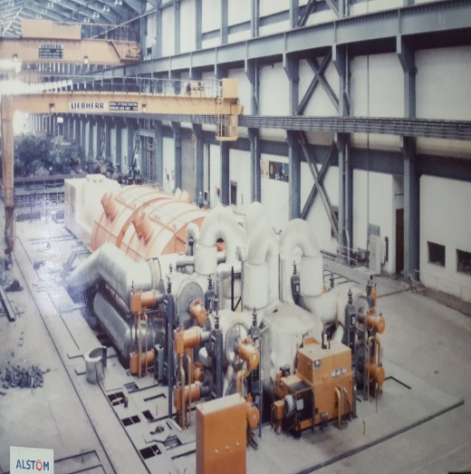
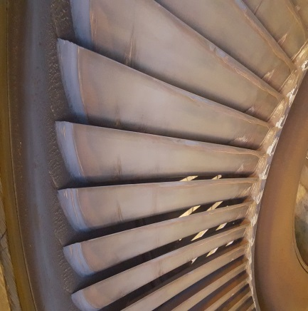
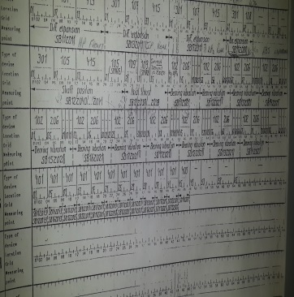
Lethabo Re-tubing of BFPT Condensers
Technical Scope Clarification
Insert image here

Slide 2
Outline
Background
High Level Scope
Technical Tender Returnables
Questions
2022/05/16

Slide 3
Background
The Boiler Feed Pump Turbine (BFPT) condensers are critical to the reliable and efficient operation of the BFPT. In the surface condenser the steam leaving the last stage of the turbine is condensed and the condensate that accumulates in the hot-well is pumped into the main condensate system and is re-used in the cycle.
The plugged tube status on the BFPT condensers has increased significantly over the last year, thus affecting heat transfer and overall efficiency of the BFPT condenser. This has necessitated the need to re-tube.

Slide 4
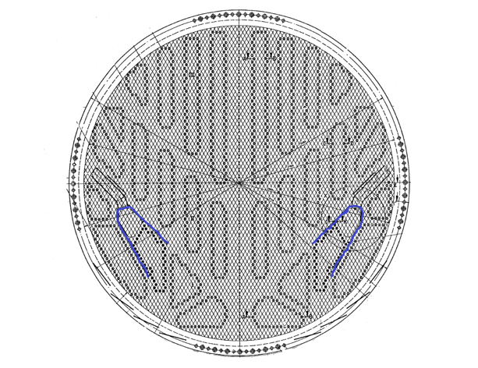
Background
This project is a like-for-like replacement with admiralty brass tubes in the condensing zone and titanium tubes in the air extraction zone.
The tube counts per unit are as follows:
  Condensing zone – 3004 admiralty brass tubes
  Air extraction zone – 226 titanium grade 2 tubes

Slide 5
High Level Scope
Scope of Work | Responsible Person
Transport of new tubes from storage area to condenser | Contractor
Application for permit to work | Employer
Issue permit to work for condenser | Employer
Isolation of condenser | Employer
Supply of new tubes | Employer
Scaffolding | Contractor
Load test of permanent crawl beams and rigging structures | Employer
Inlet and outlet water box removal and replacement | Contractor
Weld repairs, if necessary | Contractor
Tubesheet inspection, preparation, tubesheet hole cleaning and repairs | Contractor
Removal of existing tubes | Contractor

Slide 6
High Level Scope
Scope of Work | Responsible Person
Support plate inspection, support plate hole cleaning and repairs if necessary | Contractor
Tube to tubesheet joint mock up tests | Contractor
Tube installation and tube to tubesheet joint seal | Contractor
Water box door seal procurement and installation | Contractor
Steam space (demin) high level test | Contractor/Employer
Tube side (CW) waterbox leak test | Contractor
Final inspection | Contractor/Employer
Tubesheet coating | Contractor
Water box rubber lining and waterbox repairs if necessary | Contractor
Transport of scrap tubes to on-site storage area | Contractor

Slide 7
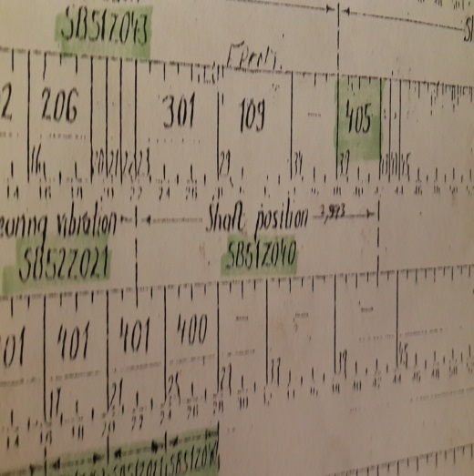

Technical Tender Returnables

Slide 8
Mandatory Criteria
Verifiable experience of the Contractor, Sub-Contractor and/or Joint Venture partner regarding heat exchanger refurbishment/re-tubing activities as detailed in the scope of work, for a turbine size greater than 100 MW, in the last 5 years.
Mandatory criteria are “must meet” criteria.

Slide 9
Qualitative Technical Criteria – Re-tubing
A valid copy of the ISO 3834 certificate, for the company doing the welding, must be supplied with tender.
Adherence to the above referenced Works Information. If the contractor adhere fully to the scope of work a letter stating this, shall be supplied. Any technical deviations shall be clearly indicated.
An example of Contractor’s procedures (mock-up and pull out test, tube removal, installation and expansion procedure).
An example of the Contractor’s QCP for a typical condenser re-tube installation.
The tool list (Appendix D in the works information) shall be included in the tender with column 2 and 4 completed. These tools need to be on site for the total duration of the specific condenser under refurbishment, these tools will not be removed from site to assist any other condenser refurbishment project, which runs concurrent with the unit that is contracted.

Slide 10
Qualitative Technical Criteria – Coating/Rubber Lining
The coating and rubber lining of condenser waterboxes shall only be performed by contractors who can produce verifiable references of similar corrosion protection on CW systems, chemical tanks and associated piping & ducts, done during the last 5 years.
Supply of the latest revisions of the specified Material Product Data Sheets and Material Safety Data Sheets.
Detailed QCP for similar work done as per coating specification in Appendix A and rubber lining specification in Appendix B of Work Instruction 375-172141
Detailed method statement/procedure as per coating specification in Appendix A and rubber lining specification in Appendix B of Work Instruction 375-172141
The minimum weighted score (threshold) required for a tender to be technically acceptable is 70%.

Slide 11


Questions

