Slide 1
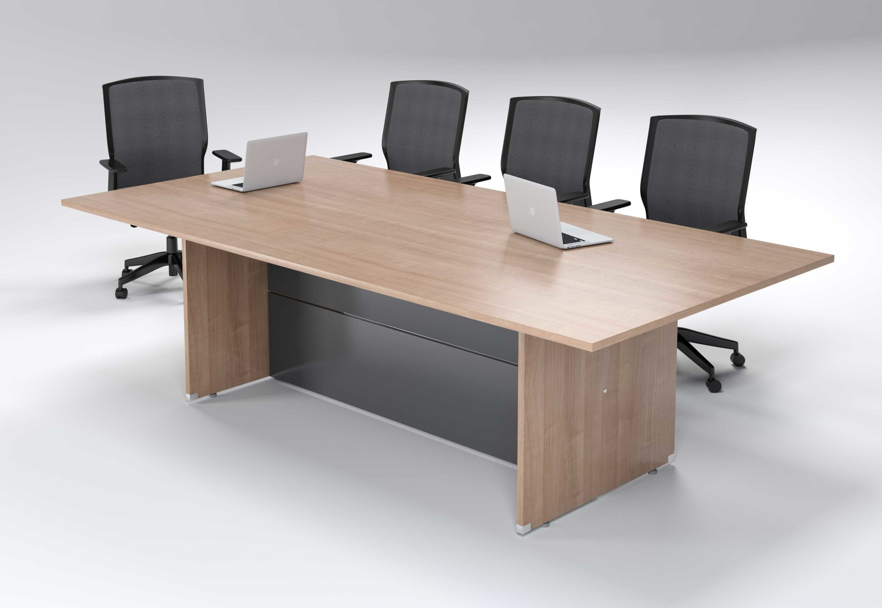
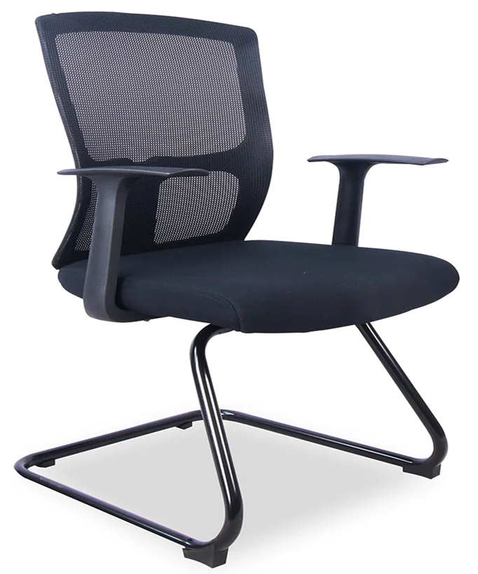
Board Room Table
Board room chairs AND High Back Chairs Black mesh back PP T-arms Black powder-coated sleigh base Memory foam Lumbar support Weight capacity 100kg

Slide 2
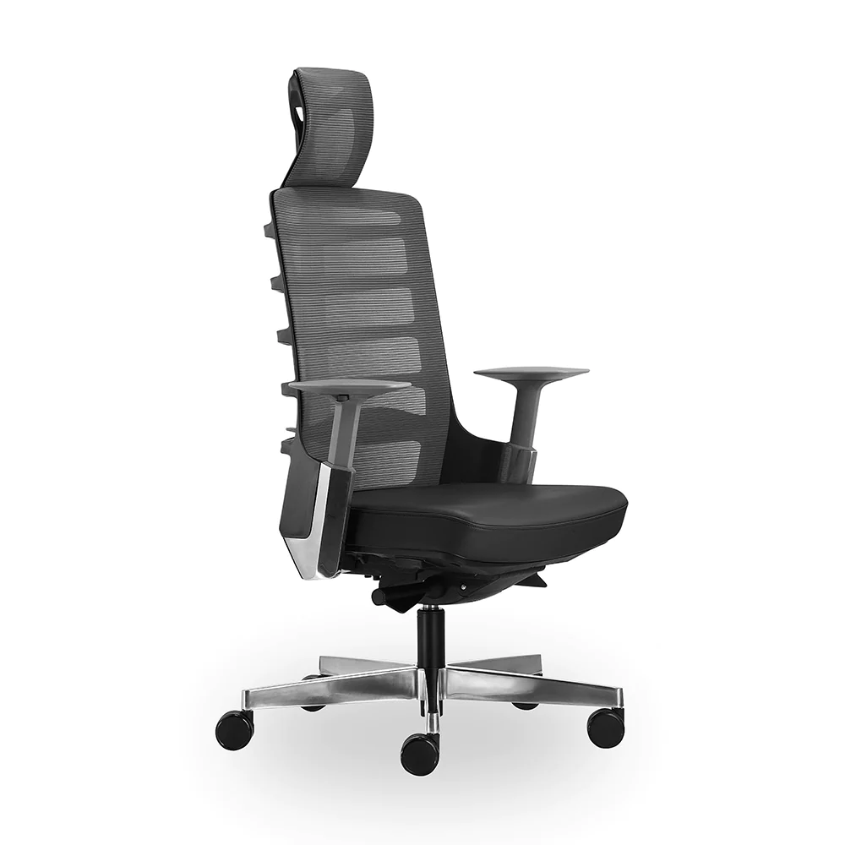
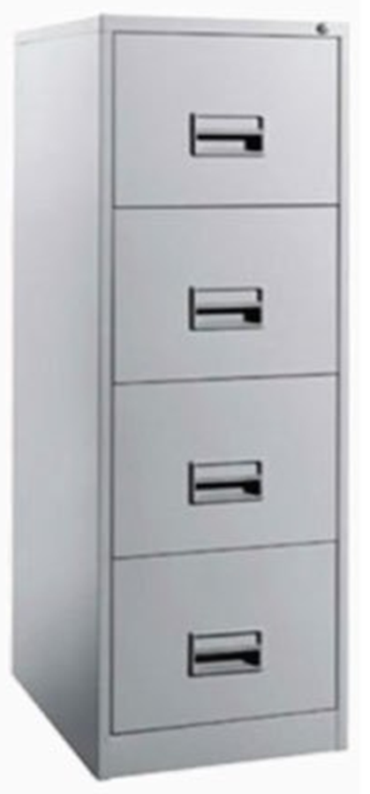
Swivel High Back Operators Chair Height adjustable lumbar support Height adjustable armrest Fabric upholstery Aluminium base Black Nylon Dual-Wheel Castors Auto-adjusts recline resistance according to user weight Weight capacity 20kg
STEEL CABINET DRAWERS
Stainless Steel 4 Drawer TriveniGold Filing Cabinet, Size: 54 X 18 X 27 Inch

Slide 3
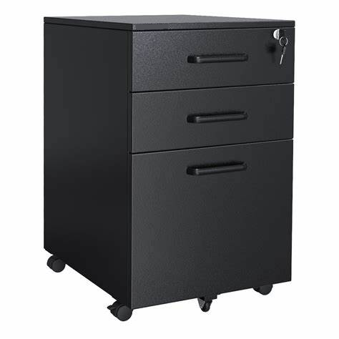
PRODUCT INFORMATION AND FEATURES:

Slide 4
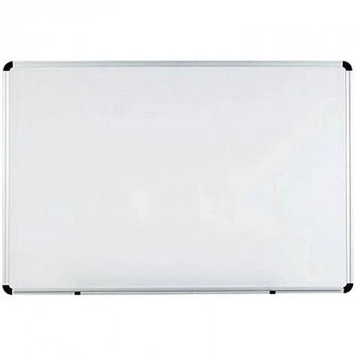
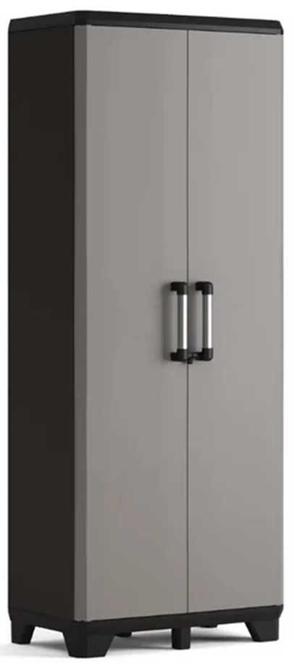
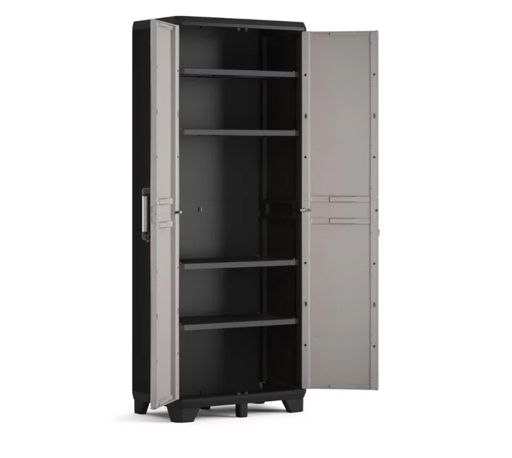
Chat board Deli Magnetic Whiteboard
Hinge Door Filling cabinets

Slide 5
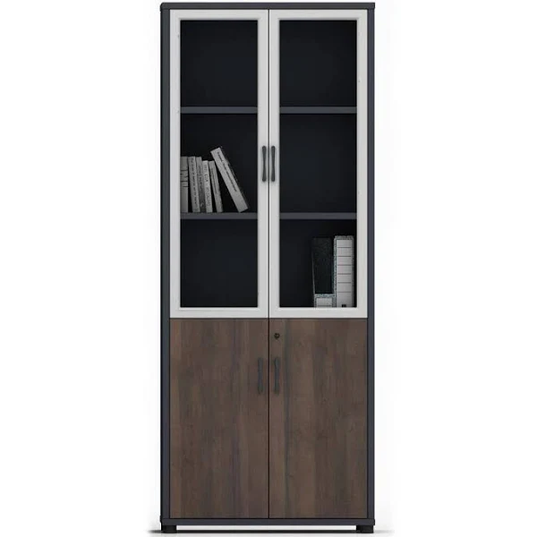
OFFICE CABINET Wall cabinet with a combination of open shelves and lockable doors. Half of the cabinet is lockable with the upper half having open shelves. Ideal to store books, files, and folders on the open shelves and personal items of value in the lockable cupboard

Slide 6
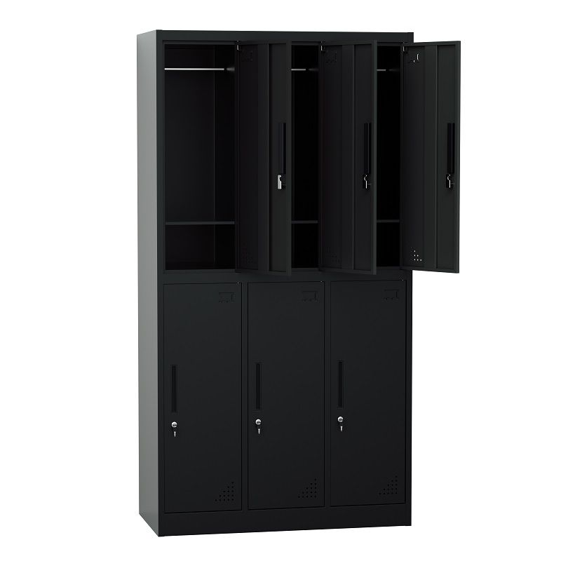
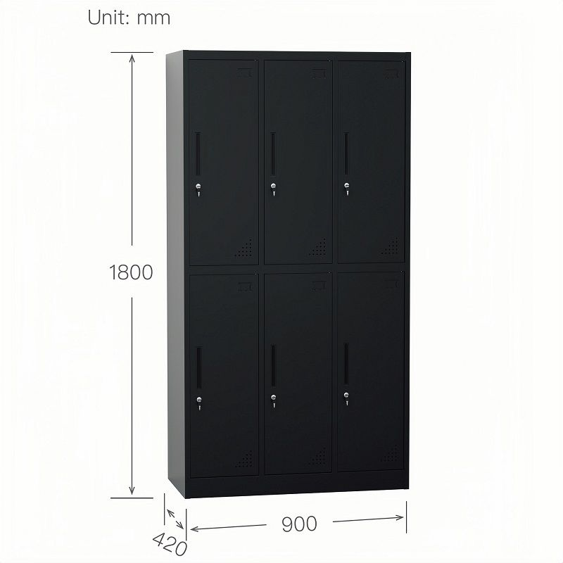
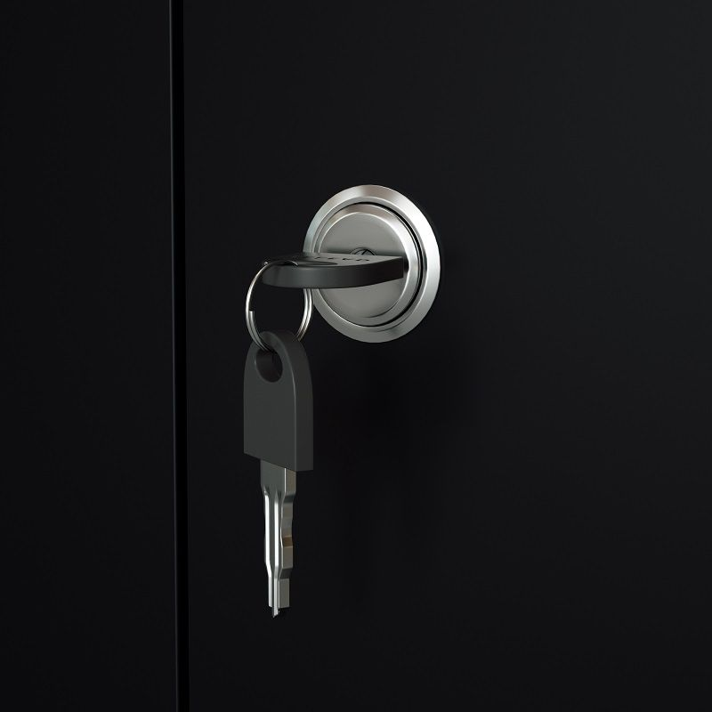
Steel 12 Door Locker Cabinet
PRODUCT INFORMATION AND FEATURES: Steel 6 Door Inner Handle Locker Cabinet With Lock - Black Use:OfficeSchool,Home,Hotel,Hospital,Company,GYM,Library,Factory,Apartments,Supermarket,Other Commercial Area

Slide 7
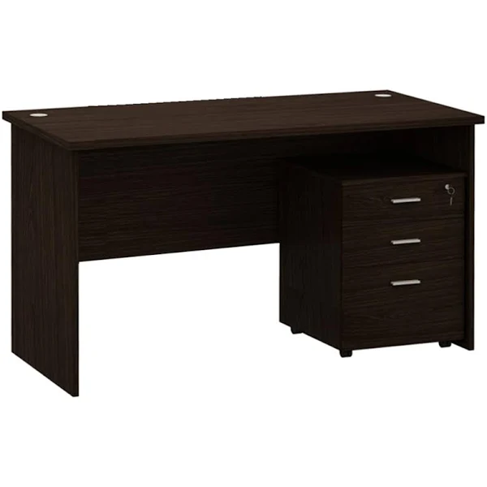
Desks with lockable drawers
Desks with lockable drawers

