Slide 1
Tutuka Unit 1 Network Switches
POS30 LAN
100Mbit, Twisted Pair
Switch 2
Switch 1
01XU101U009
01XU101U008

Slide 2
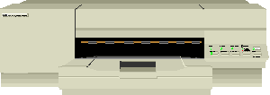

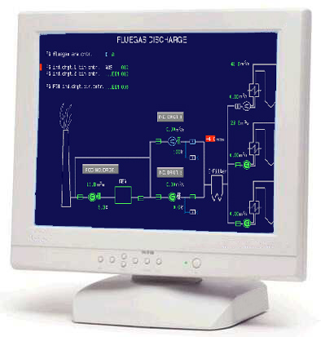


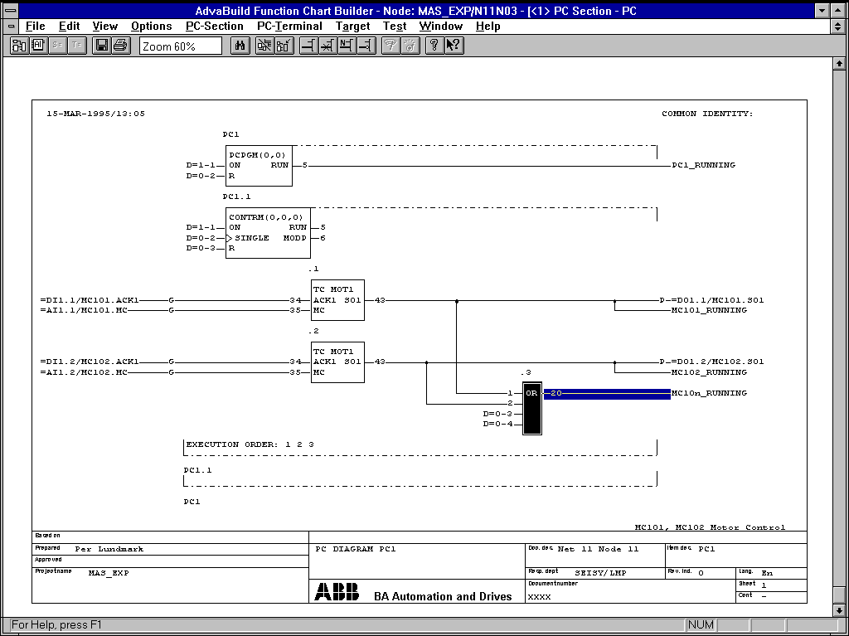



Tutuka Unit 1 Network Layout
Central Control Room
Equipment Room
01XU101U014
KVM-04
Tape Drive
EDS-Server
EDS
Printer
CDS
Printer
Process Operation
SOE Printer
Hardcopy
10.2.232.2
01XU101U006
01LA101
01LA103
01LA104
01XY103
01XY101
01XY104
01XY105
01LA102
1004
10.2.232.3
10.2.232.48
10.2.232.181
10.2.232.180
1007
1012
1011
1025
1024
Modem/ISDN Router
(Remote Access)
1010
01LA101U001
01LA101U002
1008
Telephone
Line
10.2.232.214
10.2.232.150
10.2.232.215
10.2.232.151
10.2.232.10
10.2.232.47
OPU01
OPU02
01XU101U010
1014
1013
1016
1015
01LA105
01LA106
ServerOperation Station
01XU101U007
01XU101U005
EDS Client 1+P-FUP
CDS
POS30 LAN
100Mbit, Twisted Pair
KVM Router
KVM
01XU101U013
01LA100
KVM-01
01XU101U011
Switch 2
Switch 1
KVM-02
1023
01XU101U009
01XU101U008
existing
KVM-03
Master
Clock
KVM-04
KVM Extender
1002
1000
1003
1001
01XU101U012
1027
10.2.232.202
KVM-02
KVM-03
KVM-01
1026
10.2.232.253
10.2.232.142
10.2.232.141
10.2.232.189
1009
01XU101U002
01XU101U003
01XU101U001
1006
Com-Servers
01XU101U019
Server 2
OMS/RCR
DVD
Archiving
KOAX
RG58
Server 1
OMS/RCR
01XU101U018
RS232/FO
1005
KOAX
RG58
FO/RS232
10.2.232.44
10.2.232.45
10.2.232.46
1018
1017
01XU101U016
01XU101U015
01XU101U017
192.168.72.101
192.168.72.101
1022
1019
1020
1021
87TS50
87TS50
87TS01
6 x 87TS01
PDDS
P-FUP
CDS
01XA002GA044
01XA001GA044
1,7,32.0
01XA004DA004
01XA002GA100
01XA001GA100
01XA004KA076 /84 /92
PROCONTROL P Remote Bus

