Slide 1
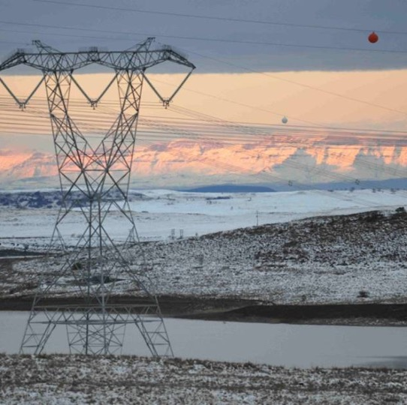

Environmental Tender Requirements for : IM Digital Transformation-Tender number: E2877NTCSAMWP
Presented By: Precious Likhethe
Date: 14 May 2026

Slide 2
Introduction
Eskom is committed to creating and sustaining the Zero Harm value and standard of Environmental . To achieve this, Environmental requirements are integrated into the Eskom procurement and supply chain processes.
Eskom’s Zero Harm value extends not only to its own employees, but to its contractors as well. This is a commitment by Eskom management to the concept that Zero Harm is the only acceptable goal. Embracing the Zero Harm value, therefore, necessitate continuous improvement to achieve and sustain better safety performance and an exceptional safety culture and ensure a safe workplace environment for contractors
Strategic objective
“Reduce contractor-related incidents by 10% every year – with more focus on minimizing the level of risk exposure from the current performance.

Slide 3
NTCSA Core Values
Excellence | Acknowledged by all for exceptional standards, performance and professionalism.
Innovation | Value-adding creativity and results oriented. Lead through excellence in innovation.
Customer Satisfaction | A commitment to meet and strive to exceed the needs of the receivers of products and services.
Integrity | Honesty of purpose, conduct and discipline in actions, and respect for people.
Zero harm | Eskom will strive to ensure that zero harm befalls its employees, contractors, the public and the natural environment.
Eskom SHEQ Policy 32-727
Ensure that SHEQ objectives and criteria are integrated in NTCSA’s procurement and investment strategies, governance structures, and decision-making processes for informed decision-making

Slide 4
Environmental Reference Documentation
The following Policies/Procedures are in support of Environmental requirements:
All applicable environment legislation | The applicable legislation that is aligned with the scope of work.
EPC32-727: Eskom SHEQ Policy | Ensure that SHEQ objectives and criteria are integrated in Eskom’s procurement and investment strategies, governance structures, and decision-making processes for informed decision-making
240-180100134- Environmental Requirement for Contractors/Suppliers Standard | This Standard outlines the environmental requirements. It sets the minimum criteria for managing supplier environmental compliance and conformity based on standards, procedures, policies, and legal obligations with which an Eskom supplier/contractor needs comply from inception to completion of the contract/transaction.
240-110600836-Contractor environmental requirements proforma | Contractor Environmental Compliance is the acknowledgement form issued to the tenderer for his or her own acknowledgement of a clear understanding of all the Environmental requirements. Signing the form will be deemed as your acceptance to conform to the following documentation and application of such within your scope of work.
240-154832228-Transmission Environmental Management Tender Returnable Document | To assess whether the contractor and/or Service Provider submitted the required environmental documentation as specified in the enquiry referenced above, and that such documentation complies with the specified requirements.

Slide 5
Environmental tender evaluation criteria
Environmental tender returnable (Objective criteria)=80%
If the tenderer fail to submit some of the document as part of the tender returnable , will not necessary be penalised during the initial technical evaluation, required information can be submitted at the negotiation stage.
7 days will be given to the supplier to submit the required information.
Environmental risk: Low

Slide 6
Environmental tender evaluation criteria
Section A: Environmental Management System Requirements
A.1 EMS Manual or a document that defines and describes the EMS and its scope
A.2 Environmental Policy Signed and Authorized by Company Owner/CEO/MD:
A.3 Company environmental objectives and planning to achieve them
A.4 Company Roles, Responsibilities and Authorities (Environmental Rep/Environmental officer/SHEQ Rep,Environmental management organogram within the Company)"
A.5 Organization Interested Parties - Needs and expectations
A.6 Environmental Communication
A.7 Nonconformity and Corrective action
A.8 Environmental Emergency Preparedness and Response
A.9 Performance Evaluation (monitoring, measurement, analysis and evaluation)
A.10 Internal Audit and Internal Audit Programme
A.11 Management Review

Slide 7
Environmental tender evaluation criteria
SECTION B: Environmental Management Programme and Environmental Authorisation
B.1 Handling of Hazardous Chemical Substances (including contaminated waste or materials)
B.5 Access Control and Routes
B.8 Environnent ambient Air Quality (i.e., Dust Control/ Management)
B.9 Rehabilitation
B.12 Resources, Competence and Awareness (Proof of training and skills of persons performing significant activities,Training matrix)
B.13 Environmental Incident Reporting (i.e., oïl spills, fire, biodiversity)
B.14 Complaints/Grievance management
B.15 Environmental Compliance Obligations

Slide 8
Environmental tender evaluation criteria
Section C: Waste Management Plan
C.1 Possible Waste types and/or streams to be generated
C.2 Applicable waste management legislation
C.3 Waste segregation and minimisation
C.4 Waste handling and disposal on site
C.5 Waste reporting template
SECTION D: Aspect & Impact Register
D.1 Environmental Aspect and Impact Register (Project Specific/SOW) (including ratings of aspects and impacts).
SECTION E: Employer defined additional requirements & miscellaneous
E.1a Waste Management activities
E.1b Pollution Control measures( e.g. dust suppression, building of bund walls, building of wash bays and workshops)
E.1d Land Management (e.g., Rehabilitation costs, Erosion control/ berms, maintenance of access roads, No Go fencing, vegetation clearing
E.1e Human Resources (Environmental Officer)
E.2a Environmental Requirements Proforma: 240-110600836 completed and signed (by the Contractor)

Slide 9
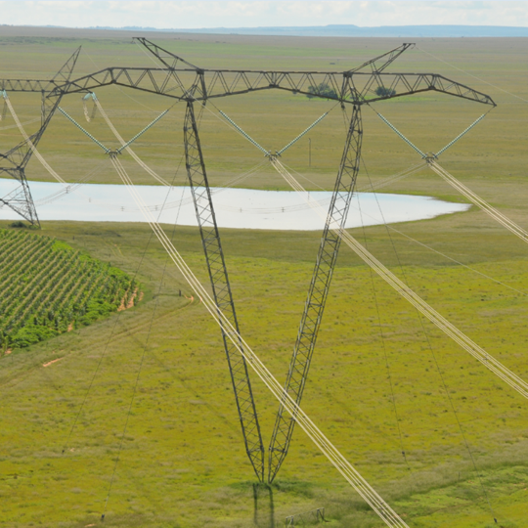
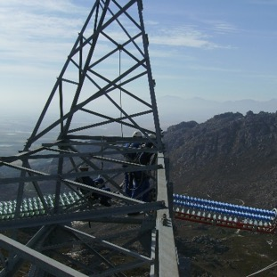
Conclusion

