Slide 1

RT57
SUPPLY AND DELIVERY OF SEDAN, LIGHT AND HEAVY COMMERCIAL VEHICLES, BUSSES, MOTORCYCLES, AGRICULTURAL TRACTORS, CONSTRUCTION PLANT AND EQUIPMENT TO THE STATE FOR A PERIOD OF 36 MONTHS
PRESENTED BY:
SITHEMBISO MAHLALELA
TRANSVERSAL CONTRACTING
Date: 1 NOVEMBER 2022
BRIEFING SESSION

Slide 2
Agenda
1. Welcome and Introduction
2. Bid Timelines
3. Background
4. Evaluation Criteria
5. Scope of Work
6. Pricing Structure
7. Other Fees/Charges
8. Bid Submission and Format of Submission
9. Q&A

Slide 3
BID TIMELINES
BID ACTIVITY | DUE DATE
Advertisement in E-tenders website | 30 September 2022
Non-Compulsory briefing session | 1 November 2022
Bid Closing Date | 5 December 2022
Notice to bidders | Bidders are required to visit the e-tenders website regularly in order to check updates regarding the bids.
Questions relating to Bid | ??????

Slide 4
Background
  RT57: Supply and Delivery of Sedan, Light and Heavy Commercial Vehicles,Busess,Motorcycles, Agricultural Tractors, Construction Plant and Equipment to the State for a period of 36 months.
  The above mention contract will assist the organ of the state to fulfil their mandates ( e.g. improve service delivery, create jobs.etc)
  Participants to the contract:
As per the Special Conditions of the contract.
    Objectives of the contract: To appoint suppliers that will supply and deliver Sedan, Light and Heavy Commercial Vehicles,Busess,Motorcycles, Vehicles,Busess,Motorcycles, Agricultural Tractors, Construction Plant and Equipment to the State for a period of 36 months.

Slide 5
Evaluation Criteria
The evaluation Criteria has been clustered into three (3) phases:
PHASE I: Pre-Qualifying Criteria for Preferential Procurement
A bidder having a B-BBEE status level contributor 1 to 8.
To support this bidders are required to submit:
  Bidders are required to complete the preference claim form (SBD 6.1) and submit their original and valid B-BBEE status level verification certificate or a certified copy or sworn affidavit at the closing date and time of the bid in order to prove compliance.

Slide 6
Evaluation Criteria (continues)
  Proof of B-BBEE status level of contributor includes the following:
  a) Original and valid B-BBEE status level contributor verification certificate or certified copies thereof.
  b) Original and valid JV B-BBEE status level contributor verification certificate or certified copies thereof.
  c) Valid B-BBEE certificate issued by the CIPC.
  d) Original and valid Sworn affidavit signed by the EME representative and attested by Commissioner of oaths or certified copy of sworn affidavit.

Slide 7
Evaluation Criteria (continues)
  e) A trust, consortium, or joint venture (including unincorporated consortia and joint ventures) must submit a consolidated B-BBEE status level verification certificate.
  5.2.3. Public entities and tertiary institutions must also submit their B-BBEE certificates.
  5.2.4. A tender that fails to meet the pre-qualifying criteria above is an unacceptable tender and will be disqualified.

Slide 8
Evaluation Criteria
The evaluation Criteria has been clustered into Three (3) phases:
PHASE II: Compliance with mandatory and other bid requirements & Mandatory Requirements and Other Bid requirements
Only bidders who qualified on Phase I will be evaluated on Phase II. During this phase a
bidder will be evaluated based on submitted documents for administrative compliance and
mandatory requirements.
Administrative Compliance: Standard Bidding Documents
a) All Standard bidding documents as listed above on Table 1 must be completed in full, signed and submitted with the bid at the closing date and time of the bid. Failure to comply may invalid your bid.
Authorisation declaration
SUB-CONTRACTING AS A CONDITION OF TENDER
LOCAL PRODUCTION AND CONTENT – BUSSES ONLY

Slide 9
Evaluation Criteria
PHASE III: PRICE AND B-BBEE (90/10 PREFERENCE POINT SYSTEM)
The bidders will be evaluated on points scored for price and B-BBEE.
Bidders are required to submit responsive bids by completing all the item
they are bidding for, mandatory response field and item questionnaires on
the provided pricing schedule for the individual items.
  All bid prices must be inclusive of all applicable taxes.
  All bid prices must be inclusive of fifteen percent (15%) Value Added Tax.

Slide 10
EXCEL PRICING
Contractors MUST submit the new offer(s) utilising the EXCEL PRICING.
After completing the EXCEL PRICING, contractors must convert the document into PDF for verification purposes should there be data loss and/or discrepancies.
Both EXCEL PRICING and PDF document must be submitted.
The EXCEL PRICING will be used for evaluation purposes.

Slide 11
EXCEL PRICING (continues)
Do not amend item number and /or Description
Correct (√) | Incorrect (X)
RT57-01-12-01 | RT57-01-12-01 Offer A RT57-01-12-01 Offer B
RT57-02-13-01 | RT57-02-13-01 Main offer RT57-02-13-01 Offer 1 RT57-02-13-01 Offer 2
RT57-03-00-01 | RT57-03-00-01 RT57-03-00-01 Alternative 1 RT57-03-00-01 Alternative 2

Slide 12
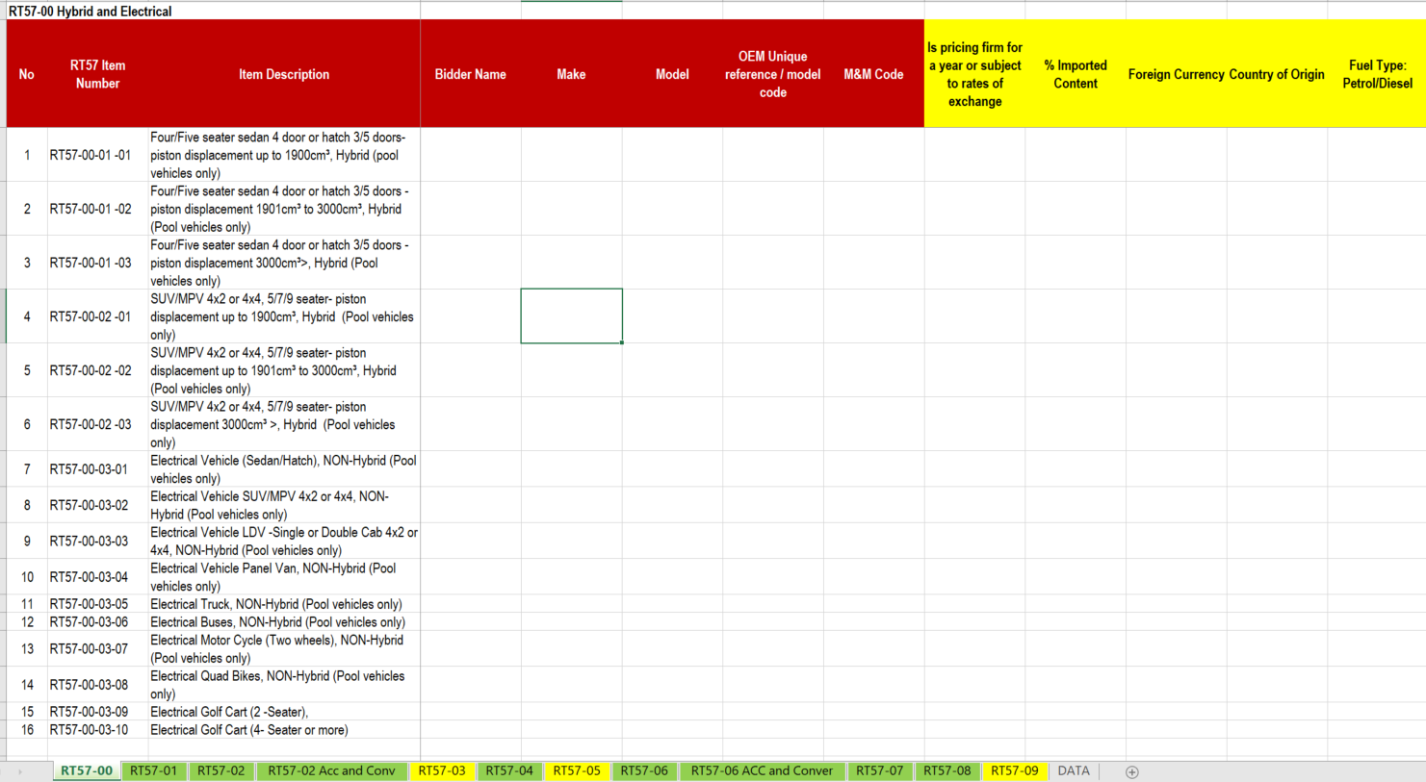
EXCEL PRICING (continues)
Contractors may add ROWS to provide alternative offers but are not under any circumstances allowed to add columns.
Addition of columns will make it difficult to consolidate data as required.
To add a row, select the entire row, right click and select insert
The EXCEL pricing has pre populate list

Slide 13
EXCEL PRICING (continues)
Do not hide rows
  Hiding or rows populate unwanted information in to the master document.
Do not hide columns
  Hiding of columns will mismatch information when being populated in to the master document.

Slide 14
OTHER FEES / CHARGES
Other fees / charges such as Delivery charges, Maintenance plans and handling fees must be submitted separately form the price schedule.

Slide 15
Category Name RT57
No | Category Number | Category Description
1 | RT57-00 | Hybrid and Electrical
2 | RT57-01 | Sedan/Hatch
3 | RT57-02 | Light Commercial Vehicle (LCV)
4 | RT57-03 | High Mobility Vehicles (Trucks)
5 | RT57-04 | Multi-Purpose Vehicle / Sport Utility Vehicle (MPV/SUV)
6 | RT57-05 | Busses
7 | RT57-06 | Panel Van
8 | RT57-07 | Motorcycle
9 | RT57-08 | EMRS/ VIP/ High performance/ Law enforcement
10 | RT57-09 | Construction Plant, Equipment and Agricultural Tractor

Slide 16
Pricing Structure
The Pricing Schedule must be submitted in two forms, as hardcopy which must be included in the bid document and in an excel spreadsheet saved in a USB/Memory stick at the closing date and time of bid.
The pricing schedule will be accessible from the e-tender portal. All prices must be submitted as soft copies (excel spreadsheet using USB and hard copy in the file). All price submitted as soft copy (excel – USB) and hardcopy in file must contain the same information. NO PDF price schedule will be accepted.
In a case where there is a legal dispute, the hardcopy version of the pricing schedule will be the legal document.

Slide 17
Bid and Format Submission
The bidder must submit at least two hard copies of the bid document together with a memory stick on or before the closing date and time to National Treasury: Tender Information Centre. Only the original bid must include the pricing together with a memory stick.
All electronic data submitted must be an exact copy of the hard copy document. Any discrepancies between the electronic data and the hard copy may invalidate the bid for the item in question.
  Format and Submission of Bid
    Bidders are required to submit their bids in the following manner:
        Section 1 Standard bidding documents
        Section 2 Comprehensive list of dealerships
        Section 3 Comprehensive list of delivery charges
        Section 4 Comprehensive list of service plans/warrantee plans
        Section 5 Certificate of local production/content (SBD 6.2)
        Section 6 Local content declaration summary schedule
        Section 7 List of approved fitment centres for Emergency Lights
        Section 8 List of all converters to be utilized
        Section 9 Vehicle Warrantees and Guarantees
        Section 10 Contact details (More than one person & Supervisor)

Slide 18
VERIFICATION PERIOD
Verification of information will be prescribed as soon as evaluation is finalised.
No information will be considered after the closing date of the verification period.

Slide 19


Questions and Answers

