Slide 1
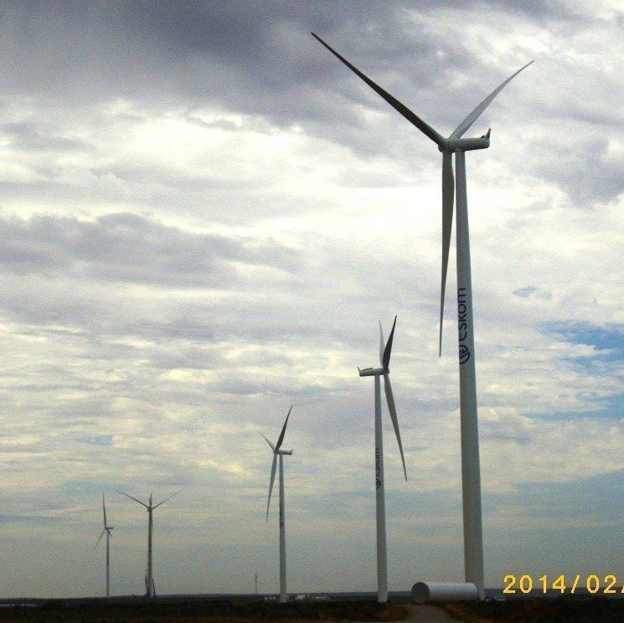
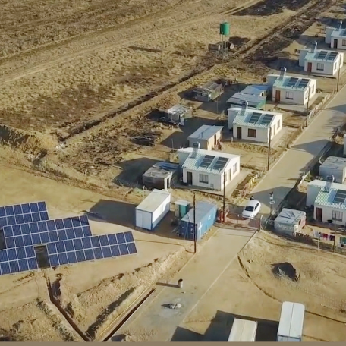
Clarification meeting
Eskom Top Talent Programme for a period of 36 months: Business Modules
Leadership Effectiveness Unit
30 May 2025

Slide 2
Context and Purpose: Top Talent Programme (TTP)
Background:
Exco, in 2022, approved the implementation of a Talent Programme, as part of an expanded retention strategy for Eskom
Participants went through a rigorous nomination and selection process
The first cohort started in October 2022 with 37 participants, of which 34 participants successfully completed the full programme
After an extensive review process, Exco approved the continuation of the programme with specific improvement requirements - Business modules
Cohort 2 started their collective developmental journey on 25 March 2025, and Cohort 3 & 4 will commence on 16 September 2025
Purpose:
The purpose of the TTP is to develop, fast track and retain key talent as identified by divisional / executive talent boards
Specifically, to build a deep succession pool for senior management and general management positions

Slide 3
Top Talent Programme – High level architecture (24 months)
Accountability framework socialisation
Nomination and selection process
On-boarding Process
Expectations as Future-fit Eskom leader
Programme outcomes
Unique development focus – as outcome of assessment / career conversation
Assign executive coach
Tailor made Individual Development plan
Pre-programme
Individual development journey
elements
Implementation of Individual Development Plan elements
Further studies, Business school exposure, Work assignment / secondments / special strategic projects
Executive Coaching
Leadership Foundation and EQ Skillset
Action learning projects based on business challenges identified and sponsored by EXCO with solutions presented at EXCO
Collective development journey
elements
Two distinct but integrated phases to the AL projects
Phase 1: Solution to the business challenge
Phase 2: Implementation of Action Learning solution
Business
Foundation
Immersion to enhance practical experience
Periodical Exco engagements
Self-assessment on knowledge aspects
Focus of this tender

Slide 4
Scope of work
Eskom requires collaboration with a business school, or leadership development provider to co-design, develop and facilitate six (6) foundational business modules, customised for Eskom, as part of a comprehensive Top Talent Programme.
The business modules are:
  1. Strategy and Execution (2 days)
  2. Profit Dynamics in energy (2 days)
  3. Strategic Stakeholder Management & Influencing (2 days)
  4. Strategic Supply Chain & Contract Management (2 days)
  5. Strategic People Management (2 days)
  6. Climate Change, Sustainability & Driving Innovation (2 days)

Slide 5
Scope of work
Eskom requires to partner with a suitable business school / leadership development partner to provide:
Design and Development:
Co-design and customised curriculum: the module content to be designed, developed and facilitated in partnership with Eskom’s Subject Matter Experts (SME’s) and aligned with the organisation's strategic needs.
Integrating Real-World Eskom Challenges: incorporate business-specific scenarios, projects, problem-solving exercises and post work assignments.
Facilitation:
Modules to be facilitated by industry experts and in collaboration with Eskom SMEs
Blended Delivery Methodology: use multiple delivery methodology e.g., classroom (2 days), off site learning at the service provider facilities, online (where applicable), and experiential learning.
Program Evaluation: the program to integrate post-program assessments.

Slide 6








Key learning principles
Leadership programmes are flexible in nature to allow for continuous review and refinement of process and knowledge components to ensure continuous fit for purpose delivery.
All core leadership programmes, across all segments, will follow the inside-out philosophy. This includes both individual reflective practice as well as collective reflection and learning; to equip leadership to drive the delivery of the organisation strategy with a different mindset.
Inside-out philosophy
Continuous improvement
Best in class partnerships
Sound partnerships with external providers to deepen learning and provide leaders with outside-in experiences of leading leadership effectiveness behavioural practices. Partnership components will be co-designed and delivered in conjunction with Eskom’s Leadership Effectiveness Unit.
Programme measurement
In person development
Evaluate effectiveness of programmes through feedback forms, including application of learning and business impact which forms part of the integrated measurement focus for leadership effectiveness.
It is imperative that sound leadership development programmes are delivered mostly in person, as programmes are focused on driving mindset change and are experiential in nature. However, blended components of virtual and possible AI learning is infused to drive digital fluency. Knowledge components can be delivered virtually / via the e-learning platform.
Development programmes
Programmes are facilitated to create mindset change through experiential learning experiences which could include the utilisation fit for purpose field immersions, crisis simulations and/or innovation labs. All programmes include sound methodologies to drive behaviour change for effective delivery of Eskom’s strategy.

Slide 7
Technical Evaluation Criteria
Criteria | Weight %
Quality of content development | 40%
Integrating of business modules to the broader architecture and real-time Eskom Challenges | 35%
Quality of facilitators | 15%
Programme management, Venue, Administration and Logistics | 10%
Total | 100%
The threshold on the technical evaluation criteria is 80%. In cases where service providers score less than 80% they will not be evaluated further.

