Slide 1
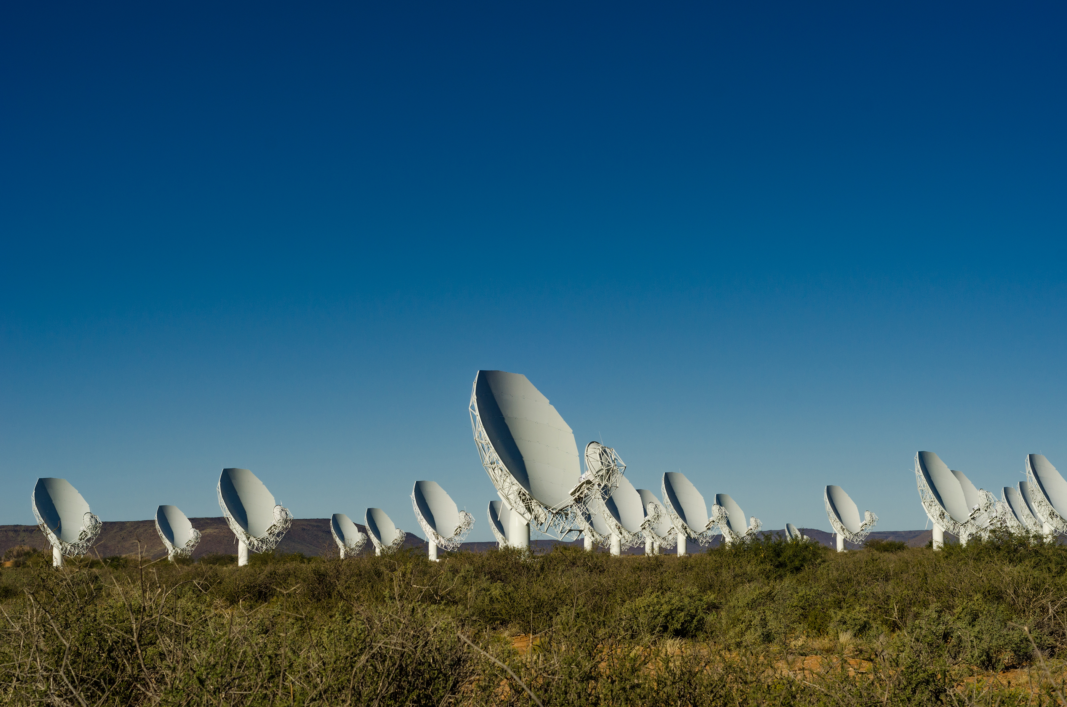

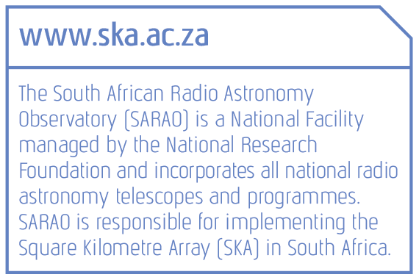
SARAO JHB OFFICE FIT-OUT REQUIRMENTS

Slide 2
CONTENT
Design Principles
Fit-out Principles
Applied Principles
Fit-out Examples

Slide 3

DESIGN PRINCIPLES
Main Building Access Control – Separate access for existing tenants
The use of Technology - Digital displays, room booking, video conference
  Existing parking bays
Indoor Air Quality must be improved
Thermal Comfort must be improved
Maximum use of Natural Light
Adequate Lighting
Acoustics must be improved
Ergonomics
Breakout spaces for meetings/ discussions
  Quiet spaces
Energy Efficiency Management to be adopted
Waste and Recycling System
Water Management System
Expandability

Slide 4
FIT-OUT PRINCIPLES
Open Workstation with screening (Allocated) - 8m²
Open Workstation with screening (Hot Desk) - 6m²
Standard Office(HR, Finance, GIS Sys, Bookable) (No.4) - 12m²
Quiet room for calls etc. (1 for each 20 open desks) - 6m² ,
Small meeting room (1 for each 30 open desks) - 12m²
Medium meeting room (1 for each 50 open desks) - 18m²
Large meeting room (1 for each 60 open desks) - 24m²
Small conference room (1 for every 70 staff) - 48m²
Circulation - 25% of nett area
Bathrooms - existing to be used
Small kitchen (1 on every floor) - 10m²
Main kitchen (Top Mezzanine floor) - 30m²
Reference document: Fit-out Standards August 2014 Government of South Australia

Slide 5
FIT-OUT PRINCIPLES
Office lockable cupboards, shelves & lateral filing – Standard Office
General storage cupboards (1 for every 40 staff) - 10m²
Store room - 12m²
Utility room (print etc.) - 12m²
Staff lockers - 1 for every 5 open desk
Exiting Reception Area - 48m²
Existing Server room – No.1
Strong Room (incl. Vault Door) - 12m²
Reference document: Fit-out Standards August 2014 Government of South Australia

Slide 6
APPLIED PRINCIPLES
45 Office Staff
Personal Workspaces | Workspaces No. | Benchmark Area (m²) | Nett Area (m²)
Open Workstation (Allocated) | 4 | 8 | 32
Open Workstation (Hot Desk) | 35 | 6 | 210
Standard Office (HR, Finance, GIS System, Bookable) | 4 | 12 | 48
Sub-Total | 45 |  | 290
Note: Cleaning protocol to be in place, due COVID-19

Slide 7
APPLIED PRINCIPLES
Interactive Spaces | No. | Benchmark Area (m²) | Nett Area (m²)
Quiet room/ (one on one meeting rooms) | 8 | 6 | 48
Small Meeting room (seat 4) | 16 | 12 | 192
Medium Meeting room (seat 6) | 7 | 18 | 126
Large Meeting room (seat 10) | 2 | 24 | 48
Small Conference room (seat 16) | 1 | 48 | 48
Medium Conference room (seat 22) – [Exiting Lab area to be converted] | 1 | 60 | 60
Small Kitchen | 2 | 10 | 20
Staff Breakout-kitchen (Top Mezzanine floor) | 1 | 20 | 20
Sub-Total 3 interactive workspaces |  |  | 562

Slide 8
APPLIED PRINCIPLES
Support Spaces | No. | Benchmark Area (m²) | Nett Area (m²)
Open plan medium meeting (seat 4) | 2 | 8 | 16
Open plan storage (filing) lockable cupboards (1 per person) | 45 | 4 | 108
General storage (joinery) | 2 | 10 | 20
Storeroom | 1 | 12 | 12
Strong room (Incl. Vault Door) | 1 | 12 | 12
Small utility room | 1 | 12 | 12
Staff lockers | 0 | 10 | 0
IT server room | 1 | 6 | 6
Reception-waiting space | 1 | 30 | 30
Sub-Total 3 support spaces |  |  | 216

Slide 9
APPLIED PRINCIPLES
Total Gross Areas | (m²)
Net office Area (Sub-Total 1 + 2 + 3) | 290+562+216 = 1068
Circulation (25%) | 267
Total gross office area (Sub-Total 4) (Excludes Interactive & Support Spaces) | 1,335
Average area per SARAO staff | 24 m² (based on net office area) | 30m² (based on total gross office area)

Slide 10
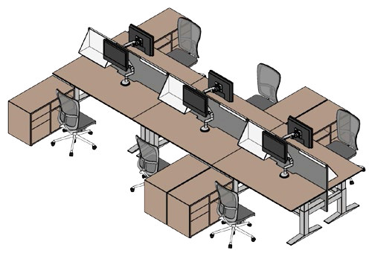
FIT-OUT EXAMPLES
Open Desks

Slide 11
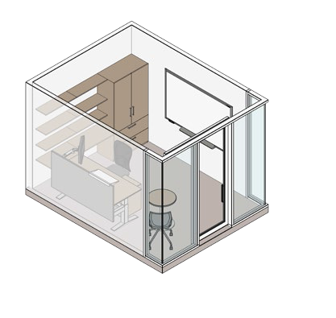
FIT-OUT EXAMPLES
Standard office

Slide 12
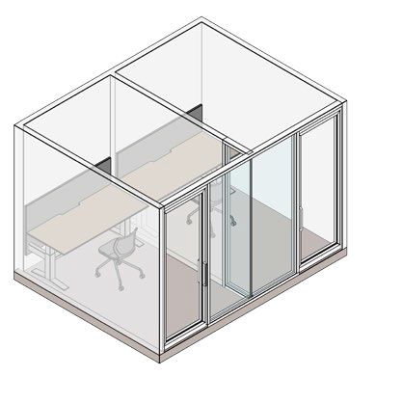
FIT-OUT EXAMPLES
Quiet room

Slide 13
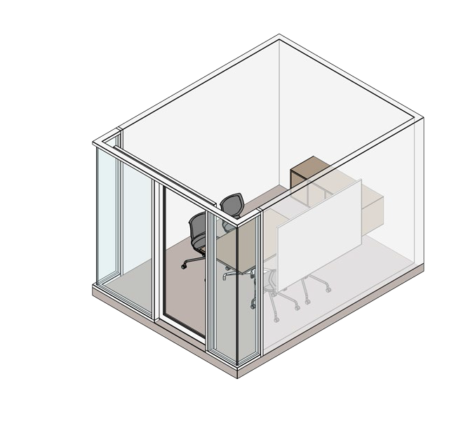
FIT-OUT EXAMPLES
Small Meeting room

Slide 14
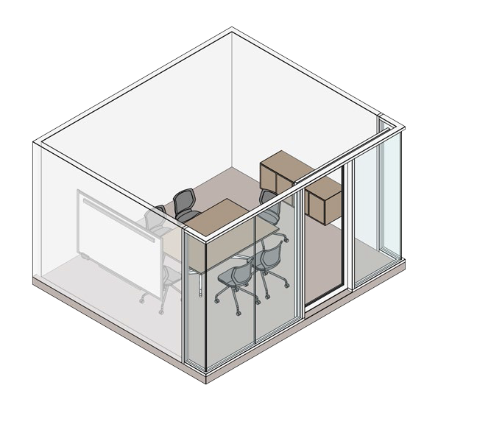
FIT-OUT EXAMPLES
Medium Meeting Room

Slide 15
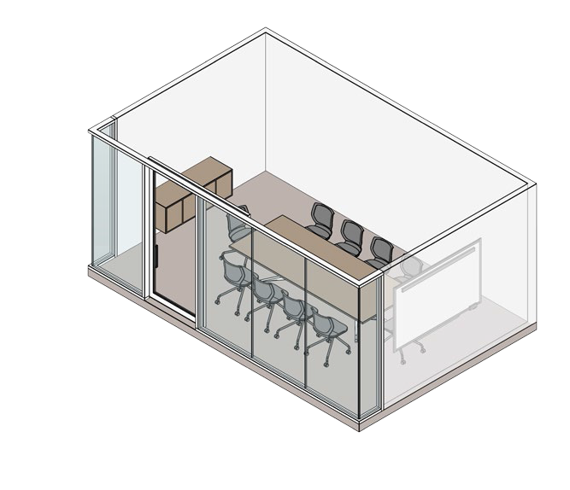
FIT-OUT EXAMPLES
Large Meeting Room

Slide 16
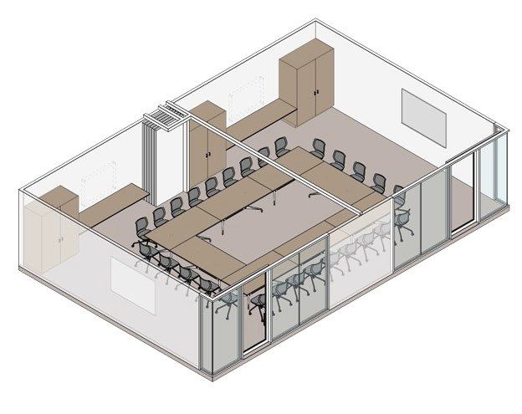
FIT-OUT EXAMPLES
Small conference rooms

Slide 17
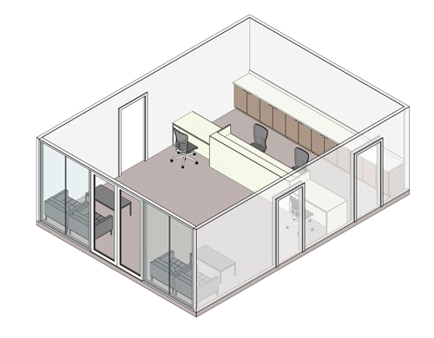
FIT-OUT EXAMPLES
Reception

Slide 18
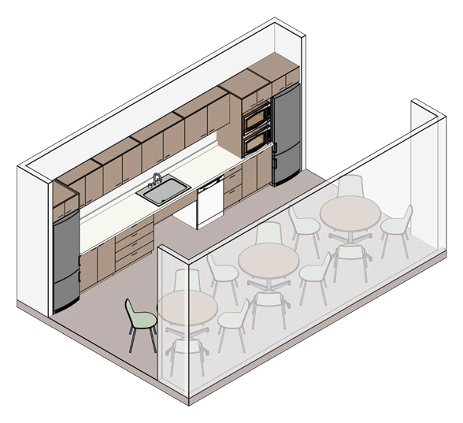
FIT-OUT EXAMPLES
Small Kitchen

Slide 19
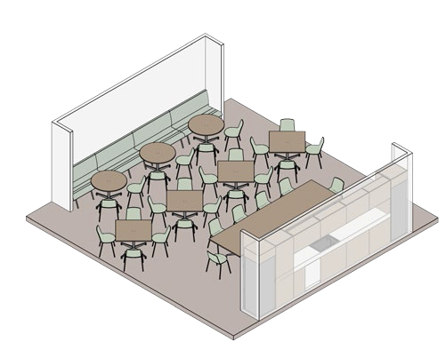
FIT-OUT EXAMPLES
Large Kitchen

Slide 20
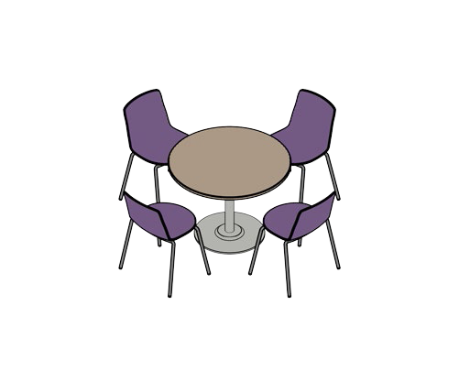
FIT-OUT EXAMPLES
Open plan meeting

Slide 21
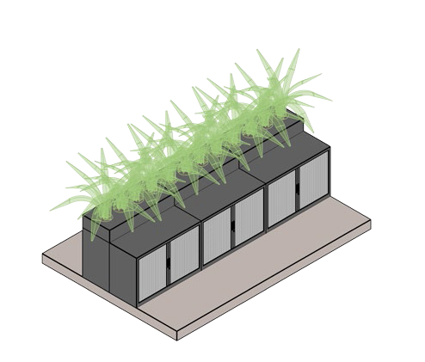
FIT-OUT EXAMPLES
Open Plan Storage

Slide 22
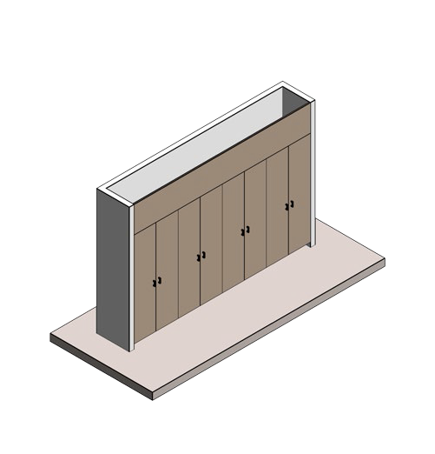
FIT-OUT EXAMPLES
General Storage

Slide 23
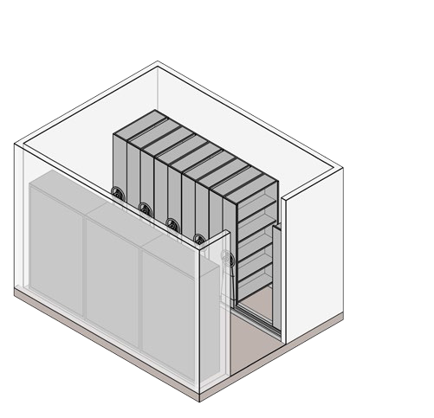
FIT-OUT EXAMPLES
Store room

Slide 24
FIT-OUT EXAMPLES
Strong room including Vault door

Slide 25
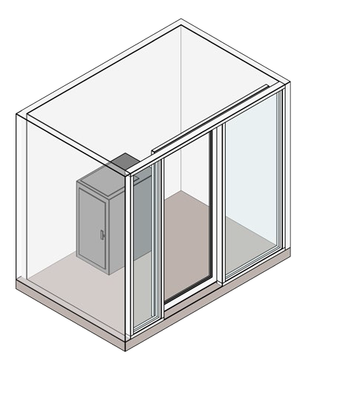
FIT-OUT EXAMPLES
Server room

Slide 26
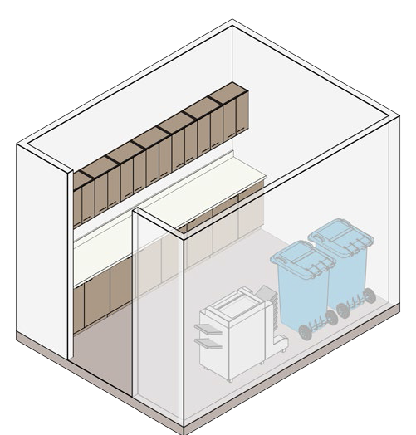
FIT-OUT EXAMPLES
Utility room

Slide 27
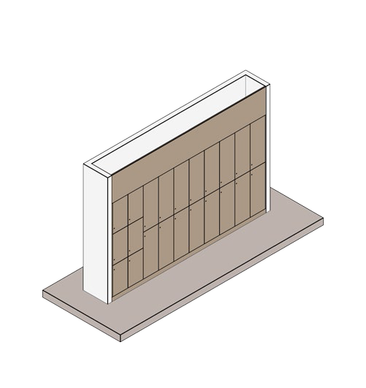
FIT-OUT EXAMPLES
Staff lockers

Slide 28

