Slide 1

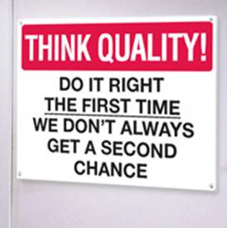


Substation Building Maintenance Clarification
Presented by: Noxolo Mngadi
Date: 27 November 2025

Slide 2
Content of the presentation
  Quality Requirement Category 4
  Section A – document submission
  Section B – document submission
  Complete Section E:Form A

Slide 3
Section A
A.1 Populate the Quality Method Statement template (The statement to be aligned to ISO 9001:2015 )
Clauses of ISO 9001:2015
  Clause 4 - Context of organization
  Clause 5 – Leadership
  Clause 6 – Planning
  Clause 7 – Support
  Clause 8 – Operation
  Clause 9 – Performance Evaluation
  Clause 10 – Improvement
Notes:
QMS

Slide 4
Section A
A.2 Quality Policy Approved by top management
Commitment to: meet customer requirements / expectations; continual improvement; satisfying all applicable requirements including statutory requirements.
A.4 Control of documented information
Describe how documents are approved, distributed, retrieved, reviewed. Control of obsolete and external origin.
Describe storage(how records are kept), protection, retrieval, retention time and disposal of records
Notes:
QMS

Slide 5
Section A
A.6 Documented information for Non-Conformance and Corrective Action
•Describe -elimination of detected non-conformance
•Describe process of Corrective Action –Prevention of recurrence (ID root cause)
A.7 Documented information for Internal audit
Planned interval, conducted by trained and independent personnel, who will conduct, how will they conduct and intervals. Reporting and correction of audit findings
Notes:
QMS

Slide 6
Section B
B.1 Documented information for defined roles, responsibilities and authorities
Submits either of these documents
  Organogram
  Job Profile
  Responsibility Matrix etc.
  Please ensure that the Quality Roles / Function is detailed

Slide 7
Section B
B.2 Documented information for Control of Externally Provided Processes, Products and Services
Describe how you ensure that work completed/supplied by external party (Sub-Contractor, Suppliers) compiles with the requirements.
  Selection
  Evaluation
  On going monitoring
  Inspection
  Product acceptance /approval / final Inspection
  Controls that you have in place
Notes:
Controls

Slide 8
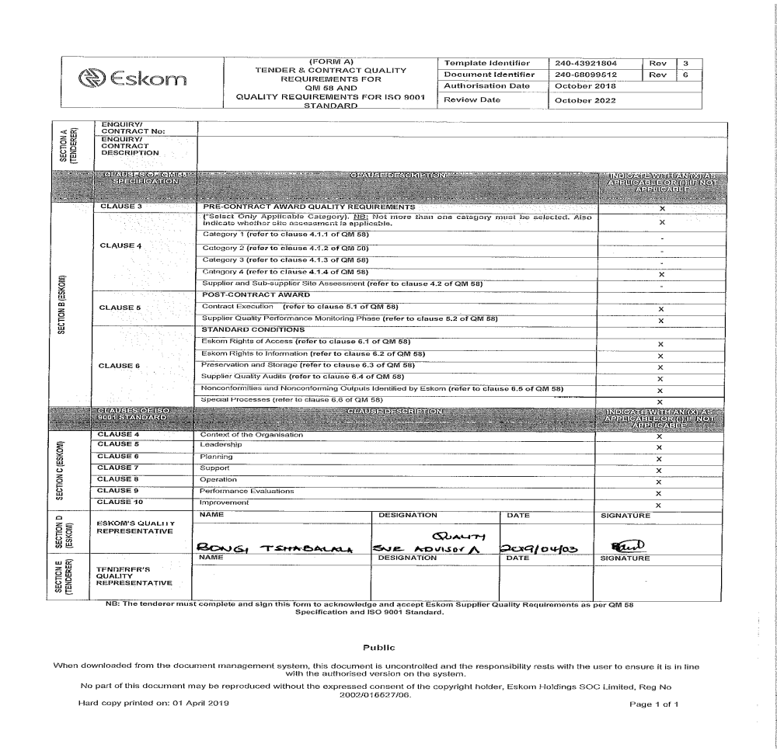
Section E - Form A completion and signing
Complete here
Complete and sign here

Slide 9
Omission Noted
Section A
  Documents not compliant to ISO 9001:2015 requirements (A1,A2,A4,A6,A7)
  Documents compliant to ISO 9001:2015 but reference made to ISO 9001:2008
  Quality Policy not approved
Section B
  B.1 Documented information for defined roles, responsibilities and authorities
    Quality role not included
  B.2 Documented information for Control of Externally Provided Processes, Products and Services
    Documentation control process only listed – no indication of other process e.g supplier/contractor management

Slide 10
Omission Noted
Section E
  Form A – enquiry number and description omitted
  Not signed by Quality Rep or Director

Slide 11


