Slide 1
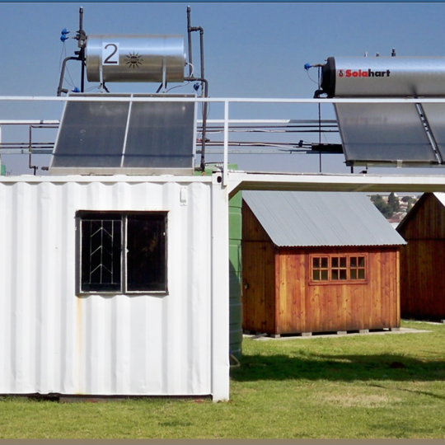
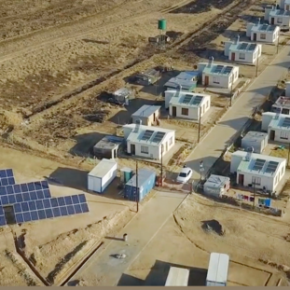
Financial Evaluation Requirements
2026 FY

Slide 2
Content
Public Interest Score
Financial Statements and ITA 34C
Notes to Financial Statement
Addition Information

Slide 3
Public Interest Score
  The Public Interest Score letter must specify:
1. Whether the AFS were internally or externally prepared.
2. Whether the company was owner managed or not owner managed.
  The Public Interest Score does not apply to companies that have been audited.

Slide 4
Financial Statement
Latest approved financial statements including comparative amounts.
AFS must be valid and not outdated, received within 18 months after year-end.
A signed director’s / member’s report.
Signed Compilers / Accounting Officers / Independent Reviewers / Audit report whichever is applicable, based on the PIS above.
Where the PIS requires an Audit or Independent Reviewers report, the Compilers / Accounting Officers report must still be submitted.
Approved Annual Financial statements must comprise :
o Statement of financial position ( Balance Sheet )
o Statement of comprehensive income ( income statement )
o Statement of changes in Equity
o Statement of cash flows
o Notes to the financial statements
o ITA 34C Income Tax Assessment for companies that have NOT been AUDITED
      ITA 34C must be provided for the current and previous financial years.
      The turnover amount shown on income statement must correspond to amount shown in ITA 34C.
      Financial analyses will not be performed if the amounts do not correspond.

Slide 5
Notes to Financial Statements
The notes to the AFS specifically referring to Accounts Receivable and Accounts Payable must give a complete breakdown of the amounts. A clear distinction must be made between Trade Debtors and other receivables as well Trade Creditors and other payables. The note must clearly show the amounts subject to interest and the terms and condition of interest.
The notes to the AFS must clearly specify the current and non-current liabilities that are subject to interest.
Members / Directors loans must be accompanied by a note specifying the terms of the loan, whether secured or unsecured, terms of repayment and interest rates.
Name of Holding company if the company is a subsidiary company.
Where there is a Holding company the Latest Signed Group Annual Financial Statements of the Holding Company may be requested at a later stage.
Information requested from companies via Procurement Office not received within five working days from date of Finance request will result in the financial evaluation being closed. Finance will issue a 1-page report stating that an opinion could not be expressed due to insufficient information.

Slide 6
Additional Information
Public Draft, bi-annual, management accounts and unsigned financial statements will NOT be accepted.
Soft copies of the AFS/required documents may be requested.

Slide 7
Conclusion

