Slide 1
.
HO/CITYTOCITY/512/02/2025
REQUEST FOR PROPOSAL (RFP) FOR APPOINTMENT OF A SUITABLE SERVICE PROVIDER FOR THE MANUFACTURING, SUPPLY, DELIVERY AND SERVICING OF INTERCITY COACHES

Slide 2
SUPPLY CHAIN MANAGEMENT PRESENTATION
DE-BRIEFING ON TENDER NUMBER: HO/CITYTOCITY/421/11/2024
REASONS FOR RE-ISSUE OF THE BID
The tender was non- responsive.
Bidders that tendered were disqualified on Technical Evaluation , they did not meet the 75% threshold

Slide 3
THE MANUFACTURING, SUPPLY, DELIVERY AND SERVICING OF INTERCITY COACHES
The purpose of the RFP
To set out the rules of participation in the Bid process referred to in this RFP.
To disseminate information on the Project contemplated in this RFP.
To give guidance to Bidders on the preparation of their RFP Bids.
To gather information from Bidders that is verifiable and can be evaluated for the purposes of appointing a successful Bidder.
To enable PRASA to select a successful Bidder that is:
technically and financially qualified and meet the empowerment criteria described in this RFP;
has sufficient experience in similar work,
has commitment and resources to provide the services required in this tender; and
carry all the obligations of the Contract.

Slide 4
RFP TIME TABLE
RFP PROCESS | MILESTONE DATES
Bid issue date | 12 March 2025
Compulsory Briefing Session for Bidders | 18 March 2025 @ 10H00
Closing date for Questions | 25 March 2025
Closing date for Responses | 27 March 2025
Closing Date for Submission of final Bid | 03 April @12H00

Slide 5
EVALUATION AND SCORING METHODOLOGY
THE EVALUATION CRITERIA
The evaluation of the Bids by the evaluation committees will be conducted at
Various levels. The following levels will be applied in the evaluation.
a) Verify completeness
b) Verify compliance
c) Detailed Evaluation of Technical –Not Applicable
e) Price Evaluation
f) Specific Goals.
g) Recommendation
h) Best and Final Offer
i) Approval

Slide 6
The evaluation committee shall use the following Evaluation Criteria depicted in the table below for the selection of the preferred bidder that shall render / deliver the required works, goods and / or services.
EVALUATION PROCESS
EVALUATION PROCESS
Stage 1
Compliance | Mandatory Compliance
 | B. Technical Other Mandatory Compliance
 | C. Other Mandatory Compliance
Stage 2
Price | 90
Specific Goals | 10
TOTAL | 100

Slide 7
STAGE 1A: MANDATORY REQUIREMENTS
If you do not submit/meet the following mandatory documents/requirements, your bid will be automatically disqualified:
^{NO} | ^{DESCRIPTION OF REQUIREMENT} | ^{COMPLIANCE: YES/NO}
¹ | In case of a Joint Venture, Consortium Agreement or Partnering Agreement it must be signed by all parties. The agreement must indicate the leading bidder where applicable and a copy of the Joint Venture, Consortium Agreement or Partnering Agreement, (If applicable) must be submitted with the tender. If not submitted, the bid will be automatically disqualified.
² | Proof of registration as a Vehicle Builder Proof of registration as a Vehicle Manufacturer Proof of registration as a Vehicle Importer

Slide 8
If you do not submit/meet the following mandatory documents/requirements, PRASA may request the bidder to submit the information within five (5) working days. Should this information not be provided, your bid proposal will be disqualified:
TECHNICAL OTHER MANDATORY COMPLIANCE
^{NO} | ^{DESCRIPTION OF REQUIREMENT} | ^{COMPLIANCE: YES/NO}
¹ | Engine: 330kW Output minimum. To be Euro 5 compliant (OEM approved specification sheet or OEM approved certificate must be supplied)
² | The permitted front axle load capacity must not be less than 7 500kg (OEM approved specification sheet or OEM approved certificate must be supplied)
³ | Bolt-On – Maintenance Contract (Coach - Chassis and Body) including Roadside Assistance and Tow-In Services as per tender documents.
^{4.} | The bidder must submit a detailed production and delivery schedule for the project which shows estimated start, finish and delivery dates to LDPT.
⁵ | Provide proof of national footprint.

Slide 9
STAGE 1B: OTHER MANDATORY COMPLIANCE
^{No.} | ^{Description} | ^{Comply}
^{a)} | Completion of ALL RFP documentation (includes ALL declarations, ALL Standard Bidding Documents (SBD)
^{b)} | ^{Letter of Good Standing: COID}
^{c)} | ^{Supply of valid SARS Pin}
^{d)} | ^{Company registration documents}
^{e)} | Copies of Directors’ ID documents
^{f)} | CSD supplier registration number

Slide 10
A maximum of 90 points is allocated for price on the following basis
STAGE 3: PRICING AND SPECIFIC GOALS - (To be submitted in envelope 2)
^{ITEM} | ^{POINTS}
^{PRICE} | ⁹⁰
^{SPECIFIC GOALS} | ¹⁰
TOTAL POINTS FOR PRICE AND SPECIFIC GOALS | ¹⁰⁰

Slide 11
Note to tenderers: The tenderer must indicate how they claim points for each preference point system.)
SPECIFIC GOALS
.
THE SPECIFIC GOALS ALLOCATED POINTS IN TERMS OF THIS TENDER | NUMBER OF POINTS ALLOCATED (90/10 SYSTEM) (TO BE COMPLETED BY THE ORGAN OF STATE) | NUMBER OF POINTS CLAIMED. (90/10 SYSTEM) (TO BE COMPLETED BY THE TENDERER) | SUPPORTING EVIDENCE TO BE PROVIDED BY THE TENDERER
Entities with a B-BBEE contributor status level of at least level 2 | 10 |  | BEE Certificate not limited to SANAS approved/ Affidavit (in case of JV, a consolidated scorecard will be accepted)
TOTAL | 10

Slide 12
TENDER VALIDITY
This RFP shall be valid for [180 days] calculated from date of Closing of this RFP.
B-BBEE REQUIREMENTS (10)
A Bidder must submit proof of Specific Goals , a Bidder failing to submit may not be disqualified and will score 0 points out of 10 for Specific Goal
JOINT VENTURE ( B-BBEE REQUIREMENTS )
Note: Failure to submit a valid and original B-BBEE certificate for the JV or a certified copy thereof at the Closing Date of this RFP will result in a score of zero being allocated for
Specific Goal
PRICING
Respondents are required to complete the Pricing Schedule/ Annexure B1:(Volume 2 /Envelop 2) and Tender Form C
EVALUATION CONT.

Slide 13
SUBMISSION OF RFP RESPONSES
INSTRUCTION FOR RESPONDING TO THE RFP
Responses to RFP must be submitted to PRASA by 03 April 2025@ 12 :00 ,at the following address: PRASA Corporate Office
UMJANTSHI HOUSE
30 WOLMARANS STREET
BRAAMFONTEIN , JOHANNEBURG
Bidders are required to complete the tender closing register when submitting their bids .
No Responses to RFP received by facsimile, telegram, telex, e-mail or other similar format will be accepted as a validly submitted Response to RFP.
A Response to RFP shall be late if it is received by PRASA at any time after the closing date and time indicated in paragraph above.
A late submission shall be clearly marked as late and shall not be admitted for consideration by PRASA. Late submissions shall be returned unopened to the submitting party.

Slide 14
RESPONSES TO THE RFP FORMAT
INSTRUCTION FOR RESPONDING TO THE RFP
All responses to the RFP must be submitted in two sealed envelopes/boxes; the first envelop/box shall have the Compliance and Technical Response, and the second envelop/box shall only have the Financial Response and Specific Goals.
Bidders must ensure that they do not indicate any financial information in the first envelop/box.
Volume 1 (Envelop 1/Package 1)
• Part A: Compliance Response
Volume 2 (Envelop 2/ Package 2)
• Part B: Financial Proposal and Specific Goals

Slide 15
RESPONSES TO THE RFP FORMAT Cont.
Volume 2 Has to be submitted in a separate sealed envelope. Bidders must make their pricing offer in envelop 2/package 2, no pricing and pricing related information should be included in the Volume 1 envelop 1.
Bidders must submit 1 original response, 1 copy and an electronic version which must be contained in CDs or Memory Cards clearly marked in the Bidders name.

Slide 16
RFP CLARIFICATIION FORM , ANNEXURE C
COMMUNICATION:
1. For specific queries relating to this RFP during the RFP process, bidders are required to adhere strictly to the communication structure requirements. An RFP Clarification Form should be submitted to Zoliswa Yangairo by no later than March 2025, substantially in the form set out in Annexure C hereto.
2. In the interest of fairness and transparency PRASA’s response to such a query will be made available to all the other Respondents who have attended a compulsory briefing session. For this purpose, PRASA will communicate with Respondents using the contact details provided at the compulsory briefing session.
3. After the closing date of the RFP, a Respondent may only communicate in writing with the Bid Secretariat, to zoliswa.yangairo@prasa.com, on any matter relating to its RFP Proposal

Slide 17
The following documents were uploaded on etender portal
DOCUMENTS ON ETENDER PORTAL :
DRAFT CONTRACT
ANNEXURE A - APPENDICES - PRASA TENDER RETURNABLE FORMS.PDF
ANNEXURE B2 VOLUME 2_FORM C V1.PDF
MASTER RFP - MANUFACTURING SUPPLY DELIVERY ANDSERVICING OF INTERCITY COACHES.PDF
ANNEXURE B1 - INTER CITY COACH - PRICING SCHEDULE -.PDF
ANNEXURE C. CLARIFICATION FORMS- FINAL.XLSX

Slide 18
SCOPE OF WORK
TECHNICAL PRESENTATION
INTRODUCTION
The PRASA Long-Distance Passenger Division was established on the 1^{st of} August 2024, to provide integrated road and rail passenger services.
The road passenger services (long distance coaches/buses) are not subsidized and compete in the open market. The Division is furthermore obliged to comply with the Climate Change Act 22 of 2024. Apart from safety requirements, the specification also take these two aspects into consideration.
Rebranding of the PRASA Long-Distance Passenger Division is in progress and subsequently the detail is not available at present, however the bidders must make provision for the use of a four-color variation, which will be sufficient to cover the cost of the new paint-layout and logo.

Slide 19
TECHNICAL PRESENTATION
PREFERRED SOLUTION
Phase one is the outright purchase of approximately 17 standard coaches in the 2025 financial year ending March 2025 – this tender.
Phase two will happen in the next financial year when approximately 78 coaches will be procured, on a financial lease basis, pending approval by the Minister of Finance as required in Section66(3) of the PFMA.
The same supplier of the buses/coaches must offer bolt-on, full maintenance contracts, which is charged and payable per kilometer operated, monthly, for the period of 6-years or 1.4 million kilometers whichever comes first, for both the chassis and body.
The road passenger services workshops have been restructured to cater for new buses/coaches with “bolt-on” maintenance contracts, in other words, the restructuring makes provision that the new buses must be maintained by the same supplier that is supplying the buses/coaches for obvious reasons such as warranty, reliability, availability and countrywide roadside assistance.

Slide 20
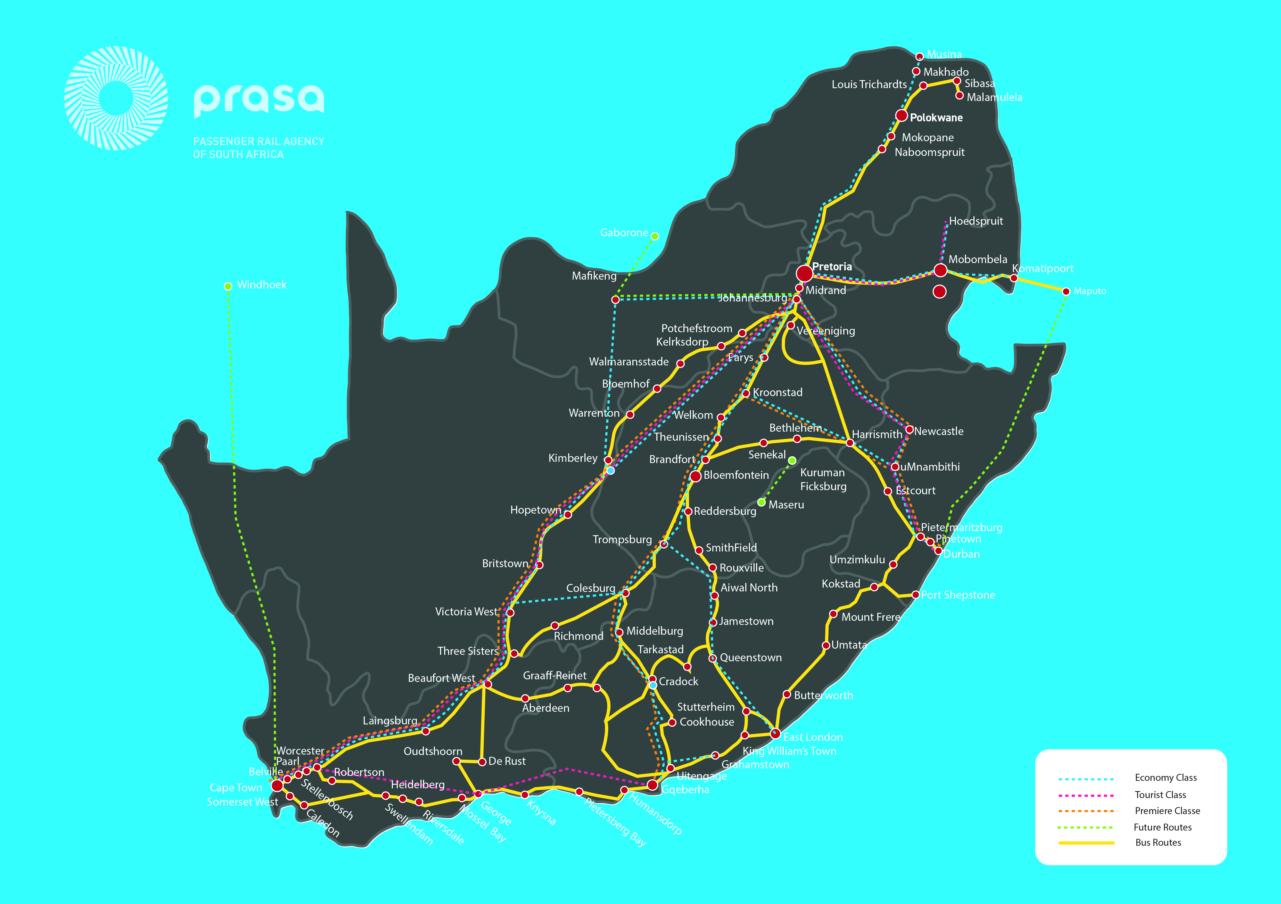

Slide 21
ON-ROUTE SUPPORT
To ensure Parts Coverage and Up-Time availability, please note the Routes that will be covered initially.
  Route 1: Pretoria to Cape Town, via Bloemfontein or vis Kimberly, and visa versa, from Cape Town via Bloemfontein or via Kimberly to Pretoria. Route 2: Cape Town via East London, Gqeberha, via Mthatha/Kokstad to Durban and visa versa, from Durban to Cape Town
PRASA TRAINING
The successful tenderer will provide the driver and technical staff training on the new coaches.
Driver training encompasses the training of 3 (three) accessor drivers in the Gauteng area.
Technical staff training encompasses the training of Technical Staff at three locations, Pretoria, Johannesburg and Cape Town.
Technical staff must be trained to perform tasks which falls outside of the bolt on maintenance agreements, for example:
  Pre-trip Inspections (Pre-Trip Inspection Sheet will be agreed on)
  Engine oil top-ups when necessary. Engine oil top-ups to be excluded from the maintenance contract rate.
  Fault Codes, etc.

Slide 22
PREFERRED COACH SPECIFICATIONS AND SUPPORT
Rear Engine Mounted Coach Chassis – a rear engine coach chassis lends itself to a coach design where low entrance passenger access is possible, and luggage space can be maximized.
Euro 5 Compliant – It is an obligation to operate the most environmentally friendly coaches available, and suitable for South African conditions (fuel quality availability), ensuring the least toxic exhaust gas emissions.
Engine Protection System – To prevent overheating and low oil pressure failures.
Front Axle Carrying Capacity – It is important to have the maximum available front axle loading capacity to ensure safety, furthermore, to maximize the Gross Vehicle Mass (GVM) so that provision for luggage weight is maximized.
Coach – The coach is homologated in South Africa (and SABS 1563 Roll-Over Compliant). Note that local content is not favored in this tender.
Driver Cabin Locker – a lockable cabin locker for driver belongings inside the driving compartment.
Fuel Tank 700 Liter (Minimum) and Add-Blue Capacity – Fuel capacity to cater for refueling at PRASA Depots only with the Add-Blue to match the distance covered without it being necessary to replenish.

Slide 23
PREFERRED COACH SPECIFICATIONS AND SUPPORT
Underfloor Body-Side Luggage Lockers – Rear engine chassis - maximum luggage capacity in the wheelbase.
Air Conditioning (heating and cooling) – Through the air conditioner heat exchanger situated in the aircon unit on top of the roof, which operates by using forced air blown through heat exchanger into the parcel shelves air conditioner ducting, not on the floor on the side corners of the coach. Centrally controlled by the driver.
Maintenance Service and Repairs – will be done at the supplier’s premises.
Body and Air Conditioner Maintenance Contracts – preferably done whilst the bus/coach is serviced by the supplier, the routine body and air conditioner unit maintenance is done as well.
Accident Repair Facility – Accident insurance will be for PRASA account through its insurance policy and procedures. Accident repairs done by the supplier’s accident repair service provider must be warranted by the supplier.
Intelligent Transportation Systems (ITS) – information is made available to PRASA as standard, and part of the maintenance contract (Automatic Vehicle Location, Vehicle Monitoring and Driver Monitoring).
Finally, note that a Performance/Bid Bond is not required for tender submission or upon acceptance of the tender.
THANK YOU AND BLESSINGS

Slide 24
THANK YOU
APPOINTMENT OF A SUITABLE SERVICE PROVIDER FOR THE MANUFACTURING, SUPPLY AND DELIVERY OF INTERCITY COACHES.
QUESTIONS TO BE SEND VIA EMAIL USING RFP CLARIFICATION FORM: ANNEXURE C.

