Slide 1
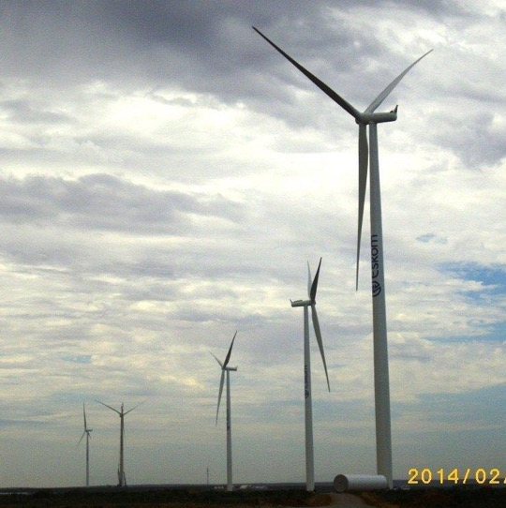
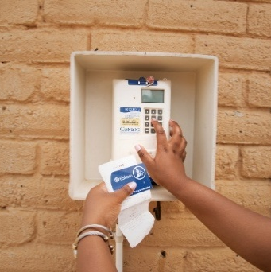
FINANCIAL REQUIREMENTS
Site Clarification Meeting
Presented by: Dumisani Mtarini
09 July 2026

Slide 2
Purpose & Roles
Provide an independent opinion on whether a potential supplier is financially viable to perform under the contract.
Identify upfront any financial difficulty that could disrupt delivery over the contract period.
Who performs the analysis
Centre of Excellence (COE): sets the methodology and analyses contracts of R300m and above.
Finance Business Partners (FBPs): analyse contracts under R300m.

Slide 3
Documents Suppliers Must Submit
Approved Annual Financial Statements (AFS) - signed and valid
Auditor / independent reviewer / accounting officer / compiler report
Signed director / member report
Public Interest Score (PIS)
ITA34C income tax assessment (only where the supplier is not audited)
Completed Financial Analysis Information List form
Validity: AFS received within 18 months of year end (S30, Companies Act). Turnaround: 10 working days when the submission is complete.

Slide 4
Level of Assurance - Public Interest Score
Element of the Public Interest Score | Points Allocation
Average number of employees during the year | Every employee = 1 point
Third party liability at financial year end | R1m (or portion thereof) = 1 point
Turnover for the financial year | R1m (or portion thereof) = 1 point
Shareholders / beneficial owners | One shareholder / owner = 1 point
Always subject to audit (any PIS): state-owned companies; public companies (listed & non-listed); companies holding fiduciary assets over R5,000,000; or where the MOI requires an audit.

Slide 5
Required Level of Assurance (PIS Interpretation)
Public Interest Score | Internally Compiled | Independently Compiled
Owner managed - 350 | Audit | Audit
Owner managed - 100 to 349 | Audit | Compilation
Owner managed - 100 or less | Compilation | Compilation
Not owner managed - 350 | Audit | Audit
Not owner managed - 100 to 349 | Audit | Independent review
Not owner managed - 100 or less | Independent review | Independent review
Assurance levels: Audit = reasonable assurance; Independent review = moderate assurance; Compilation = low assurance.
Owner-managed businesses are treated as less risky than non-owner-managed.

Slide 6
The Four Analysis Criteria
1. Going Concern - the auditor report is reviewed for doubt over the supplier ability to continue; an unqualified opinion is preferred.
2. Financial Ratios - liquidity, working capital, gearing and profitability measured against benchmarks for the current and prior year.
3. Cash Flow Position - required working capital compared with available - key for construction or upfront-cash contracts.
4. Contract Size - the average annual contract value must not exceed 50% of turnover.
Foreign-currency statements are first converted to ZAR using the Eskom Treasury rate. Mathematical errors must be corrected within 5 working days.

Slide 7
Financial Ratios & Benchmarks
Category | Ratio | Benchmark
Liquidity | Current ratio = current assets / current liabilities | >=2
Liquidity | Quick ratio = (current assets - inventory) / current liabilities | >=1
Working capital | Inventory turnover = cost of sales / inventory | >=6
Working capital | Stock days = (inventory x days) / cost of sales | <=60 days
Working capital | Debtors days = (receivables x days) / credit sales | <=60 days
Working capital | Creditors days = (payables x days) / cost of sales | <=60 days
Gearing | Debt to equity = total borrowings / equity | <=1, >0
Gearing | Interest cover = profit before tax & interest / interest | >=3
Profitability | Gross profit / revenue | >=10%
Profitability | Net profit before tax & interest / revenue | >=5%
Profitability | Return on assets = profit before tax & interest / assets | >=5%
Profitability | Return on equity = profit after tax & interest / equity | >=10%

Slide 8
Contract Size vs Financial Strength
The average annual contract value must not exceed 50% of the supplier turnover.
Maximum contract value = turnover x 50% x contract period (years).
If the contract exceeds this, a lower value is recommended.
Worked example
R30m contract over 3 years; supplier turnover R13.5m.
R13.5m x 50% x 3 = R20.25m maximum.
Recommendation: award a value not exceeding R20.25m.

Slide 9
Concluding, Safeguards & Reporting
Financially sound when: no going-concern issue, good ratios, sufficient cash, and contract size within financial strength.
Parent company guarantee - where a subsidiary is weak but the group is financially sound.
Performance bond - typically 10% of contract value (construction / engineering contracts).
Not sound (no recommendation) - a going-concern issue or overall poor financial position.
Reporting - standardised report; valid for 18 months; align submissions with tender committee dates.

Slide 10
Key Points to Communicate
Submit complete, signed and approved statements - within 18 months of year end.
The Public Interest Score sets the assurance level: audit, review or compilation.
Viability rests on going concern, financial ratios, cash flow and contract size.
Contract value should not exceed 50% of turnover over the contract period.
Marginal suppliers may need a parent guarantee or a 10% performance bond.
Reports are valid for 18 months - plan submissions around tender committee dates.

Slide 11
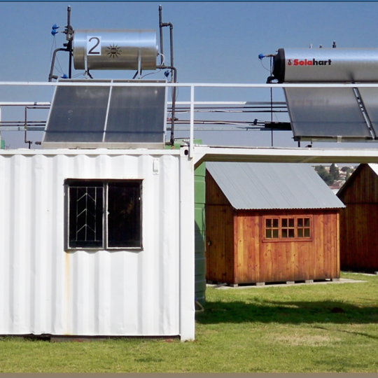

Thank you

