Slide 1
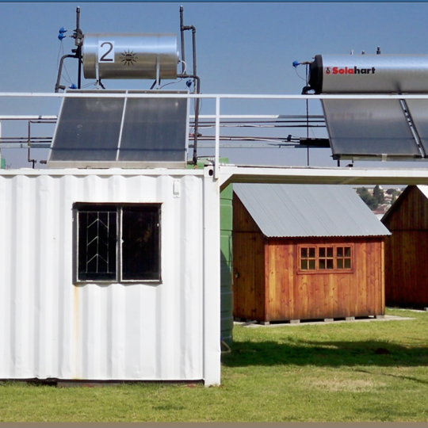
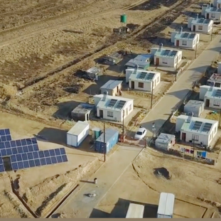
Electric Fence for the Meteorology Station for Lethabo Power Station
MWP2703CX
End User: Chantelle Moll / Sibusiso Maphumulo
4 September 2024

Slide 2
Content
Site Location
Scope
Technical Evaluation
NEC

Slide 3
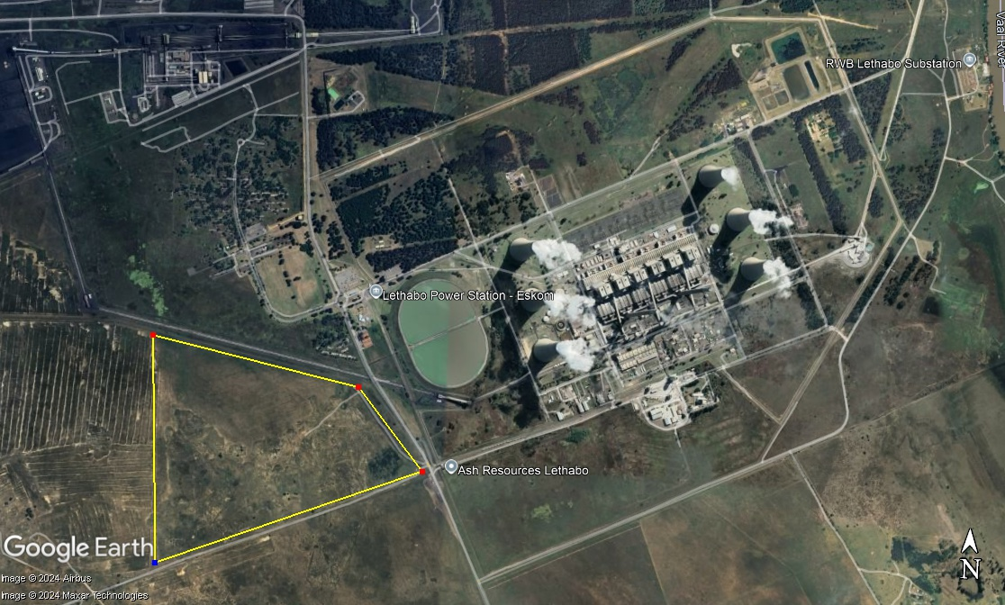
Site Location

Slide 4
Scope
Supply, delivery, installation and commissioning of a self-sustained, electric fence with app integration for remote health monitoring.
The security fence will be installed at the weather station location near Lethabo Power Station.
A 30m x 30 m fence is required with a pedestrian gate. The fence must be 2m high.
20 strand high strain wire fully galvanised fencing. The supplier it to provide the necessary posts, fittings and any other additional equipment required for installation (cement, etc).
Self-sustained electrical fencing must be installed which must include:
  Power supply including solar panels, battery backup, axillary electronics as necessary (charge controllers, energiser, regulator, protection system (battery-reversal, surge & ESD protection), etc),
  All the components required for remote health monitoring and data transmission via internet must be supplied (Accentronix Infinity with all axillary equipment, GPS/GPRS modem, antenna, booster aerial, etc - if needed),
  Strobe light and siren,
  Tensioners and strain insulators, all to be fireproof.
  Weatherproof enclosure for electrical components.
Earthing must be compliance with SABS standards.
All operational and maintenance manual to be provided after commission.

Slide 5
Scope
Additional information and document to be provided with the tender.
The contractor will be required to submit a safety file prior to commencement.
The contractor is to specify the warranty period of the full installation (workmanship) as well as the warranty of each component (fence, battery, solar panel, etc).
The company profile must be provided with the tender documents detailing company structure (organogram), core business areas, products, and services offered, breakdown of previous projects.
Past experience of the contractor must be submitted with the tender documents including track records, contracts with clients, reference letters or purchase orders for previous work / projects / contracts over the past 3 years. Include information such as description of the works, value and duration of the work.
A detailed equipment list must be submitted with the tender document, this list is to include a full list of equipment as well as all technical data sheets.
The contractor is to submit a high level scope and execution plan. Details of app features and handover documentation pack and any exclusion must be provided.

Slide 6
Technical Evaluation Criteria
Technical Returnables
Company Profile
Company Experience
Technical data sheet for all equipment
Scope and execution plan
Evaluation
Threshold of 70%.

Slide 7
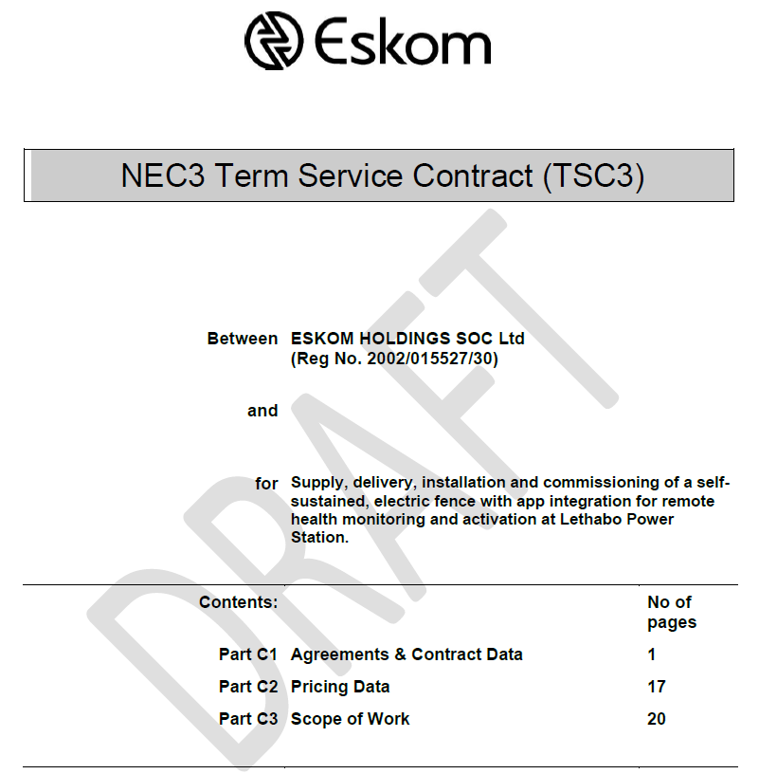
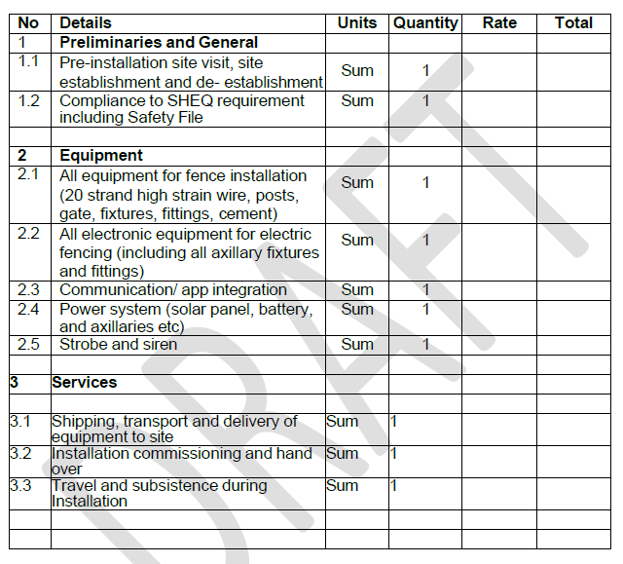
NEC

Slide 8
Questions

