Slide 1
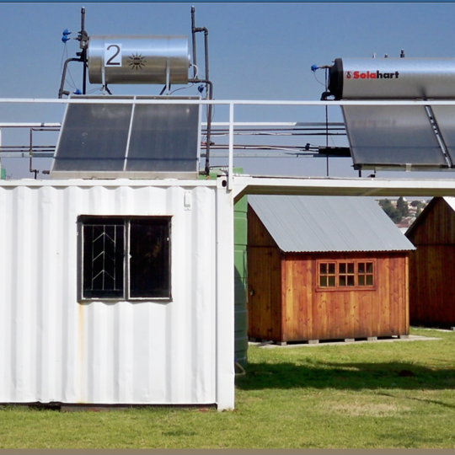
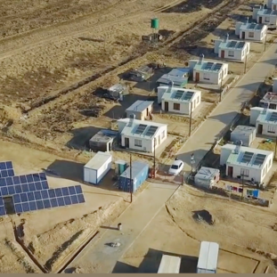
Clarification Meeting for Provision of Tax Health Assessment Review at Eskom Holdings SOC Ltd and National Transmission Company South Africa (NTCSA) for the Period of twelve (12) Months.
Pam Nolutshungu
18 March 2025

Slide 2
AGENDA
Welcome
Details of Enquiry
Commercial - Applicable
Safety & SDL&I – Applicable
Questions and Answers

Slide 3
Purpose of the clarification meeting
To assist the tenderers in understanding and complying with the requirements of this tender.
To provide a comprehensive explanation of the implications of the evaluation process and to outline, in detail the phases through which the tender will be subjected.
To assist the tenderers in complying with the requirements of the tender documents.
To ensure that the tenderers have a clear understanding of the required submissions necessary for their tender to be deemed responsive.
This clarification meeting is non-compulsory and attendance is at the tenderers discretion. Failure to attend will not lead to the disqualification of any suppliers tender documents.

Slide 4
Details of the Enquiry
Tender Number: E2633CXMWP
Closing Dates as Follows: 03 April 2026 at 10h00 / 10:00am (SAST) South African Standard Time.
All tenders must be submitted online via Eskom E-Tendering. No hard copies will be accepted at the tender office for this tender. Please be advised that access to the E-Tendering system is only available through the Eskom Tender Bulletin.
Contract duration will be for a period of four (4) months.
Eskom reserves the right to enter into negotiations with any one or more of the respondents. Please be advised that being invited to a negotiation meeting does not guarantee contract award; it is simply a required step in the procurement process.
Eskom reserves the right to negotiate any aspect that Eskom deems necessary.

Slide 5
Details of the Enquiry
NO LATE TENDERS WILL BE ACCEPTED.
Tender documents may be submitted prior to the closing date on the Eskom E-Tendering system as stipulated in the Invitation to Tender.
It is strongly advisable that tenderers avoid submitting their tender documents at the last minute. Late submissions may results in tenders not being received by 10:00 AM on the closing date, 03 April 2026 and such tenders will be considered late and deemed unacceptable.

Slide 6
Commercial Documents
Invitation to Tender
NEC3 Professional Services Short Contract (PSSC3)
These document to be completed accordingly and returned with the below listed Compliance documents.
Valid Letter of Good Standing (COIDA) – issued by Department of Labour
Company Registration Documents – issued by CIPC
B-BBEE Certificate /Sworn Affidavit – that is fully completed, correctly filled out and stamped by the authorized oath commissioner must be submitted. Failure to comply will result in a B-BBEE score of zero.
Tax Clearance Certificate - issued by SARS must be submitted.
CSD Report - for the bid company must be downloaded within the last 7 days.
Annexure J

Slide 7
Commercial Documents
SBD 4 - Declaration of interest
- requires a Declaration of Interest from applicants, stating any existing relationship /acquaintance with Eskom employees. This is to ensure that these persons are not involved in any way, to avoid corruption.
Supplier Tax Evaluation Pack – attached and must be filled and submitted back.

Slide 8
Eskom Tender Portal
Technical: Return documents as per technical evaluation criteria.
Contractual requirements:
  Safety and Health: Return documents as per safety evaluation criteria
  SDNL&I: Return documents as per SDNL&I evaluation criteria.

Slide 9
Eskom Tender Portal – Folder to be added
The new folder will be created on Eskom Tender Bulletin if there's any addition in this tender including questions from other suppliers and answers from Eskom employees. Please check the folder regularly for any addition that may be sent.
Please note that on Page 17 of the Invitation to Tender document there is a Document titled Annexure A “Acknowledgment Form” that must be completed accordingly and returned with the tender.
Please note that this clarification presentation will be uploaded on the Eskom Tender bulletin, they will serve as minutes of the clarification meeting.
Please note that questions should always be sent in writing to the email address stipulated in the Invitation to Tender on page 04 which is jiyanebp@eskom.co.za
Please do not address questions to any Eskom email addresses of persons you may know working for Eskom whether they be employees in the Procurement, Safety, Quality, Technical or SDL&I Sections.

Slide 10
Evaluation process and criteria:
Basic Compliance: Commercial
Basic compliance for this invitation to tender are:
Meet the eligibility criteria for a tenderer
As stipulated on page 04 - 05 of the invitation to tender.
Submit a complete tender with Commercial, Technical and SHEQ information.
Submission of the tender returnables from page 11 - 16 of the invitation to tender as per stipulated deadlines.

Slide 11
Evaluation process and criteria conti……
Tenderers who do not submit mandatory tender returnables as at stipulated deadlines will be disqualified.
Commercial requirements - Page 11 - 16
Technical requirements – Appendix A
SHEQ (Safety) requirements – 13 - 15 Page
SDL&I requirements - SDNL Bidders Strategy
  All Annexures attached to the invitation to tender to be completed accordingly do not leave blank spaces without providing the information, if not applicable indicate as such.
  Functionality (Technical) – Appendix A
  Price and Specific Goals (80/20 Principle)
  Objective Criteria – Not Applicable
  Contractual requirements (SDL&I & Safety)
  ALL DOCUMENTS TO BE SUBMITTED AT STIPULATED DEADLINES AS PER INVITATION TO TENDER

Slide 12
Commercial Requirements
The tenderers must complete the non-disclosure forms attached, to indicate that none of its personnel have any involvement or interest in Eskom and likewise no Eskom personnel have any involvement or interest in the respondent’s business with regard to this tender.
All costs incurred in the preparation, presentation/demonstration, and submission of your tender response will be for the tenderer’s account.
All queries to be addressed to the Buyer in writing. No telephone calls will be accepted for queries regarding this tender.
Closing time for all queries is five (05) working days prior to tender closing date, which is 26 March 2026.
Kindly be advised that the tender closing date will not be extended as Eskom urgently requires these services on site. Please note that sufficient time has been provided to the market and the clarification meeting was held three (3) weeks prior to the tender closing date.

Slide 13
Commercial Requirements ….cont
No correction pen (tippex) is to be used on any page of the tender documents to be submitted to Eskom. Tender documents must not be written in pencil and must be completed in ink. Failure to comply with these requirements will result in the tender being deemed commercially unacceptable.
The information contained in this document is of a confidential nature and may only be used for purpose of responding to this enquiry. This confidentiality clause extends to partners, whom you may decide to involve in preparing a response to this tender.
The tender and any supporting documents submitted as part of your response will become the property of Eskom. Suppliers will not be entitled to request the return of these documents at any time. Pleas be advised that Eskom retains all tender documents for audit purposes.

Slide 14
Eskom Tender Portal – Tender Returnables
Please note that the tender documentation should be submitted in the following format:
It is the suppliers responsibility to ensure that they submit the correct documents to the designated folder. Failure to do so, including submitting documents to the wrong folder, will results in disqualification. Please ensure that all required documents are submitted in each relevant folder, even if this means submitting the same document more than once, as each folder is evaluated independently.
SECTION | ORIGINAL
PART 1 will comprise of the Commercial Requirements | √
PART 2 will comprise of the Technical Requirements | √
PART 3 will comprise of the SHEQ Requirements | √
Part 4 will comprise of Finance Requirements | √

Slide 15
Binding of Tender Documents
Tenderers must ensure:
That they submit their documents electronically well in advance of the closing date to avoid potential technical issues related to internet speed or file upload sizes.
Tenderers are required to review their tender proposals, to ensure they are complete, error-free and all pages are clear and legible (no blurry pages).
Tenderers must ensure that their submissions are organized according to Eskom specified format and instructions. Eskom will not be held accountable if tenders are disqualified due to documents being submitted to the wrong folder.
After submitting your tender, please ensure that you receive the automatic response from Eskom E-tendering system, acknowledging your submission.

Slide 16

Questions and Answer
    Thank you
Thank You

