Slide 1
TENDER CLARIFICATION PRESENTATION
EASTERN REGION

Slide 2
CONTRACT SANRAL X.004-051-2018/1F
CONSULTING ENGINEERING GEOTECHNICAL SERVICES FOR SANRAL EASTERN REGION
Tender documents are available at no cost in electronic format downloadable from SANRAL website https://www.nra.co.za/sanral-tenders/status?region_id=national
Tenderers must have access to Microsoft Office © 2013 and Acrobat Adobe © 9.0, or similar compatible software.

Slide 3
CONTRACT SANRAL X.004-051-2018/1F
CONSULTING ENGINEERING GEOTECHNICAL SERVICES FOR SANRAL EASTERN REGION
NB: IN THE EVENT OF ANY INCONSISTENCIES IN THIS PRESENTATION AND TENDER DOCUMENT, THE TENDER DOCUMENT SHALL TAKE PRECEDENCE UNLESS CONFIRMED IN AN ADDENDUM

Slide 4
1. WELCOME & INTRODUCTION

Slide 5
2. IMPORTANT DATES

Slide 6
IMPORTANT DATES
SUBMISION OF FORM A1.1 CERTIFICATE OF INTENTION TO SUBMIT A TENDER | 27 MARCH 2023
SUBMISSION OF QUERIES | 4 APRIL 2023
TENDER CLOSING DATE | 24 APRIL 2023

Slide 7
3. TENDERING PROCEDURES
T1.1: TENDER NOTICE AND INVITAION TO TENDER

Slide 8
PREQUALIFICATION REQUIREMENTS
PREQUALIFICATION REQUIREMENTS FOR THIS CONTRACT
Eligibility Criteria
Only tenderers with a B-BBEE contributor status level of 1, 2, 3 and 4; who are registered on the National Treasury Central Supplier Database at the tender closing date; and meet the minimum requirements for the key persons as stated in Clause C.2.1 of the Tender Data are eligible to tender.
Joint Ventures (JV) will be allowed on condition that one JV partner is a Targeted Enterprise. The JV partner will, however, not contribute to sub-contract target for Targeted Enterprises.

Slide 9
T1.1 ENQUIRES
Queries relating to issues arising from these documents may be addressed to the following:
ALL ENQUIRIES
Contact Person | ProcurementER4@sanral.co.za

Slide 10
3. TENDERING PROCEDURES
T1.2: TENDER DATA

Slide 11
CONDITIONS OF TENDER
The conditions of tender are the standard conditions of tender as contained in Annexure C of the CIDB STANDARD FOR UNIFORMITY IN ENGINEERING AND CONSTRUCTION WORKS CONTRACTS as per Government Notice No. 423 published in Government Gazette No. 42622 of 08 AUGUST 2019 and as amended from time to time. (see www.cidb.org.za).
https://www.cidb.org.za/wp-content/uploads/2021/07/Standard-for-Uniformity-August-2019.pdf
The standard conditions of tender make several references to the tender data for details that apply specifically to this tender. The tender data shall have precedence in the interpretation of any ambiguity or inconsistency between the tender data and the standard conditions of tender.
Each item of data given below is cross-referenced to the clause marked “C” in the abovementioned Standard Conditions of Tender.

Slide 12
TENDER DATA
CLAUSE NUMBER | TENDER DATA
C1.1 | The Employer is The South African National Road Agency SOC Limited (SANRAL). The Employer’s domicilium citandi et executandi (permanent physical business address) is: 48 Tambotie Avenue VAL DE GRACE 0184 The Employer’s address for communication relating to this project is: SANRAL – Eastern Region 58 Van Eck Place Mkondeni Pietermaritzburg, 3201

Slide 13
TENDER DATA
CLAUSE NUMBER | TENDER DATA
C1.4 | The Employer’s Agent during the tender period is Email: ProcurementER4@sanral.co.za Tenderers to Note. This email address is NOT for submission of tender offers. Tenderers who submit via the above email address will be immediately disqualified.
C1.6 | Procurement Procedures A two-envelope system will be followed.

Slide 14
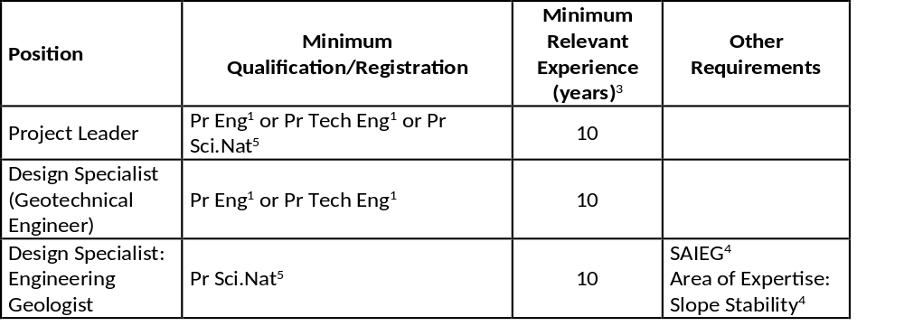
TENDER DATA
C2.1 | Only those tenderers who satisfy the following criteria are eligible to submit tenders: Meet the minimum requirements for the key persons as stated in the Scope of Works in Clause C.3.1.11: Personnel requirements; excluding 3.1.11(f), which is dealt with under Tender Data C.3.13(k). The Key Persons required for this project are: NB: Failure to meet the stipulated minimum eligibility requirements will render the tender non-responsive
¹ Registered with Engineering Council of South Africa (ECSA) or any other international body recognised by ECSA, i.e. Washington Accord, Dublin Accord and Sydney Accord.
⁵ Registered with the South African Council for Natural Scientific Professions (SACNASP)..

Slide 15
TENDER DATA
C.2.1 | Only those tenderers who satisfy the following criteria are eligible to submit tenders: KEY PERSONS (CONT) If a tenderer, including key persons, a joint venture partner or a Targeted Enterprise, submits or participates in more than one tender for the same project (X.004-051-2018/1F) , then all such tenders shall be disqualified (Tender Data C2.13.1) . When a proposed candidate for any position is not in the permanent employ of the tenderer but a contracted person, this must be indicated on form B2 and a signed letter of consent from the candidate must be submitted with the relevant B-forms. Where a proposed candidate for any position is a permanent staff member of the Tenderer - this must be indicated on form B2 and a signed letter of confirmation must be submitted with the relevant B forms. NB: Submit alternative candidates for positions identified, that could have possible conflict, by completing separate Returnable Schedules Forms B1 and B2 for the alternate. The Employer will not request alternative candidates after tender closure and will interpret the lack of any alternative candidate as an indication the tenderer accepts that it will be impossible to be awarded more projects than the limitations applicable to Key Persons. NB: Failure to meet the stipulated minimum eligibility requirements will render the tender non-responsive

Slide 16
TENDER DATA
CLAUSE NUMBER | TENDER DATA
C.2.1 (cont.) | (b) Registered on National Treasury Central Supplier Database. Tenderers, or in the event of a Joint Venture or a Targeted Enterprise, each member of the Joint Venture or Targeted Enterprise, shall be registered on the National Treasury Central Supplier Database at the closing date for tender submissions. If not registered as verified online at tender closing, the tenderer will be declared non-responsive. (c) Criteria for preferential procurement. Tenderers that have a B-BBEE contributor status level of 1, 2, 3 or 4. Tenderers shall submit a valid B-BBEE certificate or Sworn Affidavit (where applicable) in compliance with Tender Data C.3.11 as proof of eligibility.. Failure to satisfy the eligibility criteria may result in a non-responsive tender.

Slide 17
TENDER DATA
C.2.6 | Acknowledging addenda Failure non-responsive in terms of condition of tender C.3.8. Failure to apply instructions contained in addenda may render a tenderer’s offer non-responsive in terms of condition of tender C.3.8.-responsive in terms of condition of tender C.3.8.
C.2.7 | Clarification briefing A compulsory clarification briefing meeting will be held at on 03 April 2023 at 10:00 a.m. A link to the clarification briefing meeting will be sent to tenderers who complete and submit a Certificate of Intention to Submit a Tender (Form A1.1). A tenderer’s representative cannot represent more than one tenderer at the tender briefing meeting.
C.2.8 | Seeking clarification Request clarifications at least 12 (TWELVE) working days before the closing date.

Slide 18
TENDER DATA
C.2.10 | Tenderers are required to state the rates and currencies in Rand. All rates and/or sums tendered shall not be negative.
C.2.12 | Alternative Offers Alternative offers are generally not acceptable due to possible manipulation of the tender process and resulting complexity of the evaluation. Therefore, the submission of alternative tenders is strongly discouraged. The submission of alternative key persons will be declared non-responsive, even if submitted with an alternative financial offer. However, a tenderer wishing to submit an alternative offer shall first apply to the Employer with full details of the principles of the alternative for confirmation that the Employer’s standards and requirements are not compromised or reduced. Such confirmation must have been provided by the Employer in writing at least 5 (five) working days before the date of tender closing, or as extended by an addendum sent to all tenderers. The application shall not be submitted later than 7 (seven) working days before the date of tender closing given in Tender Data Clause C.2.15. Acceptable alternative offers will only be considered from a tenderer with the highest number of evaluation points for the main offer.

Slide 19
TENDER DATA
CLAUSE NUMBER | TENDER DATA
C.2.13.1 | Submitting a tender offer - Participation in More Than One Tender If a tenderer, including key persons, a joint venture partner or a Targeted Enterprise , submits or participates in more than one tender for the same project (X.004-051-2018/1F), then all such tenders shall be disqualified.
C.2.13.2 | The returnable documents shall be electronically completed in their entirety, submitted on the issued software format or fully compatible format, unless otherwise specified. Submission in the tender box Submit the tender offer electronically on a flash drive and printed hard copy of Form of Offer and summary of pricing schedule. (In the relevant MS Word 2013 and MS Excel 2013 format as issued, and not in .pdf format, except where so specified.)

Slide 20
TENDER DATA
CLAUSE NUMBER | TENDER DATA
C.2.13.3 | Only the following needs to be submitted: Volume 3 – Scanned on a flash drive The following information has to be submitted on flash drive: The 1st file in pdf format which contains: Scanned copy of Form of Offer (pdf) AND printed hardcopy of Form of Offer; and Scanned copies of all returnable schedules and attachments (pdf). A 2nd file in Excel format Completed pricing schedule (scanned copy in .pdf and copy in Excel) and printed hardcopy of Summary of Pricing Schedule In the event of any discrepancy between the contents of the electronically priced schedule and the electronically provided pricing schedule in pdf format, the contents of the provided pdf format shall be taken as the valid contents. For the information provided by the tenderer as part of his submission, e.g. rates, the signed print-out shall be taken as the valid submission

Slide 21
TENDER DATA
CLAUSE NUMBER | TENDER DATA
C.2.13.6 | A two-envelope procedure will apply as follows: 1. A folder is provided marked “TECHNICAL PROPOSAL” a. Ensure that all returnable schedules listed in T2.1 List of Returnable Schedules for inclusion in the Technical Proposal and listed in the Technical Proposal folder are electronically completed on a flash drive (all A-Forms on the provided MS Word file and convert to .pdf. and all B-Forms on the provided MS Excel file). Wherever it is a requirement to attach certificates or letters to the returnable schedules, these should be scanned in on the flash drive in .pdf format. b. Upload the A-forms (.pdf), B-Forms (Excel and .pdf) and certificates or letters (.pdf) on the flash drive. The completed flash drive should be marked with the tenderer’s company name, the project number and description and marked “TECHNICAL PROPOSAL”. c. Scan and insert a valid B-BBEE certificate. d. Scan and insert a copy of the completed Form C2.4: Key Persons for this Project and Summary of Normalised Hours Tendered. e. Electronically sign the declaration in the folder. f. Insert the electronically completed flash drive in an envelope marked “TECHNICAL PROPOSAL”.

Slide 22
TENDER DATA
CLAUSE NUMBER | TENDER DATA
C.2.13.6 continued | 2. A folder is provided marked “FINANCIAL PROPOSAL” a. Ensure that all returnable schedules listed in T2.1 List of Returnable Schedules for inclusion in the Financial Proposal and listed in the Financial Proposal folder are electronically completed on a flash drive (Contract Data and Pricing Schedule). Wherever it is a requirement to attach letters or certificates to the returnable schedules, these should be scanned in on the flash drive in .pdf format. The completed flash drive should be marked with the tenderer’s company name, the project number and description and marked “FINANCIAL PROPOSAL”. b. Electronically sign the declaration in the folder. c. Complete and electronically sign the Form of Offer and scan into the folder. A draft copy of this form is provided. d. Scan and insert a copy of the Summary of Pricing Schedule into the folder. e. Insert the electronically completed flash drive in an envelope marked “FINANCIAL PROPOSAL – DO NOT OPEN WITH TECHNICAL PROPOSAL”. Place and seal the signed and completed booklet with the electronically completed flash drive in an envelope marked “FINANCIAL PROPOSAL - DO NOT OPEN WITH TECHNICAL PROPOSAL”. 3. Each envelope shall state on the outside the Employer’s address, contract number and title as well as the Tenderer’s name, authorised representative’s name, postal address and contact telephone numbers. 4. Seal both envelopes in an outer envelope with the words “TENDER” clearly marked and bearing the Employer’s name, contract number and description as well as the Tenderer’s authorised representative’s name, postal address and contact details.

Slide 23
TENDER DATA
CLAUSE NUMBER | TENDER DATA
C.2.13.6 continued | SANRAL will not be held liable where the tenderer submit an electronic tender that cannot be accessed. The tenderer will be declared non-responsive if a tenderer submits: One (1) envelope with 1 (one) document or 1 (one) flash drive (technical and financial); Incorrectly labelled envelopes where the financial offer is labelled technical and the technical offer is labelled financial.

Slide 24
TENDER DATA
CLAUSE NUMBER | TENDER DATA
C.2.15.1 | Submission in Tender box: The Employer’s address for delivery of tender offers and identification details to be shown on each tender offer package are: Location of tender box: Reception, SANRAL Eastern Region Physical address: South African National Roads Agency SOC Limited 58 Van Eck Place Mkondeni Pietermaritzburg 3201 Identification details: Mark the envelope with the tenderer’s company name and the project number and description as follows: TENDER SANRAL X.004-051-2018/1F FOR CONSULTING ENGINEERING GEOTECHNICAL SERVICES FOR SANRAL EASTERN REGION Tenders must be submitted during hours (09:00 to 16:00) Monday to Friday at the Employer’s address. It is in the tenderer’s interest to ensure that the delivery of the tender offer is recorded in the Employer’s tenders received register and deposited in the tender box.

Slide 25
TENDER DATA
CLAUSE NUMBER | TENDER DATA
C.2.15.2 | The closing time for submission of tender offers is 11:00 on Monday, 24 April 2023. Where closing date was extended, documents that were valid at the original closing date, remain valid for the extended closing date.
C.2.16.1 | The tender offer validity period is: 180 days.
C.2.16.2 | Should the tenderer not accept the validity extension or if the tenderer does not withdraw a condition attached to a conditional acceptance, this shall result in a non-responsive tender or the tender is considered to have made an election to exclude itself from the tender process.

Slide 26
TENDER DATA
CLAUSE NUMBER | TENDER DATA
C.2.16.3 | Withdrawal of tender offers Where a tenderer, at any time after the opening of his tender offer but prior to entering into a contract based on his tender offer: withdraws his tender; gives notice of his inability to execute the contract in terms of his tender; or fails to comply with a request made in terms of C.2.17, C.2.18, C.3.9 or C.3.13; such tenderer shall be barred from tendering on any of the Employer’s tenders for a period to be determined by the Employer, but not less than 6 (six) months from a date determined by the Employer. This sanction also applies to tenders under evaluation and not yet awarded. This sanction does not apply to tenders under evaluation where a request for extension for the validity period was not accepted by the tenderer. The Employer may fully or partly exempt a tenderer from the provisions of this conditions if he is of the opinion that the circumstances justify the exemption.

Slide 27
TENDER DATA
CLAUSE NUMBER | TENDER DATA
C.2.18 | Provide other material Any additional information requested under the clause must be provided within 5 (five) working days of date of request.
C.3.1.1 | The Employer shall respond to clarifications received up to 12 (twelve) working days before tender closing date. The Employer shall respond to any clarifications from the tenderers emanating from the addenda until 3 (three) working days before tender closing date.
C.3.2 | The employer shall issue addenda until 10 (ten) working days before tender closing date.
C.3.4.1 | Opening of tender submissions The time for opening of the technical offer via live streaming is: Time: 11h00 on Monday, 24th April 2023 Location: Streaming link to be sent to all tenderers that completed and submitted Form A1.1.

Slide 28
TENDER DATA
CLAUSE NUMBER | TENDER DATA
C.3.7 | Grounds For Rejecting a tender offer in case of corrupt of fraudulent practices Prior to disqualification in terms of section 14.1 of PPR 2017, the Employer shall inform the tenderer and give the tenderer an opportunity to make representations within 14 days as to why the tender submitted should not be disqualified and as to why the tenderer should not be restricted by the National Treasury from conducting any business with any organ of state for a period not exceeding 10 years. In the event of disqualification, the Employer may, at its sole discretion, claim damages from the tenderer and impose a specified period during which tender offers will not be accepted from the offending tenderer and, the Employer shall inform the National Treasury and the CIDB in writing.

Slide 29
TENDER DATA
CLAUSE NUMBER | TENDER DATA
C.3.9 | Arithmetical errors, omissions, discrepancies and imbalanced unit rates Check responsive tenders for discrepancies between amounts in words and amounts in figures. Where there is a discrepancy between the amounts in figures and the amount in words, the amount appearing in the summary to the Pricing Schedule shall govern. Check responsive tender offers for: (a) the gross misplacement of the decimal point in any unit rate; (b) omissions made in completing the Pricing Schedule or Bills of Quantities; or (c) arithmetic errors in: (i) line item totals resulting from the product of a unit rate and a quantity in Bills of Quantities or Schedules of Prices; or (ii) the summation of the prices; (d) imbalanced unit rates. Notify shortlisted tenderers of all errors, omissions or imbalanced rates that are identified in their tender offers.

Slide 30
TENDER DATA
CLAUSE NUMBER | TENDER DATA
C.3.9 Continued | Where the tenderer elects to confirm the errors, omissions or re-balancing of imbalanced rates the tender offer shall be corrected as follows: (a) if Bills of Quantities or Pricing Schedules apply and there is an error in the line item total resulting from the product of the unit rate and the quantity, the unit rate shall govern and the line item total shall be corrected. Where there is an obviously gross misplacement of the decimal point in the unit rate, the line item total as quoted and the unit rate shall be corrected. (b) Where there is an error in the total of the prices either as a result of other corrections required by this checking process or in the tenderer’s addition of prices, the total of the prices shall be corrected. (c) Where the unit rates are imbalanced, adjust such rates by increasing or decreasing them and selected others while retaining the total of the prices derived after any other corrections made under (a) and (b) above. Where there is an omission of a line item, no correction is possible and the offer will be declared non-responsive. Declare as non-responsive and reject any offer from a tenderer who elects not to accept the corrections proposed and subject the tenderer to the sanction under 4.16.2. The tenderer is required to submit balanced unit rates for Rate Only items in the Pricing Schedule. The rates submitted for these items will be taken into account in the evaluation of tenders.

Slide 31
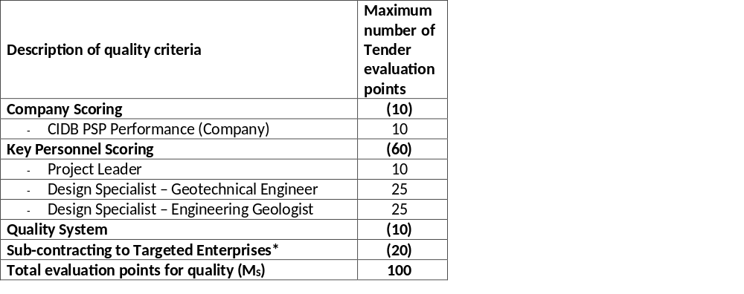
TENDER DATA
CLAUSE | TENDER
C.3.11 | Evaluating quality / functionality The quality criteria and maximum score (including the relevant returnable schedule to calculate the score) in respect of each of the criteria are as follows : A detailed explanation of the evaluation scoring is provided further in this document as “SANRAL – EXPLANATION OF CONSULTANT TENDER EVALUATION SCORING FOR CONVENTIONAL PROJECTS”. * If a Tenderer scores less than 10 points for sub-contracting they will be deemed non-responsive and will not be evaluated further. The minimum number of evaluation points for quality is not less than 80. An explanation of the evaluation methodology is provided as part of Returnable Schedule Form B2.

Slide 32
CLAUSE | TENDER
C.3.11 continued | Key persons As part of the quality criteria as specified above, key persons shall be used to calculate the technical experience and managerial ability score. For this purpose, the tenderer may propose the same candidate for more than 1 (one) position simultaneously. If this is proposed and the evidence of the candidates’ suitability is different for each position in the team then separate Returnable Schedules for each position must be completed. Each proposed candidate shall complete the relevant B1 and B2 forms included in the Returnable Schedules. The Project Leader (PL) and the Assistant Project Leader (APL) (if applicable) will be limited to participate in a maximum number of 6 (six) conventional contracts in active design phase which will be complete when the tender for the Works contract has closed. Design Specialists (DS) and Assistant Design Specialists (ADS) (if applicable) will be limited to participate in a maximum number of 6 (six) conventional contracts in the design phase with the Employer. Tenderers must submit an alternate candidate for those positions identified as being possible areas of conflict by completing separate Returnable Schedules Form B1 and B2 for the alternate. The Employer will not request alternate candidates after tender closure and will interpret the lack of any alternate candidate as an indication the tenderer accepts that it will be impossible to be awarded more projects than the limitations applicable to Key Persons. The Employer reserves the right to select according to its best interest and not the tenderers. When a proposed candidate for any position is not in the permanent employ of the tenderer but a contracted person, this must be indicated on form B2 and a signed letter of consent from the candidate must be submitted with the relevant B-forms. When a proposed candidate for any position is a permanent staff member of the tenderer, this must be indicated on Form B2, and a signed letter of confirmation must be submitted with the relevant B-forms.

Slide 33
TENDER DATA
CLAUSE | TENDER
C.3.11 continued | The following key persons shall form part of the quality criteria: Project Leader - shall be a permanent staff member of the tenderer Design Specialist: Geotechnical Engineer Design Specialist: Engineering Geologist Other required resources (Design Specialist(s)) Additional required resources (Design Specialist(s)) other than Key Persons for this project is as follows: Design Specialist: Pavement and Materials Engineer Design Specialist: Structural Engineer

Slide 34
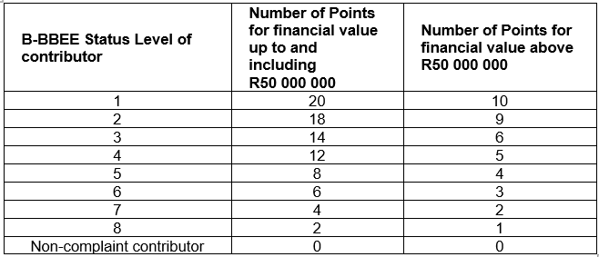
TENDER DATA
CLAUSE | TENDER
C.3.11 continued | The following table must be used to calculate the points out of 20 or 10 for B-BBEE:

Slide 35
TENDER DATA
CLAUSE | TENDER
C.3.11 continued | Eligibility for B-BEE points is subject to the following conditions: A tenderer’s scorecard shall be a B-BBEE Certificate issued in accordance with: the amended Construction Sector Codes published in Notice 931 of 2017 of Government Gazette No. 41287 on 1 December 2017 by the Department of Trade and Industry; or in the event that the Measured Entity operates in more than one sector or a sub-sector, the scorecard for the sector or sub-sector in which the majority of its core activities (measured in terms of annual revenue) are located will be acceptable. The scorecard shall be submitted as a certificate attached to Returnable Schedule Form D1; and The certificate shall: be valid at the tender closing date; and have been issued by a verification agency accredited by the South African National Accreditation System (SANAS) be in the form of a sworn affidavit (accompanied by a financial statement or Management Account on the latest financial year) or a certificate issued by the Companies and Intellectual Property Commission in the case of an Exempted Micro Enterprise (EME) with a total annual revenue of less than R1.8 million if issued in accordance with the amended Construction Sector Codes published in Notice 931 of 2017 of Government Gazette No. 41287 on 1 December 2017 by the Department of Trade and Industry; and have a date of issue less than 12 (twelve) months prior to the original advertised tender closing date (see Tender Data C.2.15);

Slide 36
TENDER DATA
CLAUSE | TENDER
C.3.11 continued | A valid B-BBEE Certificate must contain: Name of enterprise as per enterprise registration documents issued by CIPC, and enterprise business address. Value-Added Tax number, where applicable. The B-BBEE Scorecard against which the certificate is issued, indicating all elements and scores achieved for each element. The actual score achieved must be linked to the total points as per the relevant Codes. B-BBEE status with corresponding procurement recognition level. Have a date of issue and expiry (e.g. 9 June 2018 to 8 June 2019). Where a measured entity was subjected to a re-verification process, due to material change, the B-BBEE Verification Certificate must reflect the initial date of issue, date of re-issue and the initial date of expiry. Re-verification does not extend the lifespan of the B-BBEE Verification Certificate; Financial period which was used to issue the B-BBEE Verification Certificate.

Slide 37
TENDER DATA
CLAUSE | TENDER
C.3.11 continued | A valid Sworn Affidavit must contain: - Name/s of deponent as they appear in the identity document and the identity number. - Designation of the deponent as either the director, owner or member must be indicated in order to know that person is duly authorised to depose of an affidavit. - Name of enterprise as per enterprise registration documents issued by the CIPC, where applicable, and enterprise business address. - Percentage black ownership, black female ownership and whether they fall within a designated group. - Indicate total revenue for the year under review and whether it is based on audited financial statements or management accounts. - Financial year-end as per the enterprise’s registration documents, which was used to determine the total revenue. The valid format of the Financial Year-End is Day/Month/Year. - B-BBEE status level. An enterprise can only have one status level. - Date deponent signed and date of Commissioner of Oath must be the same. - Commissioner of Oath cannot be an employee or ex officio of the enterprise because, a person cannot by law, commission a sworn affidavit in which they have an interest.

Slide 38
TENDER DATA
CLAUSE | TENDER
C.3.11 continued | Compliance with any other information requested to be attached to Returnable Schedule Form D1; and In the event of an un-incorporated Joint Venture (JV), a project-specific consolidated (must contain SANRAL’s project/contract number) valid B-BBEE verification certificate in the name of the JV and issued by a verification agency accredited by the South African National Accreditation System (SANAS) shall be submitted. The points scored by a tenderer for B-BBEE must be added to the points scored for price. The points scored must be rounded off to the nearest two decimal places. Sub-Regulation 6(5) and 7(5) If the tender documents indicate that the tenderer intends subcontracting more than 25% of the value of the contract to any other person not qualifying for at least the status level that the tenderer qualifies for, 0 (zero) points for preference shall be awarded, unless the intended subcontractor is an EME that has the capability to execute the subcontract and the value of the work is below the EME threshold. Criteria for breaking deadlock If two or more tenders score the same number of points and these tenders are also the highest ranked tenders, the tender with the highest preference points will be recommended for award. If functionality is part of the evaluation process and two or more tenders score equal total points and equal preference points, the tender that scored the highest points for functionality will be recommended for award. If two or more tenders score the same number of financial points and preference points and these tenders are also the highest ranked tenders, the tenderer to be recommended for award will be decided by the drawing of lots.

Slide 39
TENDER DATA
CLAUSE | TENDER
C.3.13 (l) | Determine acceptability of preferred tenderer Price negotiations: (a) If the price offered by a tenderer scoring the highest points is not market related, the Organ of state may not award the tender to that tenderer. (b) The Organs of state may – Negotiate a market related price with the tender scoring the highest points or cancel the tender; If the tenderer does not agree to a market related price, negotiate a market related price with the tenderer scoring the second highest points or cancel the tender; If the tenderer scoring the second highest points does not agree to a market related price, negotiate a market related price with the tenderer scoring the third highest points or cancel the tender; (c) If a market related price is not agreed as envisaged in paragraph b(iii), the organ of state must cancel the tender.

Slide 40
TENDER DATA
C.3.17 | Providing copies of the contracts The Employer will provide 1 (one) signed contract document to the Service Provider.
C.3.18 | Providing written reasons for actions taken All requests from tenderers shall be in writing.
SPECIAL CONDITIONS OF TENDER CLAUSES:
SC3.19 | Jurisdiction Unless stated otherwise in the Tender Data, each tenderer and the Employer undertake to accept the jurisdiction of the law courts of the Republic of South Africa.

Slide 41
3. TENDERING PROCEDURES
PART T2: RETURNABLE SCHEDULES

Slide 42
PART T2: RETURNABLE SCHEDULES
Notes to tenderer:
1. Returnable schedules have been based on the CIDB Standard for Uniformity in Construction Procurement and incorporates National Treasury requirements within them. Returnable schedules are separated into the following categories:
i) Forms, certificates and schedules for completion by the tenderer for use in the quantitative and qualitative evaluation of the tender (Forms A, B, C and D).
A list of other returnable documents for completion by the tenderer and which will subsequently be incorporated into the contract (Section C1).
2. Failure to fully complete the relevant returnable documents shall render such a tender offer to be declared non-responsive.
3. Tenderers shall note that their signatures appended to each returnable form represents a declaration that they vouch for the accuracy and correctness of the information provided, including the information provided by candidates proposed for the specified key positions.
4. Notwithstanding any check or audit conducted by or on behalf of the Employer, the information provided in the returnable documents is accepted in good faith and as justification for entering into a contract with a tenderer. If subsequently any information is found to be incorrect such discovery shall be taken as willful misrepresentation by that tenderer to induce the contract. In such event the Employer has the discretionary right under contract condition 8.4 to terminate the contract.

Slide 43
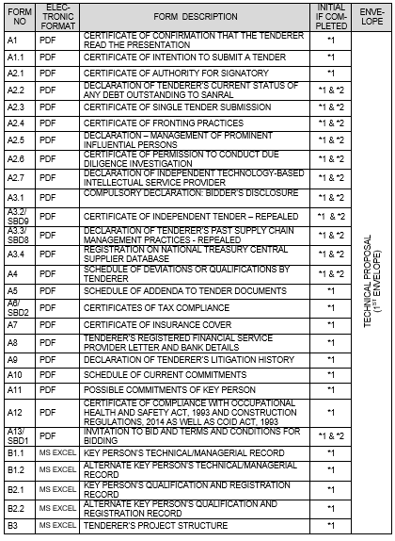
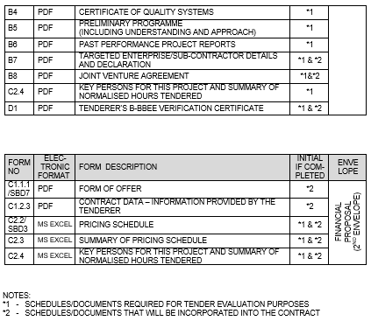
T.2.1 LIST OF RETURNABLE SCHEDULES

Slide 44

RETURNABLE SCHEDULE
FORM A1
CERTIFICATE OF ATTENDANCE AT CLARIFICATION MEETING
NB: TO BE COMPLETED AND SUBMITTED WITH THE TENDER

Slide 45
FORM A2.1: CERTIFICATE OF AUTHORITY FOR SIGNATORY
The signatory for the tenderer
the board of directors/partners resolution.
shall confirm his/her authority
tendering company’s letterhead
Duly signed and dated
In the event of a joint venture, a certificate is required from each member of the JV clearly setting out:
authority for signatory,
undertaking to formally enter into a joint venture contract should an award be made to the joint venture,
name of designated lead member of the intended joint venture, as required by tender condition 4.13.1.
3. The resolution in form A2.1 is given as an example of an acceptable format for authorisation, but submission of this page with the example completed shall not be accepted as authorisation of the tenderer’s signatory.

Slide 46
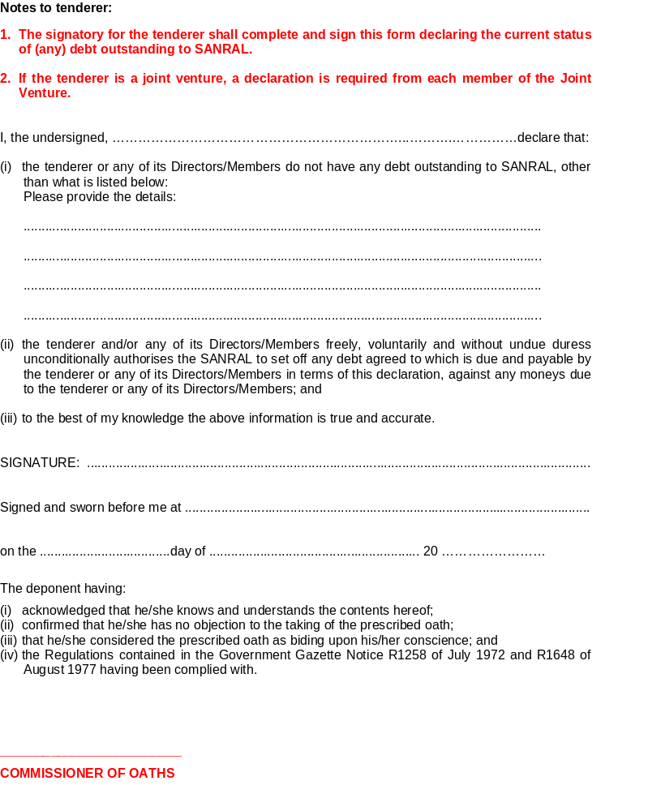
FORM A2.2: DECLARATION OF TENDERER’S CURRENT STATUS OF ANY DEBT
OUTSTANDING TO SANRAL

Slide 47
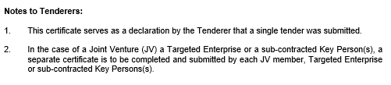
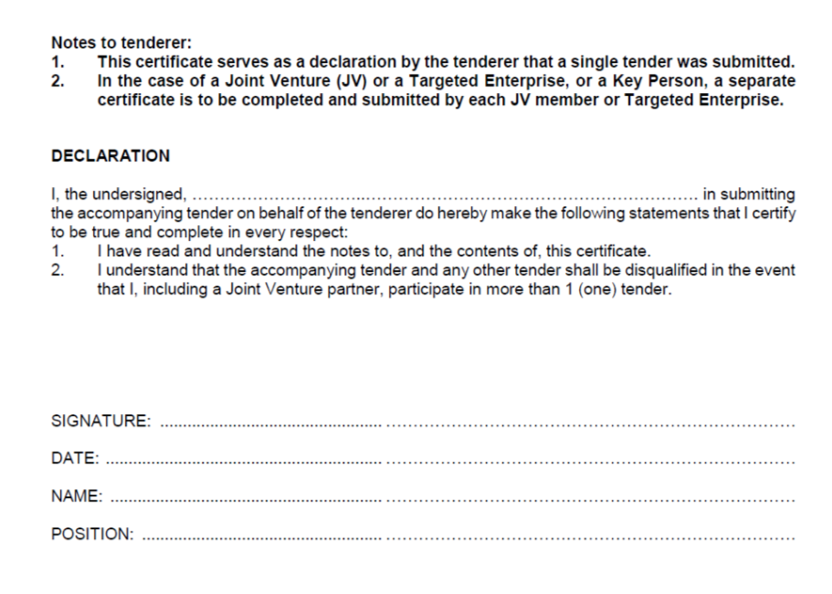
FORM A2.3: CERTIFICATE OF SINGLE TENDER SUBMISSION

Slide 48
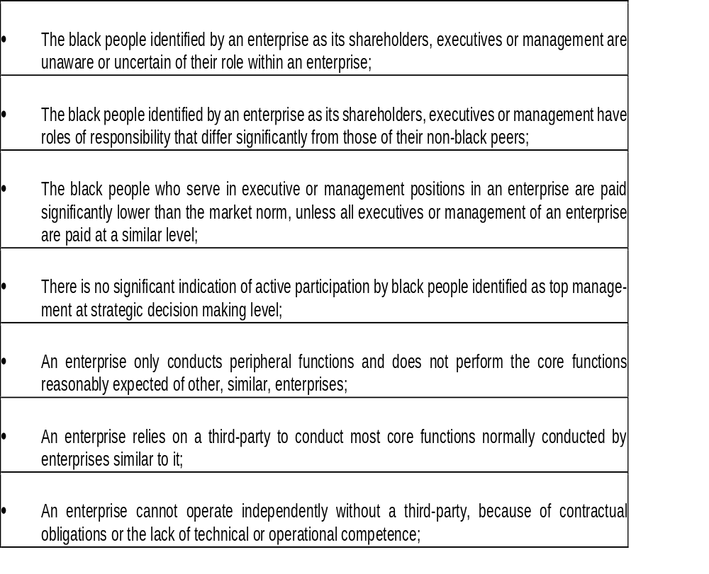
FORM A2.4: CERTIFICATE OF FRONTING PRACTICES

Slide 49
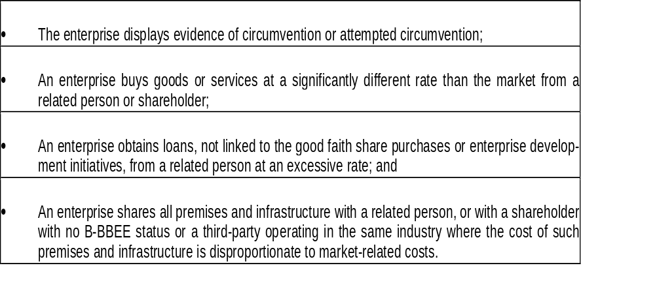


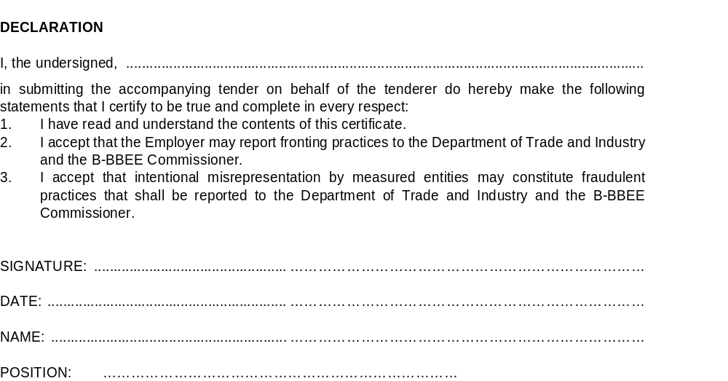

Slide 50
ALL DECLARATIONS TO BE FULLY COMPLETED AND SIGNED
FORM A2.2
FORM A2.3
FORM A2.4
FORM A2.5
FORM A2.6
FORM A2.7
FORM A3.1
FORM A6

Slide 51
RETURNABLE SCHEDULE A3.4 – REGISTRATION ON NATIONAL TREASURY CENTRAL SUPPLIER DATABASE
The tenderer shall provide a pdf. copy of the supplier registration form from National Treasury Central Supplier Database (www.treasury.gov.za). Tenderers who are not registered on the Central Supplier Database at tender closure will be declared non-responsive (refer to Tender Data, Clause C.2.1.1). In the case of a Joint Venture or a Targeted Enterprise, a pdf. supplier registration form must be provided for each member of the Joint Venture or Targeted Enterprise
Name of Service Provider: …………………….…………………………………………………………..
Central Supplier Database Supplier Number: …………………………………………………….
Supplier Commodity: …………………………………………………………………………………………
Delivery Location: ………………………………………………………………………………………………

Slide 52
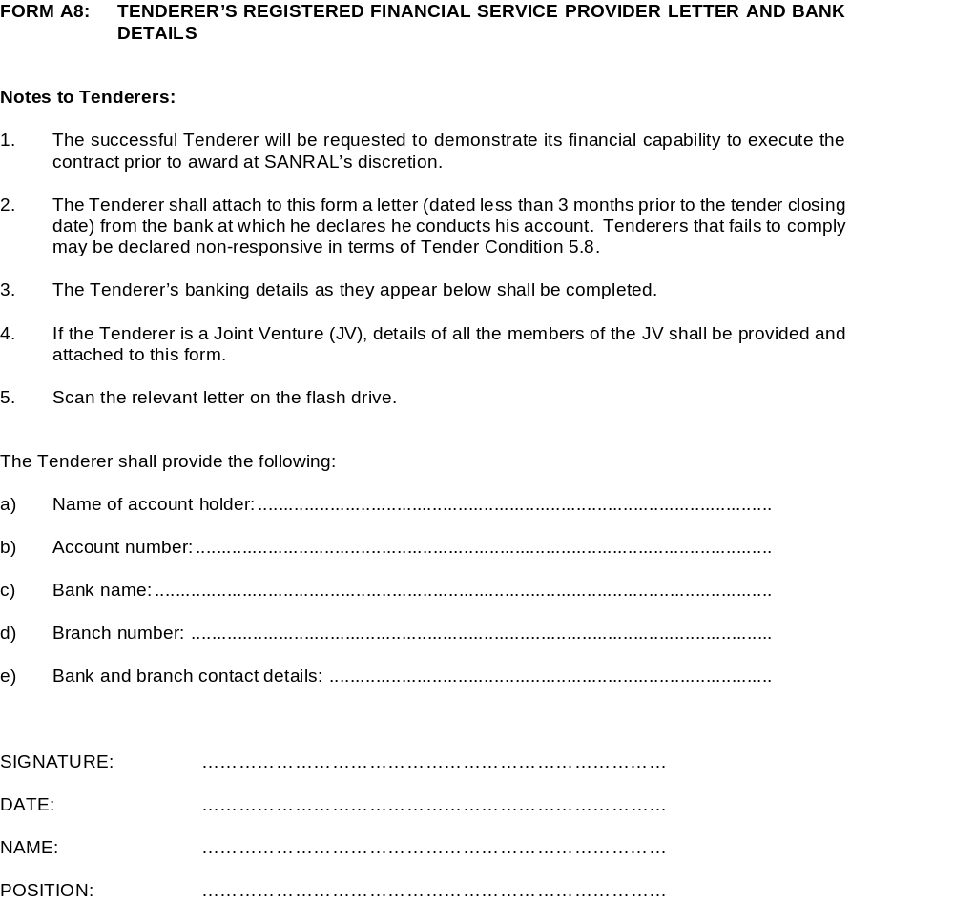
FORM A8: TENDERER’S REGISTERED FINANCIAL SERVICE PROVIDER LETTER AND BANK DETAILS

Slide 53
RETURNABLE SCHEDULE FORM A11: POSSIBLE COMMITMENTS OF KEY PERSON
Key Persons: The Project Leader and Design Specialist/s will be limited to participate in a maximum number of 6 (six) conventional contracts in design phase which will be complete after the award of the Works Contract tender for the Project Leader and after the Detailed Design Report is accepted by the Employer for the Design Specialist.
The purpose of this form is for the tenderer to identify areas of conflict with respect to Key Persons proposed for the project. Failure to identify where areas of conflict occur, or may occur, and which are subsequently discovered by the Employer shall render such offer as non-responsive, rejected and the tenderer automatically barred from tendering on SANRAL projects for a period of at least 3 (three) months from the date of tender closure.
The tenderer shall list below all projects/tenders for which the proposed Key Persons have been proposed, and for which results of an award are unknown at the date of tender closure of this project.
The start date in column 4 of the table below is that date indicated in the tender documents as being the intended start of the duties of the key personnel (i.e. expected start of design or supervisory duties).
Tenderers must submit an alternative candidate for those positions identified as being possible areas of conflict by completing separate Returnable Schedules Forms B1 and B2 for the alternate. The Employer will not request alternative candidates after tender closure and will interpret the lack of any alternative candidate as an indication the tenderer accepts that it will be impossible to be awarded more projects than the limitations applicable to Key Persons. The Employer reserves the right to select according to its best interest and not the tenderers.

Slide 54
FORM B2.2: EXPLANATION OF CONSULTANT TENDER EVALUATION SCORING FOR CONVENTIONAL PROJECTS
Tenderers Must meet a minimum of 80 Quality scores

Slide 55

CONTRACT SANRAL X.004-051-2018/1F
CONSULTING ENGINEERING GEOTECHNICAL SERVICES FOR SANRAL EASTERN REGION

Slide 56
SUMMARY OF PROJECT
The project is for CONSULTING ENGINEERING GEOTECHNICAL SERVICES FOR SANRAL EASTERN REGION .
The location for the performance of the Project is the Province of KwaZulu-Natal.

Slide 57
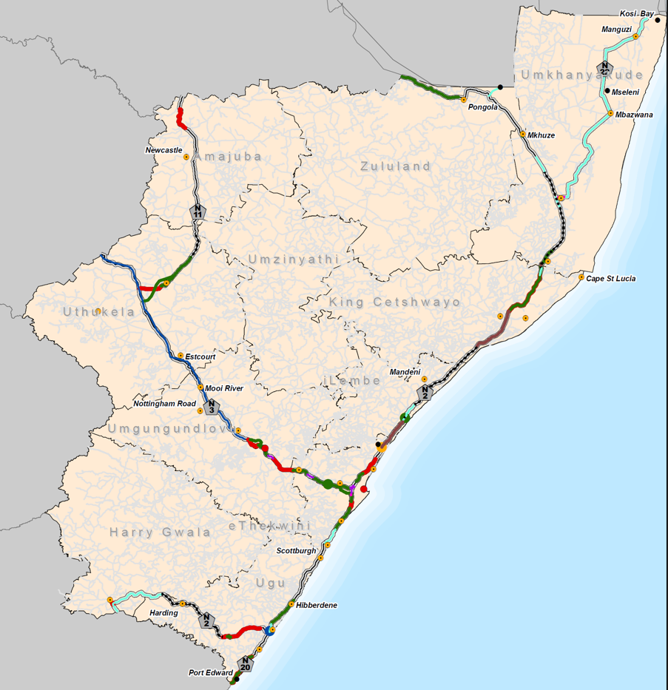

Slide 58
NOTE ON PART C3 SCOPE OF WORK
The Part C3 Scope of Work of the tender documentation contains generic specification utilised on all Consulting Engineering Tenders.
For this project limited changes to the generic specification have been made.

Slide 59
PART C1: AGREEMENTS AND
CONTRACT DATA

Slide 60
C1.2.2 CONTRACT DATA: INFORMATION PROVIDED BY THE EMPLOYER
CONTRACT SANRAL X.004-051-2018/1F
Clause | Contract Data
3.4 | The address for receipt of communications is: TO BE CONFIRMED FOLLOWING AWARD
3.5 | The project is for CONSULTING ENGINEERING GEOTECHNICAL SERVICES FOR SANRAL EASTERN REGION . The location for the performance of the Project is the Province of KwaZulu-Natal.
5.1.7 | Local Targeted Enterprises from the KwaZulu-Natal Province must participate in a minimum of 1/3 (one third) of the tendered percentage of the Contract Price (excluding provisional and prime cost sums and the respective mark-up but including provision for site supervision staff and the respective mark-up.

Slide 61
C1.2.2 CONTRACT DATA: INFORMATION PROVIDED BY THE EMPLOYER
CONTRACT SANRAL X.004-051-2018/1F
Clause | Contract Data
5.4 | The Service Provider is required to provide the Service with all reasonable care, diligence and skill in accordance with generally accepted professional techniques and standards. The Service Provider is required to provide the following insurances 1. Insurance against Professional indemnity Cover is: R25 million without a limit on the number of claims (The limit of liability is only provided to cover the Employer’s damages and does not allow for the Service Provider’s costs for defending any claim.) Period of cover: Structures – 25 years: all other instances – 10 years 2. Insurance against general public liability Cover is: R10 million Period of cover: Structures – 25 years: all other instances – 10 years 3. Third Party Liability Cover is: R25 million Target on Period of cover: Duration of contract only.

Slide 62
C1.2.2 CONTRACT DATA: INFORMATION PROVIDED BY THE EMPLOYER
CONTRACT SANRAL X.004-051-2018/1F
Clause | Contract Data
5.5 | The Service Provider is required to obtain the Employer’s prior approval in writing before taking any of the following actions: 1. Appointing Key Personnel not listed by name in the Contract Data. 2. Appointing sub-contractors for the performance of any part of the Service. 3. Expending any Prime Cost and/or Provisional Sum in the Contract or Works Contract. 4. Authorising any work under a Variation (Works Authorisation) for the Works Contract. 5. Authorising any work outside the contract limits. 6. Over-expenditure on the Works Contract. 7. Changing the scope of work for the Works Contract. 8. Acceptance of sub-standard work and/or reduced payments under the Works Contract. 9. All requirements in the relevant documents listed in Clause C3.1.6. 10. Making statements to the media regarding the project.

Slide 63
C1.2.2 CONTRACT DATA: INFORMATION PROVIDED BY THE EMPLOYER
CONTRACT SANRAL X.004-051-2018/1F
Clause | Contract Data
11.2 | The Service Provider shall not sub-contract more than 25% of the tendered contract value (including value of work allocated to Targeted Enterprise(s) but excluding any services specified in the Scope of Works to be procured under a Provisional Sum through the Employer’s Supply Chain Procurement process) to any other enterprise that does not have an equal or higher B-BBEE status level, unless the intended sub-contractor(s) is an Exempted Micro Enterprise that has the capability and ability to execute the sub-contract. The Targeted Enterprise(s) shall not be allowed to sub-contract any work that forms part of the tendered participation percentage without the Employer’s approval. All Targeted Enterprise(s)/ subcontractor(s) shall be registered on the National Treasury’s Central Supplier Database (CSD) The Service Provider shall disclose all subcontracting arrangements. If the Service Provider fails to disclose, he shall be given 14 days to make representation as to why: the contract shall not be terminated; the Service Provider shall not be penalised up to 10% of the value of the contract.

Slide 64
PROJECT INFORMATION, SCOPE OF WORKS AND SITE INFORMATION

Slide 65
C3 SCOPE OF WORKS – CONTRACT SANRAL X.004-051-2018/1F
C3.1.3 Description of the Project
The South African National Roads Agency SOC Ltd (SANRAL) is in the process of updating their geotechnical asset management system (AMS). The purpose of this AMS is to ascertain budget requirements and effectively manage geotechnical assets over a broader and long-term view. This AMS will be updated on a network level basis and subsequently integrated into a geographic information system (GIS) to create a platform for providing centralised data management, analysis and visualisation of all geotechnical assets.
An initial assessment, comprising the collation and digitization of all existing data, will have to be conducted followed by a visual assessment of all SANRAL’s geotechnical assets. The data from the initial- and visual-assessment will be used to develop an inventory database from which the inherent risks of existing geotechnical assets can be identified, prioritised and the necessary monitoring/mitigation/remediation measures implemented. The asset base will have to be inspected sporadically and updated, if necessary, for the purposes of developing and calibrating the geostatistical model.
Ad hoc and emergency/urgency geotechnical services will also be included under this service which involves the immediate response to an incident or event that threatens or may threaten (if not addressed in time) the environment, health and safety of the public or the structural integrity/stability of a geotechnical asset.
The duration of the appointment will be 5 years, however, SANRAL reserves the right to extend the appointment for Investigation/Works Contracts initiated within the first 3 years for administration, monitoring and close-out purposes.

Slide 66
C3 SCOPE OF WORKS – CONTRACT SANRAL X.004-051-2018/1F
C3.1.3 Description of the Project (continued)
The Scope of Works comprises four stages:
Stage 1: Project Assessment
The project assessment stage shall comprise the initial (desktop)- and visual-assessment of all geotechnical assets located along SANRAL’s road network, excluding concession routes.
The geotechnical assets that are included under the Scope of Works are tabulated in Table C3.1.3(a) and further detailed in TMH 21: Visual Assessment of Slopes (Part A and Part B) Committee Draft version: (Refer Appendix M).
Table C3.1.3(a): Geotechnical Assets included under the Scope of Works
Geotechnical Asset | Condition
Slopes: deep cuttings | Cuttings deeper than 5m including natural slopes and cliffs
Slopes: high fills/embankments | Fills/Embankments higher than 5m
Slope retaining structures and Lateral Supports including Rockall Mitigation Measures: | Mechanically Stabilised Earth (MSE), Gabion Walls and/or Precast Concrete block retaining walls, Reinforced concrete retaining walls, Piled retaining walls, Soil nails, Grouted rock dowels, or tensioned rock bolts, Tensioned ground anchors, Wire mesh rockfall draperies, Free standing rockfall barriers, Shallow landslide fences, Debris flow fences and structures, Barrier walls etc.
Structure-Slope Interfaces | Cuttings or embankments butting up against structures including retaining structures.

Slide 67
C3 SCOPE OF WORKS – CONTRACT SANRAL X.004-051-2018/1F
C3.1.3 Description of the Project (continued)
Stage 1: Project Assessment (continued)
The Service Provider shall conduct an initial/desktop assessment by collating and assimilating the information provided by the Employer as well as any other information available. The information shall be used to compile a preliminary geotechnical asset inventory database, determine the extent of the visual assessment and the required resources. The Service Provider shall, at the hand-over meeting, present the initial/desktop assessment to the Employer. The contents of the initial/desktop assessment shall comprise the following:
Preliminary geotechnical asset inventory database;
Extent of visual assessment and required resources;
Existing and proposed risk rating and classification system;
Initial strategy, methodology, manuals and systems to be applied for assessment, investigation and design development phases;
Potential impact on social, natural, economic, safety and statutory environment;
Compilation of a base risk register;
Envisaged programme.

Slide 68
C3 SCOPE OF WORKS – CONTRACT SANRAL X.004-051-2018/1F
C3.1.3 Description of the Project (continued)
Stage 1: Project Assessment (continued)
Subsequent to the initial/desktop assessment, the Service Provider shall carry out a comprehensive visual assessment of al geotechnical assets in accordance with TMH 21: Visual Assessment of Slopes (Part A and Part B)- Refer Appendix M. The visual assessment of concrete retaining structures shall be conducted in accordance with the TMH 19: Manual for the Visual Assessment of Road Structures (refer to Appendix C2) and industry best practice. The visual assessment shall be conducted by at least two experienced teams comprising not less than two persons per team. Each team will have to be approved by the Employer. The visual assessment shall be closely monitored, managed and coordinated by the Service Provider’s designated design specialist(s). At least 5% of potentially unstable assets shall be inspected by more than one team for quality assurance purposes. The use of innovative technologies and methods are encouraged, except if it results in the curtailment of the quality of work when compared with conventional assessment methods. However, these technologies and methods shall not be used without the Employers consent. The status quo and finalisation of the visual assessment shall be reported on at the first- and second-progress meeting respectively.
Geotechnical assets that are known to be problematic and slopes that are located in areas with a moderate to high landslide susceptibility shall be prioritised during the visual assessment. Appendix C3 provides the landslide susceptibility mapping document published by the Council of Geosciences.

Slide 69
C3 SCOPE OF WORKS – CONTRACT SANRAL X.004-051-2018/1F
C3.1.3 Description of the Project (continued)
Stage 1: Project Assessment (continued)
The Service Provider shall determine the risk rating in accordance with SANRAL’s Manual for the Visual Assessment of Road Slopes (Part A and B) and classification for each geotechnical asset listed in Table C3.1.3(a)and the TMH 19. The Service Provider shall propose a rating and classification system for aspects of geotechnical assets or components/sub-components that are not specifically covered or explicitly described in SANRAL’s Manual for the Visual Assessment of Road Slopes (Part A and B) or the TMH 19. The risk rating and classification system shall reflect the inherent environmental/structural/stability/operational/health & safety/financial/reputational risks of the geotechnical assets and shall be used to identify high-risk or high-priority assets that will require continuous monitoring/mitigation/remediation measures.
Noticeable constraints and risks to be identified during the visual assessment are inter alia:
Surface drainage, sub-surface drainage, groundwater and erosion problems;
Present or potential geotechnical instability as a result of problem soils, terrain morphology, debris flow, unfavourably dip joints, shallow groundwater table etc.;
Road safety and environmental issues resulting from geotechnical instability;
Surface/Foundation settlement, structural cracks and defects;
Corrosion, grease leaks or thrust plate gaps with regards to slope protections systems;
Adjacent land use and acquisition issues;
Site access conditions and traffic control requirements for further investigation or implementation of possible monitoring, mitigation or remediation measures;
Tampering or vandalism;
Any other issues that may be evident.

Slide 70
C3 SCOPE OF WORKS – CONTRACT SANRAL X.004-051-2018/1F
C3.1.3 Description of the Project (continued)
Stage 1: Project Assessment (continued)
Subsequent to the visual assessment and risk classification, the Service Provider shall update the geotechnical asset inventory database by including the additional parameters and any other outstanding information. The information obtained from the initial/desktop- and visual-assessment shall be incorporated into the project assessment report.
Traffic accommodation shall, as far as possible, be provided by the RRM Contractor. The Service Provider shall contact the regional SANRAL office, who will provide the contact details of the relevant RRM Contractor for any particular section of road. Provision had, however, been made in the Pricing Schedule for traffic accommodation services to be procured by the Service Provider, if instructed to do so by the Employer.
The contents and format of the project assessment report shall be as per the latest format for current SMS contracts (refer to Appendix F).

Slide 71
C3 SCOPE OF WORKS – CONTRACT SANRAL X.004-051-2018/1F
C3.1.3 Description of the Project (continued)
Stage 2: Project Reporting
The geotechnical asset and SMS inventory database shall be updated, documented, recorded and reported on a quarterly basis in the form of a geotechnical risk assessment report. Assets on newly acquired SANRAL roads, existing assets affected by road developments and incidents/failures reported by the RRM Route Manager or the Employer’s Geotechnical Representative, shall be visually assessed/rated by the Service Provider, updated on the inventory database and reported on in the geotechnical risk assessment report. The Service Provider shall, therefore, be required to liaise with the RRM consultants and Employer, at least once a month, to enquire on any information that relate to i.e. occurred failures, incidents, anecdotal evidence of failures, signs of functional/structural deterioration, updated RRM slope incident forms and any changes or developments to the road network.
Based on the outcomes of the project assessment and subsequent visual assessments, the Service Provider shall identify, prioritise and assess the geotechnical assets that pose a high-risk to the safety of the public and environment. The Service Provider shall propose the necessary monitoring/mitigation/remediation measures as well as the investigation services that will be required for the design development stage. The Service Provider shall also identify any other requirements and constraint which may have a direct or indirect effect on the proposed intervention measures.
The contents and format of the geotechnical risk assessment report shall be as per the latest format for current SMS contracts (refer to Appendix F). The process followed, that will form the basis for the contents of the geotechnical risk assessment report, is tabulated in Table C3.1.3(b):

Slide 72
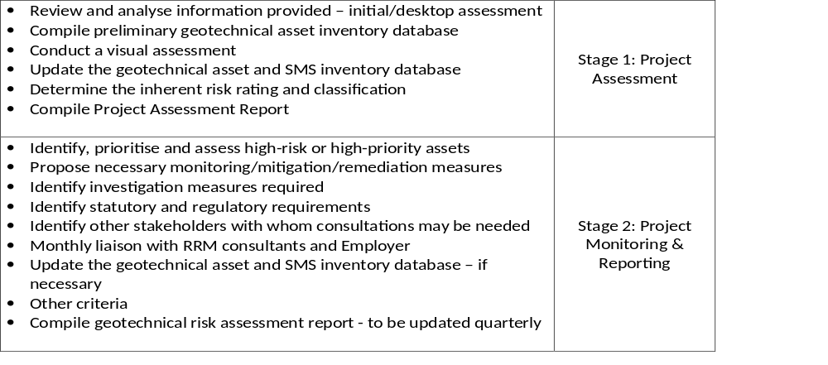
C3 SCOPE OF WORKS – CONTRACT SANRAL X.004-051-2018/1F
C3.1.3 Description of the Project (continued)
Stage 2 Project Reporting (continued)
Table C3.1.3(b): Development of Geotechnical Risk Assessment Report
Since the project assessment report forms part of the geotechnical risk assessment report, the Service Provider shall only be required to include any updated information in the subsequent geotechnical risk assessment report. Therefore, it shall not be expected of the Service Provider to submit a separate project assessment report with every updated geotechnical risk assessment report.

Slide 73
C3 SCOPE OF WORKS – CONTRACT SANRAL X.004-051-2018/1F
C3.1.3 Description of the Project (continued)
Stage 3: Geotechnical Monitoring and Investigations for Design Development
Stages 3-4 (or part thereof) shall only be executed if specifically instructed to do so by the Employer.
It will be the Service Provider’s responsibility to plan, compile the quotation/tender documentation, procure, administer and monitor the services required for geotechnical monitoring or investigations. Procurement of these services shall be in accordance with the Employer’s standard requirements and policies.
Geotechnical monitoring or investigation services may comprise inter alia:
topographic/cadastral surveys
material sampling
laboratory testing
pull-out testing
performance testing
geotechnical investigations
geophysical investigations
instrumental/survey monitoring
remote sensing
environmental investigations etc.
The Service Provider shall, so far as possible, make use of SANRAL’s Property Service Provider (PSP) for all their survey services. Provision had, however, been made in the Pricing Schedule for survey services to be procured by the Service Provider if instructed to do so by the Employer.

Slide 74
C3 SCOPE OF WORKS – CONTRACT SANRAL X.004-051-2018/1F
C3.1.3 Description of the Project (continued)
Stage 3: Geotechnical Monitoring and Investigations for Design Development (continued)
Geotechnical instrumental monitoring systems will comprise inter alia, piezometers, inclinometers, tiltmeters, extensometers and time-domain reflectometry (TDR). Depending on the nature and extent of the investigation, continuous or sporadic monitoring of instrumental/survey measurements will either be captured on-site or remotely through real-time monitoring. The Service Provider shall procure and install the appropriate instrumental/survey monitoring systems by means of a quotation/tender process, suggest measurement frequencies, conduct measurements, assess and analyse the measurements.
Pull-out testing and performance testing shall be conducted on various anchored systems to verify their structural- and functional-integrity. The Service Provider shall inter alia assess existing measurements, advise the Employer on additional investigations and the potential risk of excessive movements or non-conformance.
The Service Provider shall perform a detailed assessment of all the high-risk or high-priority assets that were investigated for design development. The Service Provider shall then compile a geotechnical asset stability assessment report containing the evaluation of each asset that was investigated. The report shall at least address the results from investigation that were conducted, relevant stability analyses, probable cause of instability and possible recommendations on the monitoring/mitigation/remediation measures required.
The contents and format of the geotechnical asset stability assessment report shall be as per agreed between the Employer and the Service Provider. The South African Pavement Engineering Manual (SAPEM) Chapter 7: Geotechnical Investigations and Design Considerations, shall be used as a basis for the required contents as well as the latest format for current SMS contracts (refer to Appendix F).

Slide 75
C3 SCOPE OF WORKS – CONTRACT SANRAL X.004-051-2018/1F
C3.1.3 Description of the Project (continued)
Stage 4: Design Development, Tender Documentation, Construction Procurement, Administration and Monitoring of Works
The Service Provider shall be responsible for the planning and design (concept/preliminary/detailed), design reports, quotation/tender documentation, construction procurement, administration and monitoring of works contracts for the proposed monitoring/mitigation/remediation measures. These contracts shall be grouped in a logical manner (similar scope of works, geology, locality etc.) to maximise efficiency in case the Employer decides to bundle the projects. The Employer reserves the right to put out to quotation/tender a separate contract for the design development, administration and monitoring of works for contracts with an estimated contract value greater than R30 million.
In the event that the proposed monitoring/mitigation/remediation measures fall within the scope and/or expertise of the RRM contractor; the Employer may instruct the Service Provider to utilise the RRM contractor to execute the proposed monitoring/mitigation/remediation measures. The Service Provider shall then be responsible for the administration and monitoring of works.
The contents and format of the design reports shall be as per agreed between the Employer and the Service Provider. The South African Pavement Engineering Manual (SAPEM) Chapter 7: Geotechnical Investigations and Design Considerations, shall be used as a basis for the required contents as well as the latest format for current SMS contracts (refer to Appendix F).

Slide 76
C3 SCOPE OF WORKS – CONTRACT SANRAL X.004-051-2018/1F
C3.1.3 Description of the Project (continued)
Ad Hoc and Emergency/Urgency Geotechnical Services
Ad hoc and emergency/urgency geotechnical services shall only be executed if specifically instructed to do so by the Employer.
Ad hoc and emergency/urgency geotechnical services involve the immediate response to an incident or event that threatens or may threaten (if not addressed in time) the environment, health and safety of the public or the structural integrity/stability of a geotechnical asset. This may be as a result of natural or man-made geohazards which include, but are not limited to:
tectonics
ground instabilities and movements
anthropogenic ground instabilities
abnormal rainfall/floods/droughts etc.
In these instances, environmental damage, financial loss, loss of life or loss of service is an imminent risk. Under this service, the Service Provider’s Geotechnical Engineer or Engineering Geologist shall be available to respond to a request from the Employer within 24 hours of being notified. The Service Provider will be deemed to have responded to the Employer within 24 hours of being notified if he/she were able to inspect conditions on site after the incident/event, recommend the necessary make-safe or temporary mitigation measures, assess the inherent environmental / structural / stability / operational / health & safety / financial / reputational risks and give verbal feedback to the Employer. Within 48 hours after inspecting the conditions on site, the Service Provider (in cooperation with the Employer’s Geotechnical Representative) shall submit an incident report on the risks, emergency requirements and recommended monitoring/mitigation/remediation measures.

Slide 77
C3 SCOPE OF WORKS – CONTRACT SANRAL X.004-051-2018/1F
C3.1.3 Description of the Project (continued)
Take note that ad hoc and emergency/urgency geotechnical services are not only limited to the assets tabulated in Table C3.1.3(a), but shall include any geotechnical/geological aspect within, or bordering, the road reserve that, as a result of any form of geohazard, may have a direct or indirect effect on SANRAL’s road reserve or anything/anyone contained within. The formation of a sinkhole on the boundary of the road reserve, for example, shall therefore have to be assessed and investigated by the Service Provider.
Dependent on the degree and extent of the inherent risks, the Employer may instruct the Service Provider to further assess, investigate, report, design, compile quotation/tender documentation, procure construction services, administer and monitor the necessary monitoring/mitigation/remediation measures.
In case the Service Provider’s key personnel do not possess the relevant area of expertise or competency with regards to a specific geohazard that are not slope related, allowance had been made under section C3.8 (Additional Duties, Special Services and Specialist Advice) for the appointment of such specialist services and advice.
In the event that the proposed monitoring/mitigation/remediation measures fall within the scope and/or expertise of the RRM contractor; the Employer may instruct the Service Provider to utilise the RRM contractor to execute the proposed monitoring/mitigation/remediation measures. The Service Provider shall then be responsible for the administration and monitoring of works.

Slide 78
C3 SCOPE OF WORKS – CONTRACT SANRAL X.004-051-2018/1F
C3.1.3 Description of the Project (continued)
Additional Responsibilities
Property Reports: The Service Provider shall provide the Employer’s PSP with a property report and the necessary information required for the land acquisition and declaration process.
Authorisations: The Service Provider shall obtain the necessary authorisations before any investigations or work will be carried out on site.
Stakeholder Engagement: The Service Provider shall be responsible for all stakeholder engagement, public participation and social facilitation processes necessary for executing the scope of work. This shall include consultation with interested and effected parties during the assessment and investigation stages.

Slide 79
C3 SCOPE OF WORKS – CONTRACT SANRAL X.004-051-2018/1F
C3.1.4 Determination of Remuneration
Table C3.1.4(a): Remuneration payable
Section | Stage | Remuneration payable
C3.2 | Project Assessment | Tendered separately
C3.3 | Investigations for Design Development | Tendered separately
C3.4 | Design Development: Concept Design Preliminary Design Detailed Design | Tendered separately
C3.5 | Tender Documentation | Tendered separately
C3.6 | Clarification Meeting, Tender Period & Tender Evaluation | Tendered separately
C3.7 | Administration & Monitoring of the Works Contract | Tendered separately
C3.8 | Additional Duties, Special Services and Specialist Advice | Tendered separately
C3.9 | Quality Control: Works Contract | Tendered separately
C3.10 | Close Out | Tendered separately

Slide 80
C3 SCOPE OF WORKS – CONTRACT SANRAL X.004-051-2018/1F
C3.1.5 Employer’s Cost Estimate
For the purposes of this project, the current budget for the Works is based on the applicable works categories comprising the Design Development, Administration & Monitoring and Close Out phases.
Category 1: R 100 Million (Provision for 12 Projects)
Category 2: R 200 Million (Provision for 10 Projects)
Category 3: R 240 Million (6 Projects)
(EST) Total project value: R 540 Million (28 Projects)
(excluding contingencies, CPA during the construction period and VAT)
The sum of the estimated costs of the relevant works categories (including pro-rata of Section 1300) forms the basis on which the Service Provider shall tender his fee to cover all his costs to develop the de­tailed design including training. Project assessment costs and production of tender documentation in­cluding evaluation of tenders received are not considered to contribute to the development of the design and are separately billed. The final cost of the Works will, however, depend on the strategy selected by the Employer based on the most appropriate and cost-effective options identified by the Service Provider during the project assessment and design phases. Scope of work changes may cause an increase or decrease in the fee offered to produce the design.

Slide 81
C3 SCOPE OF WORKS – CONTRACT SANRAL X.004-051-2018/1F
C3.1.7 Stakeholder and Community Liaison and Social Facilitation
a) Purpose
To give effect to the need for transparency and inclusion in the process of delivering services, the Service Provider shall liaise with the project Stakeholders and affected Communities for the duration of the contract’s life cycle. This shall be achieved through structured engagement with the PLC which was established for this purpose.
b) Existing contracts
The Employer currently has routine road maintenance (RRM) contracts in progress along the route. The Service Provider shall not visit the site for purposes of undertaking any investigation without first informing the Route Manager of the visit and what type of investigation is intended. The RRM contractor needs to be able to plan his accommodation of traffic duties and no inspection or investigation can take place without acquiring assistance from the RRM for safe conduct through the site or protection when undertaking intrusive or out-of-vehicle surveys. The Service Provider shall timeously liaise with the Employer and his appointed Route Managers in order to program the assistance required. The contact details of the parties involved in the RRM contract will be provided to the Service Provider on request.

Slide 82
C3 SCOPE OF WORKS – CONTRACT SANRAL X.004-051-2018/1F
C3.1.7 Stakeholder and Community Liaison and Social Facilitation (continued)
c) Stakeholders
Any Stakeholder who is affected by the Employer’s operations in the Target Area(s) and/or who has an interest or concern in the project, either as a decision maker, participant or affected party and may include, amongst others, the following entities:
Provincial departments;
Municipal departments;
Traditional authorities;
Community interest groups;
Organised youth representation;
Organised women representation
Organised disabled people representation;
Organised labour representation;
Other structured community groups such as religion, education, farming, etc.;
Transport industry forums;
Business sector forums;
Road user forums;
Environmental interest groups;
Road safety interest groups; and
Any other recognised relevant and representative structure
The project is located along the National Road Network of SANRAL Eastern Region, excluding concession routes, within the provincial boundaries of KwaZulu-Natal.

Slide 83
C3 SCOPE OF WORKS – CONTRACT SANRAL X.004-051-2018/1F
C3.1.7 Stakeholder and Community Liaison and Social Facilitation (continued)
d) Target Area for the sourcing of labour for Construction Contract
The target area for the sourcing of labour only needs to be defined in consultation with the Project Liaison Committee (PLC) and may typically include:
One or more Provinces;
One or more Metropolitan and District Municipalities;
One or more Local Municipalities; or
One or more Wards that are wholly located within an area within a predefined radius of the construction activity.
One or more of the areas listed in the definition of Designated Groups.

Slide 84
C3 SCOPE OF WORKS – CONTRACT SANRAL X.004-051-2018/1F
C3.1.7 Stakeholder and Community Liaison and Social Facilitation (continued)
e) Designated Group for sub-contracting to Works Contractor
Unless otherwise stated in the Works Contractor’s tender documents, a minimum of 30% (thirty percent) sub-contracting provision will apply as a contractual obligation, and will be restricted to:
Black designated groups as defined in the Codes of Good Practice issued in terms of Section 9(1) of the Broad-Based Black Economic Empowerment Act, 2003 (Act 53 of 2003);
Black people as defined in Section 1 of the Broad-Based Black Economic Empowerment Act, 2003 (Act 53 of 2003);
Black people who are women and who are South African citizens;
Black people who are youth as defined in Section 1 of the National Youth Development Agency Act, 2008 (Act 54 of 2008);
Black people who are people with disabilities as defined in Section 1 of the Employment Equity Act, 1998 (Act 55 of 1998)
Black people who are military veterans as defined in Section 1 of the Military Veterans Act, 2011 (Act 18 of 2011);
Black people who are living in rural or under-developed areas or townships;
Small enterprises as defined in Section 1 of the National Small Enterprise Act, 1996 (Act 102 of 1996);
Exempted Micro Enterprises (EMEs) as defined in terms of the Code of Good Practice on black economic empowerment issued in terms of Section 9(1) of the Broad-Based Black Economic Empowerment Act, 2003 (Act 53 of 2003), with an annual turnover of R10 million or less (Construction Sector Amended Codes of Good Practice); and
Qualifying Small Enterprises (QSEs) as defined in terms of the Code of Good Practice on black economic empowerment issued in terms of Section 9(1) of the Broad-Based Black Economic Empowerment Act, 2003 (Act 53 of 2003), with an annual turnover of R10 million and R50 million (Construction Sector Amended Codes of Good Practice).

Slide 85
C3 SCOPE OF WORKS – CONTRACT SANRAL X.004-051-2018/1F
C3.1.7 Stakeholder and Community Liaison and Social Facilitation (continued)
f) Project Liaison Committee (PLC) and Project Management Team (PMT)
A Project Liaison Committee (PLC) has either been established prior to commencement of the contract or shall be established as soon as possible by the Service Provider. The PLC re­presents the project’s Stakeholders. The PLC consist of representatives of project Stake­holders and affected communities from the following local municipalities, AbaQulusi Local Municipality, Alfred Duma Local Municipality, Big 5 Hlabisa Local Municipality (The), City of uMhlathuze Local Municipality, Dannhauser Local Municipality, Dr Nkosazana Dlamini Zuma Local Municipality, eDumbe Local Municipality, Emadlangeni Local Municipality, Endumeni Local Municipality, Greater Kokstad Local Municipality, Impendle Local Municipality, Inkosi Langalibalele Local Municipality, Jozini Local Municipality, KwaDukuza Local Municipality, Mandeni Local Municipality, Maphumulo Local Municipality, Mkhambathini Local Municipality, Mpofana Local Municipality, Msinga Local Municipality, Msunduzi Local Municipality, Mthonjaneni Local Municipality, Mtubatuba Local Municipality, Ndwedwe Local Municipality, Newcastle Local Municipality, Nkandla Local Municipality, Nongoma Local Municipality, Nquthu Local Municipality, Okhahlamba Local Municipality, Ray Nkonyeni Local Municipality, Richmond Local Municipality, Ubuhlebezwe Local Municipality, Ulundi Local Municipality, Umdoni Local Municipality, uMfolozi Local Municipality, Umhlabuyalingana Local Municipality, uMlalazi Local Municipality, uMngeni Local Municipality, uMshwathi Local Municipality, Umuziwabantu Local Municipality, Umvoti Local Municipality, Umzimkhulu Local Municipality, Umzumbe Local Municipality, uPhongolo Local Municipality, as well as the Project Management Team (PMT) and their representatives.
The PMT comprises representation from the Employer, the Service Provider and the Contractor (during construction phase). Together with the PLC, the PMT is responsible for successful project Stakeholder and community liaison and successful implementation of the Employer’s Contract Participation Goals.
Where a PLC has not been established, the Service Provider, under the guidance of the Em­ployer, shall establish such a committee within the boundaries of the Local and/or District Municipality. Allowance has been made for these requirements in the Pricing Schedule under Additional Duties.

Slide 86
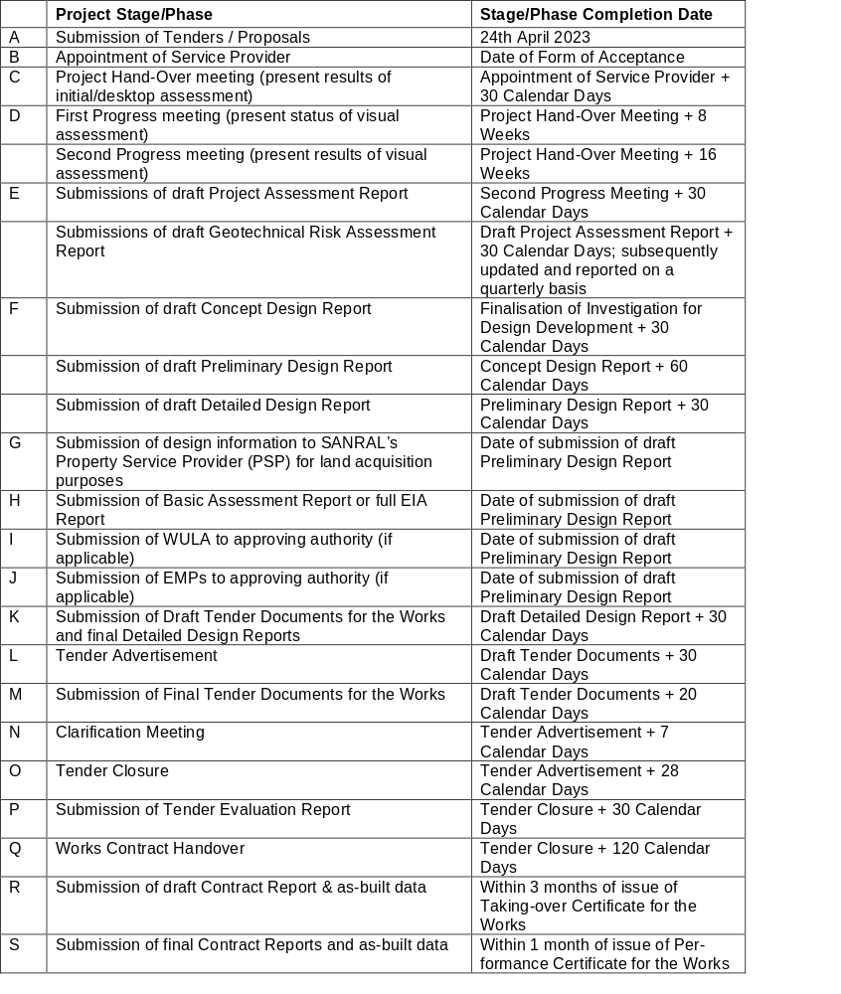
C3.1.9 Project Programme

Slide 87
C3.1.11 Personnel Requirements – Minimum Requirements
Position | Minimum Qualification/Registration | Minimum Relevant Experience (years)³ | Other Requirements | Key Person
Project Leader | Pr Eng¹ or Pr Tech Eng¹ or Pr Sci.Nat⁵ | 10 |  | Yes
Assistant Project Leader | Pr Eng¹ or Pr Tech Eng¹ or Pr Sci.Nat⁵ | <10 |  | In permanent employment of the tendering entity or Targeted Enterprise
Design Specialist (Geotechnical Engineer) | Pr Eng¹ or Pr Tech Eng¹ | 10 |  | Yes
Assistant Design Specialist: | Pr Eng¹ or Pr Tech Eng¹ | <10 |  | In permanent employment of the tendering entity or Targeted Enterprise
Design Specialist: Engineering Geologist | Pr Sci.Nat⁵ | 10 | SAIEG⁴ Area of Expertise: Slope Stability⁴ | Yes
Additional Design Specialist | Pr Eng¹ or Pr Tech Eng¹ | 10 |  | No
Assistant Design Specialist Engineering Geologist | Pr Sci.Nat⁵ | <10 | SAIEG⁴ | No
Slope Assessor Level I | Pr Eng¹, Pr Tech Eng¹ or Pr Sci.Nat⁵ | 5 |  | No
 | Not Registered | 10
 | Not Registered | 10 |  | No
Slope Assessor Level II | Pr Eng¹, Pr Tech Eng¹ or Pr Sci.Nat⁵ | 10 |  | No
 | Not Registered | 15
 | Not Registered | 15 |  | No
Surveyor | Registered Professional Surveyors, Technologist Surveyors, Technician Surveyors (GPr⁷ or GTg⁷ or GTc⁷) | 5 | Member of SAGC⁷ | No
Environmental Practitioner² | Refer to sub-service procurement document
OHS Specialist | Investigation/Design Phase: SACPCMP⁶ registration as a Professional Construction HSE Agent Construction Phase: SACPCMP⁶ registration as a Professional Construction HSE Agent or Manager | As required by SACPCMP⁶ |  | No
Road Safety Audit Team Leader | Pr Eng¹ or Pr Tech Eng¹ | 10 | Road safety course (5 CPD) Minimum 2 (two) audits within 3 (three) years | No
Contract Engineer | Pr Eng¹ | 10 | Relevant Geotechnical Experience. | No
Assistant Contract Engineer | Pr Eng¹ or Pr Tech Eng¹ | <10 |  | In permanent employment of the tendering entity or Targeted Enterprise

Slide 88
C3 SCOPE OF WORKS –CONTRACT SANRAL X.004-051-2018/1F
C3.7 ADMINISTRATION AND MONITORING OF THE WORKS CONTRACT C3.7.2 Administration and Monitoring a) Fulfilling the functions of the Contract Engineer (CE) Three (3) months prior to the commencement of the Works Contract, the Service Provider shall submit for consideration and approval to the Employer a detailed proposal in the Employer’s prescribed format which shall include a CV of appropriate experience and qualifications for the proposed Contract Engineer. In addition, the Service Provider shall also complete Returnable Schedule Forms B1 and B2 for the proposed Contract Engineer. Amongst other criteria to be used, shall be the individual threshold of 80% and the limitation to participate in a maximum number of 6 (six) conventional contracts in active construction phase with the Employer which will be completed after the Taking-Over Certificate is issued to the Contractor. The approved Engineer for the project shall be that person listed in the tender as the Contracts Engineer, who shall be authorized by the Service Provider to carry out the work intended by the specifications and the duties required by the FIDIC general conditions of contract.

Slide 89
C3 SCOPE OF WORKS –CONTRACT SANRAL X.004-051-2018/1F
C3.7 ADMINISTRATION AND MONITORING OF THE WORKS CONTRACT C3.7.3 Establishment of supervisory personnel on site a) Supervisory team The Service Provider shall be required to provide a team on site to monitor, administer and measure the Works in accordance with the requirements of the Works Contract, Employer’s standard require­ments and industry good practice. Provision has been made in the Pricing Schedule for the envisaged staffing requirement. The establishment of such staff, however, shall be subject to the approval of the Employer. The minimum requirements for qualification and experience of the supervisory team are specified in Clause C3.1.11.

Slide 90
C4 SITE INFORMATION – CONTRACT SANRAL X.004-051-2018/1F
C.4.1 LOCATION OF THE PROJECT
The proposed project relates to all geotechnical assets located along the National Road Network of the SANRAL Eastern Region, excluding concession routes, within the provincial boundaries of KwaZulu-Natal. The National Routes in the Eastern Region include:
N2 (Previously R61) from Mtumvuna River to Mbizana River (Section 22) – Estimated distance is 45 km
N2- Brookes Nek (Provincial Boundary) to Port Shepstone (Sections 21X & 22X)
N2 – Port Shepstone to Mpumalanga Border ( Sections 22 to 32)
N3 from Durban to Cedara ( Hiton) – Estimate 82km
N11 from Bergville interchange to Volksrust (Sections 1 to 3). Estimated distance of 175km
P720 (R69) from N2 to Golela Border post with Swaziland. Estimated distance of 10km
R022 from Hluhluwe to Khosi Bay Border Post ( Sections 1 to 5). Estimated distance of 175km.

Slide 91
C4 SITE INFORMATION – CONTRACT SANRAL X.004-051-2018/1F
C.4.2 GEOTECHNICAL Information
A list of current and historic geotechnical contracts is provided in Appendix G. The list contains information regarding location and type of geotechnical problem, the remedial measures, construction details (if available) and monitoring information.
C.4.3 MATERIAL SOURCES
The nearest and most economical commercial material sources must be utilised when required. The necessary sampling and testing of materials shall be undertaken to ensure that the materials conform to the specified engineering properties. Provision has been made in the Pricing Schedule

Slide 92
C4 SITE INFORMATION – CONTRACT SANRAL X.004-051-2018/1F
C.4.4 LAND REQUIREMENTS
TABLE 4.4
DESCRIPTION | CURRENT | ENVISAGED
Permanent land acquisition | Remaining within road reserve | Not required Future failed slope areas extending beyond the road reserve may require permanent expropriation.
Temporary land requirements | Remaining within road reserve | Only applicable when access to site is required.

Slide 93
C4 SITE INFORMATION – CONTRACT SANRAL X.004-051-2018/1F
C.4.5 ENVIRONMENTAL REQUIREMENTS
TABLE 4.5
DESCRIPTION | CURRENT | ENVISAGED
EIA | Remaining within existing road reserve | Standard Basic Assessment (EIA Scoping)
EMP | Remaining within existing road reserve | Standard EMP

Slide 94
C4 SITE INFORMATION – CONTRACT SANRAL X.004-051-2018/1F
C.4.6 Drainage
Drainage forms an integral part of this project. Surface and subsurface drainage problems must be identified that may affect the stability of slopes. Appropriate remedial measures must be implemented where necessary, e.g. cut-off drains, dewatering measures, etc.
C.4.7 Structures
Structures such as retaining walls, restraining beams, bridge piers, etc. must be investigated for signs of movement or instability. Refer to Appendix C2 for structures that are monitored for stability.
Structures information are available in SARDS online.
C.4.8 Sub-service Providers
The following sub-service may be required on this project:
Survey
Environmental Assessment Practitioner
External OHS auditor
Drilling contractor
Permanent ground anchor monitoring contractor.
Geophysicists
Geohydrologists
Specialist technical subservices
Laboratory testing

Slide 95
THANK YOU
Queries relating to issues arising from these documents may be addressed to:
ProcurementER4@sanral.co.za

