Slide 1
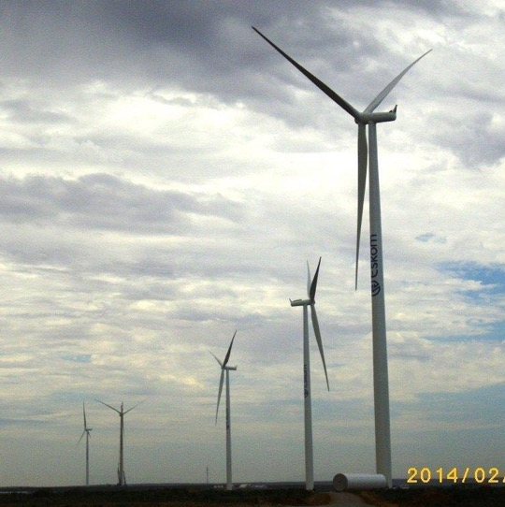
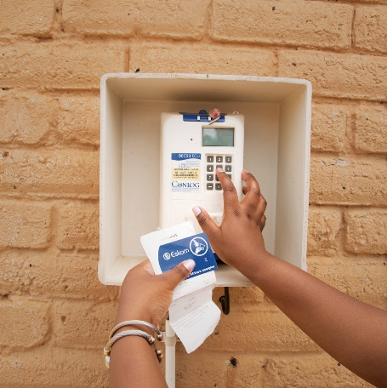
Non-Compulsory Clarification meeting Galvanizing of steel for the Power Plant Maintenance in Mpumalanga Operating Unit on an “as and when required basis” over a period of five (05) years
Cindy Ledwaba
10 July 2025

Slide 2
Content
1. Tender Submission
2. Basic Compliance
3.Requirements
4. Questions & Answers

Slide 3
Tender Submission
Tender number: E1455DXMP
Issue date :30 June 2025
Closing date and time :21 July 2025 at 10h00 SAST
Tender validity period :120 days from the closing date and time
Tenders are to be submitted electronically via Eskom E- tendering site by the stipulated closing date and time. Please note it is the responsibility of the supplier to ensure that the tender submission is submitted before the closing time
Date: 21 July 2025
Time: 10H00 a.m.
Note: No late tenders will be accepted

Slide 4
Tender Submission
The tenderer must upload the tender via Eskom Tender bulletin site on the Eskom E- tendering page. The documents need to be upload under the folder Technical, Commercial, Financial, and other.
All documents need to be submitted in a PDF format (The upload size per document is 500 megabytes and total submission is restricted to 4 gigabytes). The price list needs to be submitted in PDF.
No Zip/condense files can be uploaded
No hard copy will be accepted
If for some reason you resubmit your tender, then the latest version of the tender submitted will only be accepted and all previous submission/s will be null and void.
Please ensure that the submission status is indicated as complete.
Supplier Help Manual guide and video can be found on Eskom E-Tendering page

Slide 5
Basic compliance
Basic compliance with this Invitation to Tender requires a tenderer to meet all the following requirements:
Basic compliance for this invitation to tender are:
• Meet the eligibility criteria for a tenderer (Page 8 of the Invitation to tender)
For Electronic Tender Submissions the following shall apply:
• The tenderer must upload the tender via Eskom Tender
bulletin site on the Eskom E- tendering page. The
documents need to be uploaded under the folder
Technical, Commercial, Financial, and other.
For E-Tendering, a tenderer’s failure to have submitted/uploaded
tender documents will render the tender non-responsive.

Slide 6
Mandatory requirements
The following are the Commercial mandatory returnable to be submitted at tender closing:
Returnable required at Tender closing (Disqualifiable)
Completed NEC 3 Term Services Contract pricing schedule (TSC)
Annexure E- CPA for local goods and services
Annexure A- Completed and signed Authorisation Form (Annexure A)
Note – The authorisation form must be submitted to confirm the authority of the supplier’s representative to act as an authorised agent on behalf of the supplier. A tenderer must declare that the information provided in its tender is true and correct and that the signatory to the tender is duly authorized to sign all documents related to the Enquiry and any ensuing contract.
Suppliers failing to submit the above at tender closing will be disqualified and eliminated for further evaluation

Slide 7
Mandatory Contractual requirements
Valid B-BBEE Certificates / Sworn Affidavits
Tax Compliance Status (TCS) e-filing PIN from SARS
Valid Original certificate of good standing or proof of application issued by the relevant body.
Proof of National Treasury Central Supplier Database registration (CSD) that has a tax compliant status at award.
Tax Evaluation questionnaire
Please submit at tender closing.

Slide 8
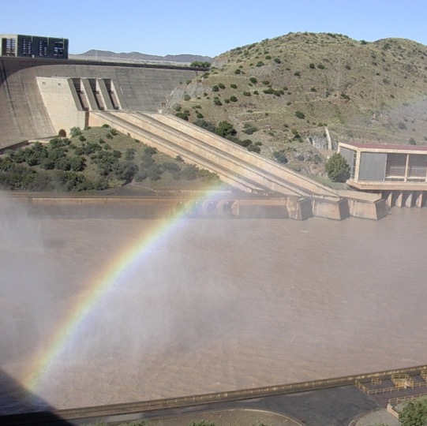

Questions and Answers

