Slide 1
Independant Technical Study
20 October 2025

Slide 2
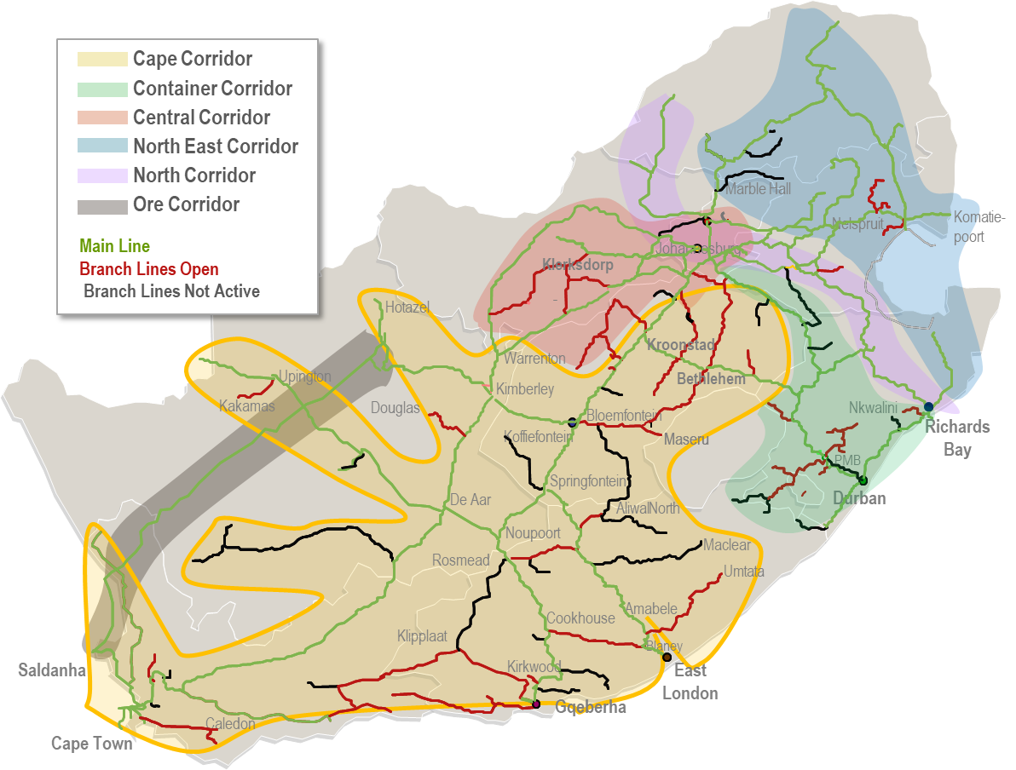
Requirment
DESKTOP STUDY FOR RAIL INFRASTRUCTURE ASSET CONDITION ASSESSMENT AND COST VALIDATION OF THE COPEX AND SUSTAINABLE CAPEX SCOPE FOR THE:
1) NORTH EAST CORRIDOR,
2) CENTRAL CORRIDOR, AND
3) CAPE CORRIDOR
  .

Slide 3
Context and Background
Transnet Rail Infrastructure Manager (TRIM) develop condition assessment annually for all their corridors that focus on:
  The capacity of the network: expressed in usable train paths (slots) during a defined time period, determined by the network configuration.
  The substance of the network: referring to the average remaining lifetime of the individual network components. A high substance for example means that a component is new.
  The quality of infrastructure: expressed as network availability and reliability.
TRIM approach funding sources in the market to fund maintenance and expansion projects in support of Network stability.
Funders require independant validation of the network condition with specific reference to the annual assessments to support funding instrument applications.
In summary, the outcome of the desktop study should inform the acceptability of the current condition assessment data and validate the existing scope and costings.
  .

Slide 4
Main Corridor inclusions
North-East Corridor
The North-East corridor stretches from the Limpopo River in Beitbridge, Limpopo province, through Komatipoort, and down to Richards Bay on the East coast. Operations include the transportation of high-yielding freight on three prominent linear flows (Pit to Port), which are defined as follows: -
  Phalaborwa to Maputo and Richards Bay, mainly transporting Magnetite and Rock Phosphate for export markets
  Witbank to Maputo, mainly transporting Chrome and Coal for export markets
  Witbank to Richards Bay, transporting coal and chrome for export markets.
Central Corridor
The CentralCor is located in the heart of the Freight Rail network, connecting to four other corridors. Geographically, it covers three provinces: Gauteng, Free State, and the Northwest.
The corridor, which connects Mafikeng to Krugersdorp and Vryburg via rail lines, is critical to the north-south interface in landlocked Botswana, promoting regional integration.
Cape Corridor
The Cape Corridor stretches from Warrenton in the Northern Cape to Cape Town in the South.
The route includes sections of the Vereeniging-Bloemfontein-East London and Gqeberha routes, as well as branch lines such as Bellville-Bitterfontein and De Aar-Upington
  .

Slide 5
High Level Scope
The study scope include:
  Conduct random field inspections to validate the rail infrastructure asset condition assessment measurement data.
  Validate the current infrastructure Copex and Sustainable Capex scope; derived from the existing condition assessment data.
  Validate the costing done by TRIM on the Copex and Sustainable Capex scope.
  Development of a desktop implementation plan for completing the required refurbishments, targeted maintenance or upgrades.
Scope Exclusions
  Customer owned infrastructure such as private sidings as well as municipal sidings on the corridor are excluded from the technical assessment.
  .

Slide 6
Objectives
The technical condition assessment aims to achieve the following objectives:
  Random field inspections must be done on the network infrastructure covering the perway, formation and embankments, structures (tunnels, bridges), overhead traction equipment, substations, train authorisation systems (signalling) and telecommunication subsystems to determine the current performance, condition data of the rail infrastructure of the NorthEastCor, Central Corridor and the Cape Corridor;
  A fair assessment and validation of the proposed minimum Copex & sustaining Capex scope required to satisfy the slot and reliability/availability requirements in relation to the condition assessments;
  A validation of the TRIM costing for the scope in point (2) above;
  A report on the outcome of the desktop validation findings;
  The report must, where applicable, validate TRIM’s scope and cost deviations from the current TRIM findings and update the final scope and costing schedules;
  Sequencing the report to (i) NorthEastCor, (ii) Central Corridor and (iii) CapeCor.
  .

Slide 7
Information to be provided
Network diagrams reflecting the extent of electrification and voltage and train authorisation systems and type
List of assets and their locations
Where possible the age of the asset or last major upgrade will be provided
Access to MICA data from the measuring test coaches
Maintenance schedules and practices relevant to the scope of work will be available on request and where practicable. Interviews may be necessary and easier in certain cases.
Historical and current traffic data - Where applicable
Up-to-date Operational Safety Occurrences and Security-Related Incidents for last 12 months - Where applicable
TOMS data (5 years) - Where applicable
  .

Slide 8
Approach to conclude work
Analysis of existing reports and data related to rail infrastructure, including technical reports, maintenance records, and safety reports,
Development of random field inspection samples on each corridor to validate the acceptability of the current condition assessment data,
Site visits to collect random field inspections sample data,
Interviews with rail infrastructure management to validate data,
Analysis of data collected from site visits and interviews and correlation with desktop analysis,
Validate the TRIM scope, costing of the proposed infrastructure maintenance scope, and
Development of validated scope recommendations, cost estimates and corrective action plans based on the analysis.
  .

Slide 9
Sequencing
Please note that there was changes in sequencing and the requirement is as follows:
  Central Corridor
  Cape Corridor
  North-East Corridor
  .

Slide 10
Deliverables
A detailed report outlining the findings of the field assessments and possible deviations from the existing data,
A detailed report outlining the validity of the Copex and Sustaining Capex scope for the 3 corridors,
A detailed report with the validated scope and updated costing from the desktop study.
A presentation of the findings and recommendations to TRIM.
  .

Slide 11
Project plan and proposed timelines
Methodologies, approaches and procedures to conduct the scope of work, as outlined, is required.
A project plan to conduct the scope of work and sequencing, with each task having an associated resource and time estimate must be provided.
All activities must fit into a total period of three months (Key requirement).
A summary of the assignment and supervision of suitably qualified staff and quality control must be provided.
  .

Slide 12
THANK YOU

